Slide 1



EMPOWERING DEVELOPMENT USING AWS SERVERLESS APPLICATION MODEL AND MICROSERVICES
Roberto Hernandez April 2024

Slide 2
Table of Content
Who am I?
What we will be learning Today?
Microservices
AWS Serverless Application Model
Why is it relevant?
Demos!

Slide 3
Microservices
What are microservices?
Microservices are small, independent, and loosely coupled. A single small team of developers can write and maintain a service.
Each service is a separate codebase, which can be managed by a small development team.
Services can be deployed independently. A team can update an existing service without rebuilding and redeploying the entire application.
Services are responsible for persisting their own data or external state. This differs from the traditional model, where a separate data layer handles data persistence.
Services communicate with each other by using well-defined APIs. Internal implementation details of each service are hidden from other services.
Supports polyglot programming. For example, services don't need to share the same technology stack, libraries, or frameworks.

Slide 4
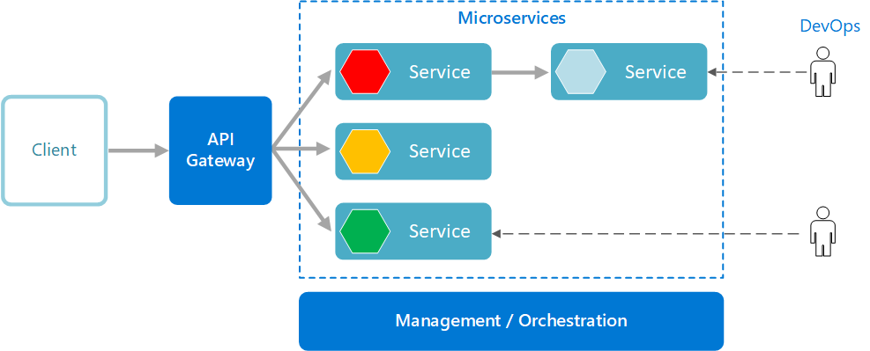
Microservices

Slide 5
AWS Serverless
Azure Serverless
VS
Elastic Container Service
Elastic Kubernetes Service
AWS Lambdas
AWS App Runner
Amazon S3 Static Web Hosting
Azure Container Apps
Azure Kubernetes Services
Azure Function
Azure App Services
Azure Storage Static Web Hosting

Slide 6
AWS Serverless Application Model
The AWS SAM template specification is an open-source framework that you can use to define and manage your serverless application infrastructure code. The AWS SAM template specification is:
Built on AWS CloudFormation – Use the AWS CloudFormation syntax directly within your AWS SAM template, taking advantage of its extensive support of resource and property configurations. If you are already familiar with AWS CloudFormation, you don't have to learn a new service to manage your application infrastructure code.
An extension of AWS CloudFormation – AWS SAM offers its own unique syntax that focuses specifically on speeding up serverless development. You can use both the AWS CloudFormation and AWS SAM syntax within the same template.
An abstract, short-hand syntax – Using the AWS SAM syntax, you can define your infrastructure quickly, in fewer lines of code, and with a lower chance of errors. Its syntax is especially curated to abstract away the complexity in defining your serverless application infrastructure.
Transformational – AWS SAM does the complex work of transforming your template into the code necessary to provision your infrastructure through AWS CloudFormation.
https://docs.aws.amazon.com/serverless-application-model/latest/developerguide/what-is-sam.html

Slide 7
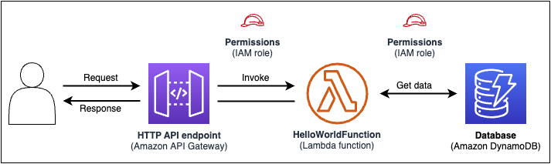
AWS Serverless Application Model
Example:
https://docs.aws.amazon.com/serverless-application-model/latest/developerguide/what-is-sam.html

Slide 8
AWS Serverless Application Model
Tools:
SAM CLI
Get started – Initialize your project.
Code, Test, Debug
Deploy
For Developers
For Continuous Delivery
https://docs.aws.amazon.com/serverless-application-model/latest/developerguide/what-is-sam.html

Slide 9
AWS Serverless Application Model
Example:
https://docs.aws.amazon.com/serverless-application-model/latest/developerguide/what-is-sam.html

Slide 10
Demos
SAM
00 – Write your first SAM.
01 – Initialize a more complex SAM.
02 – Build security using API_Keys.
03 - Build security using Cognito (JWT Tokens)
04 – Store information in a database (DynamoDb).
05 – Fire notifications by using Kinesis and SES.

Slide 11
Summary
Don’t miss out!
Be quick to deliver robust Microservices with SAM.
Contact & Resources
Roberto Hernandez
Email: roberto.Hernandez@infernored.com
X: @hernandezrobert
Documentation:
https://aws.amazon.com/serverless/
https://serverlessland.com/
https://docs.aws.amazon.com/serverless-application-model/
GitHub:
https://github.com/aws-samples/serverless-patterns
https://github.com/overridethis

