Slide 1
Case study: Lane Detection for Autonomous Vehicles using Computer Vision Algorithm
Course Code : 19AI621
Course Name : Computer Vision
Course Instructor : Dr. Senthilkumar T
Team Members :
Abhishek Gopinath Kovath [CB.EN.P2AID20002]
Alan Henry [CB.EN.P2AID20010]
Jiss Joseph Thomas [CB.EN.P2AID20024]

Slide 2
Contents
Problem Statement
Dataset Description
Analytical and Analytics Questions
Block Diagram
Preprocessing in Spatial and Frequency Domain
List of Features
Face Detection and Tracking
Scene
List of Objects in the scene and its features
Face Detection
Face Detection Algorithms and Deep Learning Architecture
Performance Metrics
Deep Learning Architectures
Training, Testing and validation

Slide 3
Problem Statement/Objective:
To detect lanes on the given dataset of video or images of roads or as real-time, using computer vision algorithms which could be helpful in the proper implementation of autonomous driving.

Slide 4
Dataset Description
Type | Colour Image
Size | Multiple sizes
Row * Column | NA
Resolution | NA
Colour Model | RGB
Format | PNG
Data Acquisition | Web, Camera
No of classes | 3
No of Images | 853
Annotation | PASCAL VOC format.

Slide 5
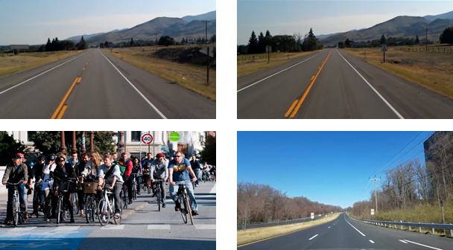
Sample Images:

Slide 6
Analysis Based Questions
How many vehicles in the frame
what are the objects detected in it
How many pedestrians are detected in it
Detecting road signs.
Objects on the interest area.
Lines inside the interest area.
Traffic signals detected
Wet area inside the interest area.
Dividers inside the frame.
How far the lanes to be detected.

Slide 7
Analytics Based Questions
Why vehicles are less in a specific area
Why more pedestrians are found at a certain point
Why the road is wet?
What type of road we are travelling on.
What time do most people drive
Do people dim their light while passing
How often a certain route is taken.
How many speed breakers were detected to analyze whether there is a school nearby.
Why there is no horn sign detected
Why vehicle in the front is slowing down

Slide 8
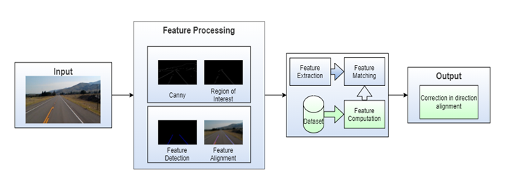
Block Diagram

Slide 9
Preprocessing in Spatial Domain
Spatial Domain Filters:
Average Filter
Weighted Average Filter
Gaussian Blurring
Median Filter
Image Sharpening
Roberts Filter
Sobel Filter
Gamma Transform
Log Transform

Slide 10
Preprocessing in Frequency Domain
Frequency Domain Filters:
Low Pass Filter
High Pass Filter
Ideal Low Pass Filter
Ideal High Pass Filter
Butterworth Low Pass Filter
Butterworth High Pass Filter
Gaussian Low Pass Filter
Gaussian High Pass Filter

Slide 11
Observation after Comparison Between Spatial and Frequency Domain Filters:
Spatial Domain:
Input -> Image Processing -> Output
Frequency Domain:
Frequency + Distribution -> Image Processing -> Inverse Transformation -> Output
The spatial domain deals with the image plane itself whereas the Frequency domain deals with the rate of pixel change.
The spatial domain works based on direct manipulation of pixels whereas the Frequency domain works based on modifying Fourier Transform.
The spatial domain takes less time to computer whereas the Frequency domain takes more time to compute.

Slide 12
Feature Detection and Tracking
List of Features:
Feature Name | Purpose | Category[Image/Vision]
Edges | To detect lanes | Image or Video
Blobs | To detect vehicles | Image or Video
Corner | To identify the type of vehicles o object, present in the data | Image or Video
Ridges | To identify the shape and outline the objects | Image or Video

Slide 13
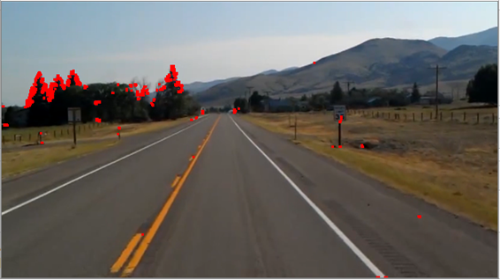
Feature Detection and Tracking
Harris Corner Detection:
Take the grayscale of the original image
Apply a Gaussian filter to smooth out any noise
Apply Sobel operator to find the x and y gradient values for every pixel in the grayscale image
For each pixel p in the grayscale image, consider a 3×3 window around it and compute the corner strength function. Call this it’s Harris value.
Find all pixels that exceed a certain threshold and are the local maxima within a certain window (to prevent redundant dupes of features)
For each pixel that meets the criteria in 5, compute a feature descriptor.

Slide 14
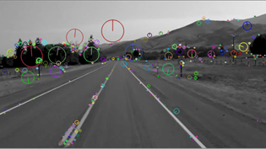
Feature Detection and Tracking
SIFT (Scale-Invariant Feature Transform):
Scale-space Extrema Detection (Feature point (also called key point) detection)
Potential location for finding features.
Feature point localization
Accurately locating the feature key points.
Orientation assignment
Assigning orientation to key points.
Feature descriptor generation.
Describing the key points as a high dimensional vector.
Keypoint Matching

Slide 15
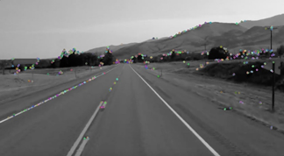
Feature Detection and Tracking
SURF (Speeded-Up Robust Features):
Feature Extraction
Integral Images
Hessian matrix-based interest points
Scale-space representation
Feature Description
Orientation Assignment
Extract Descriptor Components

Slide 16
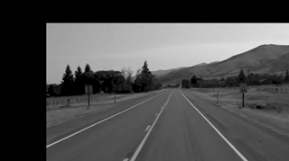
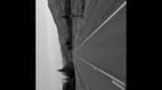
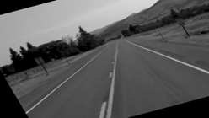
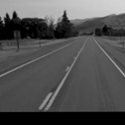

Feature Detection and Tracking
Multiscale Oriented Patches Descriptor (MOPS)::
Translation
Rotation
Affine Transformation
Perspective Transformation
Scaling

Slide 17
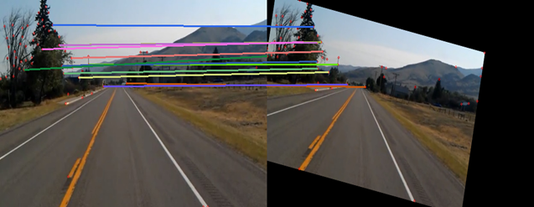
After Feature Detection and Tracking

Slide 18
List of objects in the scene and the features:
Object Name | List of features for the object
Lanes | Shape, Colour, Texture
Vehicles | Shape, Colour, Size
Pedestrians/Cyclists | Shape, Colour, Size
Signals and Signboards | Shape, Colour, Size

Slide 19
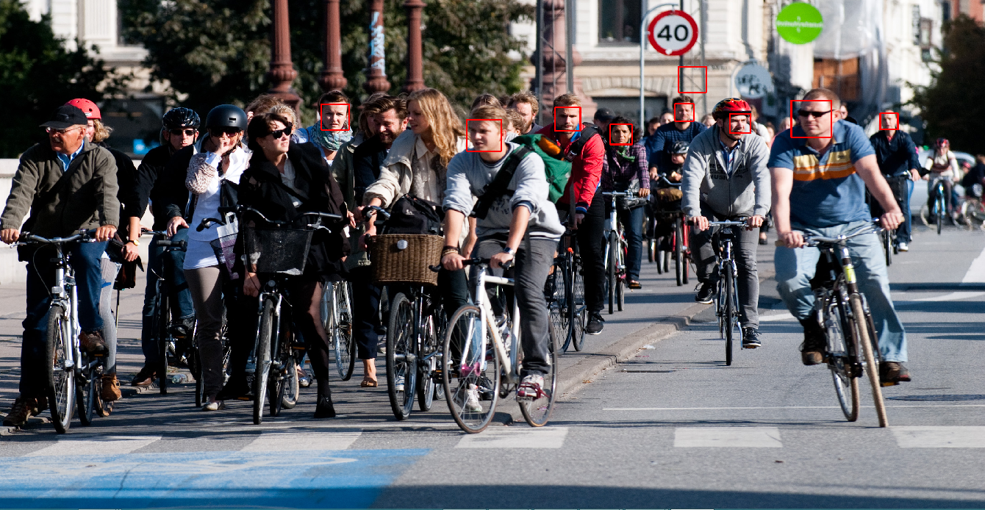
Face Detection Viola-Jones Algorithm:
Number of faces detected : 9
Number of falsely detected faces : 1
False Positive Rate : 8/9
Detection Rate :7/14

Slide 20
Face detection algorithms and Deep learning architecture:
Face Detection Algorithm | URL | Deep learning architecture
Facenet | https://machinelearningmastery.com/how-to-develop-a-face-recognition-system-using-facenet-in-keras-and-an-svm-classifier/ | Facenet
Histogram of Oriented Gradients using Dlib | https://www.pyimagesearch.com/2014/11/10/histogram-oriented-gradients-object-detection/
Haar Cascade Classifiers using OpenCV | https://becominghuman.ai/face-detection-using-opencv-with-haar-cascade-classifiers-941dbb25177
CNN based face detector from dlib | https://towardsdatascience.com/cnn-based-face-detector-from-dlib-c3696195e01c | dlib

Slide 21
Performance Metrics:
Metric | Formula
Peak Signal to Noise Ratio (PSNR) | A PSNR value of 30 dB above is preferred and ideally higher it is that much better.
Mean Squared Error (MSE) | There is no correct value. The closer it is to zero better and if it's zero it means the model is perfect.
Structural Similarity Index (SSIM) | Generally, it is ideal to get 1 which means high structural similarity and 0 if no structural similarity
Intersection Over Union (IoU) | Ideally, IoU > 0.5 is considered a good prediction.
Accuracy | An ideal value for it is closer to 100.
Precision | An ideal value for it is closer to 100.
Recall | An ideal value for it is closer to 100.
F1-Score | An ideal value for it is closer to 100.

Slide 22
Deep Learning Architectures
Architecture Name | Category | Learning | Year | Applications
LeNet | Spatial Exploitation | Supervised Learning | 1998 | Recognizing simple digit images, recognition of handwritten zip code digits
AlexNet | Spatial Exploitation | Supervised Learning | 2012 | allows for multi-GPU training by putting half of the model's neurons on one GPU and the other half on another GPU
VGGNet | Spatial Exploitation | Supervised Learning | 2014 | Architecture included in the Keras library used for large scale image recognition
GoogleNet | Spatial Exploitation | Supervised Learning | 2014 | It achieves efficiency through reduction of the input image, whilst simultaneously retaining important spatial information.
ResNet | Depth + Multi-Path | Supervised Learning | 2015 | Extremely deep networks can be trained using standard SGD (and a reasonable initialization function) through the use of residual modules.

Slide 23
Training, Testing, and Validation
Training data is used to help your machine learning model make predictions. It’s the largest part of your dataset, forming at least 70-80% of the total data you’ll use to build your model.
Validation data is primarily used to determine whether your model can correctly identify new data or if it’s overfitting to your original dataset.
Testing data is used after both training and validation. It aims to test the accuracy of your final model against your targets.
Rule of 10:
It is a common rule of thumb that we need more than 10 times the data for the model than its degree of freedom. The degree of freedom can be anything it can be an attribute, a parameter, or a column in our data that affects the output of the model. The main aim is to compensate for most of the variability that our parameters may bring into the input of the model.

Slide 24
Thank You

