Slide 1








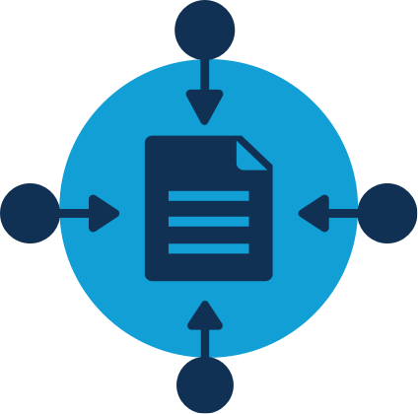


Notes:
…overture, a suite of modular software micro services each with their own narrowly defined responsibilities that combines (move to next slide)

