Slide 1
VDM++ Tutorial
Architecture

Slide 2
Aim
To position the use of VDM++ in the context of “architecture”.

Slide 3
Overview
What is architecture?
Enterprise versus software architectures
Different types of architecture
An example
Roundtrip engineering

Slide 4
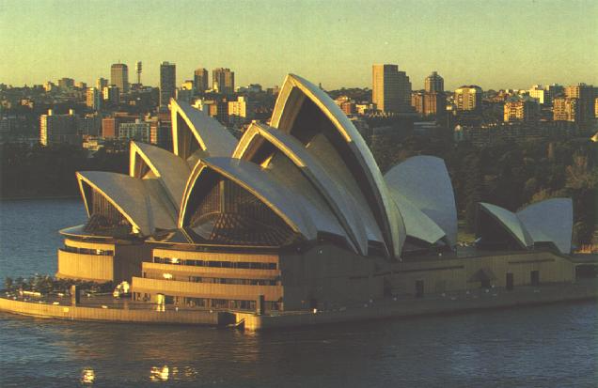
What is architecture?

Slide 5
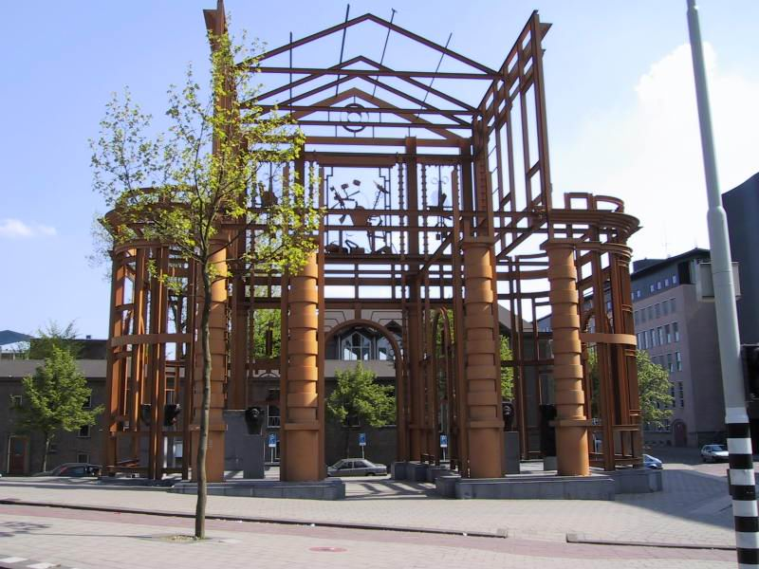
What is architecture?

Slide 6
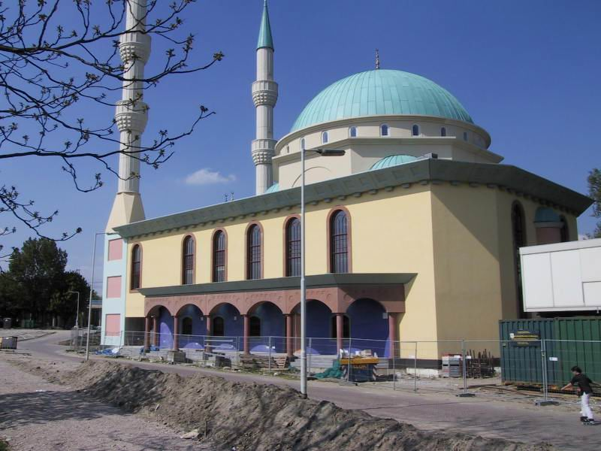
What is architecture?

Slide 7

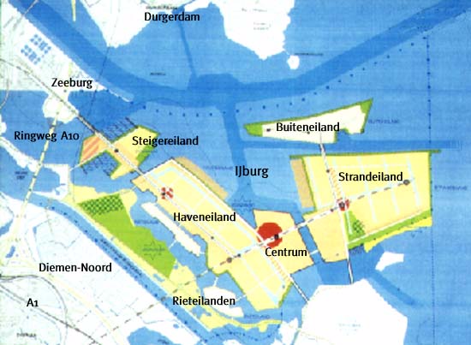
What is architecture?

Slide 8
Different types of architecture
Business Architecture
Governance Architecture
Application Architecture
Safety Architecture
Architecture of the
Technical Infrastructure

Slide 9
Drivers
Drivers for designing architecture:
  Business principles
  IT principles
  Stakeholders
Drivers for designing software:
  (Functional and non-functional) requirements

Slide 10
Architecture design process
Three phases:
Conceptual phase: focus on what
Logical phase: focus on how
Physical phase: focus on with what

Slide 11
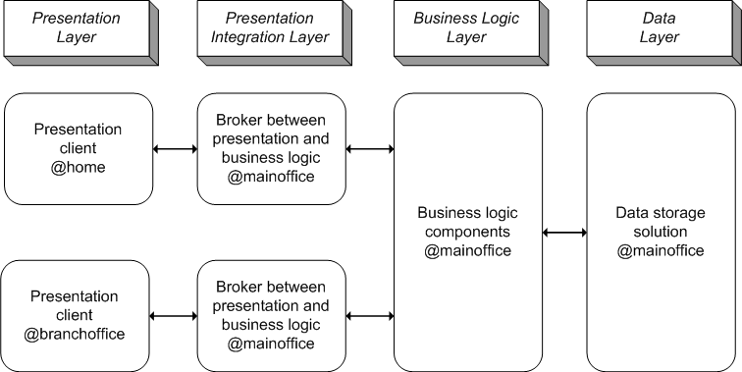
Example: Conceptual Phase

Slide 12
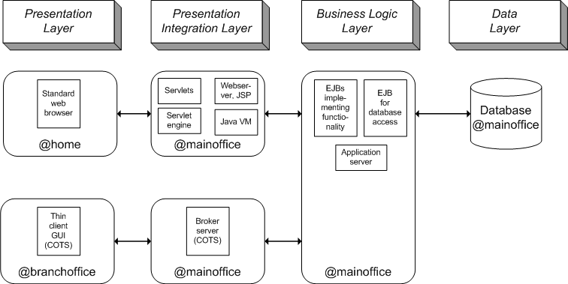
Example: Logical Phase

Slide 13
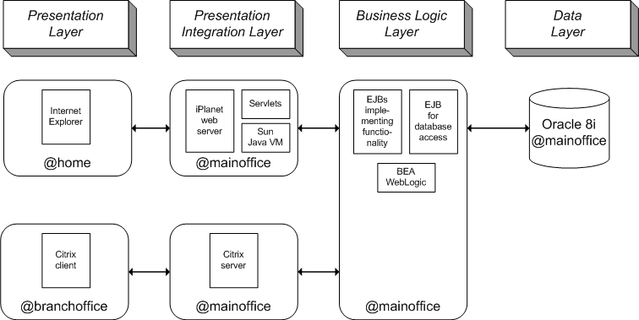
Example: Physical Phase

Slide 14
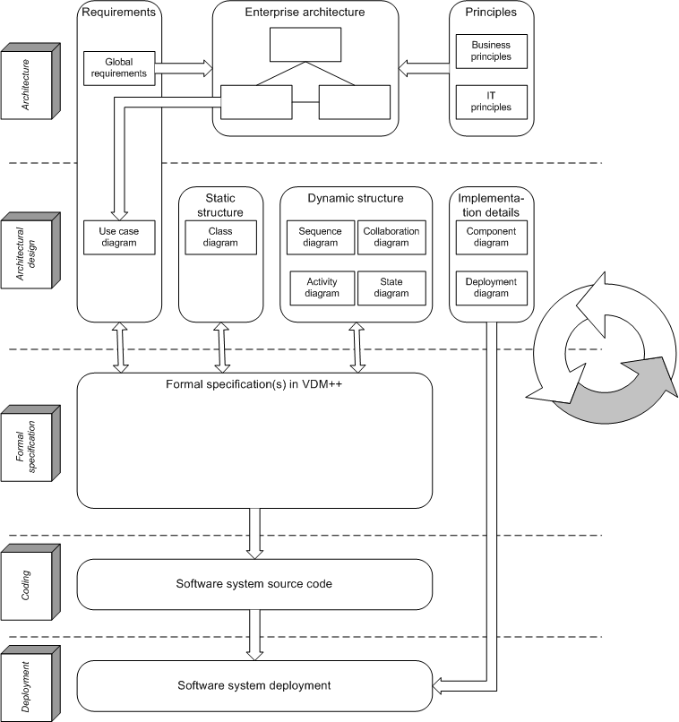
Roundtrip engineering

