Slide 1
VDM++ Tutorial
Industrial Experience with VDM++

Slide 2
Overview
VDMTools References
The TradeOne Project
  The VDM++ Architecture
  Metrics from TradeOne
Summary

Slide 3
VDMTools References
More than 150 clients world-wide
France
Aerospatiale Espace et Defense
Dassault Aviation
Dasssault Electronique
CISI CEA et Defense
CEA Leti
Cap Gemini
LAAS
Matra BAe Dynamics
U.K.
British Aerospace Systems & Equipment
British Aerospace Defense
Adelard
ICL Enterprise Engineering
Rolls Royce
Transitive Technologies
Italy
ENEA
Ansaldo
The Netherlands
Dutch Dept. of Defence
Origin
Chess
Portugal
Sidereus
Denmark
Danish Railways
Baan Nordic
Odense Steel Shipyard
DDC International
North America
Boeing
Rockwell Collins
Lockheed Martin
DDC-I, Inc.
Rational Software Corp.
Formal Systems Inc.
Concordia University
Japan
RTRI (Japan Railways)
JFITS
Germany
GAO mbH

Slide 4
Further Information
Applying Formal Specification in Industry. P.G. Larsen, J. Fitzgerald and T. Brookes. Published in "IEEE Software" vol. 13, no. 3, May 1996
A Lightweight Approach to Formal Methods S.Agerholm and P.G. Larsen. In Proceedings of the International Workshop on Current Trends in Applied Formal Methods, Boppard, Germany, Springer-Verlag, October 1998.
Applications of VDM in Banknote Processing P. Smith and P.G. Larsen. + Application of VDM-SL to the Development of the SPOT4 Programming Messages Generator, A. Puccetti and J.Y. Tixadou + Formal Specification of an Auctioning System Using VDM++ and UML, M.Verhoef et. al.
Published at the First VDM Workshop: VDM in Practice with the FM'99 Symposium, Toulouse, France, September 1999.
Most accessible from http://www.ifad.dk/publications.htm

Slide 5
Overview
VDMTools References
The TradeOne Project
  The VDM++ Architecture
  Metrics from TradeOne
Summary

Slide 6
The TradeOne Project
Organisation: JFITS, Japan
VDM++ Champion: Shin Sahara
Back-office for trading securities
Two subsystems developed using VDM++
  Tax exemption subsystem
  Options subsystem

Slide 7
Understanding the Domain
Security: ownership of stocks, options, bonds ...
Option: Contract that entitles owner to buy/sell a security before a certain date
Bond: Contract to pay a sum of money at a fixed interest

Slide 8
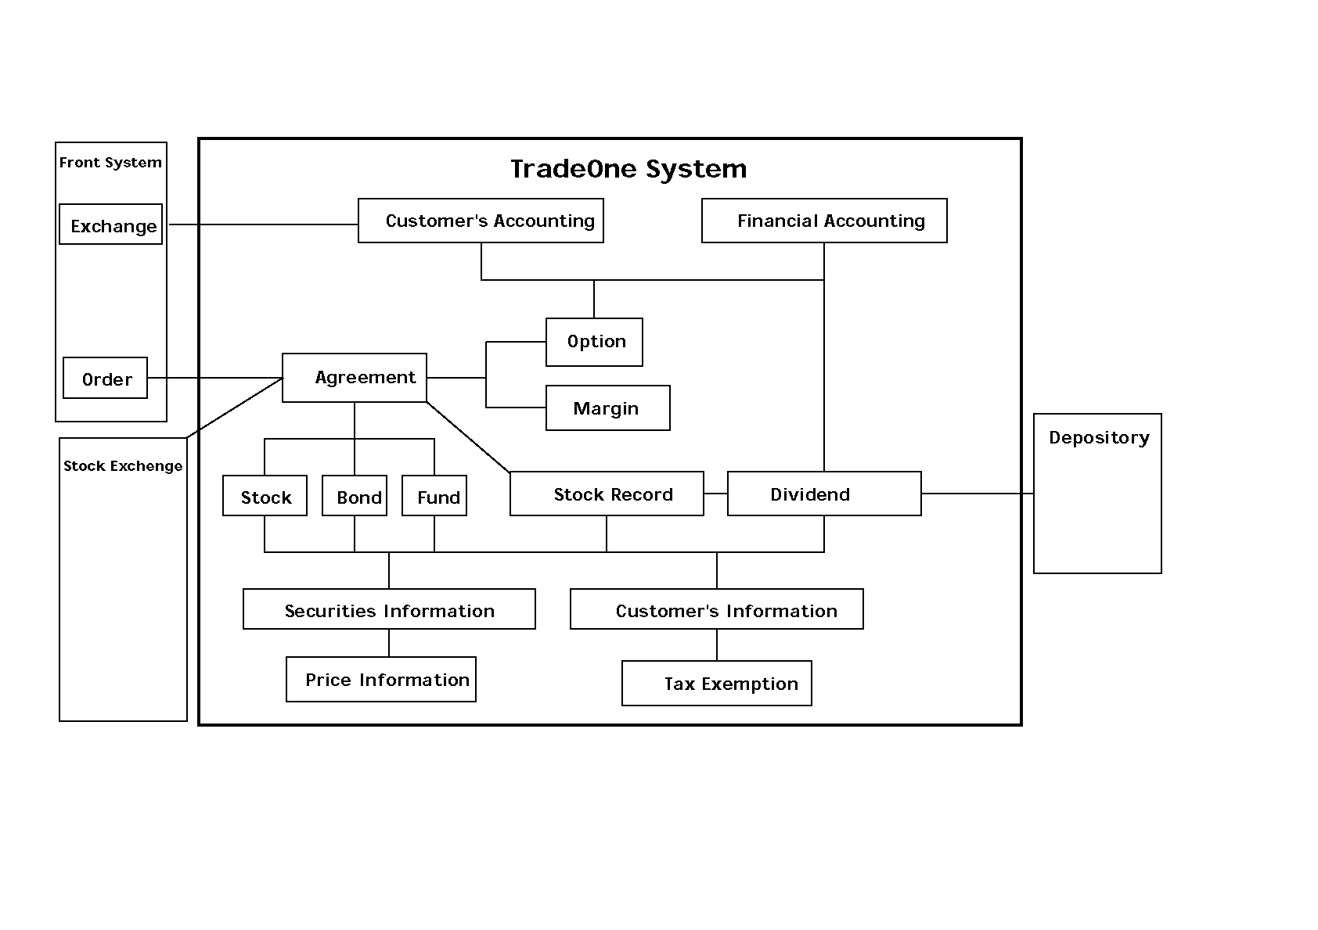
Overview of TradeOne

Slide 9
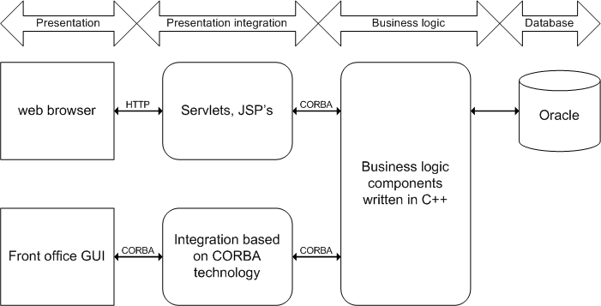
TradeOne Overall Architecture

Slide 10
Databases and Business Logics
class TradeOne
...
instance variables
protected db1 : DataBase1;
...
protected dbN : DataBaseN;
operations
public BusinessLogic1: ... ==> ()
...
public BusinessLogicM: ... ==> ()
end TradeOne

Slide 11
A Layered Approach
Layer | Satisfying
test case | regression test
scenario | post-condition
business logic | business application
designation + environment | information hiding of DB
practical DB access | append,select,delete,update
basic DB access | undo, old value access, diff
basic record structure | data needed

Slide 12
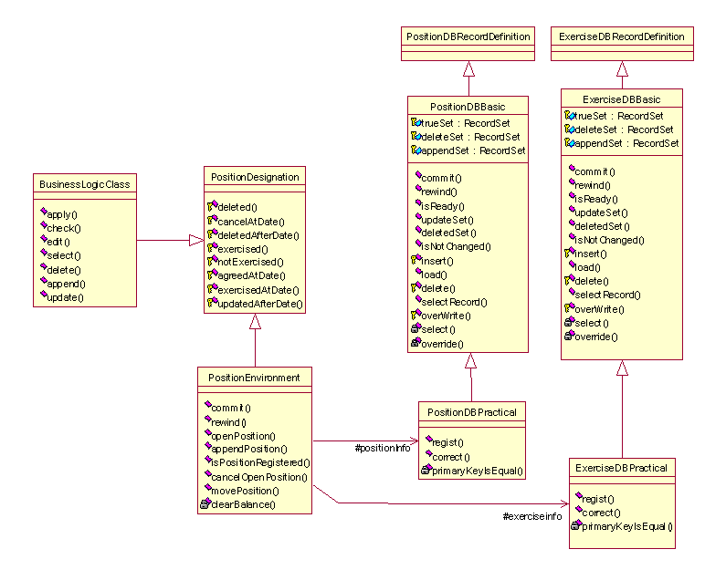
Class Diagram with Layers

Slide 13
The Basic Record Structure
class RecordDefinition
types
public Key :: ...;
public Attribute :: ...;
public Record ::
key : Key
attr : AttrPart;
functions
public KeyMatch: Key * Record -> bool
KeyMatch(key,rec) == ...;
end RecordDefinition

Slide 14
Dates are Essential
class Date
...
functions
public
HowManyDayOfWeekBetween2Date: Date * Date * dayOfWeekName -> int
HowManyDayOfWeekBetween2Date(date1, date2, dayName) ==
...
post
let startDate = min(date1,date2),
endDate = max(date1,date2)
in
exists designatedDateSet : set of Date &
forall aDate in set designatedDateSet &
startDate.LessEqual(aDate) and
aDate.LessEqual(endDate) and
dayName = GetDayName(aDate) and
RESULT = card designatedDateSet;
end Date

Slide 15
Basic Database Structure
class DataBaseBasic is subclass of RecordDefinition
...
instance variables
protected trueSet : RecordSet := {};
protected deleteSet : RecordSet := {};
protected appendSet : RecordSet := {};
inv forall rec1,rec2 in set trueSet &
rec1.key = rec2.key => rec1 = rec2;
operations
public Select: Key ==> RecordSet
Select(key) == ...;
public Insert: Record ==> ()
Insert(rec) == ...;
public Delete: Key ==> ()
Delete(key) == ...;
public Update: Record ==> ()
Update(rec) == ...;
...
end DataBaseBasic

Slide 16
Practical Database Interfaces
class TaxExemptionDBPractical is subclass of TaxExemptionDBBasic
...
operations
public RegisterApplyAmt: Key * Money ==> ()
RegisterApplyAmt(key,aplAmt) ==
def newRecord = mkRecord(key,aplAmt,normal)
in
Insert(newRecord)
pre true
post ApplyAmtRegistered(key,aplAmt);
...
end TaxExemptionDBPractical

Slide 17
A Business Logic Example
class RegisterTaxExemptionApplyAmt is subclass of TaxExemptionDesignation
operations
public Apply: TaxExemptionDBPractical * Key * Money ==> ()
Apply(DB,key,aplAmt) ==
if ProperTaxExemptionApplyAmt(aplAmt)
then def recSet = DB.Select(key)
in cases card recSet:
(0) -> DB.RegisterApplyAmt(key,aplAmt),
(1) -> let oldRec in set recSet
in if AbolishedClient(oldRec)
then DB.ReRegisterApplyAmt(key,aplAmt)
else exit <ClientNotAbolished>,
others -> exit <TaxExemptionKeyDuplicated>
end
else exit <ImproperTaxExemptionApplyAmt>;
end RegisterTaxExemptionApplyAmt_1

Slide 18
An Example Scenario
class RegisterTaxExemptionApplyAmt_1 is subclass of TaxExemptionDesignation
operation
public Observe: RegisterTaxExemptionApplyAmt *TaxExemptionDBPractical *Key *
Money ==> bool
Observe(BL,DB,key,aplAmt) ==
always return false
in (BL.Apply(DB,key,aplAmt);
return true
)
pre DB.Ready() and
ProperTaxExemptionApplyAmt(aplAmt) and
def recSet = DB.Select(key)
in
recSet = {}
post RESULT = true and
DB.ApplyAmtRegistered(key,aplAmt);
...
end RegisterTaxExemptionApplyAmt_1

Slide 19
General Test Cases
class TestCase
...
operations
public Run: Scenario * BusinessLogic * ... ==> ()
Run(SN,BL,...) ==
let DataDeclaration
in
def result = SN.Observe(BL,...)
in
Closing;
...
end TestCase

Slide 20
Overview
VDMTools References
The TradeOne Project
  The VDM++ Archtiecture
  Metrics from TradeOne
Summary

Slide 21
Overall Size of TradeOne
System | Number of DSI (C++)
Total TradeOne | 1,342,858
Tax exemption subsystem | 18,431
Option subsystem | 60,206

Slide 22
Defect Metrics
What are defect ratios elsewhere?
The Tax Exemption subsystem
Number of defects | 12
Defect ratio | 0.65/KDSI
Measured at integration test level
Overall defect ratio for TradeOne: 1.12
Defect ratio at NASA for critical code: 0.1/KDSI
Highly tested code: 1/KDSI
High quality code: 3/KDSI
Normal commercial code: 30/KDSI
After release (7th May): no defects in VDM++ sub-systems!! About 350 defects in overall TradeOne system.
The Option subsystem
Number of defects | 43
Defect ratio | 0.71/KDSI

Slide 23
Productivity Metrics
The Tax Exemption subsystem
 | Estimate | Realised | Estimate/Realised
Effort | 38.5MM | 14MM | 36%
Schedule | 9M | 3.5M | 39%
COCOMO Estimates
Based on DSI
Additional parameters
For example experience
The Option subsystem
 | Estimate | Realised | Estimate/Realised
Effort | 147.2MM | 60.1MM | 41%
Schedule | 14.3M | 7M | 49%

Slide 24
Overview
VDMTools References
The TradeOne Project
  The VDM++ Architecture
  Metrics from TradeOne
Summary

Slide 25
Summary
TradeOne has promising results
  Defect rates
  Productivity
It will be interesting to follow this in the future
More in the new VDM++ book
Discussion

