Slide 1
VDM++ Tutorial
Demonstration of VDMTools®

Slide 2
Overview
VDMTools® Introduction
Cash Dispenser: A small demo

Slide 3

VDMTools® Overview
Syntax & Type Checker
The Rose-VDM++ Link
Interpreter (Debugger)
Document Generator
API (Corba), DL Facility
Code Generators
- C++, Java

Slide 4
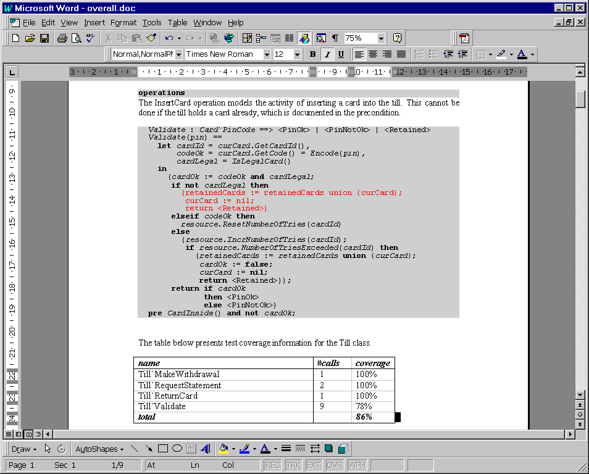
Documentation in MS Word/RTF
One compound document:
Documentation
Specification
Test coverage
Test coverage statistics

Slide 5
Architecture of Rose UML Link
VDM++ Toolbox
Rational Rose 2000
UML
Diagrams
Class
Repository
Class
Repository
Merge Tool
UML model
file
VDM++ Files

Slide 6
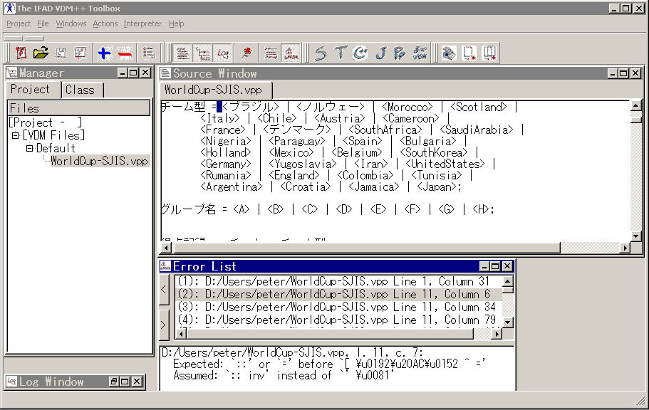
International Support

Slide 7
Overview
VDMTools® Introduction
Cash Dispenser: A small demo

Slide 8
The Cash Dispenser Model
Model of a system of tills and a central resource.
Customers interact with tills by inserting a card and entering a PIN
Central resources contains detailed records of customers’ bank accounts
“Illegal” cards are kept by the till.

Slide 9


A Cash Dispenser Example
Tills
Central
Repository

Slide 10
Requirement Specification
There are many tills which can access a central resource containing the
detailed records of customers’ bank accounts. A till is used by inserting
a card and typing in a PIN (Personal Identification Number) which is encoded
by the till and compared with a code stored on the card.
After successfully identifying themselves to the system, customers may
try to:
1. view the balance of their accounts
2. make a withdrawal of cash
3. ask for a statement of their account to be sent by post.
Information on accounts is held in a central database and may be unavailable.
In that case 1) above may not be possible. If the database is available,
any amount up to the total in the account may be withdrawn, subject to a
fixed daily limit on withdrawals. This means that the amount withdrawn
within the day must be stored on the card.
“Illegal” cards are kept by the till.

Slide 11
Development Process
Analysis (using VDM-SL with API animation)
  alternative to use cases
  abstraction from multiple tills
Design (using Rose VDM++ Link with systematic testing and API animation)
  abstraction from possible failures of tills
Implementation (with concurrent VDM++ model and automatic Java code generation combined with user interface)

Slide 12
UML Class Diagram
Till
Clock
cardOk : bool = false
CentralResource
date : Date
illegalCards : set of Card`CardId = {}
-clock
GetDate()
Create()
numberOfTries : map Card`CardId to nat = {|->}
SetDate()
Validate()
maxNumberOfTries : nat = 3
CardInside()
Create()
Letterbox
GetBalance()
-resource
AddAccount()
-letterbox
InsertCard()
GetBalance()
ReturnCard()
Withdrawal()
PostStatement()
IsLegalCard()
IsLegalCard()
GetLastStatement()
CardValidated()
PostStatement()
MakeWithdrawal()
AddIllegalCard()
RequestStatement()
IncrNumberOfTries()
Encode()
ResetNumberOfTries()
{ordered}
-statements
0..*
NumberOfTriesExceeded()
0..*
Account`AccountId
Account`AccountId
Letter
-accounts
date : Clock`Date
Account
name : Cardholder`Name
-curCard
-retainedCards
address : Cardholder`Address
0..*
balance : nat
balance : nat
0..1
0..*
0..1
transactions : seq of Transaction = []
transactions : seq of Account`Transaction
Card
dailyLimit : nat = 2000
code : Code
Create()
cardId : CardId
Create()
accountId : Account`AccountId
AddCard()
Cardholder
GetBalance()
GetCode()
GetCardIds()
name : Name
GetCardId()
Withdrawal()
Card`CardId
address : Address
GetAccountId()
MakeStatement()
Card`CardId
Create()
ValidTransaction()
-cards
Create()
Sum()
GetName()
TransactionsInvariant()
GetAddress()
DateTotal()

