Slide 1
Cilium and VDM- Towards formal analysis of Cilium policies
Tomas Kulik, Sweet Geeks
and
Jalil Boudjadar, Aarhus University

Slide 2
Agenda
Kubernetes and networking
Security challenges
Cilium network overlay
VDM meets cilium – a good match?
Analysis of security policies
Concluding Remarks

Slide 3
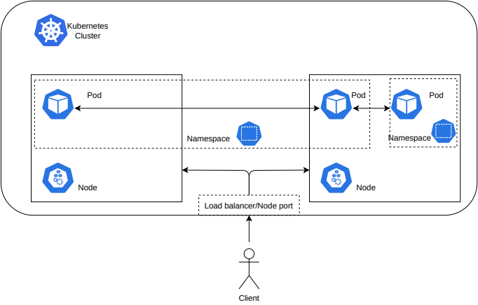
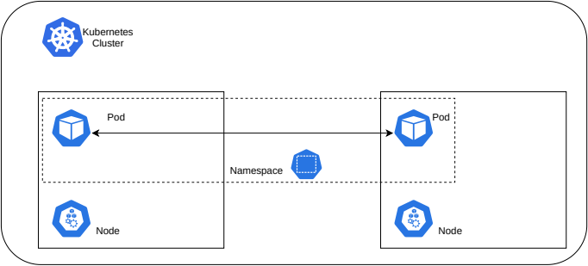
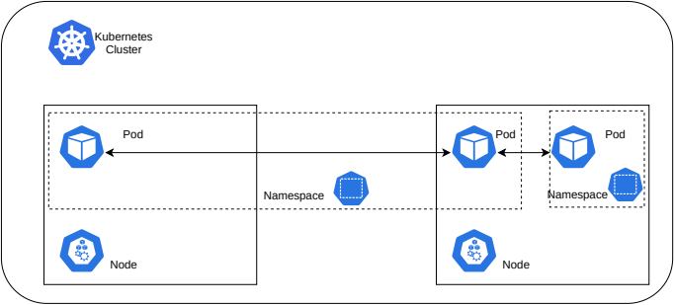
Kubernetes and networking
Notes:
Only a broad idea here.
Note environment includes the cyber-physical environment of the SoI, and also the business environment that benefits from the DT.
Introduce the idea of an SoI interacting with its environment. The SoI may be a CPS, and indeed have humans in it (e.g., a twin of a process such as scheduling field engineers), so I’m at this stage avoiding calling this a “physical object” or a “physical twin”. We should discuss.
I don’t refer to sensors or actuators at this point, only to the data flows here.
I’d like to explore the idea that a DT should enhance the SoI in some way – i.e., the DT does not cause the SoI to deviate from its original spec. This thought is motivated by the difference between Model-based control and DTs.
The DT’s beneficiaries include those wanting to achieve along-term optimisation of the SoI – the DT can be experimented with “offline” as it were to facilitate what-if.

Slide 4
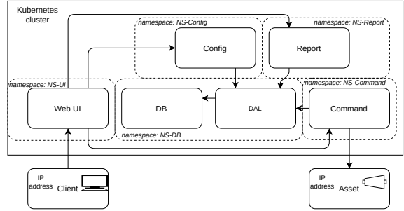
Security challenges

Slide 5
Cilium network overlay
Provides:
  Internal networking
    Different modes of operation
  Load balancing
  Service mesh
But mainly:
  Cilium policies
    Extension to Kubernetes network policy object
09/09/2024

Slide 6
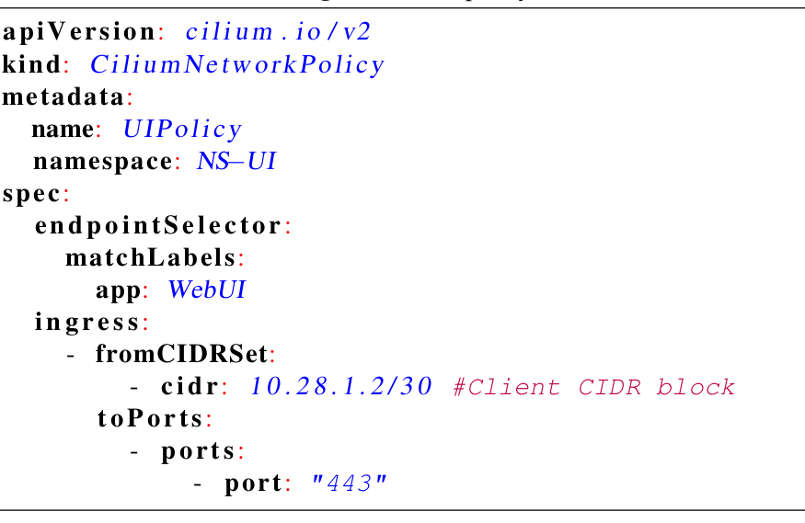
Cilium policy
09/09/2024

Slide 7
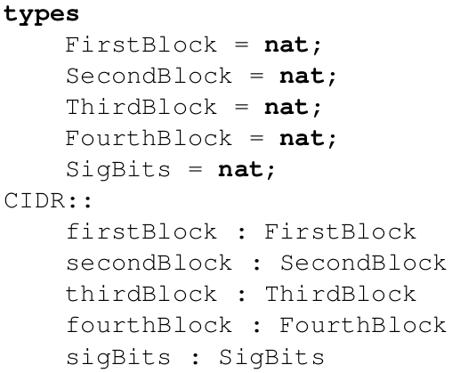
Cilium and VDM
09/09/2024

Slide 8
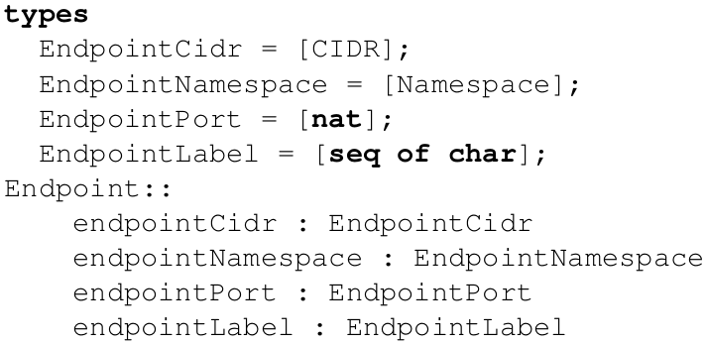
Cilium and VDM
09/09/2024

Slide 9
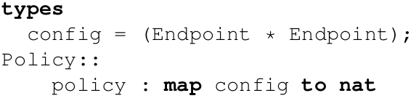
Cilium and VDM
09/09/2024

Slide 10
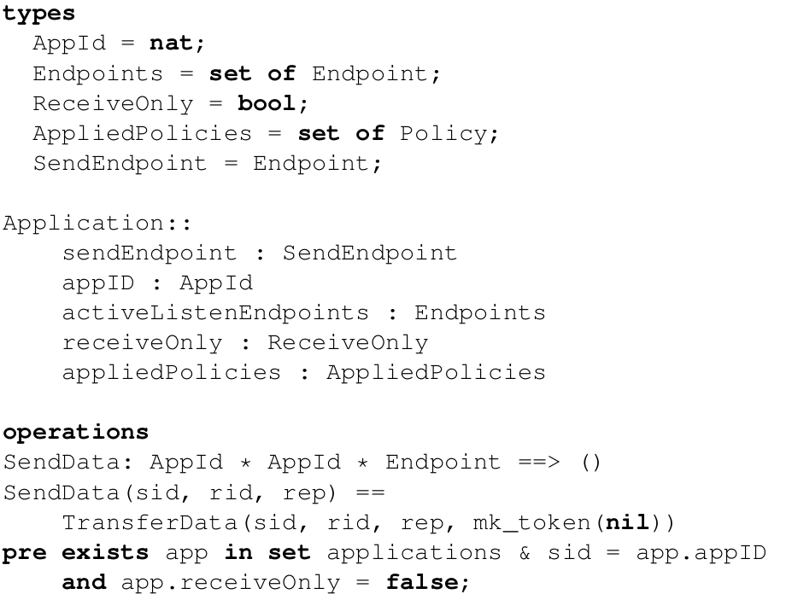
Cilium and vdm (Application)
09/09/2024

Slide 11
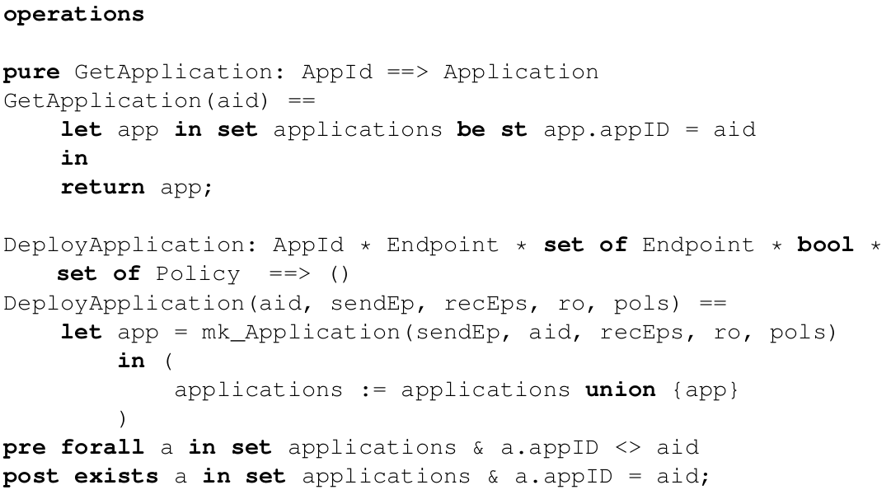
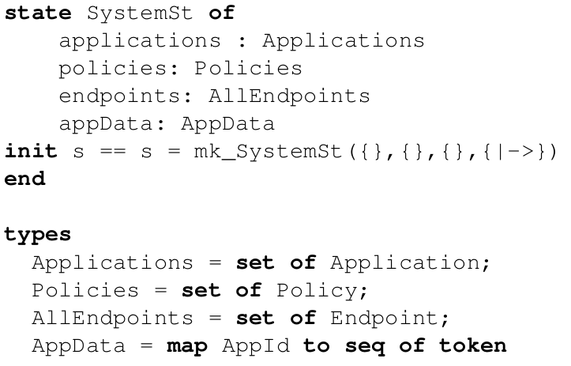
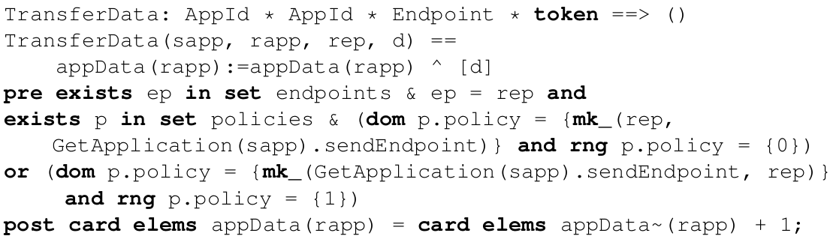
Vdm building a system
09/09/2024

Slide 12
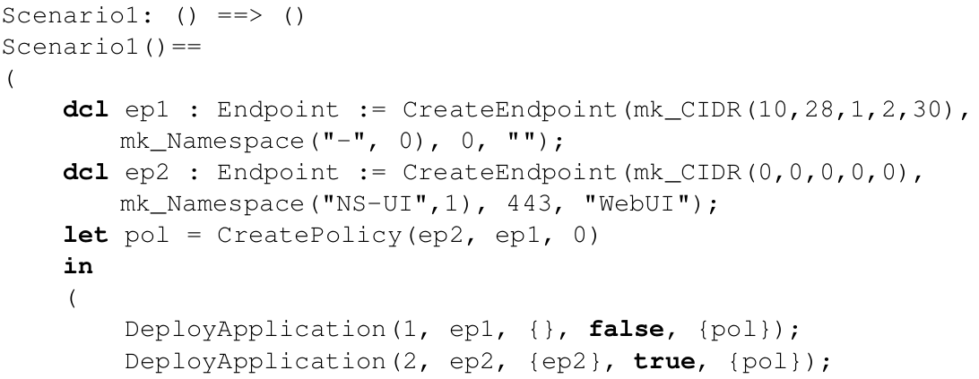
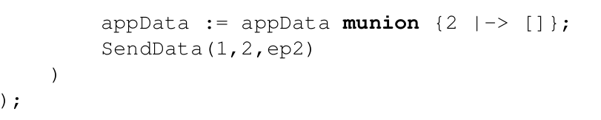
Analysis of security policies
09/09/2024

Slide 13
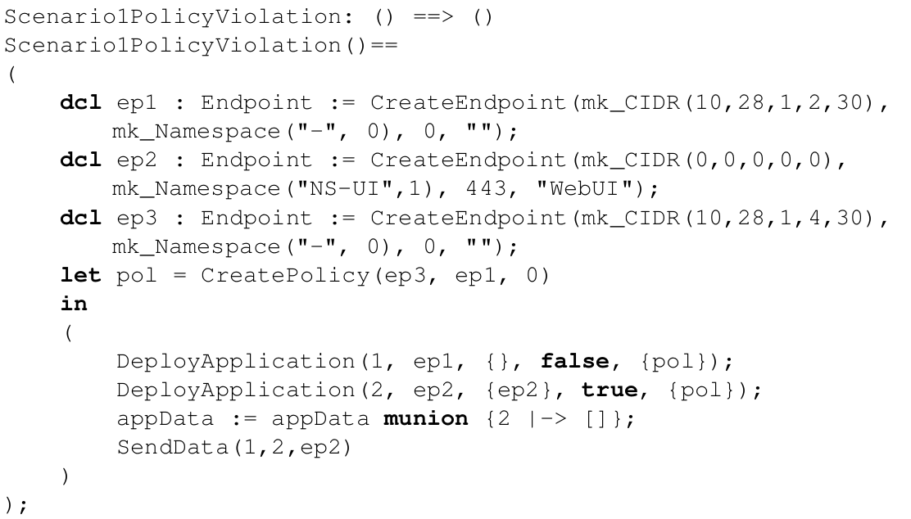
Analysis of security policies
09/09/2024

Slide 14
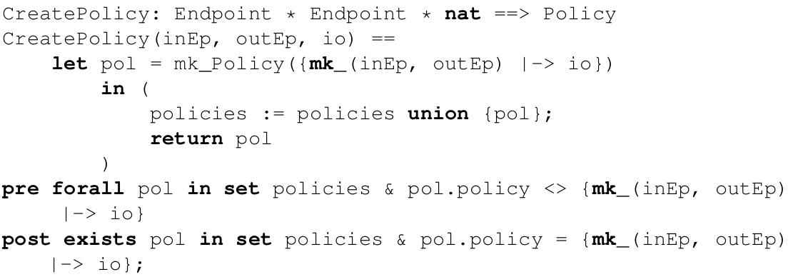
VDM Create policy - helper
09/09/2024

Slide 15
Similar analysis - egress
09/09/2024

Slide 16
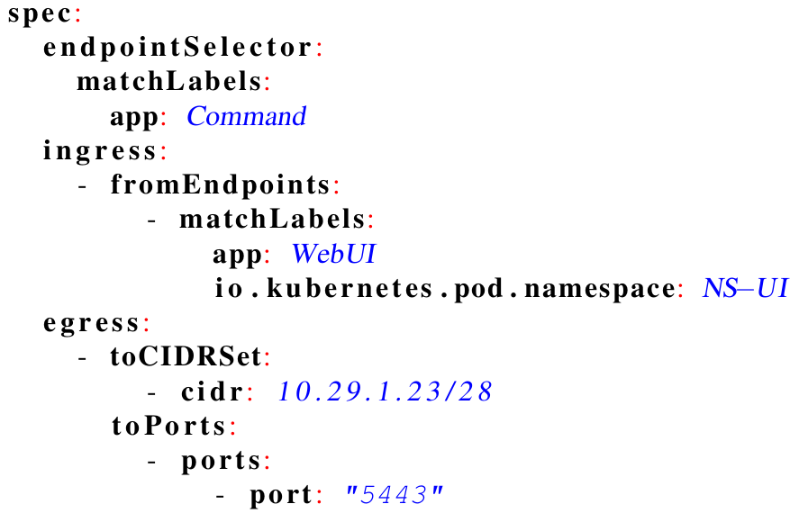
Cilium policy
09/09/2024

Slide 17
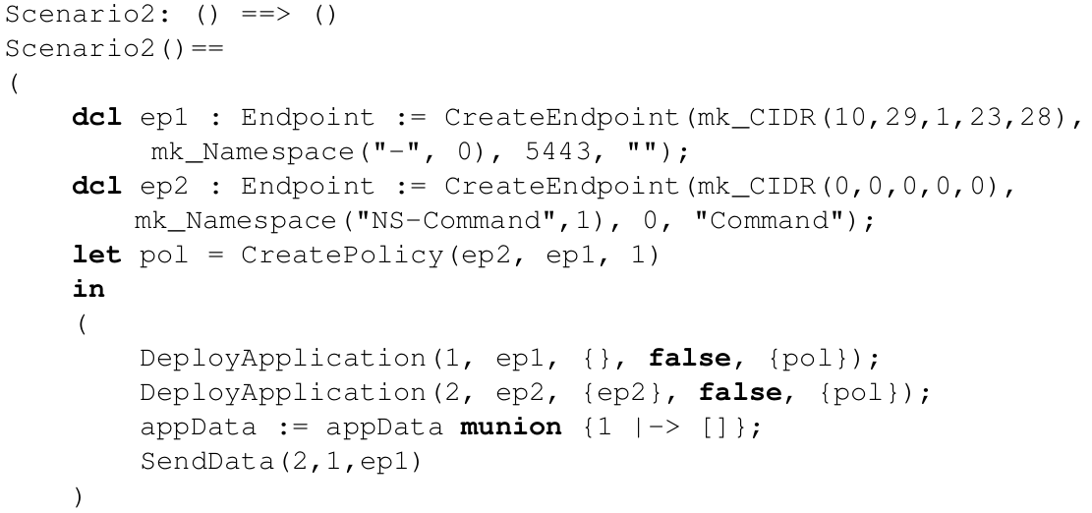
Formal analysis
09/09/2024

Slide 18
Concluding remarks
Current model:
    Initial work on formalizing Cilium Policies
    Only TCP/UDP policies considered
    Manual creation of a VDM model from Cilium policies
Future work:
    Considerations for higher layer protocols
    Use of VDMJ tooling to automatically read in policies
    Combinatiorial testing with several pods and their endpoints
09/09/2024

Slide 19
Questions
?
?
?
09/09/2024

