Slide 1
VDM++ Tutorial
Concurrency

Slide 2
Overview
Introduction
Concurrency primitives in VDM++
Example: POP3 Server
Concurrency and VDMTools®

Slide 3
Introduction
Why Concurrency?
Why Concurrency in VDM++?
What’s possible?
What’s not possible?

Slide 4
Overview
Introduction
Concurrency primitives in VDM++
Example: POP3 Server
Concurrency and VDMTools®

Slide 5
Concurrency Primitives in VDM++
Concurrency in VDM++ is based on threads
Threads communicate using shared objects
Synchronization on shared objects is specified using permission predicates

Slide 6
Threads
Modelled by a class with a thread section
  class SimpleThread
  thread
  let - = new IO().echo(”Hello World!”)
  end SimpleThread
Thread execution begins using start statement with an instance of a class with a thread definition
  start(new SimpleThread)

Slide 7
Thread Communication
Threads operating in isolation have limited use.
In VDM++ threads communicate using shared objects.

Slide 8

Producer-Consumer Example
Producer has a thread which repeatedly places data in the buffer
Consumer has a thread which repeatedly fetches data from the buffer

Slide 9
The Buffer Class
class Buffer
instance variables
data : [seq of char] := nil
operations
public put : seq of char ==> ()
put(newData) ==
data := newData;
public get : () ==> seq of char
get() ==
let oldData = data
in
( data := nil;
return oldData
)
end Buffer

Slide 10
Permission Predicates
What if the producer thread generates values faster than the consumer thread can consume them?
Shared objects require synchronization.
Synchronization is achieved in VDM++ using permission predicates.
A permission predicate describes when an operation call may be executed.
If a permission predicate is not satisfied, the operation call blocks.

Slide 11
Permission Predicates: Details
Permission predicates are described in the sync section of a class
  sync
  per <operation name> => predicate
The predicate may refer to the class’s instance variables.
The predicate may also refer to special variables known as history counters.

Slide 12
History Counters
History counters provide information about the number of times an operation has been
  requested
  activated
  completed
Counter | Description
#req(op) | The number of times that op has been requested
#act(op) | The number of times that op has been activated
#fin(op) | The number of times that op has been completed
#active(op) | The number of currently active invocations of op (#req - #fin)

Slide 13
The Buffer Synchronized
Assuming the buffer does not lose data, there are two requirements:
  It should only be possible to get data, when the producer has placed data in the buffer.
  It should only be possible to put data when the consumer has fetched data from the buffer.
The following permission predicates could model these requirements:
  per Put => data = nil
  per Get => data <> nil

Slide 14
The Buffer Synchronized (2)
The previous predicates could also have been written using history counters:
For example
  per Get => #fin(Put) - #fin(Get) = 1

Slide 15
Mutual Exclusion
Another problem could arise with the buffer: what if the producer produces and the consumer consumes at the same time?
The result could be non-deterministic and/or counter-intuitive.
VDM++ provides the keyword mutex
  mutex(Put, Get)
Shorthand for
  per Put => #active(Get) = 0
  per Get => #active(Put) = 0

Slide 16
Overview
Introduction
Concurrency primitives in VDM++
Example: POP3 Server
Concurrency and VDMTools®

Slide 17
Example: POP3 Server
Protocol which allows email clients to fetch messages from a server.
Server contains a collection of messages for a number of users.
Server is typically capable of communicating with multiple clients concurrently.

Slide 18
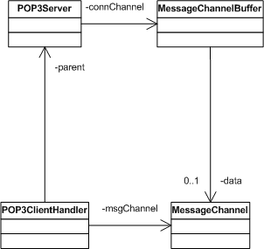
Class Structure

Slide 19
Behaviour
The server listens constantly for clients.
When a client initiates contact, a client handler is spawned.
The client handler then responds to commands from the client, until the client terminates the session.

Slide 20
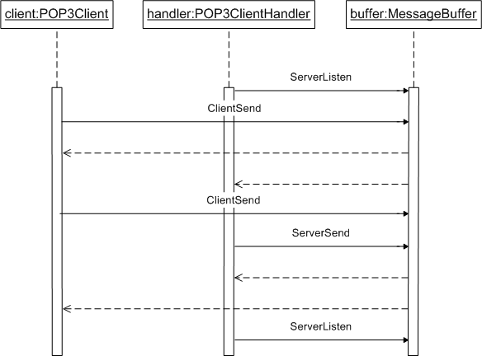
Sequence Diagram

Slide 21
Overview
Introduction
Concurrency primitives in VDM++
Example: POP3 Server
Concurrency and VDMTools®

Slide 22
Concurrency and VDMTools®
VDMTools® provides
  Type checking of thread and sync sections of a class.
  Execution of threads, using a variety of scheduling algorithms, which the user can select.
  Code generation of thread and sync sections of a class (Java only).

Slide 23
Summary
Language primitives for support of concurrency
  threads
  permission predicates
POP3 example – see forthcoming book for more details!
Support within VDMTools®

