Slide 1
VDM++ Tutorial
Implementing in Java

Slide 2
Overview
Introduction
Overview of Java code generation
Options for Java code generation
Keep tags
POP3 Example

Slide 3
Introduction
Benefits of automatic code generation
Drawbacks of automatic code generation

Slide 4
Overview
Introduction
Overview of Java code generation
Options for Java code generation
Keep tags
POP3 Example

Slide 5
Overview of Java Code Generation
Handwritten Java
VDM++ Model
VDMTools® Java Code Generator
Java Files
Executable code
VDM.jar

Slide 6
Overview of Java Code Generation (2)
VDM++ model
  Must be type correct
  Not all VDM++ language constructs supported
Handwritten Java
  main function must be provided
  Further handwritten code may be provided (e.g. GUI)

Slide 7
Overview of Java Code Generation (3)
VDM.jar
  Utility methods required by the generated code
  Distributed with VDMTools®

Slide 8
Code generation example
VDM++
op : nat ==> ()
op(n) ==
i := i + n
Java
private void op (final Integer n) throws CGException
{
i = UTIL.NumberToInt(
UTIL.clone(
new Integer(
i.intValue() +
n.intValue())));
}

Slide 9
Overview
Introduction
Overview of Java code generation
Options for Java code generation
Keep tags
POP3 Example

Slide 10
Options for Java code generation
Several user-definable options exist
These dictate which parts of the model are code generated and/or how the model is code generated.
  Generate only skeletons
  Generate only types
  Generate integers as longs
  Generate code with concurrency constructs
  Generate pre- and post functions/operations
  Check pre- and post-conditions
  Select interfaces

Slide 11
Overview
Introduction
Overview of Java code generation
Options for Java code generation
Keep tags
POP3 Example

Slide 12
Keep tags
It is sometimes desirable to hand-edit the generated code.
These edits could be lost if the code is regenerated.
Keep tags prevent this problem.
Special comments surrounding each generated element.

Slide 13
Keep tags example
// ***** VDMTOOLS START Name=op KEEP=NO
private void op (final Integer n) throws CGException
{
i = UTIL.NumberToInt(
UTIL.clone(new
Integer(i.intValue() +
n.intValue())));
}
// ***** VDMTOOLS END Name=op

Slide 14
Overview
Introduction
Overview of Java code generation
Options for Java code generation
Keep tags
POP3 Example

Slide 15
POP3 Example
POP3 server example described earlier can be code generated into Java, compiled and executed.
The POP3 client GUI also described earlier can be reused with the generated code.

Slide 16
Server side
Code automatically generated, using VDMTools® concurrency option
External interfaces must be “wrapped” to allow communication via sockets

Slide 17
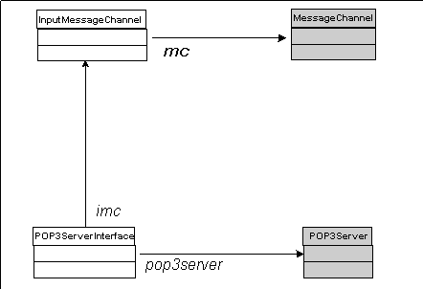
Server side (2)

Slide 18
Client side
POP3 client GUI used for assessment of external consistency reused.
Exploits a variation of the Factory Method pattern

Slide 19
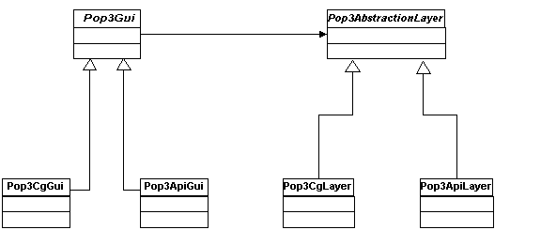
Client side (2)

Slide 20
Summary
Benefits and drawbacks of automatic code generation
Practical tool support
Realistic example

