Slide 1
VDM++ Tutorial
Model Quality

Slide 2
Overview
Introduction
Assessing internal consistency
Assessing external consistency

Slide 3
Introduction
What is model quality?
  Quality is ...
    ”The totality of features and characteristics of a product, process or service that bear on its ability to satisfy stated or implied needs” (ISO 8402)
  Fitness for purpose
  So need to keep the model’s purpose clear!
  V&V Potential
Internal and external consistency
  Internal: does the model describe something?
  External: does it describe the system we want?

Slide 4
Overview
Introduction
Assessing internal consistency
Assessing external consistency

Slide 5
Assessing Internal Consistency
Basic checks
  Syntax
  Static types
Advanced checks
  Partial operator application
  Respecting invariants
  Satisfiability
Rising confidence, falling automation (and rising cost!)

Slide 6
Assessing Internal Consistency
Protection of partial operators
public RemoveDeletedMessages: POP3Types`UserName ==> bool
RemoveDeletedMessages(user) ==
let oldMsgs = GetUserMessages(user),
newMsgs = [ oldMsgs(i) | i in set inds oldMsgs
& not oldMsgs(i).IsDeleted()]
in
( SetUserMessages(user, newMsgs);
return true );
May be undefined …
but protected here
So there is an obligation on us to show i in set dom oldMsgs in this context.
Such integrity properties can be generated by automated analysis.

Slide 7
Assessing Internal Consistency
Respecting invariants & satisfiability
public RemoveDeletedMessages: POP3Types`UserName ==> bool
RemoveDeletedMessages(user) ==
let oldMsgs = GetUserMessages(user),
newMsgs = [ oldMsgs(i) | i in set inds oldMsgs
& not oldMsgs(i).IsDeleted()]
in
( SetUserMessages(user, newMsgs);
return true );
and this has side-effects on the state. We ought to be confident that, given these inputs, it will not break any invariants that apply on the state.
Integrity property on SetUserMessages generated to give confidence that it does not break the invariant, given any valid inputs.
Where functionality is specified implicitly, it’s necessary to show satisfiability: that a function/operation exists to satisfy the pre-/post- specification. (Difficult to do by testing alone!)

Slide 8
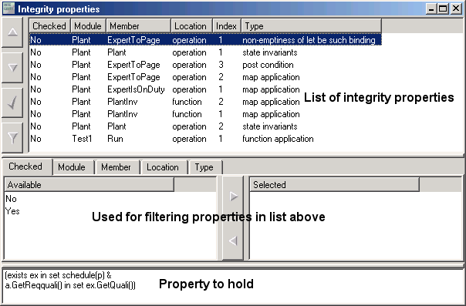
Assessing Internal Consistency
Integrity Properties
All these conditions that can’t be automatically checked can be formulated as proof obligations. The context appears in the hypotheses.
We can build an automatic generator for obligations and use semi-automatic proof support to discharge them (see Natsuki Terada’s paper).

Slide 9
Assessing Internal Consistency
From consistency checks into implementation
  Retain pre- and post-conditions alongside function/operation bodies.
  These, and invariants, become (conditionally compiled) assertions in the implementation.
How much internal consistency checking would you do in practice?
  Remember you are free to choose!

Slide 10
Overview
What is model quality?
Assessing internal consistency
Assessing external consistency

Slide 11
Assessing External Consistency
VDMTools® has a Corba API.
This API exposes all of the functionality of the tool.
=> An external program can execute a model within the tool.
This external program could be a GUI using the icons and metaphors normally used within the application domain.
In this way, domain experts and even end-users can help to assess the model.

Slide 12
Overview of VDMTools® API
Any language for which a Corba object request broker (ORB) exists, may be used (Java, C++, Perl, Python...)
The following steps must be performed:
  Connect to VDMTools®
  Interact with tool
  Release resources acquired from tool (references to variables held within tool)
  Close connection

Slide 13
Example: POP3 Client
POP3 client written in Java
Client connects to VDMTools® API using Sun’s ORB
Client interacts with VDM++ model of POP3 server
Results of interaction shown in GUI

Slide 14
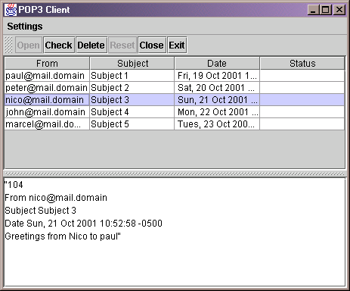
POP3 Client

Slide 15
Summary
Model quality is “fitness for purpose”
  Includes implicit qualities e.g. readability, accessibility of documentation.
  Internal consistency
    Highly formal
    Limited conclusions about the model
    Levels of automated support
  External consistency
    Does the model embody desired properties?
    Check through animation & testing

Slide 16
Summary
A range of assessment technologies:
  Machine-assisted consistency checking
    Traditional syntax/type-checking
    Advanced checking (integrity property generation)
  Machine-assisted validation by test & coverage
    Domain and scenario-based tests
    Tests generated from real application data
    Test coverage tools
  Inspection-style reviews with domain experts.

