Slide 1


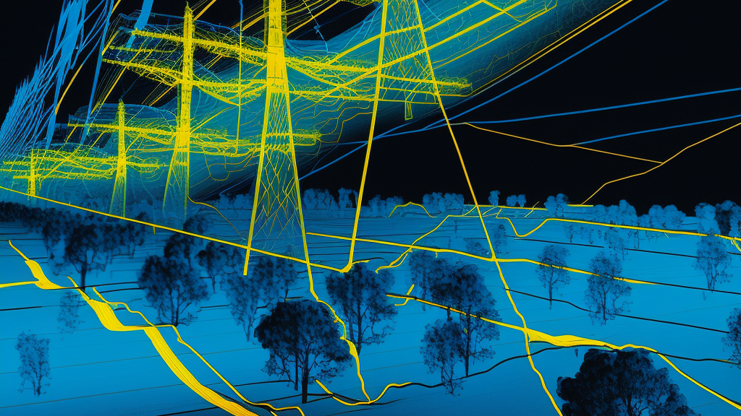

Project “Wingspan”
TFS LiDAR Processing in VR

Slide 2
Project “Wingspan”?
WHAT: An Optimal LiDAR point cloud data pipeline for:
3D Visualization (Core)
VR-based Interaction and Data Labeling
Processing and Derivative Data Products
HOW: Through the use of the Unity Game Engine’s DOTS (Data-Oriented Technology Stack)
WHY: To optimize our interaction and agency with LiDAR Data, by making it:
Widely accessible
Visually performant
More intuitive to our specific needs

Slide 3
Data Pipeline
AEP Engineering
AEP GIS
Existing LiDAR Projects Drive
Telecom
TGIS
Project “WingSpan”
DGIS
Real-Estate
Generation

Slide 4
Progress in Unity
Able to instantiate cubes procedurally using ECS system, and designate their starting location
Exploring options to parse initial LiDAR point cloud files
LAZ most common format in LiDAR folder

