Slide 1
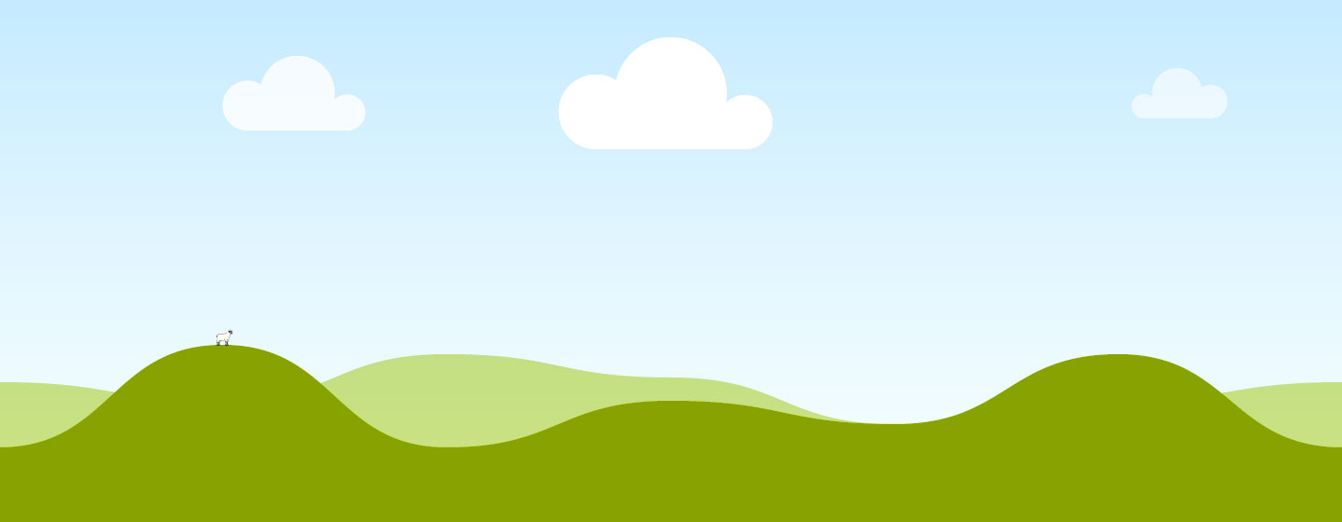
ASSESSMENT 03 / DIGITAL HABITS & WELLBEING
01 / OPENING
DIGITAL HABITS / SLEEP / PERCEIVED STRESS
03
Screen Habits and Sleep Show Distinct Links to Reported Stress
Assessment 3 | Final Visualization Report
University of Hertfordshire • Presenter: Truong Tan Phat • 9027KVDX
DATA SOURCE • 100,000 records • Python analysis
UNIVERSITY OF HERTFORDSHIRE • FINAL VISUALIZATION REPORT
Notes:
[Look at audience] Good morning. Today I am presenting my Assessment 3 visualization report. [Pause - 1s] I examine how screen habits and sleep relate to reported stress. First, I will explain the data and audit checks. Then I will walk through three analytical visualizations. One final visualization brings the patterns together. [Point to title] These are observed associations, not evidence of cause and effect.
1

Slide 2
02 / DATASET & AUDIT
A Clean, Real-World Dataset of 100,000 People
All records passed quality checks across 6 everyday habits.
Six original variables cover screen habits and wellbeing; repeated values do not prove duplicate respondents.
100,000
0
MISSING OR INVALID VALUES
RECORDS • SIX VARIABLES
1,865
REPEATED VALUE PATTERNS
Screen time / TikTok / Platforms
Sleep / Stress / Mood
SOURCE· Kaggle / Screen Time Impact on Mental Health (synthetic dataset)
https://www.kaggle.com/datasets/abhishekdave9/digital-habits-vs-mental-health-dataset
Notes:
[Point to the large number] The dataset contains one hundred thousand records and six original variables. They cover screen behaviour, sleep, stress and mood. [Pause - 1s] Before plotting, I audited completeness, valid ranges, consistency and uniqueness. There were no missing or invalid values in those checks. The data contained 1,865 repeated patterns of recorded values. These are not necessarily duplicate people, so I retained them. [Point right] This audit establishes what the dataset can reliably describe.
2

Slide 3
03 / ANALYTICAL APPROACH
Sorting People by Their Daily Sleep and Stress Levels
Python Groups Sleep and Stress to Reveal Differences Across Screen-Time Levels
Pandas prepared the variables; regression, boxplots and group comparisons provide complementary evidence.
SLEEP DURATION
STRESS LEVELS
LOW
<6h
6–8h
>8h
MODERATE
HIGH
1–4
5–7
8–10
Separate plots examine association, distribution and interaction; the final chart summarises time balance.
Notes:
I used Python to prepare the data for visualization. [Point left] I grouped stress into low, moderate and high levels. I also compared shorter, middle and longer sleep durations. The regression chart shows the screen-time relationship. The boxplot shows sleep distributions across stress groups. The interaction plot compares stress at similar screen-time levels. Finally, a balance chart summarizes screen hours relative to sleep hours. Each chart answers a different question.
3

Slide 4
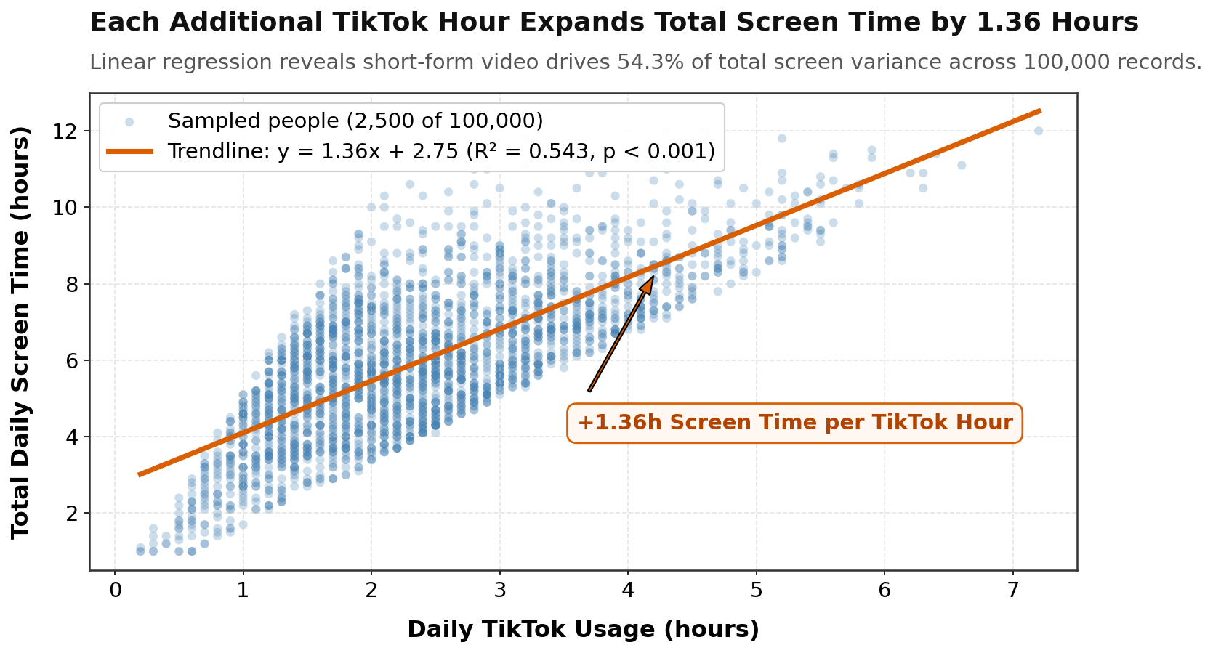
04 / FINDING 01
TikTok Keeps People on Their Phones Much Longer
+1.36h
PER TIKTOK HOUR
TikTok time is part of total screen time. This association is not causal.
Notes:
[Point to rising line] Our first finding is a clear positive relationship. Each extra TikTok hour is associated with 1.36 additional hours of total screen time. The line comes from the full dataset. The dots are a smaller sample for readability. [Pause - 1s] One important caution: TikTok use is already part of total screen time. So this chart supports association, not a causal claim. Next, I move from screen behaviour to sleep and reported stress.
4

Slide 5
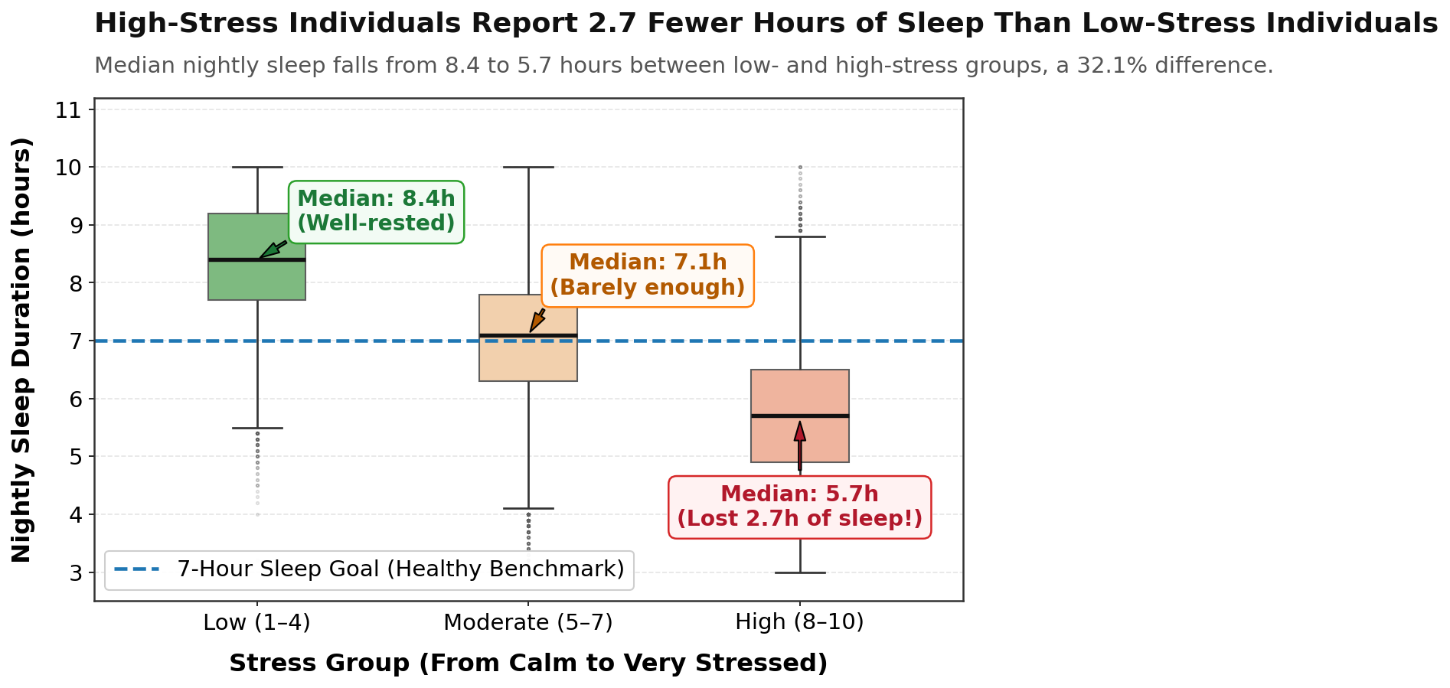
High Stress Steals Nearly 3 Hours of Sleep Every Night
05 / FINDING 02
−2.7h
MEDIAN SLEEP GAP
The boxes also show how individual sleep durations vary within each stress group.
Notes:
[Point to first and last boxes] Sleep differs sharply across stress groups. The low-stress group reports a median of 8.4 hours. The high-stress group reports 5.7 hours. That is a 2.7-hour gap. [Pause - 1s] The boxplot matters because it shows more than a single average. It also displays spread and overlap between people. The pattern is strong, but we cannot tell whether stress reduced sleep, or sleep affected stress.
5

Slide 6
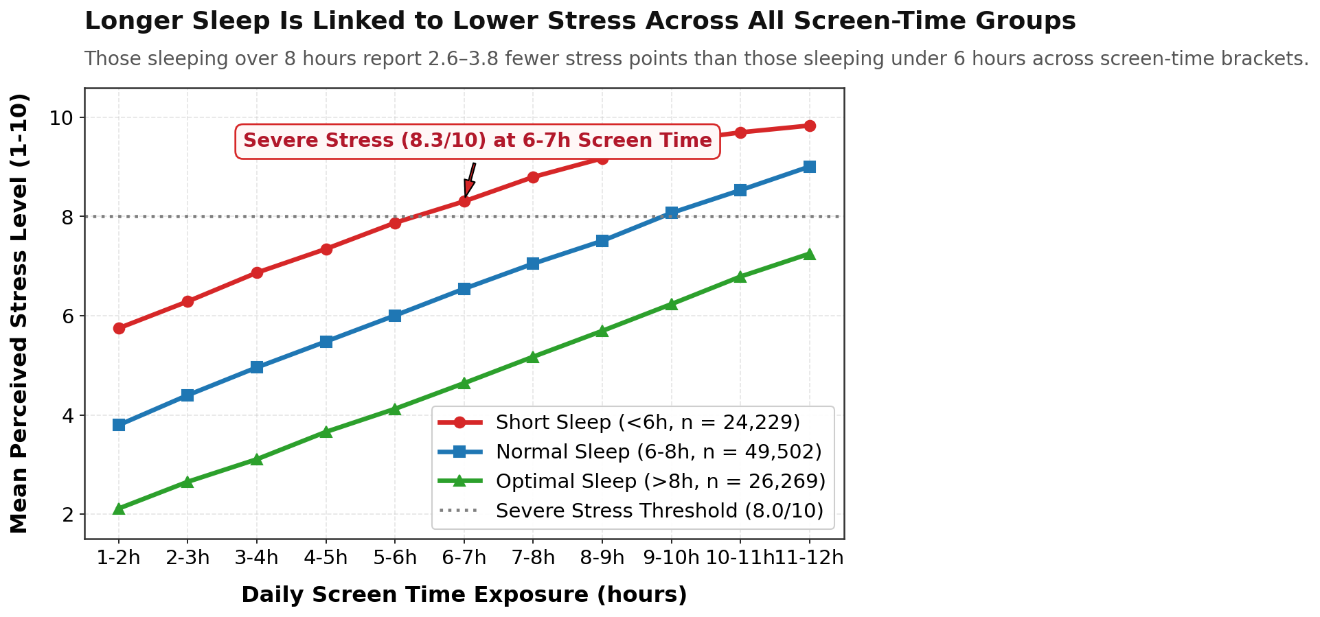
Sleeping 8 Hours Protects the Brain from Phone Fatigue
06 / FINDING 03
2.6–3.8
STRESS-POINT GAP
Sleep groups remain separated, even when daily screen-time ranges are comparable.
Notes:
[Point across the lines] The third chart compares sleep and stress at similar screen-time levels. Across these brackets, longer sleepers report lower average stress. The gap ranges from roughly 2.6 to 3.8 points. [Pause - 1s] That difference stays visible as screen time rises. This does not prove that more sleep protects people from screen exposure. It suggests sleep duration is worth measuring alongside screen use when assessing wellbeing.
6

Slide 7
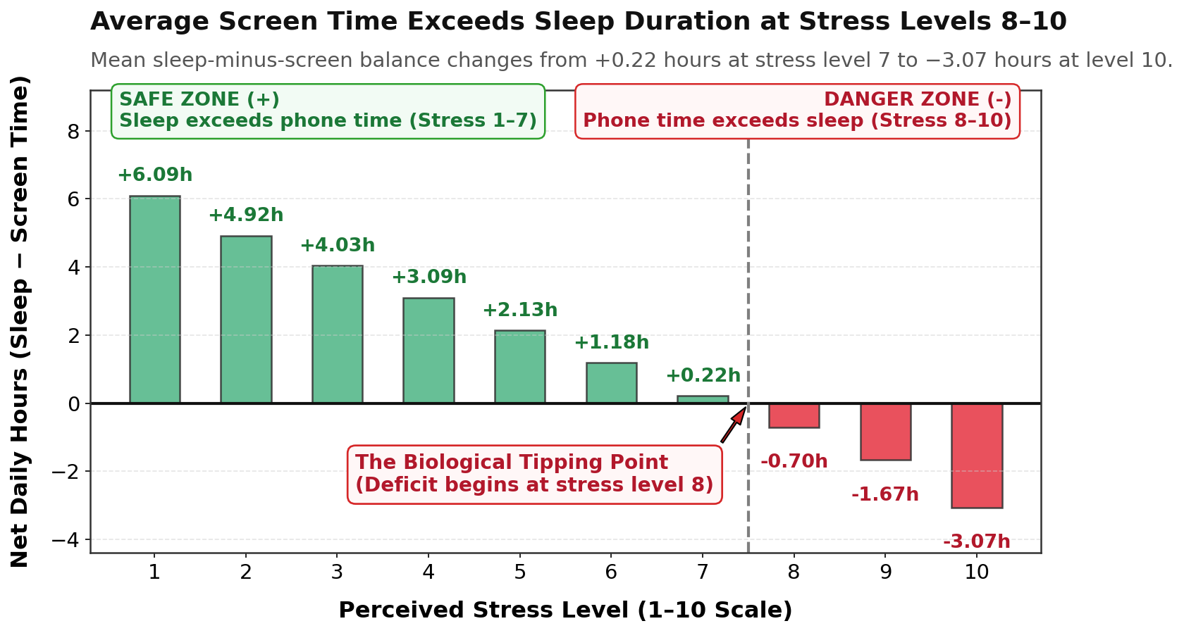
07 / SUMMARY VISUALIZATION
When Phone Time Beats Sleep, Severe Stress Begins
−3.07h
AT STRESS LEVEL 10
A negative balance means screen hours exceed sleep hours; it is not a diagnosis.
Notes:
[Point to the zero baseline] The final chart subtracts screen time from sleep time. Above zero, sleep takes more hours. Below zero, screen time takes more hours. At stress level eight, the group average becomes negative. By stress level ten, the gap reaches 3.07 hours. [Pause - 1s] This is a descriptive comparison of time use. It is not a clinical threshold or a direct measure of sleep deficiency.
7

Slide 8
08 / KEY FINDINGS
Protect Sleep First, Control Phone Time Second
Higher Screen Use and Shorter Sleep Coincide with Higher Reported Stress
Three analytical views establish the relationships; a fourth summarises sleep–screen time balance.
+1.36h
TikTok / total screen time
8.4h
5.7h
→
LOW STRESS
HIGH STRESS
2.6–3.8
Stress gap between sleep groups
Median sleep declines by 2.7 hours
−3.07h
Sleep–screen balance at stress 10
Notes:
[Pause - 1s] Here are the four findings together. First, an extra TikTok hour corresponds to 1.36 more total screen hours. Second, high-stress respondents report 2.7 fewer median sleep hours. Third, longer sleepers report 2.6 to 3.8 fewer stress points across screen-time groups. [Point to the final metric] Fourth, the sleep-minus-screen balance reaches negative 3.07 hours at stress level ten. These charts form one coherent story, but they do not establish causation.
8

Slide 9
09 / THANK YOU
THANK YOU.
The clearest message:
Screen Habits and Sleep Are Linked to Reported Stress.
Questions?
Notes:
[Look directly at the audience] Thank you for listening. [Pause - 1s] My key message is simple. Screen habits and sleep show meaningful relationships with reported stress. The data show meaningful associations with reported stress. They also show why careful auditing and honest interpretation matter. I would be happy to explain the chart choices, the audit results, or the limitations. [Pause - 1s] I welcome your questions.
9

