Slide 1
TalentLens
CV discovery with evidence you can inspect
Los pichones de Oveun
Open Agent Hackathon 2026
Notes:
English submission deck. Team: Ariana García, Maria Rodriguez, Diego Rodríguez Domínguez. App code is new, inspired by the pre-existing Cora recruiting concept. Track proposal: Wildcard / Tinkerer. No video or final submission is claimed. Sources: docs/SUBMISSION.md and Official Rules https://hackathon.genai.works/resources?id=01a08ff1-54cc-709a-bfe7-6b34452b676b

Slide 2
Recruiters need the reasoning behind a shortlist
01
02
03
Understand the role
Compare the evidence
Prepare the conversation
Translate a job description into professional requirements and open questions.
Read a collection of CVs and connect claims to the original documents.
Identify gaps, ask targeted questions and keep the next step under human control.
TalentLens
02
Notes:
Target users are recruiters and small hiring teams. This is a problem statement, not a measured productivity claim. Source: README.md, problem and workflow.

Slide 3
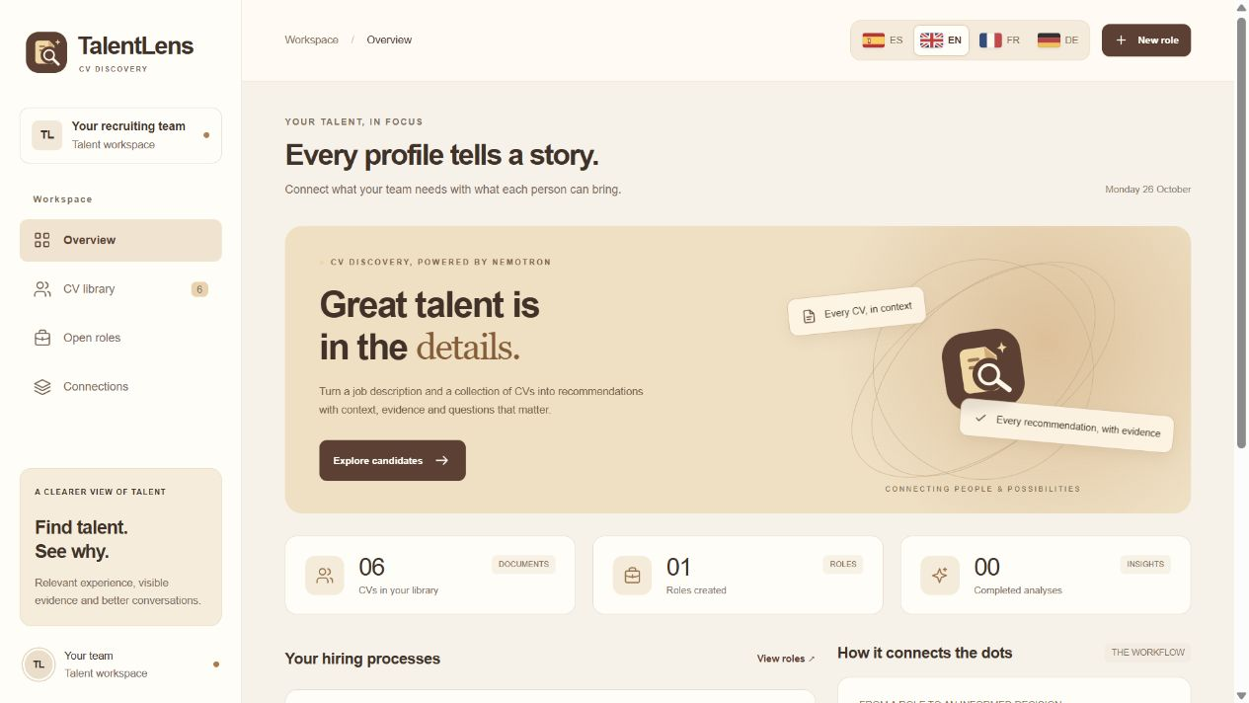
A workspace in four languages
English, Spanish, French and German. Source quotations retain their original wording.
TalentLens
03
Notes:
Real TalentLens UI captured on 26 October 2026. English, Spanish, French and German share one translated interface. Source: public/i18n.js. The screenshot shows an input workspace before inference, not a finished AI run.

Slide 4
The agent workflow
01
Zetaris data layer
Import an authorised candidate view through read-only Lightning REST.
02
Nemotron understands the role
Extract requirements and validate each quote against the job description.
03
H-MEM recalls verified facts
Retrieve relevant evidence from earlier processes with document and version lineage.
04
Nemotron compares every CV
Produce qualitative recommendations, evidence gaps and interview questions.
05
The recruiter reviews
Inspect citations, resolve uncertainties and save the next step.
TalentLens
04
Notes:
Sources: server/analysis.js, server/providers.js, server/completion-stream.js, server/hmem.js. At most four model calls including one correction per stage. Nightshift is the primary provider. All recommendations come from Nemotron.

Slide 5
Each sponsor has a working role
Zetaris
Two fictional CSV sources form a joined candidate view. TalentLens reads it through a SELECT-only account.
NVIDIA Nemotron
The model interprets requirements and CVs, proposes candidates and explains evidence and missing information.
Meterless Nightshift
Authenticated inference routes to Nemotron. Reports retain the actual model ID and execution receipts.
Meterless H-MEM
Evidence-backed memory survives restarts and supports later vacancies, source checks and human conflict review.
TalentLens
05
Notes:
Sources: docs/SUBMISSION.md, examples/zetaris/README.md, examples/zetaris/verified-analysis.json, server/hmem.js. Meterless official H-MEM contract revision 1742dec56a66e58eef9dda2d2b865823758ca8cd. Nightshift runtime 1.2.1. NVIDIA model nvidia/nemotron-3.5-lightning-30b-a3b.

Slide 6
Memory stays connected to its source
A professional claim
First role
Nemotron supports the requirement with a literal CV quote.
“Led the creation of a design system with 35 components.”
After restart
SQLite retains the fact, document version and audit history.
Fictional CV: Alex Rivera
Another role
H-MEM verifies the source and supplies relevant prior evidence to Nemotron.
TalentLens
06
Notes:
Source: server/hmem.js and scripts/verify-live-hmem.js. Example quote is from fictional Alex Rivera in server/demo.js. Retrieval relevance ranks memories, not candidates. H-MEM excludes deleted, conflicted, superseded or unverifiable facts from normal recall.

Slide 7
Recommendations remain open to inspection
Alex Rivera
React and TypeScript, automated tests and a documented design system.
Sam Torres
Backend experience and React dashboards. TypeScript and accessibility need clarification.
Dani Vega
Design systems and accessibility experience. Professional programming experience is not declared.
Qualitative proposals, original quotations and interview questions. A person chooses the next step.
TalentLens
07
Notes:
Actual fictional example: examples/zetaris/verified-analysis.json, live run on 22 October 2026. These observations illustrate document evidence, not hiring outcomes. Exact recommendations and order may vary on new model runs.

Slide 8
Verification covers evidence, memory and deletion
29
13 / 13
automated tests pass
official H-MEM checks pass
Exact citations and complete candidate coverage
Deletion invalidates in-flight analyses and translations
Source updates, tenant isolation and restart persistence
TalentLens
08
Notes:
Verified locally on 26 October 2026: npm test 29/29, npm run test:hmem:conformance 13/13. Tests use mocks for external services. Historical real three-CV run: examples/zetaris/verified-analysis.json. Separate live H-MEM run evidence is documented in submission/README.md when available. Coverage: tests/workflow.test.js, tests/hmem.test.js, tests/analysis.test.js.

Slide 9
Prototype boundaries and next improvements
Current scope
Next improvements
Local, single-user workspace
25 CVs per analysis
Text PDFs, DOCX and TXT
Explicit consent before inference
OCR for scanned documents
Production identity and access control
Broader prompt-injection and bias evaluation
Larger, consented evaluation datasets
TalentLens
09
Notes:
Sources: README.md Scope and limits. No production readiness, performance benefit, fairness guarantee or actual hiring outcome is claimed. Proposed future capabilities are not implemented features.

Slide 10
TalentLens connects a role to verifiable experience
Nemotron proposes candidates.
Recruiters inspect the evidence and decide.
Ariana García Maria Rodriguez Diego Rodríguez Domínguez
github.com/oveun-software/hackaton
TalentLens
10
Notes:
Project repository: https://github.com/oveun-software/hackaton . Development uses Codex. Cursor is optional under the updated rules and is not claimed as the primary development tool. Pre-existing Cora concept is disclosed in docs/SUBMISSION.md. Team roster checked in HackOS on 26 October. Submission remains pending.

