Slide 1
1

Slide 2
2

Slide 3
3

Slide 4
Multi-Agent Path Planning Benchmark
by Johann Schmidt

Slide 5
Agenda
General Idea
Settings
Evaluation
Implementation
Future Work

Slide 6
Agenda
General Idea
Settings
Evaluation
Implementation
Future Work

Slide 7
General Idea
Notes:
→ designed to work with both simulation and real world robots

Slide 8
General Idea
WORLD
Notes:
→ designed to work with both simulation and real world robots

Slide 9
General Idea
OBSTACLES
Notes:
→ designed to work with both simulation and real world robots

Slide 10
General Idea
ROBOTS
Notes:
→ designed to work with both simulation and real world robots

Slide 11
General Idea
WAYPOINTS
2
1
3
Notes:
→ designed to work with both simulation and real world robots

Slide 12
General Idea
2
1
3
Notes:
→ designed to work with both simulation and real world robots

Slide 13
Agenda
General Idea
Settings
Evaluation
Implementation
Future Work

Slide 14
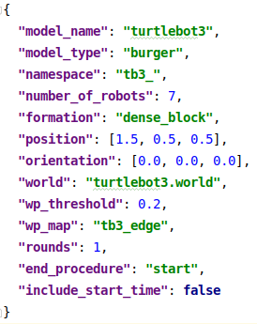
Settings
Notes:
→ designed to work with both simulation and real world robots

Slide 15
Settings
Notes:
→ designed to work with both simulation and real world robots

Slide 16
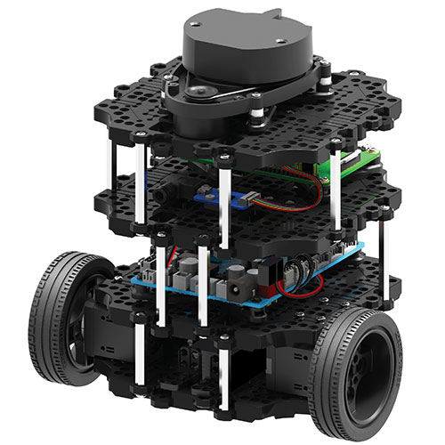
Model Specifications
model_name: "turtlebot3"
model_type: "burger"
namespace: "tb3_"
https://robots.ieee.org/robots/turtlebot3/
Notes:
→ designed to work with both simulation and real world robots

Slide 17
Settings
Notes:
→ designed to work with both simulation and real world robots

Slide 18
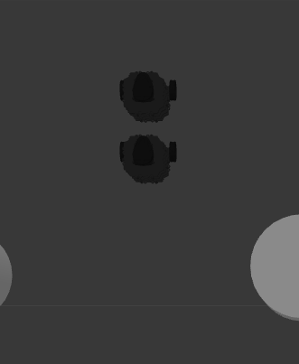
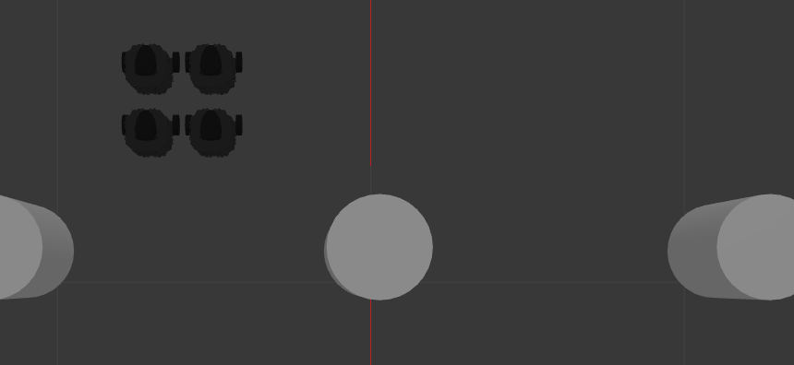
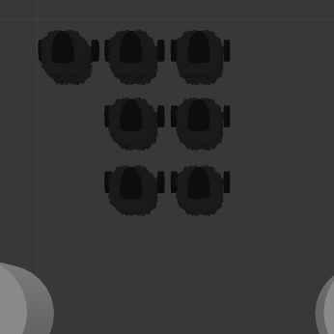
Spawning
Notes:
→ designed to work with both simulation and real world robots

Slide 19
Settings
Notes:
→ designed to work with both simulation and real world robots

Slide 20
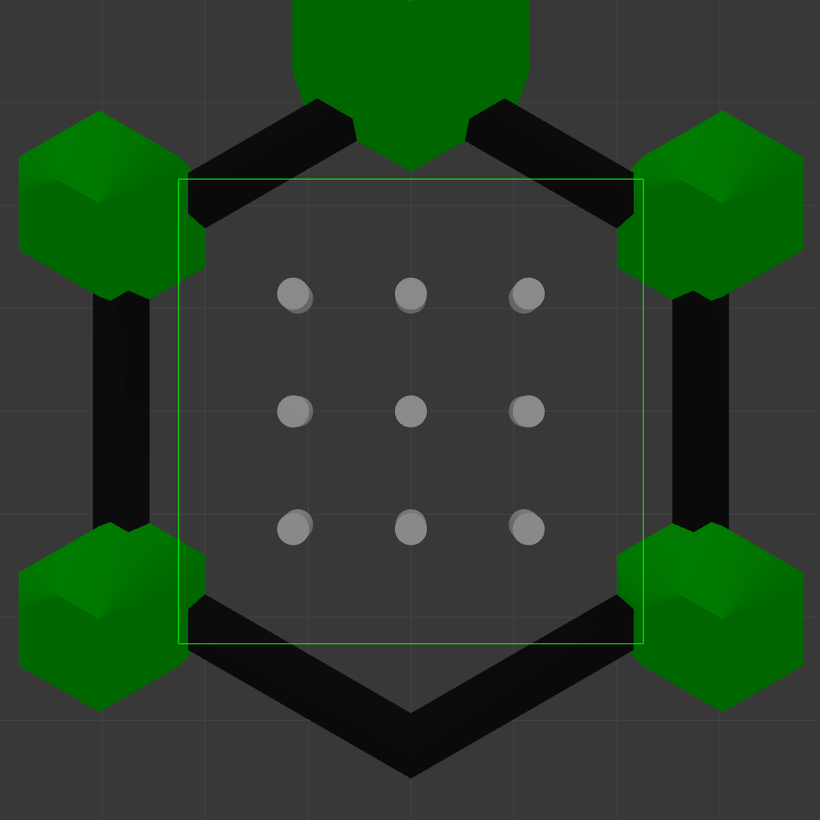
World I: TB3
Notes:
→ designed to work with both simulation and real world robots

Slide 21
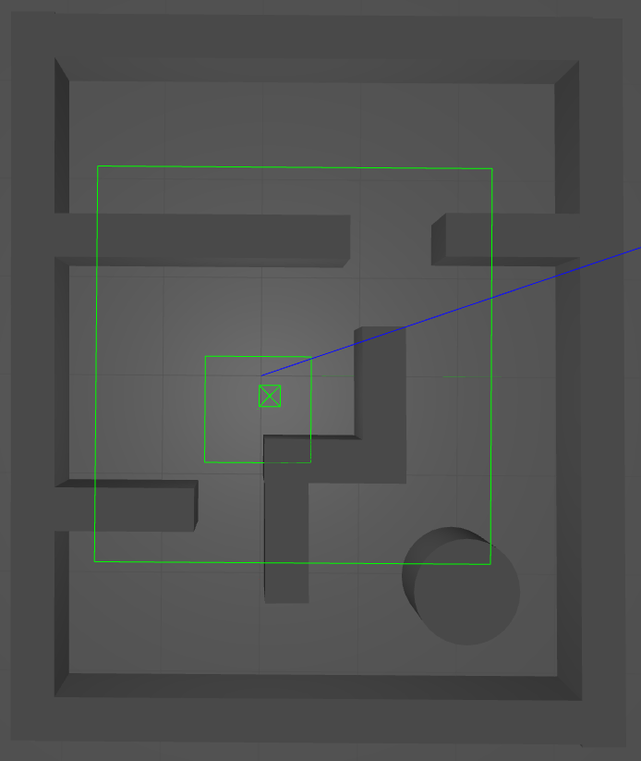
World II: Maze
Notes:
→ designed to work with both simulation and real world robots

Slide 22
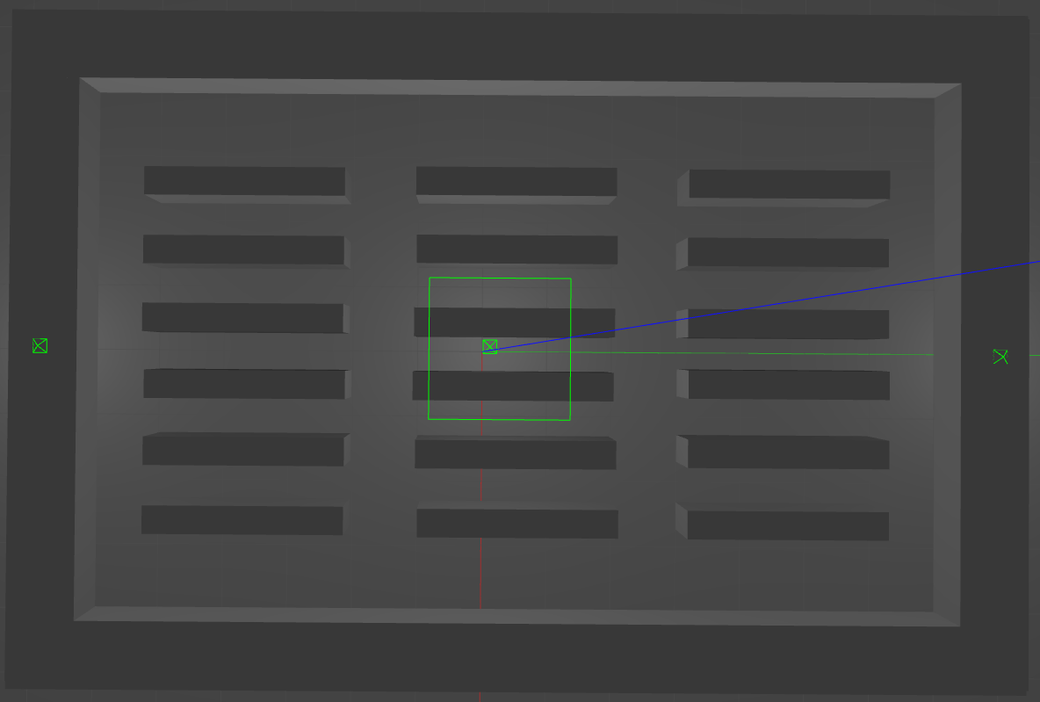
World III: Warehouse I
Notes:
→ designed to work with both simulation and real world robots

Slide 23
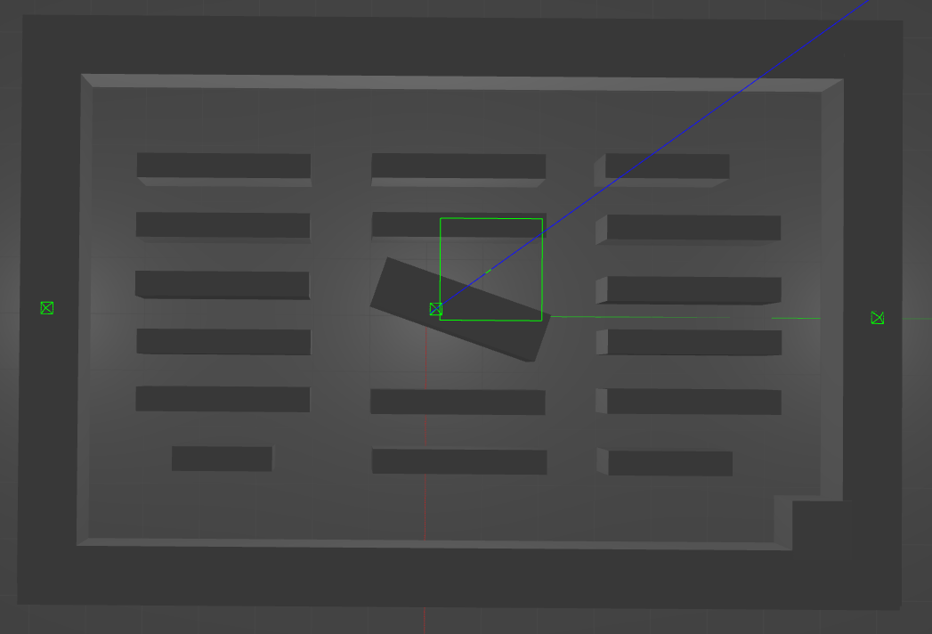
World IV: Warehouse II
Notes:
→ designed to work with both simulation and real world robots

Slide 24
Settings
Notes:
→ designed to work with both simulation and real world robots

Slide 25
WP Threshold
WP WITH THRESHOLD
WP WITHOUT THRESHOLD
Notes:
→ designed to work with both simulation and real world robots

Slide 26
Settings
Notes:
→ designed to work with both simulation and real world robots

Slide 27
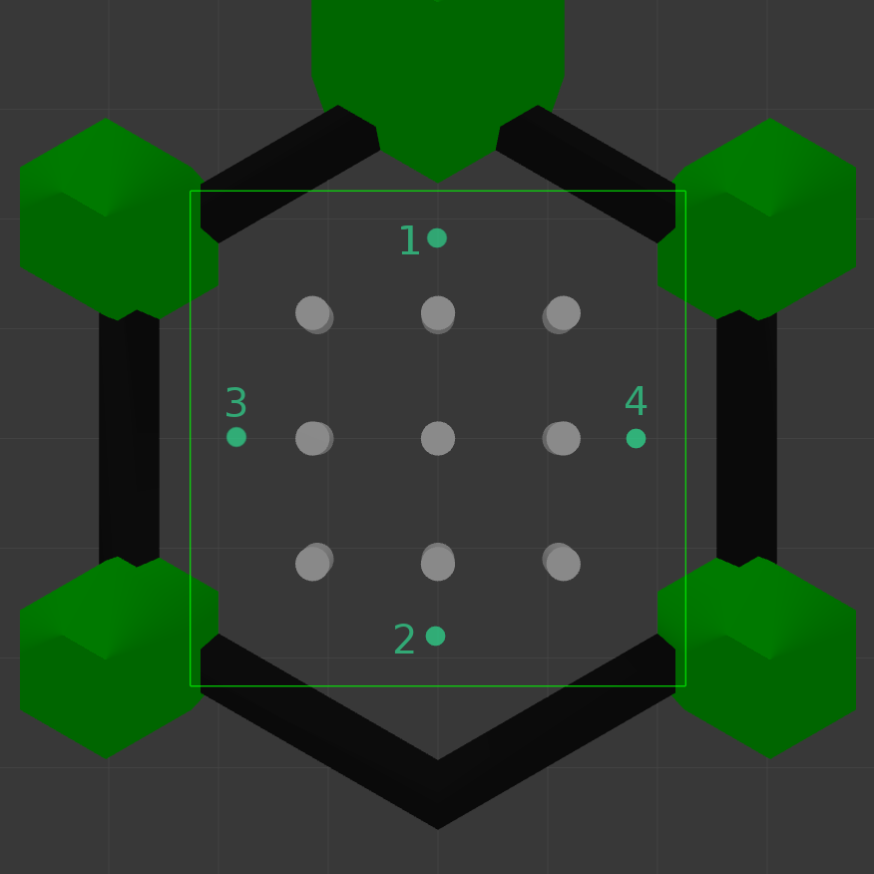
World I: TB3
Notes:
→ designed to work with both simulation and real world robots

Slide 28
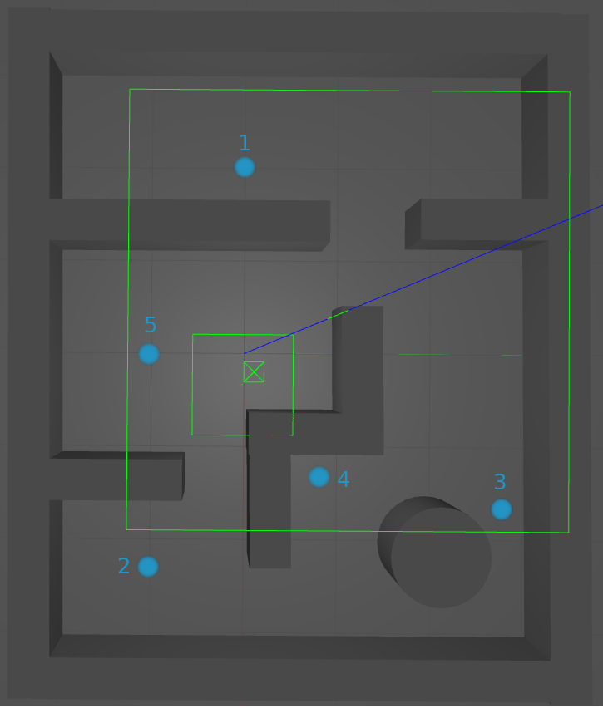
World II: Maze
Notes:
→ designed to work with both simulation and real world robots

Slide 29
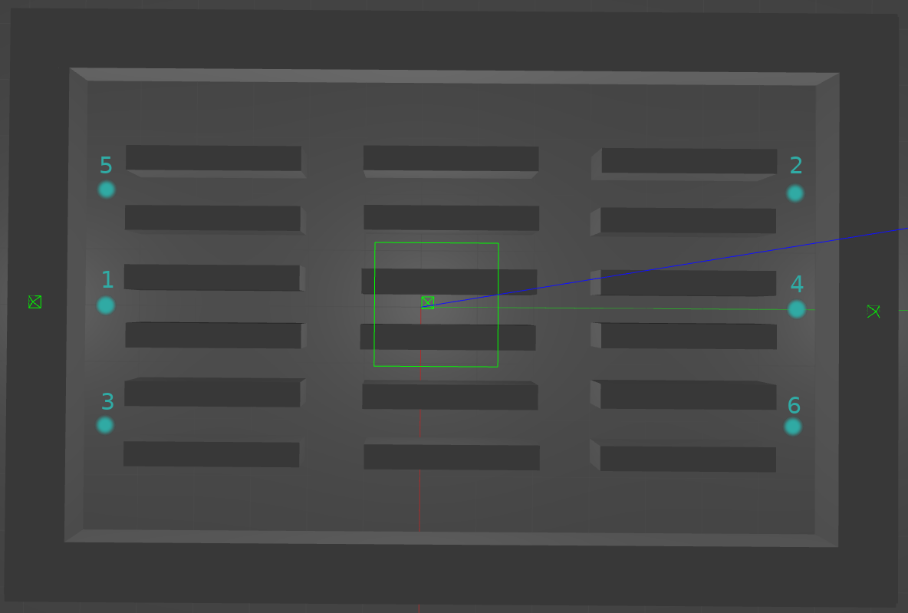
World III: Warehouse I
Notes:
→ designed to work with both simulation and real world robots

Slide 30
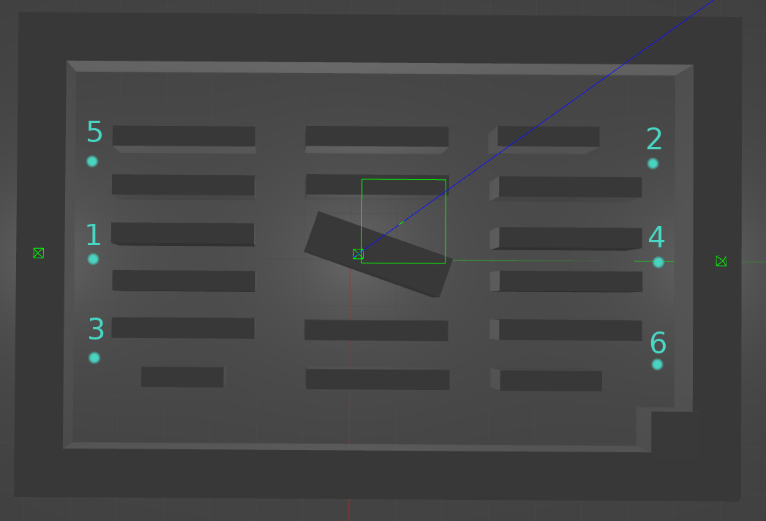
World IV: Warehouse II
Notes:
→ designed to work with both simulation and real world robots

Slide 31
Settings
Notes:
→ designed to work with both simulation and real world robots

Slide 32
Rounds
2
1
3
Rounds:
0
1
2
Notes:
→ designed to work with both simulation and real world robots

Slide 33
Settings
Notes:
→ designed to work with both simulation and real world robots

Slide 34
End Procedure
2
1
3
RETURN TO START POSITIONS
Notes:
→ designed to work with both simulation and real world robots

Slide 35
End Procedure
2
1
3
DESPAWN
Notes:
→ designed to work with both simulation and real world robots

Slide 36
End Procedure
2
1
3
IDLE MODE
Notes:
→ designed to work with both simulation and real world robots

Slide 37
End Procedure
2
1
3
STAY AT LAST WP
Notes:
→ designed to work with both simulation and real world robots

Slide 38
Settings
Notes:
→ designed to work with both simulation and real world robots

Slide 39
Agenda
General Idea
Settings
Evaluation
Implementation
Future Work

Slide 40
Evaluation
WP-Time:
Flowtime:
Avg. Flowtime:
Makespan:
Avg. Makespan:
w₁
w₂
w₁
w_{n}
…
Notes:
→ designed to work with both simulation and real world robots

Slide 41
Agenda
General Idea
Settings
Evaluation
Implementation
Future Work

Slide 42
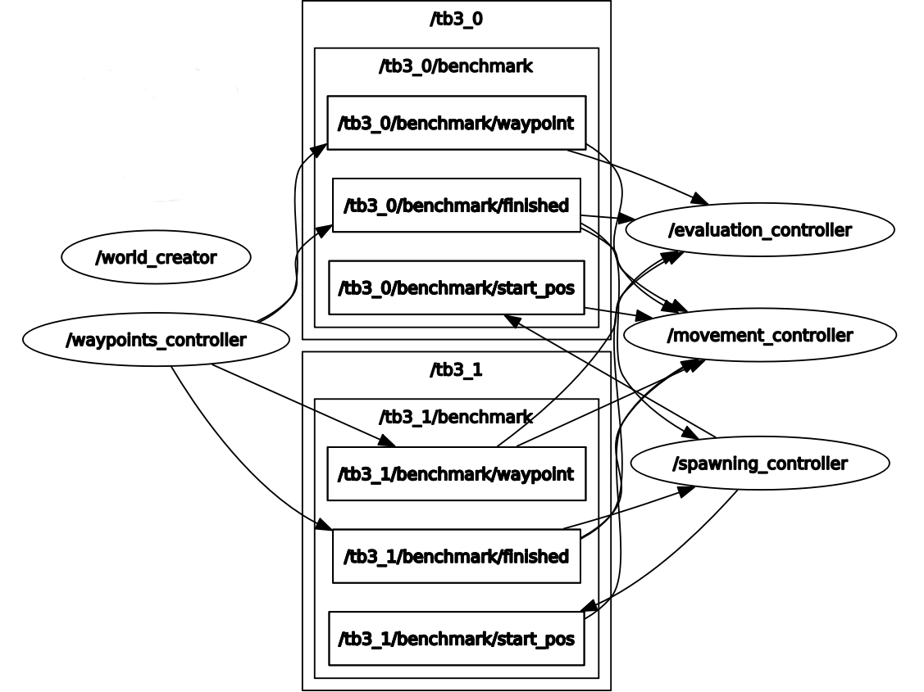
Implementation
Notes:
→ designed to work with both simulation and real world robots

Slide 43
Agenda
General Idea
Settings
Evaluation
Implementation
Future Work

Slide 44
Future Work
Test in real world application
Add more worlds
Notes:
→ designed to work with both simulation and real world robots

Slide 45
Thank you
Notes:
→ designed to work with both simulation and real world robots

