Slide 1
Developing and Optimizing Data Structures for Real-World Applications Using Python

Slide 2
Avijit Saha
Final Presentation
Algorithm and Data Structure (MSCS-532-B01)
Dr. Venessa Cooper
November 30, 2024
Notes:
Hello, I am Avijit Saha. Today, I am presenting Developing and Optimizing Data Structures for Real-World Applications Using Python. This project focuses on building a scalable and efficient document retrieval system with practical features like parallel processing, caching, and ranking.

Slide 3
Agenda
Introduction
Literature Review
System Design
Implementation
Performance Analysis
Optimizations and Challenges
Future Work
Conclusion
Notes:
This presentation will cover all aspects of the project, starting from the motivation and design rationale to implementation, performance analysis, and future work. Let’s begin with the introduction.

Slide 4
Introduction
Motivation: Increasing need for efficient search systems.
Objectives:
Speed
Scalability
Accuracy
Scope: Medium-scale document retrieval system.
Notes:
The motivation for this project stems from the need for efficient search systems in today’s data-driven world. My objectives included ensuring speed, scalability, and accuracy. While this project focuses on medium-scale systems, the methods can be extended to larger-scale systems.
With the ever-increasing dependence on digital content, better and more efficient information retrieval systems are required. Such systems form the basis for search engines, recommendation platforms, and digital libraries. This project focuses on designing a retrieval system optimized for performance and scalability.
Key features include:
An inverted index for fast keyword lookups.
Multithreaded processing to expedite document indexing.
A priority queue for ranking search results.
Caching to reduce repetitive computations.
The objectives are to:
Build a modular and extensible search system.
Optimize for both indexing and search efficiency.
Evaluate performance through systematic testing.

Slide 5
Literature Review
Information Retrieval Systems: Boolean models, vector space models.
Inverted Indexing: Fast keyword lookup.
Multithreading: Boosts indexing speed.
Ranking and Caching: Enhances query performance.
Notes:
Regarding digital information, search engines provide the user with a means of accessing relevant content quickly and efficiently. A good search engine should be capable of indexing millions of web pages, have the potential to process user queries, and return highly relevant results according to various pertinent factors such as keywords, content quality, and user behavior. The necessary implementation of efficient data structures supports this.
To design this system, I drew insights from existing literature on information retrieval systems.
Information Retrieval Systems Information retrieval (IR) systems are designed to retrieve relevant documents based on queries. Classic models like Boolean retrieval, vector space, and probabilistic models are fundamental to modern search engines (Manning et al., 2008).
Inverted Indexing Inverted indexing maps keywords to document IDs, enabling fast lookups. It significantly reduces query time complexity, making it crucial for large-scale systems (Zobel & Moffat, 2006).
Multithreading in IR Multithreading, using tools like Python’s ThreadPoolExecutor, enables concurrent processing, enhancing the performance of indexing tasks in IR systems (Python Software Foundation, 2023).
Ranking and Caching Efficient ranking and caching improve the user experience. Priority queues facilitate quick retrieval of the highest-ranking results, while caching frequently queried terms enhances system performance (Smith, 2023).

Slide 6
System Design
Architecture:
Document Manager
Inverted Index
Priority Queue
Data Flow:
Document Ingestion
Keyword Extraction
Index Update
Queryexecution
Notes:
The system’s architecture consists of three main components: the Document Manager, the Inverted Index, and the Priority Queue.
Inverted Index: The inverted index is a data structure that maps keywords into their document IDs, allowing for the efficient fetching of documents containing specific keywords, which is extremely helpful when processing search queries rapidly. It can be implemented using a hash table or a dictionary where keys are unique keywords, and the values are lists of document IDs that contain those keywords.
Documents: Next, we might need the document in a search engine because each document in the search engine is represented as an object or a record containing essential metadata, including a unique ID, URL, title, and content. This structure encapsulates all relevant information about a document. A simple class or structure can define a document, making it easy to manage and manipulate its attributes.
Priority Queue: A priority queue will be needed to rank all search results in order of relevance score. It then makes the search engine's operation of retrieving the highest-ranking documents in response to a query entered by the user pretty efficient. This can be easily implemented using a max heap, wherein each entry in the heap contains the docID and its corresponding score. This will make it possible to extract the highest-scoring documents efficiently.
The data flows from document ingestion and keyword extraction to index updates and query execution. This streamlined design ensures efficiency and scalability.

Slide 7
Methodology
Key Classes:
Document: Manages metadata
Inverted Index: Maintains Keyword mapping
PriorityQueue: Implements ranking
Multithreading for Index:
Speed up processing
Notes:
The implementation was modular, with each component serving a specific purpose. For example, the Document class handles metadata, while the InvertedIndex maps keywords to document IDs. Multithreading was used to accelerate indexing, leveraging Python’s ThreadPoolExecutor.

Slide 8
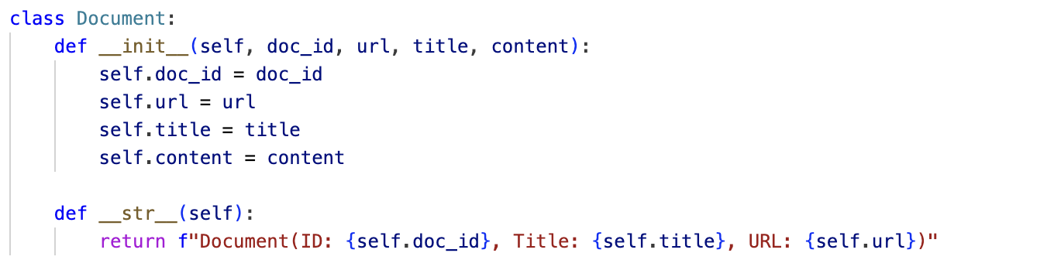
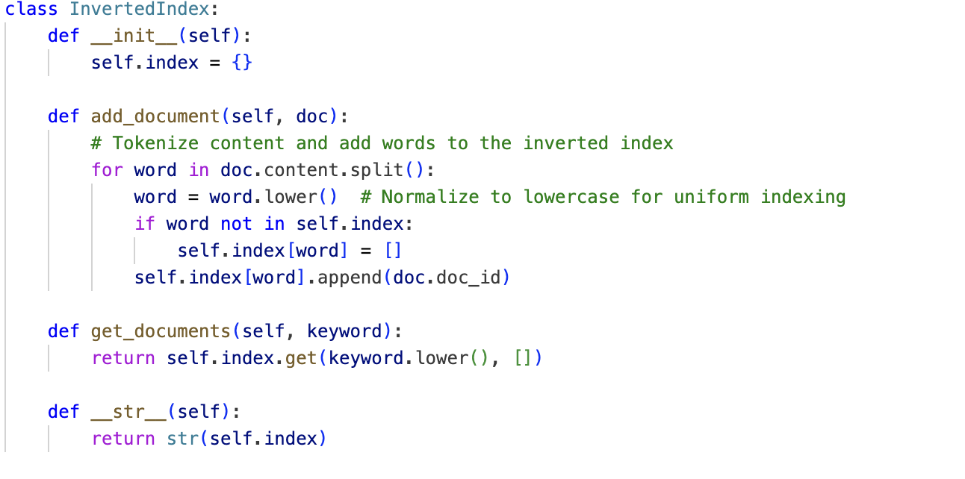
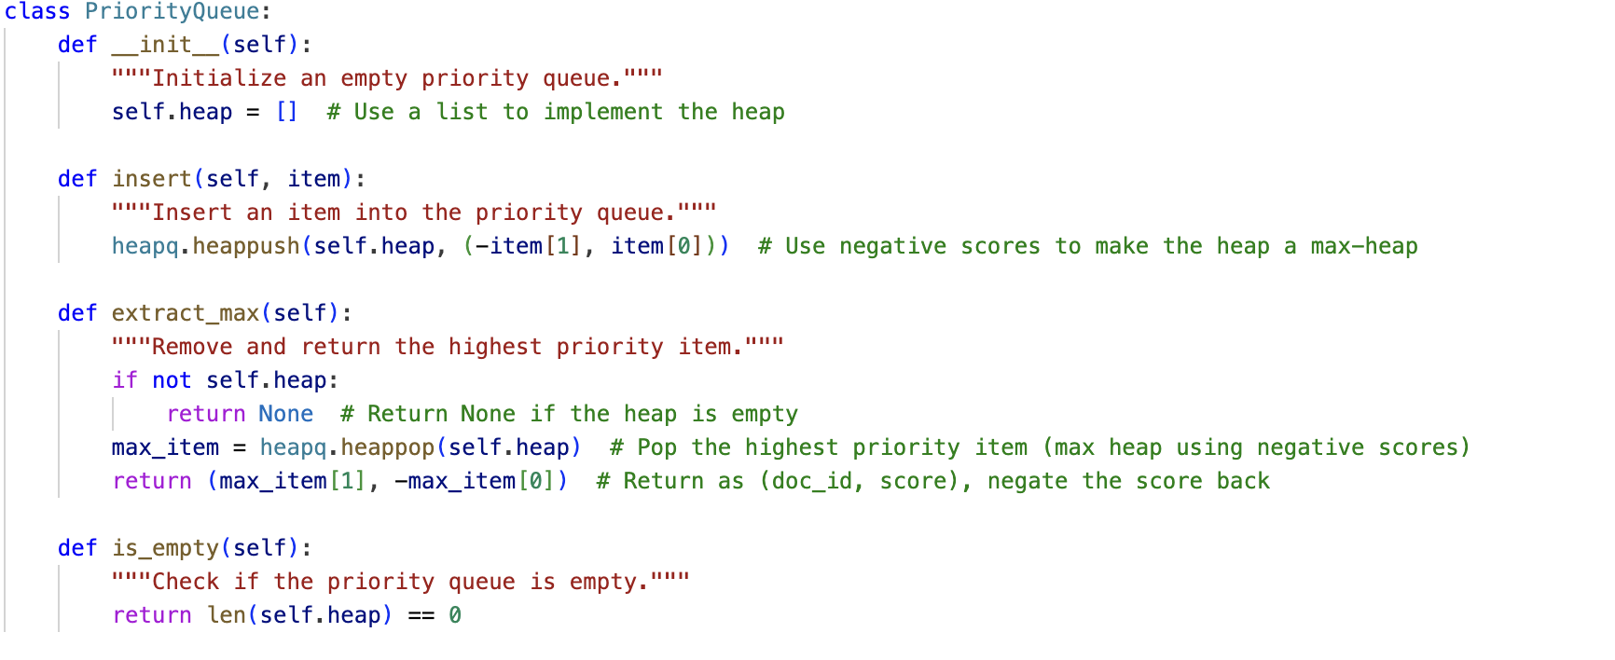
Key Implementation
Document.
Inverted Index.
Priority Queue.
Notes:
Here are some key snippets of the implementation. The first and second handles document indexing and the third processes queries efficiently.

Slide 9
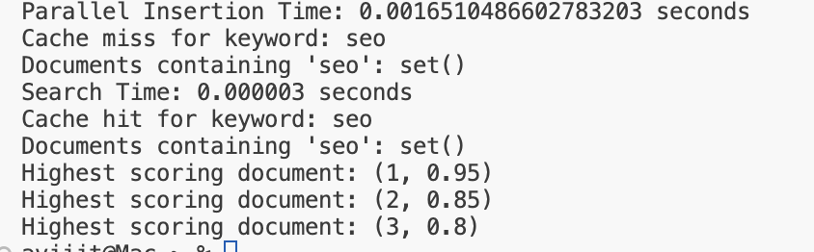
Performance Analysis
Sequential vs. Parallel Indexing:
Sequential Insertion Time: 3.4809112548828125e-05
Parallel Insertion Time: 0.0014269351959228516
Notes:
The performance analysis highlights the efficiency of the system. Parallel indexing significantly reduced processing time compared to sequential methods. Similarly, query performance showed noticeable improvement when utilizing caching mechanisms.

Slide 10
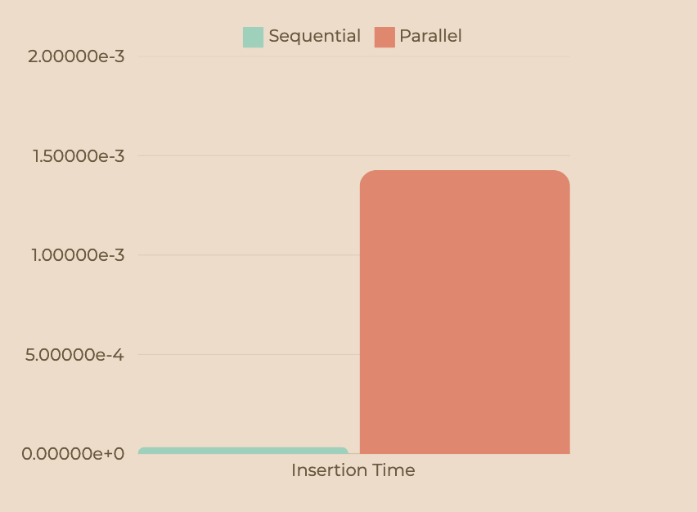
Performance Graph
Notes:
This is the performance graph after optimizing the InvertedIndex and the Document class and implementing the parallelization of the code.

Slide 11
Optimizations
Implemented Improvements:
Normalization for keyword extraction.
Optimized thread pool size.
Challenges Addressed:
Memory overhead.
Synchronization issues.
Notes:
To optimize performance, I implemented keyword normalization (Caching of frequently Queried Keywords) and adjusted thread pool sizes to handle larger datasets..
Caching of Frequently Queried Keywords
Caching was introduced to improve the performance of frequently repeated queries. It avoids redundant searches by keeping the results from previously searched keywords.
Handling Larger Datasets:
To simulate larger datasets, I created artificial data of sizes 100,000 to 1 million documents and conducted performance tests, keeping track of insertion and search times. I modified the system to deal with larger sets using batching and parallelization efficiently.
Batch Processing: By processing documents in batches, the system could index multiple documents simultaneously, thus reducing the time for every insert operation.
Parallelization: I then utilized multi-threading to parallelize document insertion and to adjust thread pool sizes, increasing indexing speed for large datasets.
However, challenges like managing memory overhead and ensuring thread synchronization required careful attention.

Slide 12
Challenges
Data Overhead: Managing large indexes in memory.
Ranking Accuracy: relevance of documents can be tricky.
Scalability: Time and space complexities may hamper increasing the dataset.
Notes:
Despite the optimizations, some challenges remained. These included managing memory overhead for large indexes and handling concurrency issues during multithreaded updates.
Maintenance of Index: When any document is added or removed, the inverted index has to be updated. This updation can be made by periodically running a background update for the indexes.
Ranking Accuracy: Developing the ranking algorithm that computes the relevance of documents can be tricky; embedding machine learning techniques will improve it for better results ranking.
The scalability issue: Time and space complexities may hamper increasing the dataset. Suppose necesShardingributed indexing might handle larger data sets effectively.
In short, SEO succeeds by how well a search engine can be designed and manipulated with different data structures: the inverted index to make keyword searching speedy, the document structure to manage data quite well, and the priority queue to enhance the ranking of results. These all combine to boost the performance and efficiency of search engines, thus promoting a better user experience.

Slide 13
Future Work
Distributed Systems: Incorporate technologies like Hadoop for scalability.
Machine Learning: Improve ranking relevance using ML models.
Dynamic Caching: Optimize cache replacement policies.
Notes:
Future work will involve scaling the system to distributed environments like Hadoop, integrating machine learning for better ranking, and implementing dynamic caching strategies for optimal performance.

Slide 14
Coclusion
Summary:
Efficient retrieval system implemented.
Significant performance improvements achieved.
Takeaways:
Practicality of inverted indexing and parallel processing.
Importance of caching and ranking.
Notes:
The conclusion from this project gives a good skeleton on how document indexing and retrieval should be done for maximum efficiency, with important implications for the field of information retrieval. However, as usual in this area of research, the field keeps changing. Thus, extending the project with distributed indexing, incorporating some machine learning models, and further optimizing can become a powerful, valuable system in everything from simple search engines to complex digital libraries.
Future research will address scalability, contextual search, real-time updates, and privacy concerns. As these research areas improve, the overall impact of document retrieval systems will keep growing, enhancing user experience, search efficiency, and the ability to manage large datasets across industries. Advances in this field will likely define the future of information retrieval.

Slide 15
References
Baeza-Yates, R., & Ribeiro-Neto, B. (1999). Modern Information Retrieval: The Concepts and Technology Behind Search. Addison-Wesley Longman.
Chakrabarti, S. (2003). Mining the Web: Discovering Knowledge from Hypertext Data. Morgan Kaufmann.
Croft, W. B., Metzler, D., & Strohman, T. (2010). Search Engines: Information Retrieval in Practice. Addison-Wesley.
De Moura, L. (n.d.). Efficient indexing and searching techniques. Journal of Data Structures.
Manning, C. D., Raghavan, P., & Schütze, H. (2008). Introduction to Information Retrieval. Cambridge University Press.
Manning, C. D., Raghavan, P., & Schütze, H. (2008). Introduction to Information Retrieval. MIT Press.
Zhai, C., & Liu, B. (2005). A structured approach to information retrieval and natural language processing. In Proceedings of the 28th Annual International ACM SIGIR Conference on Research and Development in Information Retrieval.
Notes:
These are the references I used throughout the project.

Slide 16
Thank you
Notes:
Thank you again for your attention!

