Slide 1
Developing and Optimizing Data Structures for Real-World Applications Using Python

Slide 2
Avijit Saha
Final Presentation
Algorithm and Data Structure (MSCS-532-B01)
Dr. Venessa Cooper
November 30, 2024
Notes:
Hello, I am Avijit Saha. Today, I will present Developing and Optimizing Data Structures for Real-World Applications Using Python. This project focuses on building a scalable and efficient document retrieval system with practical features like parallel processing, caching, and ranking.

Slide 3
Agenda
Introduction
Literature Review
System Design
Implementation
Performance Analysis
Optimizations and Challenges
Future Work
Conclusion
Notes:
"This presentation will cover all aspects of the project, starting from the motivation and design rationale to implementation, performance analysis, and future work. Let’s begin with the introduction."

Slide 4
Introduction
Motivation: Increasing need for efficient search systems.
Objectives:
Speed
Scalability
Accuracy
Scope: Medium-scale document retrieval system.
Notes:
The motivation for this project stems from the need for efficient search systems in today’s data-driven world. My objectives included ensuring speed, scalability, and accuracy. While this project focuses on medium-scale systems, the methods can be extended to larger-scale systems.

Slide 5
Literature Review
Information Retrieval Systems: Boolean models, vector space models.
Inverted Indexing: Fast keyword lookup.
Multithreading: Boosts indexing speed.
Ranking and Caching: Enhances query performance.
Notes:
To design this system, I drew insights from existing literature on information retrieval systems.
Information Retrieval Systems Information retrieval (IR) systems are designed to retrieve relevant documents based on queries. Classic models like Boolean retrieval, vector space, and probabilistic models are fundamental to modern search engines (Manning et al., 2008).
Inverted Indexing Inverted indexing maps keywords to document IDs, enabling fast lookups. It significantly reduces query time complexity, making it crucial for large-scale systems (Zobel & Moffat, 2006).
Multithreading in IR Multithreading, using tools like Python’s ThreadPoolExecutor, enables concurrent processing, enhancing the performance of indexing tasks in IR systems (Python Software Foundation, 2023).
Ranking and Caching Efficient ranking and caching improve the user experience. Priority queues facilitate quick retrieval of the highest-ranking results, while caching frequently queried terms enhances system performance (Smith, 2023).

Slide 6
System Design
Architecture:
Document Manager
Inverted Index
Priority Queue
Data Flow:
Document Ingestion
Keyword Extraction
Index Update
Queryexecution
Notes:
The system’s architecture consists of three main components: the Document Manager, the Inverted Index, and the Priority Queue. The data flows from document ingestion and keyword extraction to index updates and query execution. This streamlined design ensures efficiency and scalability.

Slide 7
Methodology
Key Classes:
Document: Manages metadata
Inverted Index: Maintains Keyword mapping
PriorityQueue: Implements ranking
Multithreading for Index:
Speed up processing
Notes:
The implementation was modular, with each component serving a specific purpose. For example, the Document class handles metadata, while the InvertedIndex maps keywords to document IDs. Multithreading was used to accelerate indexing, leveraging Python’s ThreadPoolExecutor.

Slide 8
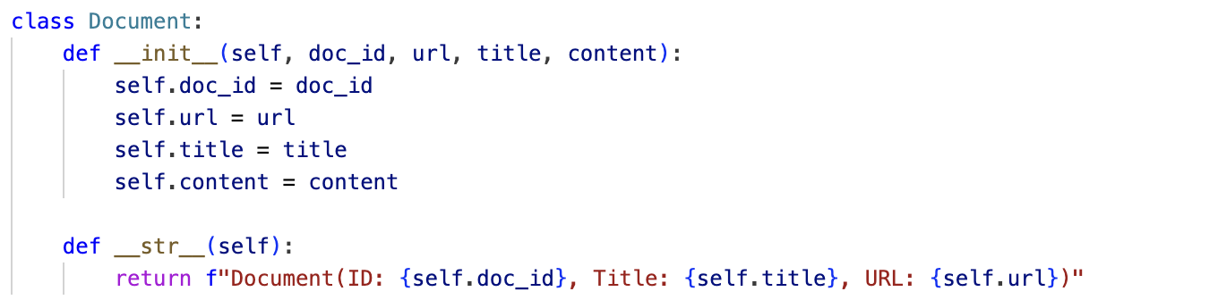
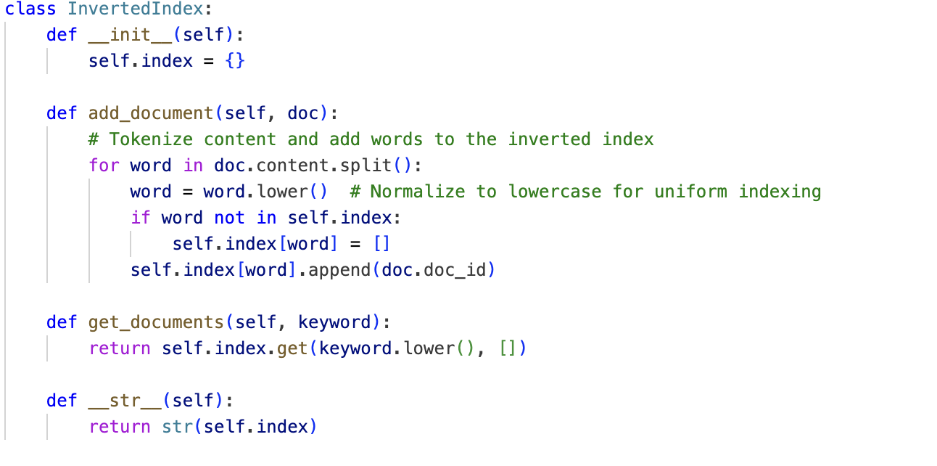
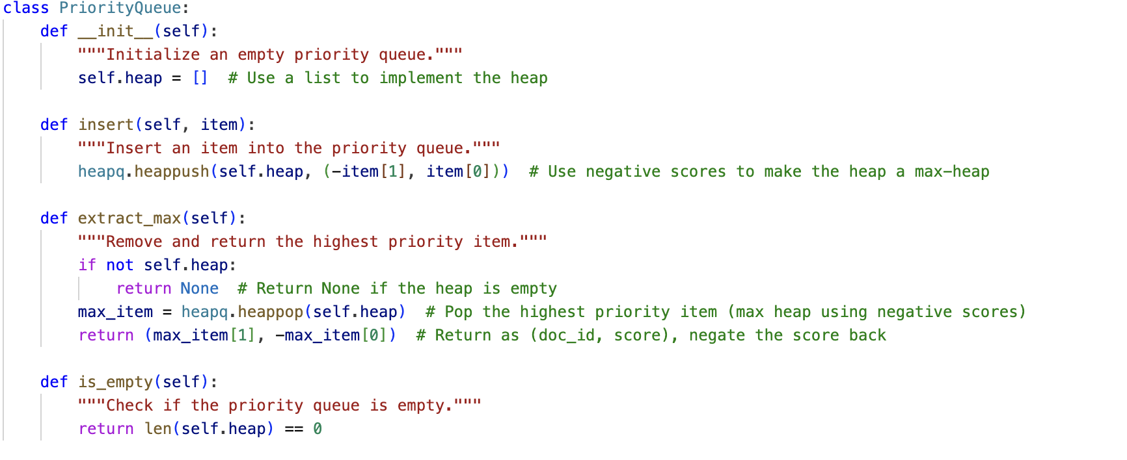
Key Implementation
Document.
Inverted Index.
Priority Queue.
Notes:
Here are some key snippets of the implementation. The first and second handles document indexing and the third processes queries efficiently.

Slide 9
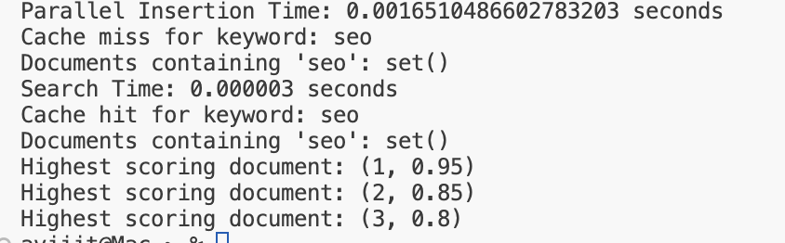
Performance Analysis
Sequential vs. Parallel Indexing:
Sequential Insertion Time: 3.4809112548828125e-05
Parallel Insertion Time: 0.0014269351959228516
Notes:
The performance analysis highlights the efficiency of the system. Parallel indexing significantly reduced processing time compared to sequential methods. Similarly, query performance showed noticeable improvement when utilizing caching mechanisms.

Slide 10
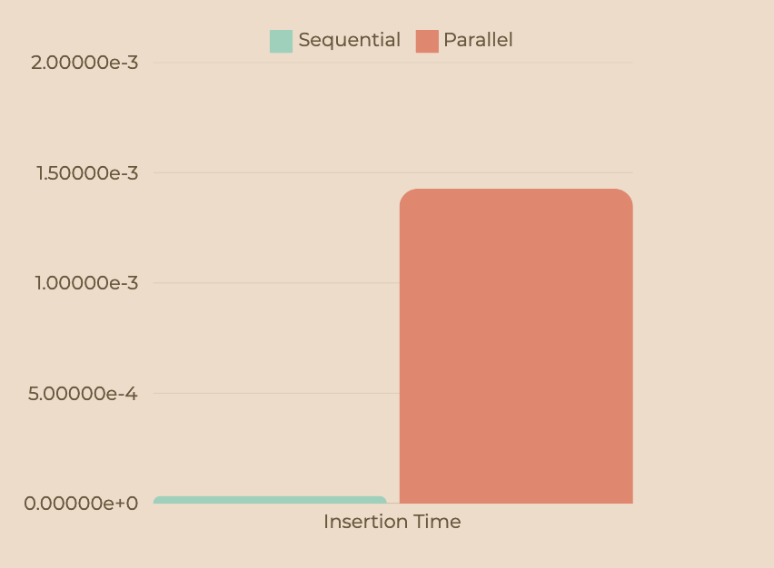
Performance Graph
Notes:
This is the performance graph after optimizing the InvertedIndex and the Document class and implementing the parallelization of the code.

Slide 11
Optimizations
Implemented Improvements:
Normalization for keyword extraction.
Optimized thread pool size.
Challenges Addressed:
Memory overhead.
Synchronization issues.
Notes:
To optimize performance, I implemented keyword normalization and adjusted thread pool sizes. However, challenges like managing memory overhead and ensuring thread synchronization required careful attention.

Slide 12
Challenges
Data Overhead: Managing large indexes in memory.
Concurrency Issues: Thread-safe updates to shared structures.
Relevance: Balancing speed and accuracy.
Notes:
Despite the optimizations, some challenges remained. These included managing memory overhead for large indexes and handling concurrency issues during multithreaded updates.

Slide 13
Future Work
Distributed Systems: Incorporate technologies like Hadoop for scalability.
Machine Learning: Improve ranking relevance using ML models.
Dynamic Caching: Optimize cache replacement policies.
Notes:
Future work will involve scaling the system to distributed environments like Hadoop, integrating machine learning for better ranking, and implementing dynamic caching strategies for optimal performance.

Slide 14
Coclusion
Summary:
Efficient retrieval system implemented.
Significant performance improvements achieved.
Takeaways:
Practicality of inverted indexing and parallel processing.
Importance of caching and ranking.
Notes:
In conclusion, this project successfully developed an efficient document retrieval system. The results demonstrate the practicality of combining inverted indexing, parallel processing, caching, and ranking mechanisms.

Slide 15
References
Baeza-Yates, R., & Ribeiro-Neto, B. (1999). Modern Information Retrieval: The Concepts and Technology Behind Search. Addison-Wesley Longman.
Chakrabarti, S. (2003). Mining the Web: Discovering Knowledge from Hypertext Data. Morgan Kaufmann.
Croft, W. B., Metzler, D., & Strohman, T. (2010). Search Engines: Information Retrieval in Practice. Addison-Wesley.
De Moura, L. (n.d.). Efficient indexing and searching techniques. Journal of Data Structures.
Manning, C. D., Raghavan, P., & Schütze, H. (2008). Introduction to Information Retrieval. Cambridge University Press.
Manning, C. D., Raghavan, P., & Schütze, H. (2008). Introduction to Information Retrieval. MIT Press.
Zhai, C., & Liu, B. (2005). A structured approach to information retrieval and natural language processing. In Proceedings of the 28th Annual International ACM SIGIR Conference on Research and Development in Information Retrieval.
Notes:
These are the references I used throughout the project.

Slide 16
Thank you
Notes:
Thank you again for your attention!

