Slide 1
Smart HR
AI for Predicting and Explaining Employee Turnover
Groupe 23:
Noa LIEGEOIS
Ovia CHANEMOUGANANDA
Alexandre FAU
Marie-Lou JODET
Arshitha KANDUKURI

Slide 2



The Problem
High employee turnover
Cost for the company
Lack of anticipation

Slide 3

Our Solution
Explaining you the main reasons why employee are leaving the company
Predict the risk of an employee leaving the company
Helping the HR department understand the dynamics at play and make decisions

Slide 4
Dataset Presentation
We used the employee information provided by your company : https://www.kaggle.com/datasets/rhuebner/human-resources-data-set/data
The dataset allowed us to access information such as gender, marital status, salary, date of birth, etc.
We then proceeded to process the data in order to reveal key elements while protecting the anonymity of the employees

Slide 5

Data Preparation
Removing the employee’s names
Removing the employees who had been fired
Converting Date of Birth into Age
Converting Date of Hire into Tenure Years
Encoding categorical variables (Reason for leaving, ethnicity, citizenship,
Latino, state)

Slide 6
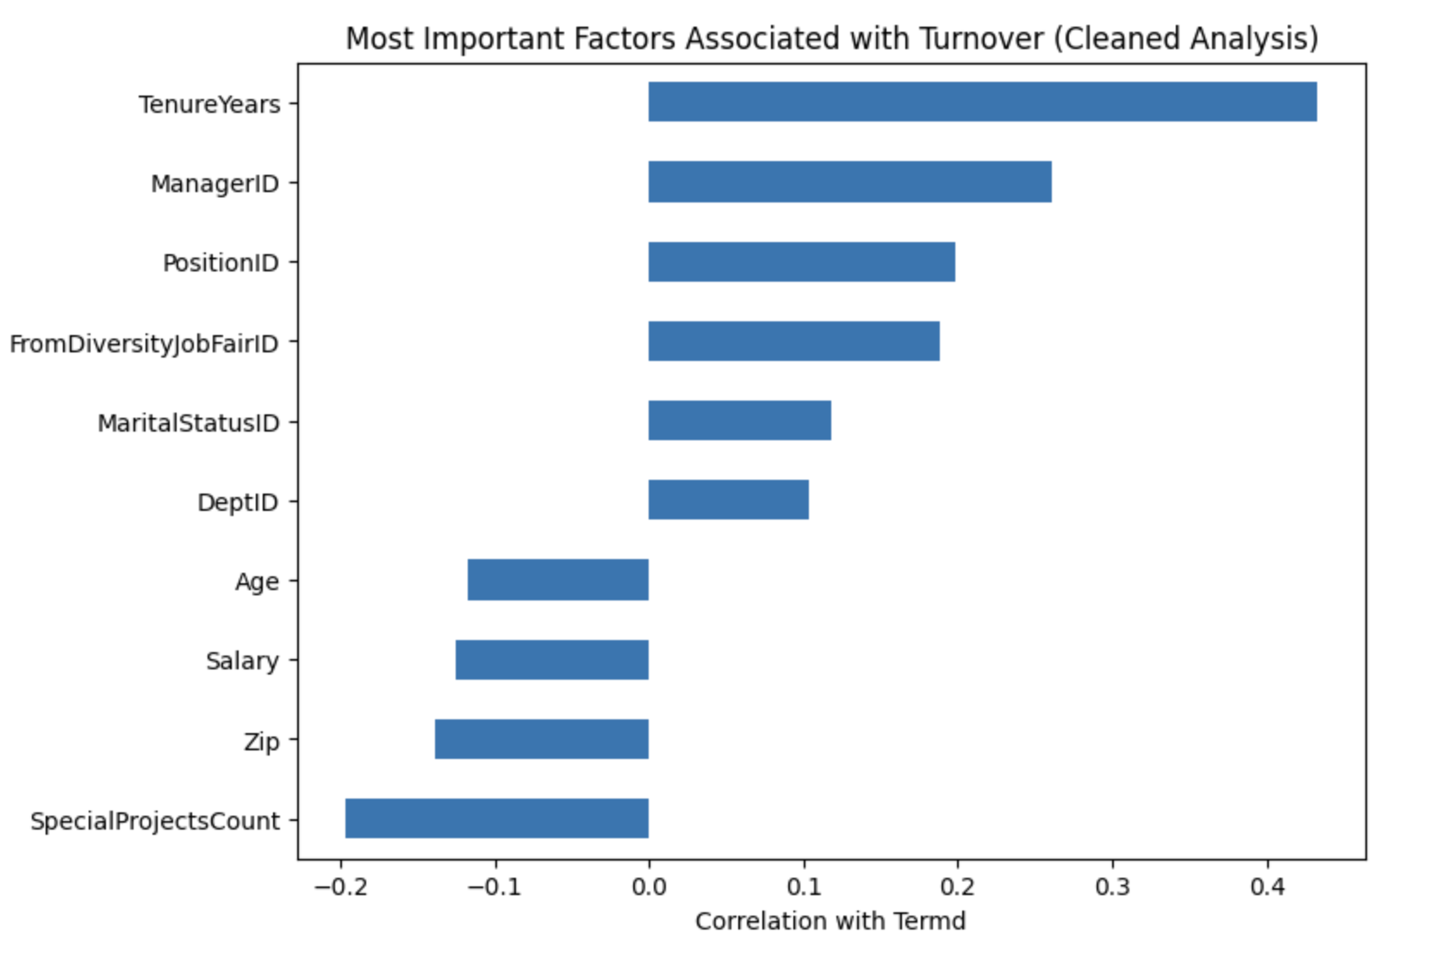
Exploratory Analysis
Correlation graph
Key Variables

Slide 7
Model Choice
Why Logistic Regression?
Suitable for binary classification (leave / stay)
Easy to interpret → understand key factors
Fast and efficient on small datasets
Provides probabilities to assess risk

Slide 8
Impact & Conclusion
Business Impact
Anticipate employee resignations
Reduce hiring and training costs
Improve employee retention
Support data-driven HR decisions
Conclusion
Smart HR helps companies:
→ Predict employee turnover → Understand the reasons → Take action early
Moving from reactive to proactive HR management

