Slide 1
EMPLOYMENT MANAGEMENT SYSTEM
A PHP · MySQL Web Application for Departments, Positions, Employees & Reporting
Your Name | Course / Module | Date

Slide 2
Introduction
1
Centralizes employee, department & position data
i
What is an Employment Management System?
A web-based application that centralizes how an organization records and manages its workforce data — departments, job positions, employee records, and user access — replacing manual, paper-based or spreadsheet-based tracking.
2
Reduces manual record-keeping errors
3
Provides a foundation for HR reporting
Employment Management System
2

Slide 3
Objectives & Scope
1
2
3
Manage Employees
Organize Departments
Define Positions
Create, update, view and remove employee records
Structure the organization into departments
Track job positions linked to departments
4
5
6
Control Access
Generate Reports
Track Changes
Login & user accounts for authorized staff only
Summarize workforce data for decision-making
Version-controlled development via Git & GitHub
Employment Management System
3

Slide 4
Tools & Technology Stack
XA
VS
Gi
Hb
XAMPP
VS Code
Git
GitHub
PHP, Apache & MySQL — local development server
Writing PHP, HTML, CSS & JavaScript
Version control for tracking code changes
Remote repository to store the project online
Claude Code is used alongside this stack to help scaffold files, write PHP/SQL, debug errors, and manage Git commits.
Employment Management System
4

Slide 5
Project Structure
employment-management-system/
config/database.php
├── config/
│ └── database.php
├── index.php
├── login.php
├── dashboard.php
├── employees/
├── departments/
├── positions/
├── css/
└── js/
Central place for the MySQL connection settings
employees / departments / positions
One folder per module — keeps CRUD logic organized
index.php, login.php, dashboard.php
Entry point, authentication, and main landing page
Employment Management System
5

Slide 6
Database Design
Database: employment_management
department
position
employee
user_account
• department_id
• position_id
• employee_id
• user_id
• department_name
• title
• name
• username
• department_id (FK)
• position_id (FK)
• password
• department_id (FK)
• employee_id (FK)
Employment Management System
6

Slide 7
Development Workflow
Recommended build order
1
Install tools
2
Create project folder
3
Create the database
XAMPP, VS Code, Git
employment-management-system/
employment_management
4
Build the DB connection
5
Build modules in order
6
Connect to GitHub
PHP ↔ MySQL
Login → Dashboard → Departments → Positions → Employees → Users → Reports
Push local project to a repo
Employment Management System
7

Slide 8
Key Features
Authentication
Employee CRUD
Secure login restricts the system to registered user accounts
Create, view, update and delete employee records
Departments & Positions
Attendance & Leave
Maintain the lookup tables employees are assigned to
Clock in/out, mark absences, and manage leave requests
Payroll
Reports
Run payroll and generate payslips from position salaries
Headcount, payroll cost and attendance summaries
Employment Management System
8

Slide 9
System Walkthrough
A screen-by-screen look at each module

Slide 10
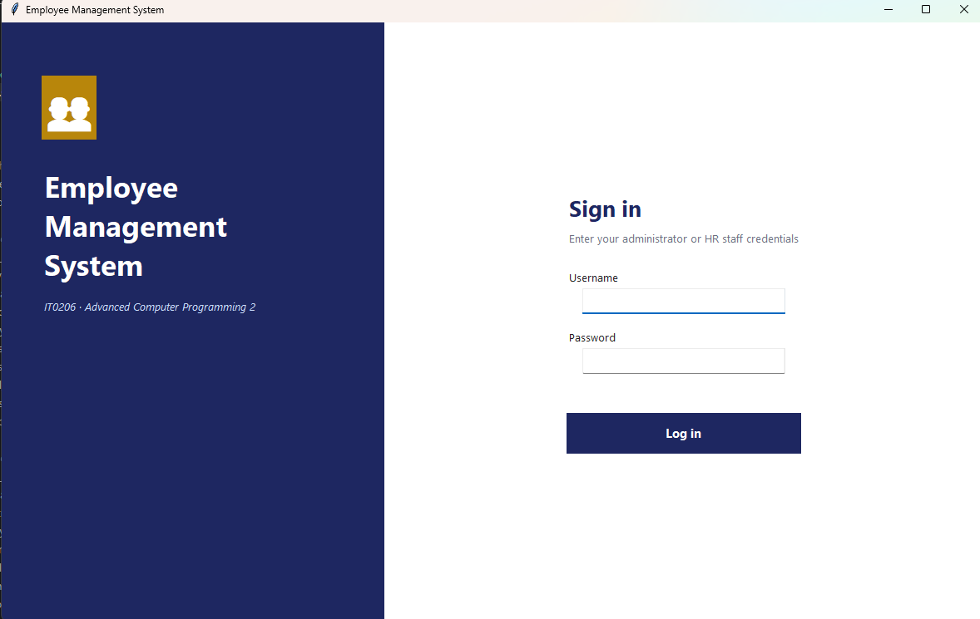
Login & Authentication
1
Login & Authentication
The entry point to the system. Only administrators or HR staff with valid credentials can sign in — everything else in the app sits behind this screen.
Username & password fields with a single Log in action
Prevents unauthorized access to employee data
Session identifies the logged-in role (e.g. admin) shown in the sidebar

Slide 11
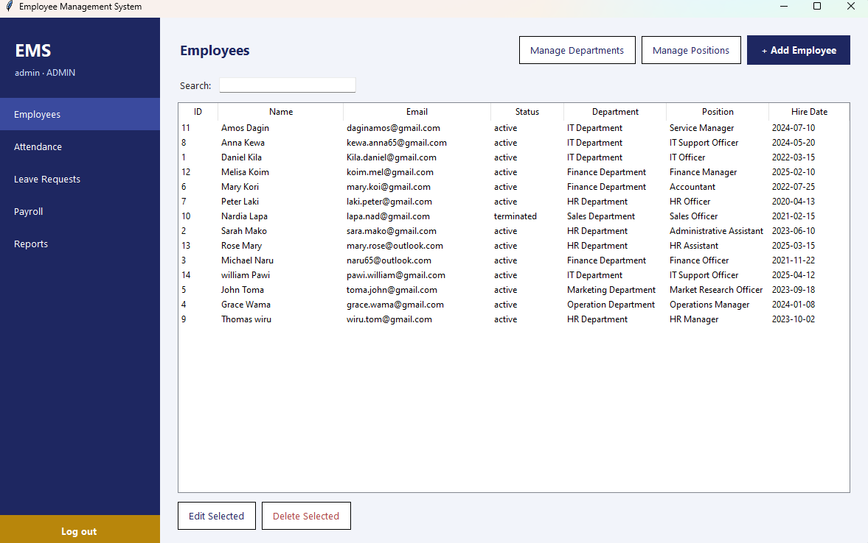
Employee Directory
2
Employee Directory
The main Employees screen lists every staff member with their department, position, status and hire date, and is the hub for the CRUD operations.
Search box to quickly filter employees
Columns: ID, Name, Email, Status, Department, Position, Hire Date
Edit Selected / Delete Selected act on chosen rows
Quick links out to Manage Departments & Manage Positions

Slide 12
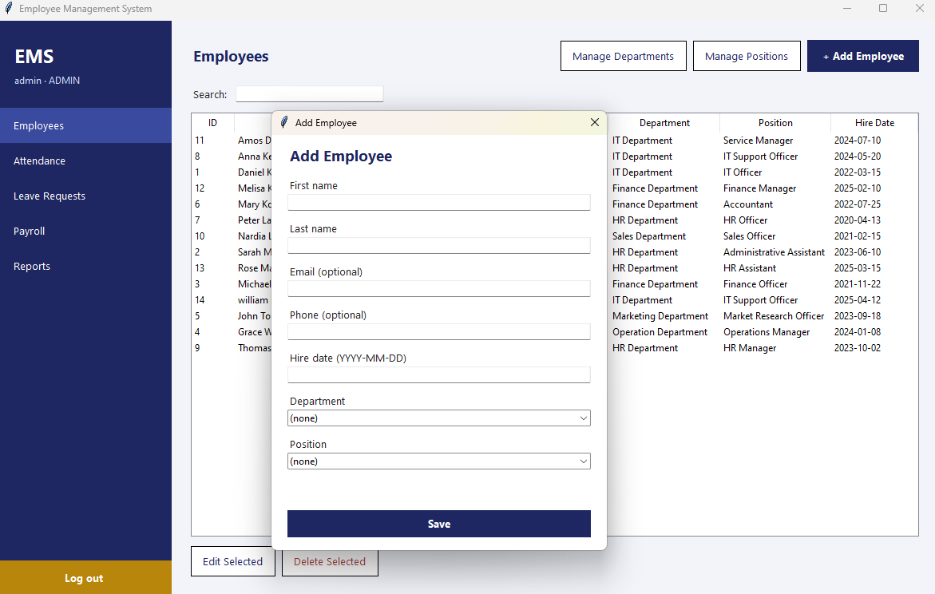
Add Employee
3
Add Employee
A dedicated form for onboarding a new staff member, capturing personal details plus their department and position assignment.
First name, last name, optional email & phone
Hire date entry (YYYY-MM-DD)
Department and Position selected from dropdowns
Save writes a new row into the employee table

Slide 13
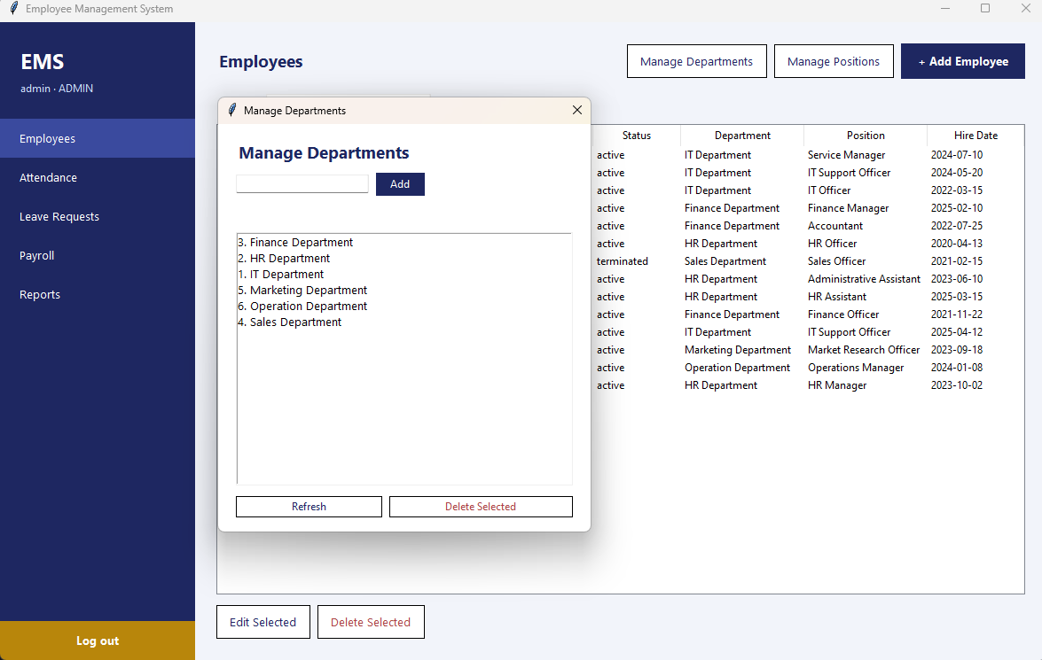
Manage Departments
4
Manage Departments
A simple lookup-table manager. Departments created here populate the dropdowns used on the Employee and Position forms.
Add a new department by name
Live list of existing departments (IT, HR, Finance, Sales, Marketing, Operations)
Delete Selected removes a department

Slide 14
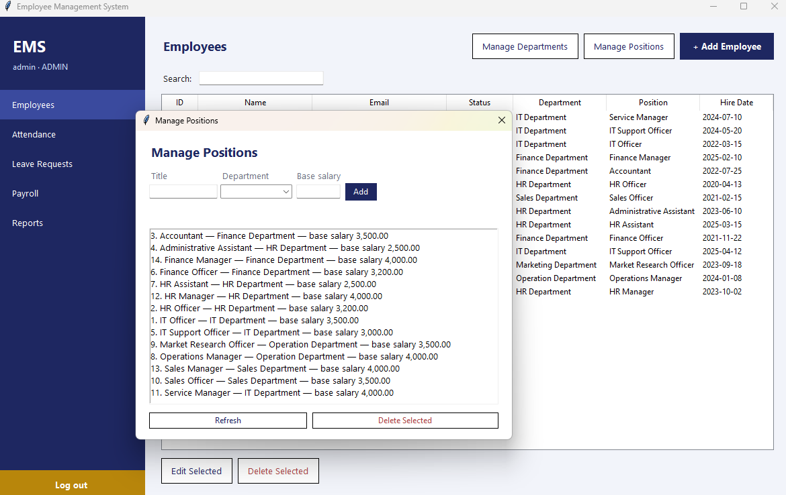
Manage Positions
5
Manage Positions
Positions extend departments with a job title and a base salary, which Payroll later reads from when generating payslips.
Title + Department + Base salary on one row
Each position is linked to a single department
Feeds both the Employee form and the Payroll run

Slide 15
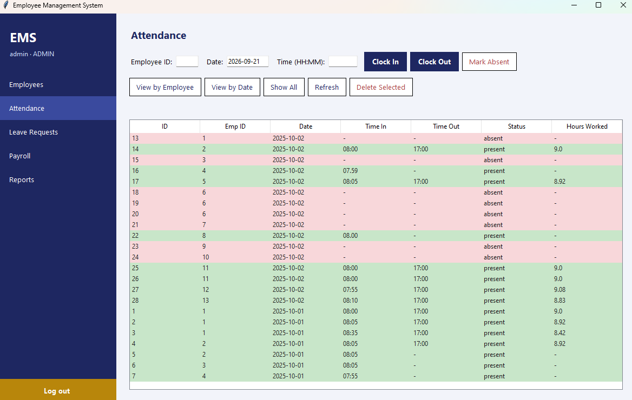
Attendance Tracking
6
Attendance Tracking
Daily attendance is logged per employee with clock-in/out times, and can be marked absent when no time is recorded.
Clock In, Clock Out and Mark Absent actions by Employee ID + date
Hours Worked calculated automatically from time in/out
View by Employee, View by Date, or Show All

Slide 16
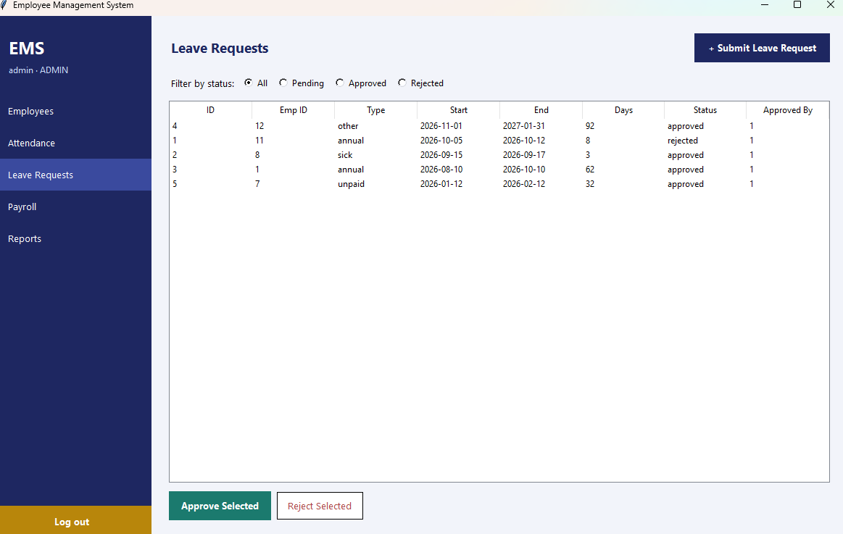
Leave Requests
7
Leave Requests
Employees' leave requests (annual, sick, unpaid, other) are tracked with start/end dates and an approval workflow.
Filter by status: All, Pending, Approved, Rejected
Days is calculated from the start and end dates
Approve Selected / Reject Selected update the request status

Slide 17
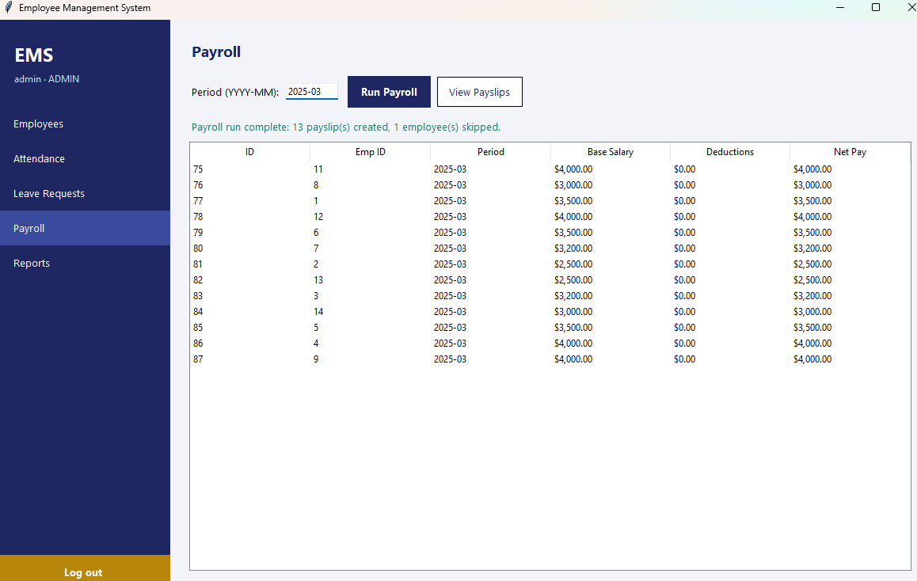
Payroll
8
Payroll
Run Payroll generates a payslip for every active employee for a given period, pulling each employee's base salary from their position.
Period entered as YYYY-MM, then Run Payroll
Produces Base Salary, Deductions and Net Pay per employee
View Payslips shows the generated records; skips inactive staff

Slide 18
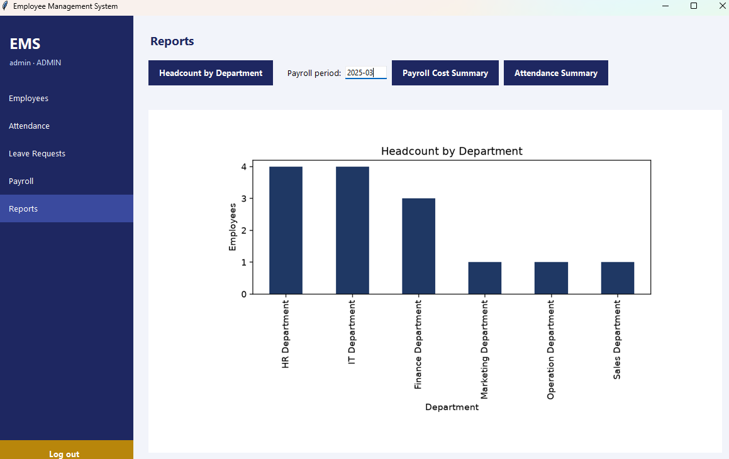
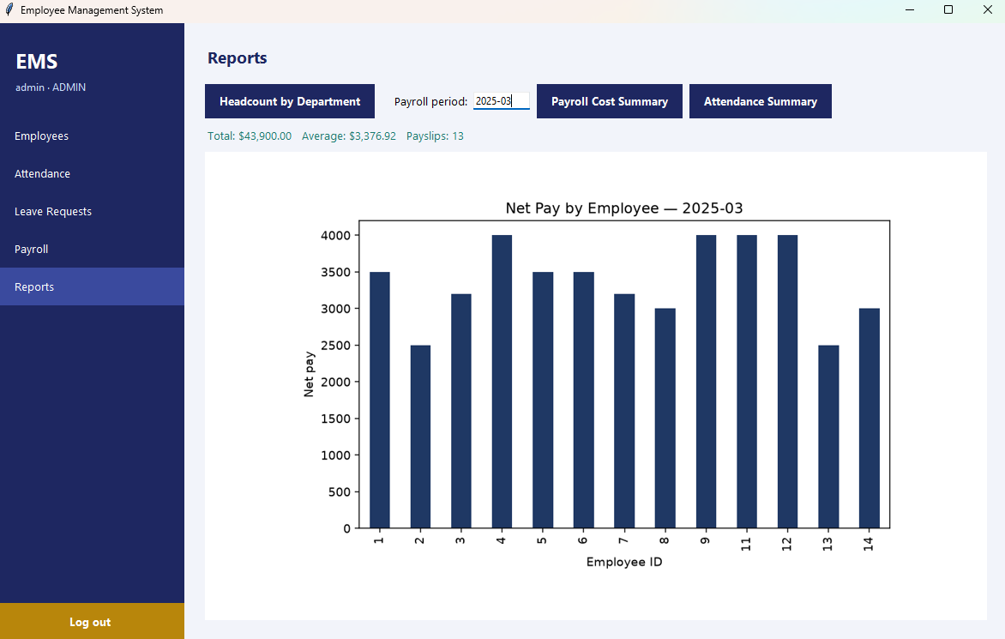
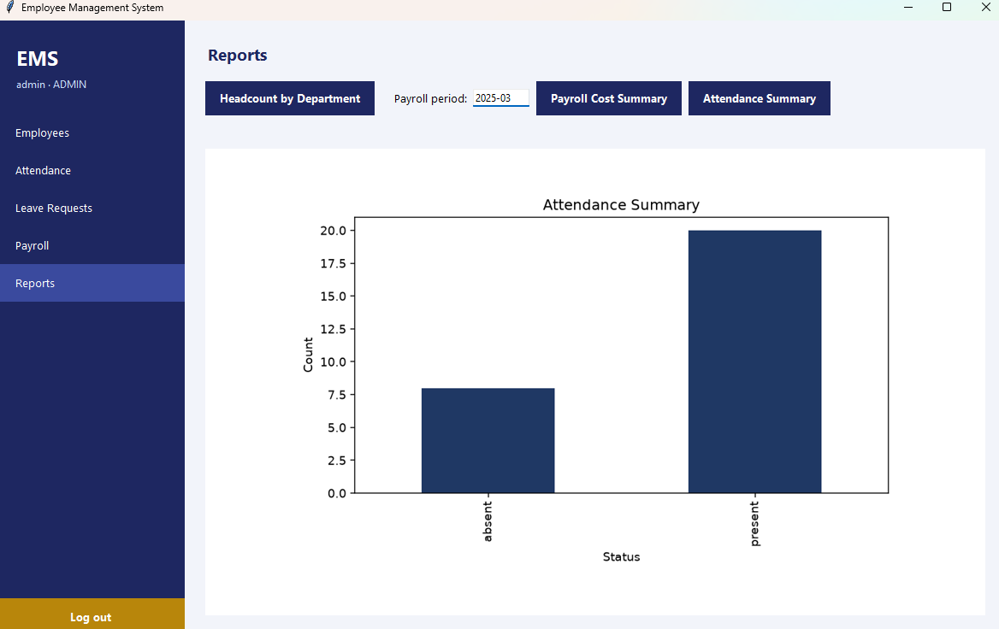
Reports & Analytics
Three built-in views over the workforce data
Headcount by Department
Net Pay by Employee
Attendance Summary
All three are generated from the Reports screen: pick a payroll period and switch between Headcount, Payroll Cost, and Attendance summaries.
Employment Management System
17

Slide 19
Version Control with Git & GitHub
git add .
git commit
git push
Stage changed files
Save a snapshot locally
Upload to GitHub
A local project folder is connected to a GitHub repository so that changes can be tracked, backed up, and shared throughout development.
Employment Management System
18

Slide 20
Challenges & Lessons Learned
Add your own experience here — e.g. database connection issues, debugging PHP errors, or learning Git workflows.
1
Technical Challenge
What was the hardest part to build or debug?
2
A Key Lesson
What would you do differently next time?
3
Using AI Tools
How did Claude Code help — and where did you still need to understand the code yourself?
Employment Management System
19

Slide 21
Conclusion & Future Improvements
Conclusion
Future Improvements
The Employment Management System successfully organizes employee, department and position data behind a secure login, built on a PHP + MySQL stack and tracked with Git/GitHub throughout development.
Payroll management
Leave / attendance tracking
Role-based access control
Analytics & data visualization
Exportable reports (PDF/Excel)
Employment Management System
20

Slide 22
Thank You
Questions & Discussion

