Slide 1

Pundra University of Science & Technology
Department of Computer Science & Engineering
Topic: Blockchain Technology
Presented By
Name: Al Arman Ovi
Id: 01821106013
Batch: 18th

Slide 2
Outlines:
How does Blockchain Technology work.
Blockchain Technology data store technic.
Types of Blockchain Technology.
Transaction process of Blockchain Technology.
Applications of Blockchain Technology.
Advantages and Disadvantages.
Future of Blockchain Technology.

Slide 3
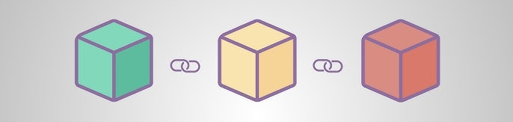
How does Blockchain Technology work
Blockchain stores data in blocks that are linked together in a chain, forming a digital ledger. The power to update the blockchain is distributed among the nodes, or participants, of a computer network.
Figure 1: Blockchain Technology

Slide 4
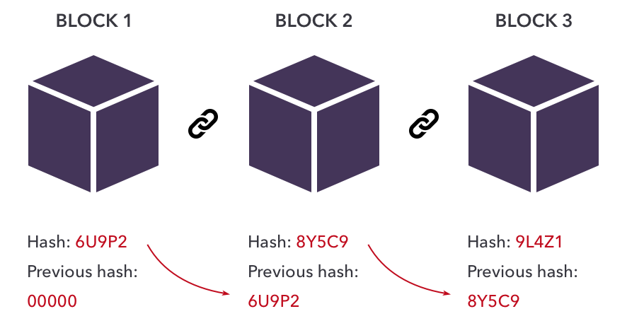
Blockchain Technology data store technic
Hash
Hash
Hash
Data
Previous Hash
Data
Previous Hash
Data
Figure 2: Blockchain Technology data store technic

Slide 5
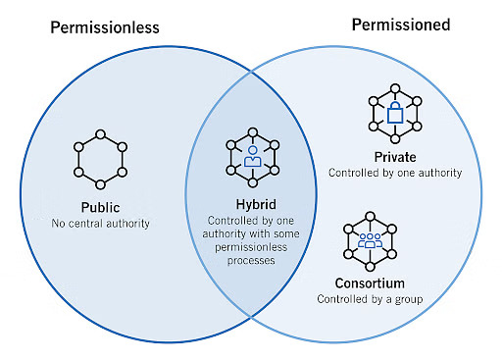
Types of Blockchain Technology
Figure 3: Blockchain Technology types

Slide 6
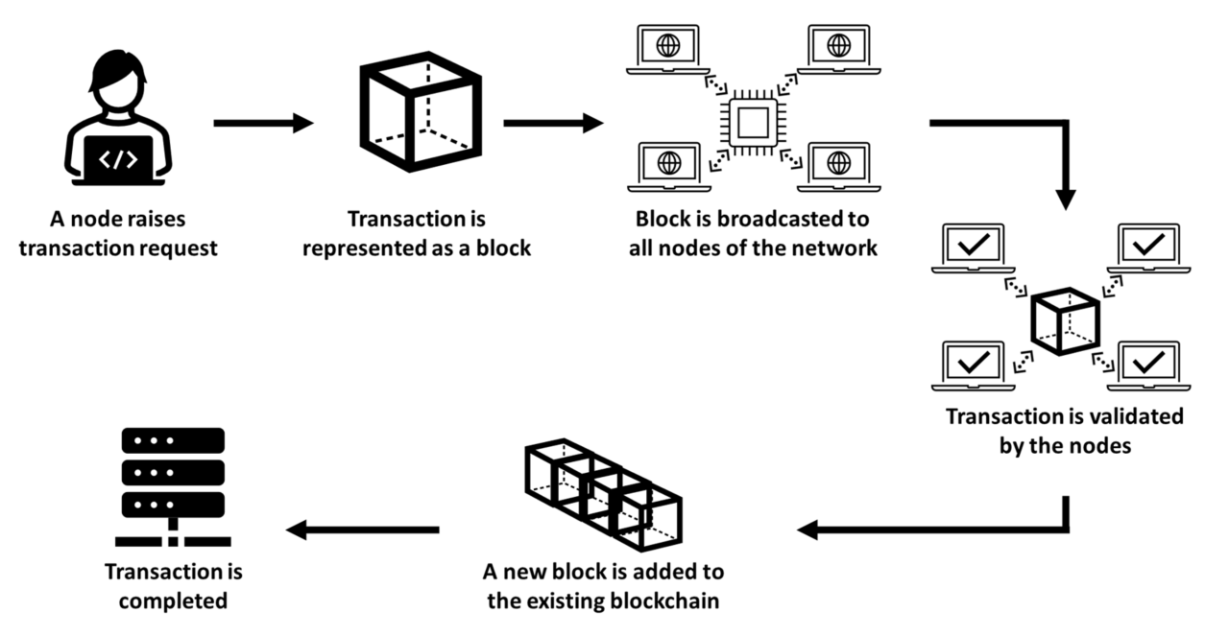
Transaction process of Blockchain Technology
Figure 4: Blockchain Technology Transaction process

Slide 7
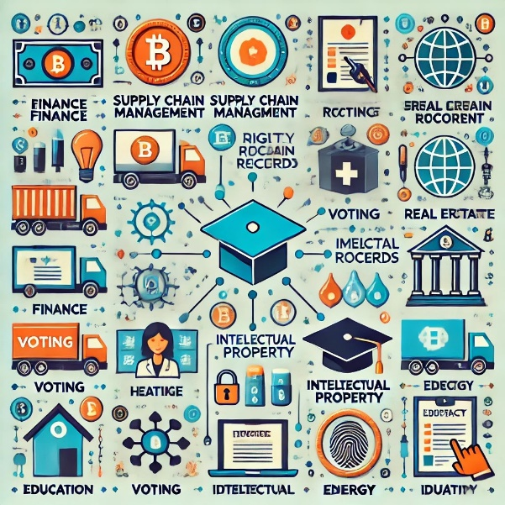
Applications of Blockchain Technology
Finance: Enables secure, low-cost, real-time transactions and decentralized financial services (DeFi).
Supply Chain: Tracks products end-to-end for transparency and fraud prevention.
Healthcare: Secures and shares patient records for better privacy and streamlined care.
Voting: Provides tamper-proof, verifiable digital voting systems.
Real Estate: Simplifies property transactions with smart contracts and digital titles.
Intellectual Property: Protects creators’ rights with verified ownership records.
Energy: Facilitates peer-to-peer energy trading and renewable tracking.
Education: Stores and verifies academic credentials securely.
Logistics: Tracks shipping data securely to prevent fraud.
Digital Identity: Empowers users with self-controlled, private digital identities.

Slide 8
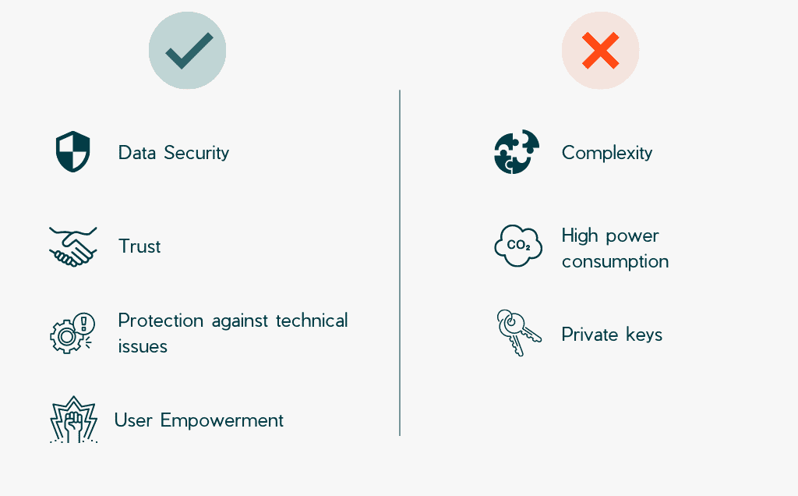
Advantages and Disadvantages

Slide 9
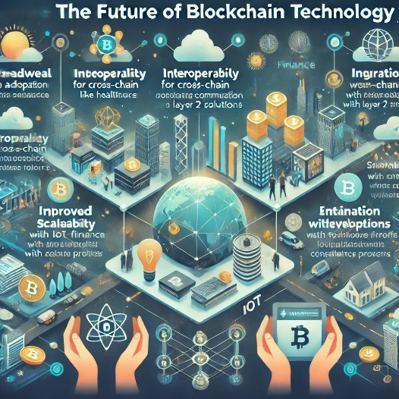
Future of Blockchain Technology
Interoperability: Development of cross-chain solutions for better communication between networks.
Improved Scalability: Use of layer 2 solutions for faster and cheaper transactions.
Regulatory Developments: Clearer regulations for safer business and user environments.
Decentralized Finance (DeFi) Growth: Expansion of decentralized financial services.
Integration with Emerging Technologies: Combining blockchain with AI and IoT for enhanced solutions.
Enhanced Privacy Features: Adoption of zero-knowledge proofs for confidential transactions.
Sustainability Efforts: Focus on eco-friendly consensus mechanisms to reduce energy consumption.
Widespread Adoption: Increased use in finance, healthcare, and supply chain sectors.

Slide 10
Any Questions ?

Slide 11
Thank You

