Slide 1
CHARISMART
Donation & Surplus Food Redistribution Network
CSE-3208: System Analysis & Design Lab
SUBMITTED TO
SUBMITTED BY
Md. Mynoddin
Assistant Professor
Department of Computer Science and Engineering
Rangamati Science and Technology University
Team Name: Null Pointer
Ovi Das — 2101011035 (Project Manager)
Akhaiye Marma — 2101011012 (System Analyst)
Annah Tripura — 2101011015 (UI/UX Designer)
Ovi & Akhaiye (Developer Lead)
Abu Arif Naim — 2101011034 (QA / Tester)
Department of Computer Science and Engineering
Rangamati Science and Technology University
2026
ChariSmart | SAD Lab Defense | 1

Slide 2




ChariSmart
Donation & Surplus Food Redistribution Network
CSE-3208 · System Analysis & Design Lab — Final Defense Presentation
Donor
Admin Verification
NGO / Orphanage
Volunteer / Rider
Restaurant / Wedding Hall / Household
Safety + Trust + Approval
Need-based food request
Pickup + Delivery Tracking
ChariSmart | SAD Lab Defense | 2

Slide 3



Problem & Motivation
The manual donation process is fast to start but difficult to verify, match and track.
Surplus food wasted
NGOs / orphanages need timely meals
Manual calls cause delay
ChariSmart creates a verified workflow
from events, restaurants and households
for beneficiaries
duplicate claims, and poor accountability
from donation to delivery
Food safety depends on verification and expiry awareness.
Pickup window and volunteer assignment reduce delivery uncertainty.
A match record improves fairness, traceability and defense clarity.
ChariSmart | SAD Lab Defense | 3

Slide 4

Objectives & Scope
The project is more than a food donation website: it models a complete redistribution network.
IN SCOPE
OUT OF SCOPE NOW
Donor, NGO/orphanage, volunteer and admin roles
Real-time GPS route optimization
Food donation with quantity, pickup window and expiry
Payment or financial donation module
Request approval, matching, volunteer assignment and delivery tracking
External government food certification API
SAD artifacts: SRS, DFD, UML, ERD, testing and final report
Separate mobile application
ChariSmart | SAD Lab Defense | 4

Slide 5
Key Actors & Main Workflows
Each actor has a clearly separated responsibility in the system.
Donor
Recipient
Admin
Volunteer
Posts surplus food
Requests meals
Verifies and matches
Delivers food
Main Workflow
1
2
3
4
›
›
›
Register and verify accounts
Submit food and requests
Auto-match by score
Assign, pickup, deliver
ChariSmart | SAD Lab Defense | 5

Slide 6
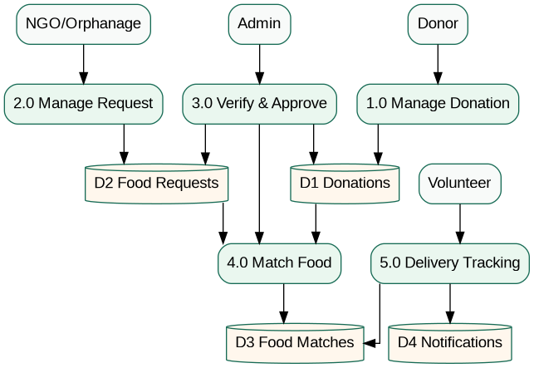



System Modeling: DFD
Data flow connects field actors, admin decisions, system stores and notifications.
Donation management stores surplus food data.
Request management stores NGO/orphanage needs.
Verification and approval prevent unsafe or fake workflows.
Matching connects donations and requests before delivery tracking.
Level 1 DFD
ChariSmart | SAD Lab Defense | 6

Slide 7
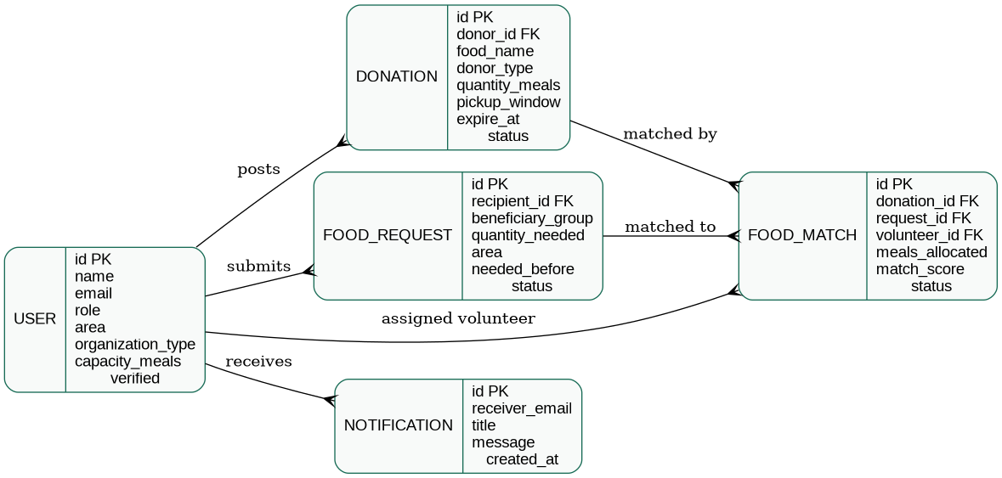
Database Design: ERD
FoodMatch is the bridge between donation, recipient request and volunteer delivery.
USER
DONATION
FOOD_REQUEST
FOOD_MATCH
admin, donor, recipient, volunteer
food, quantity, pickup window, expiry
beneficiary group, quantity, needed-before
ChariSmart | SAD Lab Defense | 7
match score, volunteer, delivery status

Slide 8


Prototype Features
The fixed source code now supports the required ChariSmart workflow.
Four role dashboards
Verification & trust model
admin, donor, NGO/orphanage, volunteer
admin verify, block/unblock
Matching score uses
area + quantity + expiry + urgency + verification
Donation intake
Request approval & matching
donor type, meals, pickup window, expiry validation
matching score computed on approval
Status lifecycle
Volunteer assignment
Delivery confirmation
pending › approved › matched › assigned › picked_up › delivered
pickup update and delivery confirmation
recipient confirms delivery and rating
Auto-expiry protects
ChariSmart | SAD Lab Defense | 8

Slide 9
Testing & Quality Assurance
The project includes a manual test checklist aligned with the prototype workflow.
Registration
Verification
Donation
Request
Delivery
Donor / recipient / volunteer
Admin verify, block, unblock
Valid and invalid pickup window
Approve and match
Assign, pickup, deliver, rate
15
test cases included
ChariSmart | SAD Lab Defense | 9

Slide 10

Limitations & Future Scope
The prototype is suitable for SAD Lab defense and can be extended for production.
CURRENT LIMITATIONS
FUTURE SCOPE
Area-based matching, not live GPS routing
Map and live rider tracking
Admin-controlled safety verification
Image proof for food and delivery
SQLite database for lab-scale demo
SMS / push notifications
SMTP needs configuration for real email
Production database and audit logs
ChariSmart | SAD Lab Defense | 10

Slide 11




Defense Summary
ChariSmart demonstrates a complete analysis-to-prototype SAD workflow.
Problem analysis
+ feasibility
SRS + requirements
traceability
DFD + UML + ERD
system design
Working Flask
prototype
Prepared Deliverables
Fixed source code ZIP
Final project report
SRS document
Diagram sources & images
Defense slide deck
“ChariSmart reduces food waste through verified, need-based, expiry-aware redistribution from donor to beneficiary.”
ChariSmart | SAD Lab Defense | 11

