Slide 1
Lecture 5: Probabilistic Latent Semantic Analysis
Ata Kaban
The University of Birmingham

Slide 2
Overview
We learn how can we
  represent text in a simple numerical form in the computer
  find out topics from a collection of text documents

Slide 3

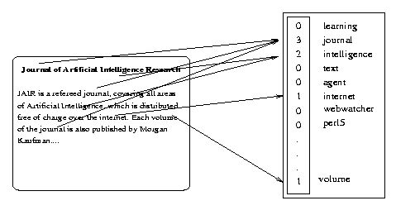
Salton’s Vector Space Model
Represent each document by a high-dimensional vector in the space of words
Gerald Salton
’60 – ‘70

Slide 4
Represent the doc as a vector where each entry corresponds to a different word and the number at that entry corresponds to how many times that word was present in the document (or some function of it)
  Number of words is huge
  Select and use a smaller set of words that are of interest
  E.g. uninteresting words: ‘and’, ‘the’ ‘at’, ‘is’, etc. These are called stop-words
  Stemming: remove endings. E.g. ‘learn’, ‘learning’, ‘learnable’, ‘learned’ could be substituted by the single stem ‘learn’
  Other simplifications can also be invented and used
  The set of different remaining words is called dictionary or vocabulary. Fix an ordering of the terms in the dictionary so that you can operate them by their index.

Slide 5
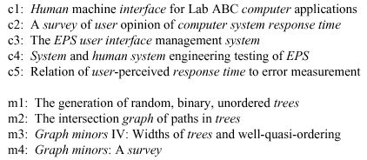
Example
This is a small document collection that consists of 9 text documents. Terms that are in our dictionary are in bold.

Slide 6
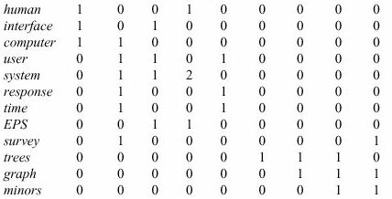
Collect all doc vectors into a term by document matrix

Slide 7
Queries
Have a collection of documents
Want to find the most relevant documents to a query
A query is just like a very short document
Compute the similarity between the query and all documents in the collection
Return the best matching documents
When are two document similar?
When are two document vectors similar?

Slide 8
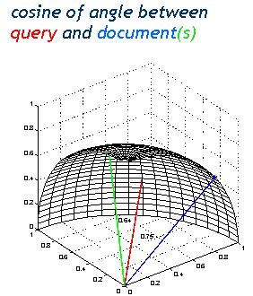
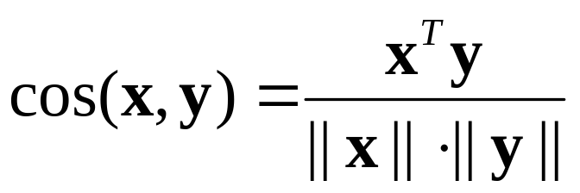
Document similarity
Simple, intuitive
Fast to compute, because x and y are typically sparse (i.e. have many 0-s)

Slide 9
How to measure success?
Assume there is a set of ‘correct answers’ to the query. The docs in this set are called relevant to the query
The set of documents returned by the system are called retrieved documents
Precision: what percentage of the retrieved documents are relevant
Recall: what percentage of all relevant documents are retrieved

Slide 10

Problems
Synonyms: separate words that have the same meaning.
  E.g. ‘car’ & ‘automobile’
  They tend to reduce recall
Polysems: words with multiple meanings
  E.g. ‘saturn’
  They tend to reduce precision
→ The problem is more general: there is a disconnect between topics and words

Slide 11
‘… a more appropriate model should consider some conceptual dimensions instead of words.’ (Gardenfors)

Slide 12
Latent Semantic Analysis (LSA)
LSA aims to discover something about the meaning behind the words; about the topics in the documents.
What is the difference between topics and words?
  Words are observable
  Topics are not. They are latent.
How to find out topics from the words in an automatic way?
  We can imagine them as a compression of words
  A combination of words
  Try to formalise this

Slide 13
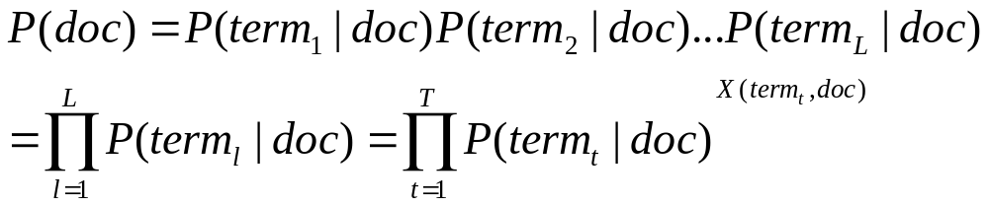
Probabilistic Latent Semantic Analysis
Let us start from what we know
Remember the random sequence model
We know how to compute the parameter of this model, ie P(term_t|doc)
- We ‘guessed’ it intuitively in Lecture1
We also derived it by Maximum Likelihood in Lecture1 because we said the guessing strategy may not work for more complicated models.
Doc
t1
t2
tT

Slide 14
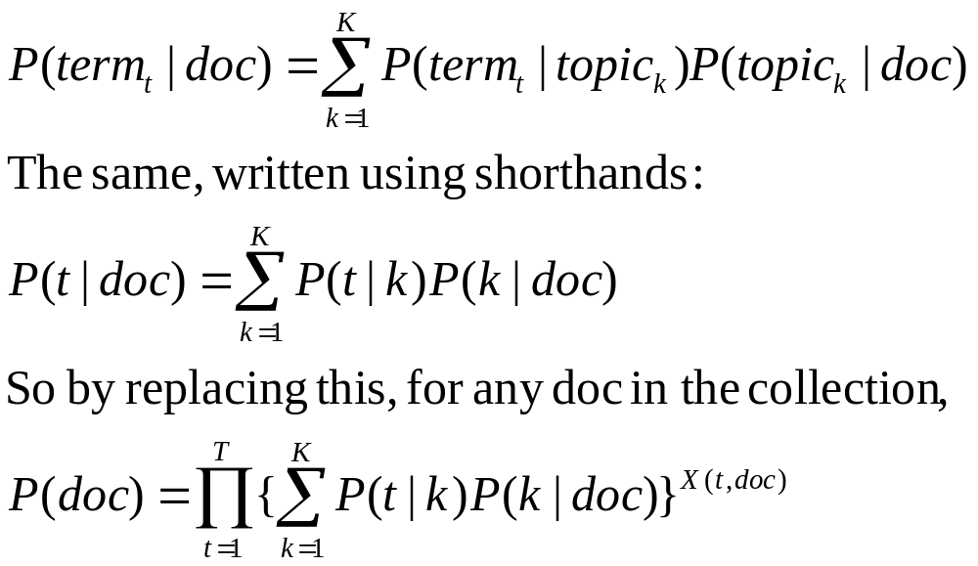
Probabilistic Latent Semantic Analysis
Think: Topic ~ Factor
Now let us have K topics as well:
Doc
k1
k2
kK
t1
t2
tT
Which are the parameters of this model?

Slide 15
Probabilistic Latent Semantic Analysis
The parameters of this model are:
  P(t|k)
  P(k|doc)
It is possible to derive the equations for computing these parameters by Maximum Likelihood.
If we do so, what do we get?
  P(t|k) for all t and k, is a term by topic matrix
  (gives which terms make up a topic)
  P(k|doc) for all k and doc, is a topic by document matrix
  (gives which topics are in a document)

Slide 16
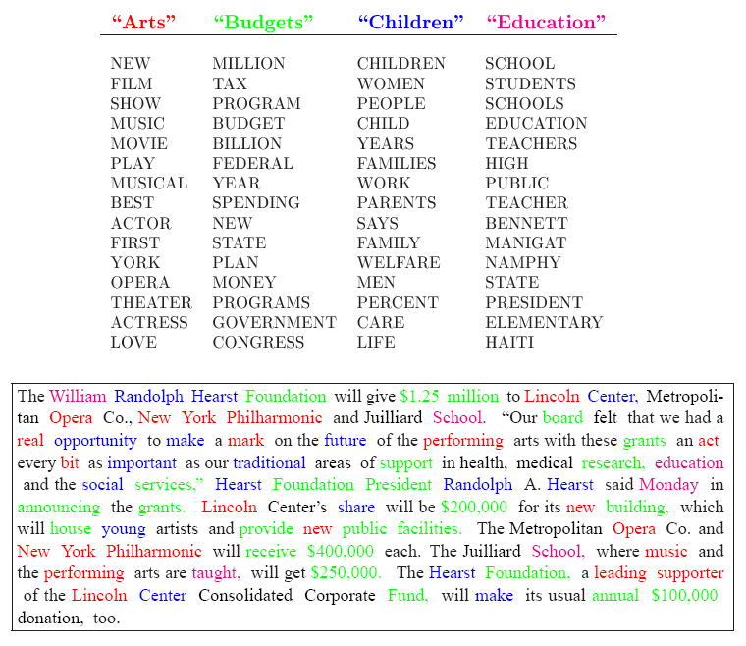

Slide 17
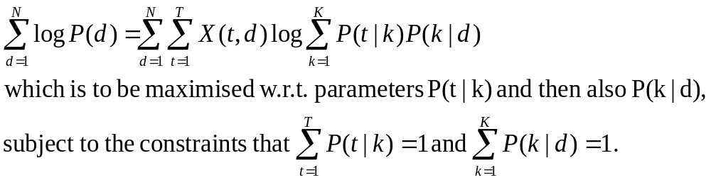
Deriving the parameter estimation algorithm
The log likelihood of this model is the log probability of the entire collection:

Slide 18
For those who would enjoy to work it out:
- Lagrangian terms are added to ensure the constraints
- Derivatives are taken wrt the parameters (one of them at a time) and equate these to zero
- Solve the resulting equations. You will get fixed point equations which can be solved iteratively. This is the PLSA algorithm.
Note these steps are the same as those we did in Lecture1 when deriving the Maximum Likelihood estimate for random sequence models, just the working is a little more tedious.
We skip doing this in the class, we just give the resulting algorithm (see next slide)
You can get 5% bonus if you work this algorithm out.

Slide 19
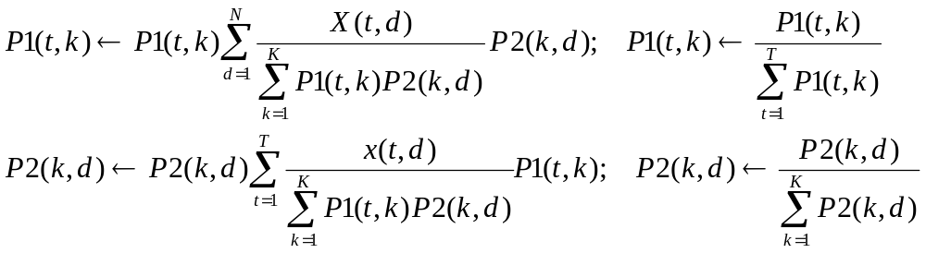
The PLSA algorithm
Inputs: term by document matrix X(t,d), t=1:T, d=1:N and the number K of topics sought
Initialise arrays P1 and P2 randomly with numbers between [0,1] and normalise them to sum to 1 along rows
Iterate until convergence
  For d=1 to N, For t =1 to T, For k=1:K
Output: arrays P1 and P2, which hold the estimated parameters P(t|k) and P(k|d) respectively

Slide 20
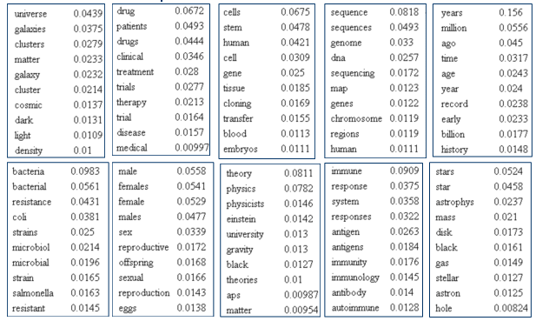
Example of topics found from a Science Magazine papers collection

Slide 21
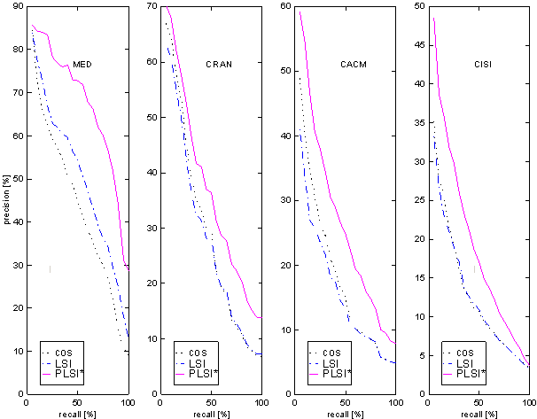
The performance of a retrieval system based on this model (PLSI) was found superior to that of both the vector space based similarity (cos) and a non-probabilistic latent semantic indexing (LSI) method. (We skip details here.)
From Th. Hofmann, 2000

Slide 22
Summing up
Documents can be represented as numeric vectors in the space of words.
The order of words is lost but the co-occurrences of words may still provide useful insights about the topical content of a collection of documents.
PLSA is an unsupervised method based on this idea.
We can use it to find out what topics are there in a collection of documents
It is also a good basis for information retrieval systems

Slide 23
Related resources
Thomas Hofmann, Probabilistic Latent Semantic Analysis. Proceedings of the Fifteenth Conference on Uncertainty in Artificial Intelligence (UAI'99) http://www.cs.brown.edu/~th/papers/Hofmann-UAI99.pdf
Scott Deerwester et al: Indexing by latent semantic analysis, Journal of te American Society for Information Science, vol 41, no 6, pp. 391—407, 1990. http://citeseer.ist.psu.edu/cache/papers/cs/339/http:zSzzSzsuperbook.bellcore.comzSz~stdzSzpaperszSzJASIS90.pdf/deerwester90indexing.pdf
The BOW toolkit for creating term by doc matrices and other text processing and analysis utilities: http://www.cs.cmu.edu/~mccallum/bow

