Slide 1
Appollo
Release and deploy management, august 2016

Slide 2
agenda
1. Change Management
2. Release management
3. Incident management

Slide 3

Scenario
A client changes his mind about a certain feature and comes to us asking to change it. Depending on how difficult we estimate the change to be, we follow one of three procedures to implement the change.
In the event of a standard change requested from the client, we already have pre-determined procedures that have been established with the client. These are low risk changes and are pre-authorized by the Change Manager. ( e.g. The client wishes for the color scheme to change).
In the event of a normal change requested by the client, we progress through it using normal change procedures, explaining the risk/reward to the client. These are not considered emergency changes and are made sooner or later, depending on the importance of other tasks set for the next sprint.
In the event of an emergency request change, we will have predetermined actions as to keep the risks to a minimum, even though we don’t plan on making such changes lightly. This type of change will be reserved in the case of an error that impacts the business to a high degree.

Slide 4

Backup plan
Should anything go wrong with any of the following types of changes, such as errors in the live deployment of the product, we have emergency backups ready to revert the changes as to keep the application downtime as low as possible, aiming for a 95% application uptime.

Slide 5
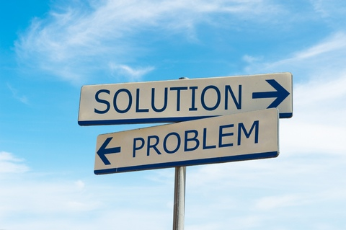
Backup plan
The steps in such an event are :
We take the application down on the main server
Shortly afterwards we restart the application on the backup server that runs a older version of it, while we work on the live version
Once the live version is up and running, we change once again from the backup server to the live environment.

Slide 6
agenda
1. Change Management
2. Release management
3. Incident management

Slide 7
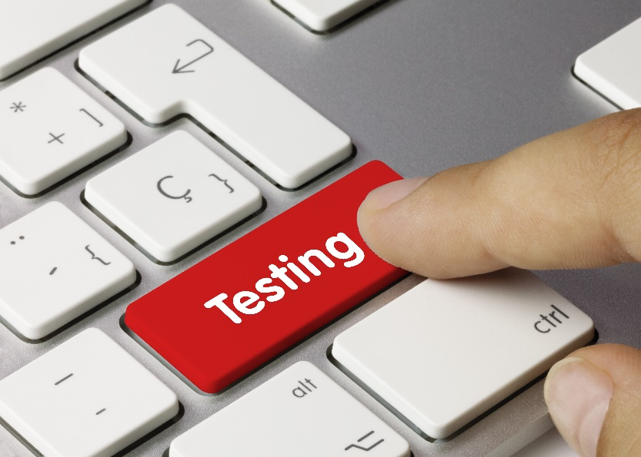
Testing it
Once the changes have been developed and tested by our team, we deploy them on a test server to check for bugs and errors that might appear on a live version, and should everything go smoothly the changes are then deployed to the live application with as little downtime as possible so that the users experience does not degrade, usually at the time discussed with the business analyst and the client so that the business sees as little impact as possible.

Slide 8
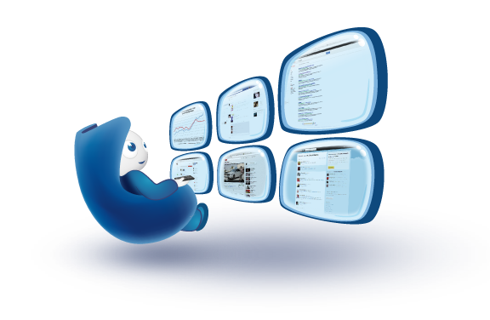
Monitoring it
We then keep the live application closely monitored in order to check if everything is going smoothly after the release once the public gets their hands on it. Should a problem appear, we have the backup procedures detailed above.

Slide 9

Documenting it
Release documentation will be kept, detailing problems, issues and anything out of the ordinary that might’ve gone on throughout the change and deploy process.

Slide 10
agenda
1. Change Management
2. Release management
3. Incident management

Slide 11
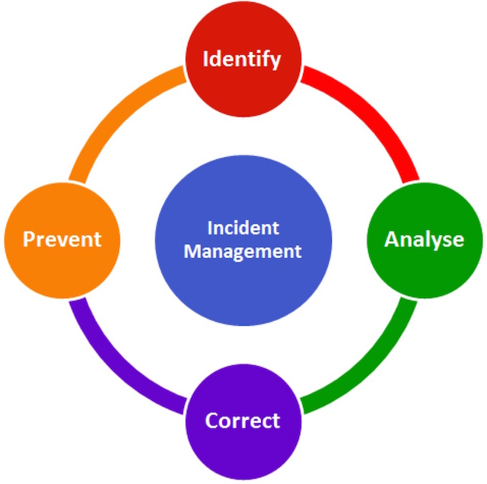
Steps
Incident detection
Identification and classifying
Initial support (if possible)
Prioritization
Analysis
Problem solving
Incident closure

Slide 12
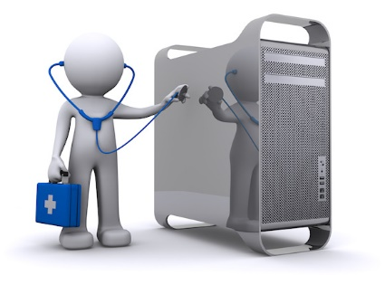
Incident detection
At the time an incident happens, either by a call, or e-mail from a customer, either by the detection of our team, we take all the information needed so the problem is solved as fast as possible.

Slide 13
II. Identification and classifying
The problem is identified and classified, and if it is a major incident, the application is temporary shut down:
Problem at the training materials: if the problem is at the learning page, it is found out where is the problem: the materials, the slider, the hyperlinks from the buttons, the sidenav, the search and advanced search, the download button;
Problem with the account;
Problem at the content editor’s page: upload, delete materials and questions;
The admin page: users’ management or download requests.

Slide 14

III. Initial support (if possible)
We tell the client to do one of the followings:
Refresh the page;
Logout and login back;
Check internet connection;
Check if the information he provided is correct and the problem is not something else.

Slide 15
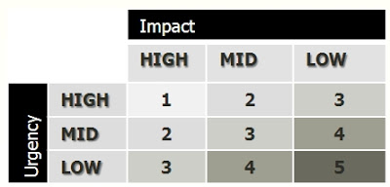
IV. Prioritization
It is checked if the problem comes from a single user or from more users, if it breaks the whole platform, or if it is a security issue. After that, a priority is given and the problem is given resources accordingly.

Slide 16
V. Analysis
Now further investigations are made in order to accurately find the problem. The following are checked:
Problem with the local environment;
Problem with the server;
Problem with the database: the user is registered more than once or materials or not existent;
Problem with the materials: not shown, bad position, wrong material shown, bad description;
Problem with the download;
Problem with the upload.

Slide 17
VI. Problem solving
The problem is solved by:
Admin: the problem is a download request not given or not shown -> solved directly from the admin page
Our team: refresh of database, server, or the development team implements something to solve the problem
After that, tests are done in order to verify if the problem is solved, and when everything is done, the application is built again.

Slide 18
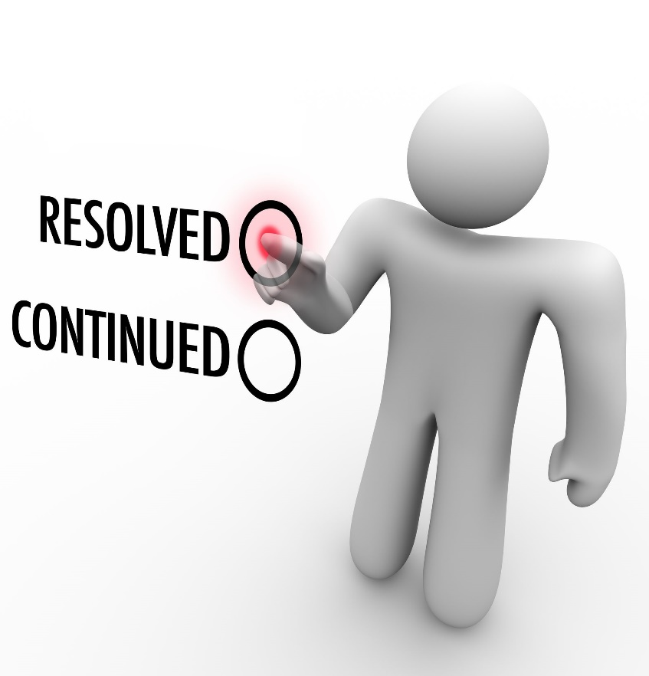
VII. Incident closure
The client is announced that the problem is solved and is told what the resolution was.

Slide 19
THANK YOU
Carnaru TUDor
Chile Ovidiu
Chiriac dorin
Application management

