Slide 1

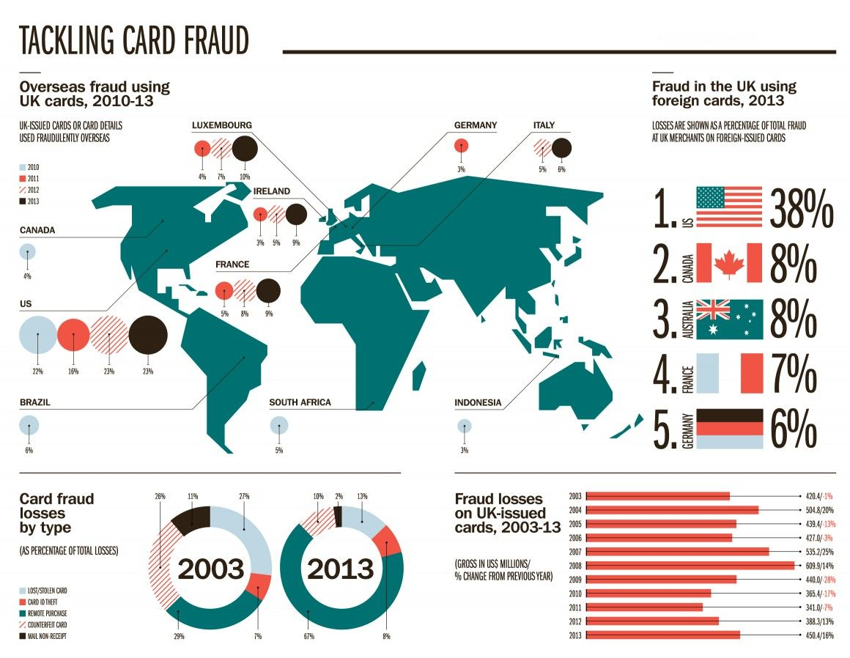
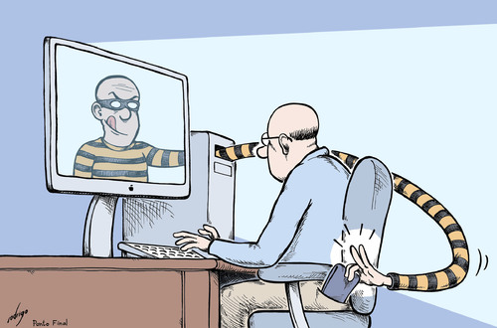
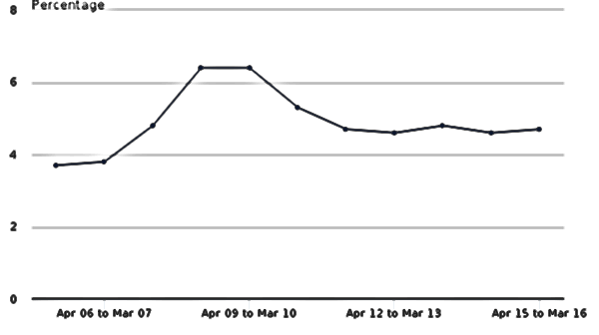
BIG DATA AND FRAUD DETECTION
ETHICAL & LEGAL
With the potential of big data analysis growing at a tremendous speed, there is now a very big gap between what is possible and what is legally allowed to do. Any new development in this process now comes with a high risk of public relations disasters and unintended consequences. It is in this space that organizations have to clearly answer the ethical questions raised.
For each bit of data collected, organizations have to be able to describe its context, consent, substance, ownership, fairness, considerations, accessibility and accountability. These facets constitute the Ethical awareness framework, developed by the UK and Ireland Technical Consultancy Group (TCG). (Chessell 2014)
INTRODUCTION
Fraud has now become the most prevalent crime in the world with people being ten times more likely to be a victim of online fraud than a victim of physical theft (Evans 2016). With such a huge increase in its popularity, security experts are looking for innovative ways to combat this type of crime. The concept of data analysis dates back in the 80’s, but back then it was not economically feasible to do it on a large scale (Cardenas, Manadhata, and Rajan 2013). Big Data, with its efficient ways of storing and analysing data (HDFS and MapReduce) has completely revolutionized this process and made it mainstream.
WHAT IS IT?
Big data analysis involves the mass collection of traffic and personal data(Ips, login times, card usage, locations, transactions etc), thus being able to create a personal behavioural model for each individual. Using this data and previous known occurrences of fraud, mathematical models can be built, trained and then used to estimate the likeliness of a fraud event taking place in real-time. These predictive models help to focus resources in the most efficient manner to prevent or recuperate fraud losses. (Inc 2016). BELOW – percentage of card users who suffered fraud in England and Wales
AN IMPROVEMENT SUGGESTION
A problem that may occur with this system is data provenance. Malicious insertion of data can alter the outcomes of the predictor models significantly and some security has to be in place to tackle this. Big Data can be further used in this issue, by creating a model that evaluates each entry and gives it a credibility rating.
OTHER USES
This technology has been adopted by the police to identify criminal patterns ranging from burglaries, to murders and paedophilia. Police is now capable of analysing an individual from his past crimes, create a behavioural pattern(method of entry, time of crime, etc). The information can then be included in nation-wide records, helping to identify patterns as to how crimes are likely to occur.(Kwapien 2016)
CONCLUSION
Big data is quickly changing the face of security, but it is creating a world where keeping control over our personal information is constantly challenged. It is therefore important that future data scientists are trained in the values of privacy and made aware of the thin ethical line between privacy and security. They need to be trained into creating solutions that follow agreed privacy guidelines.

