Slide 1

Context
http://profs.info.uaic.ro/~vcosmin/index.php?pagina=pagini/practica_sgbd
http://profs.info.uaic.ro/~adiftene/Scoala/2016/IP/index.htm
http://profs.info.uaic.ro/~acf/java/tap_15-16_sem2.html
http://profs.info.uaic.ro/~vidrascu/
http://profs.info.uaic.ro/~fltiplea/
Is there a better way?
I need to check my grades

Slide 2
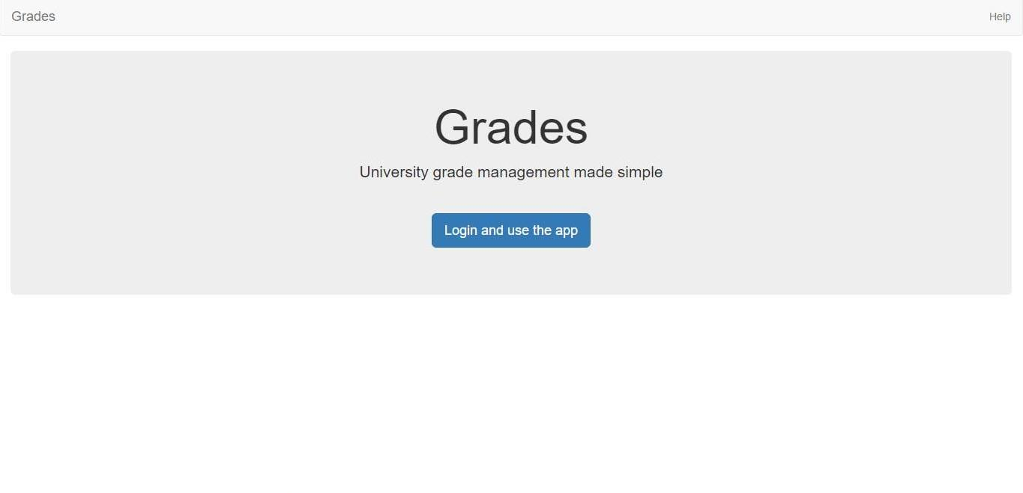
Intention
This looks interesting
Now I can save time and “study“ more

Slide 3
Intention
Facebook authentication
Manage users
Single page application
Grades
Administrator panel
Configure roles
Configure registrations
User

Slide 4
Courses
Adds courses initially with no modules or evaluation attributed to it
When a new When a module is created , it is associated with the respected course and if it is the first module from the respective course, the evaluation is constituted from this module
Administrator
Professor
Only an administrator (and the developer) has the permissions to add courses
Only a professor (and the developer) has the permissions to create modules

Slide 5

Professors
Can view all students
Can add or remove modules created by him
Authentication
Grades
Has PROFESSOR roles
If he is a course professor , then he can add laboratory professors to his course
Professor
Can add or remove a student’s grade

