Slide 1

Grades
University grade management made simple
Pricop Ovidiu
Butnaru Nicolae-Adrian
Dorneanu Cristian
Ciuc Tiberiu-Constantin

Slide 2

Context
http://profs.info.uaic.ro/~vcosmin/index.php?pagina=pagini/practica_sgbd
http://profs.info.uaic.ro/~adiftene/Scoala/2016/IP/index.htm
http://profs.info.uaic.ro/~acf/java/tap_15-16_sem2.html
http://profs.info.uaic.ro/~vidrascu/
http://profs.info.uaic.ro/~fltiplea/
Is there a better way?
I need to check my grades

Slide 3
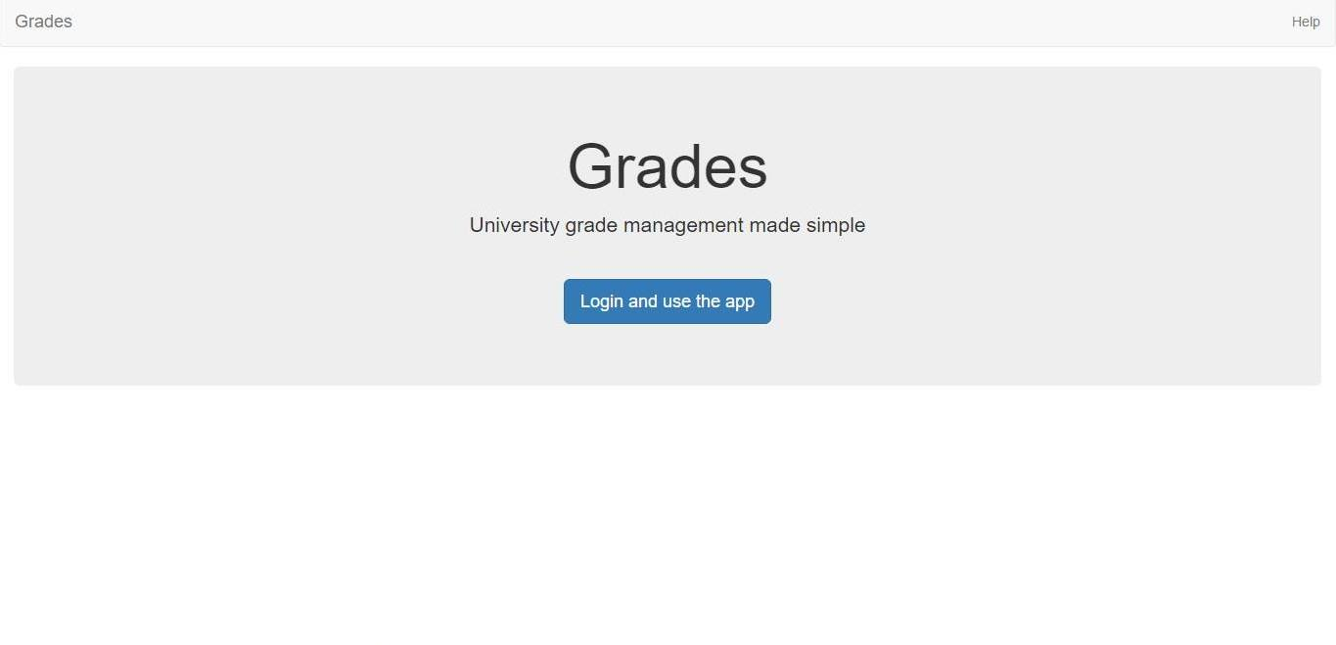
Intention
This looks interesting
Now I can save time and “study“ more

Slide 4
Intention
Facebook authentication
Manage users
Single page web application
Administrator panel
Configure roles
User
Configure registrations

Slide 5

Application workflow
Redirect based on
faculty status
Roles
Authenticated
User
Faculty status
based app routes
Configures
Logs out
Root Administrator
(Developer)
Confirms identity
Logs in & Obtains API credentials
Adds
Assumes registration
Registra-tions
User
Associate
with

Slide 6

Authentication and Permissions
Submits request on specific resource with obtained Auth Data
Credentials
validation
Authentication
Gateway
Authorization
Gateway
Auth Request
Update User DB
Credentials
Role-based access validation (on the requested resource)
{
user: …,
apiKey: …,
keyExpires: …,
}
Authorization
Succeeded
Redirect URL
with API Auth Data
Actual application (request handler) computation
Receives response (Success with data / Error)

Slide 7
Grades Restful API
Submits requests with headers
that contain API Credentials
/students
/register
Grades API
/professors
/registrations
/v1
JSON based
communication
/auth
/courses
/grades
/roles

Slide 8

Configuring Actors
Adds
Adds
ADMINISTRATIVE
PERSONNEL
USERS
Adds grades to
Receives grades from
STUDENT
PROFESSOR
PRINCIPAL
SECRETARY

Slide 9

Professors
Can view all students for whose evaluation is responsible
Can add or remove modules created by him/her
Authentication
Has PROFESSOR roles
If he is a course professor , then he can add laboratory professors to his course
Professor
Can add or remove a students’ grades

Slide 10
Courses
Adds courses initially with no modules or evaluation attributed to it
When a new module is created , it is associated with the respective course. Modules are build in bottom-up manner
Administrator
Professor
Only an administrator (and the developer) has the permissions to add courses
Only a professor (and the developer) has the permissions to create modules

Slide 11
Adding grades
has access on MODULES, STUDENTS, PROFESSORS (if he is the course professor) and GRADES resources
has access on GRADES (only their own grades)
resource
PROFESSOR
STUDENT
adds a grade to a module from one of his courses
receives a grade to a module from one of his courses

Slide 12
Students
has access on
GRADES and COURSES (only his own grades and courses) RESOURCES
authenticates
GRADES
has
STUDENT
role
STUDENT

Slide 13
Client & User Interface
On-demand server requests (Rest.js)
Unidirectional application state management (Redux.js)
Statically hosted
SINGLE PAGE WEB APPLICATION
Reactive design (React.js)
Responsive design (Bootstrap)
Highly reusable components (React.js)

Slide 14
Architectural design keynotes
Takes advantage of the fast Node V8 JavaScript engine
Secure social authentication via oAuth and facebook
Flexible and highly configurable permission system
Scalable in terms of API action-handlers
API can be used outside the confines of the browser
Strongly consistent and highly flexible database system via MongoDB and Mongoose
Multiple layers of data validation – up to and including schema validators
Clean asynchronous action handlers via async.js
Unit tests for application-critical components

Slide 15
What we learned – Part 1
‘Callback hell’ quickly becomes a problem – we found async.js as an elegant solution
Need to be careful with Mongoose nested objects in schema
Code is not really asynchronous until you call process.nextTick()
Asynchronous code must be carefully crafted and not modify outer variables that are used after the async block
Unpredictable mongoDB test results at first experience
Github is no joke; neither is a github repository something you want to mess up

Slide 16
What we learned – Part 2
Synchronizing code changes among team members is hard – highly structured (modularized) coding is necessary
Did we mention that Github is no joke? Merging code is no joke either
Refactoring, extracting functions so that tests still pass

Slide 17

Questions

Slide 18
Thank you for your time!

