Slide 1
MOAT ACADEMY
WEB APPLICATION DEVELOPMENT TRAINING
CSS Box Model2 (background properties, border, margin and padding), Semantic DIVs, – Day 3

Slide 2
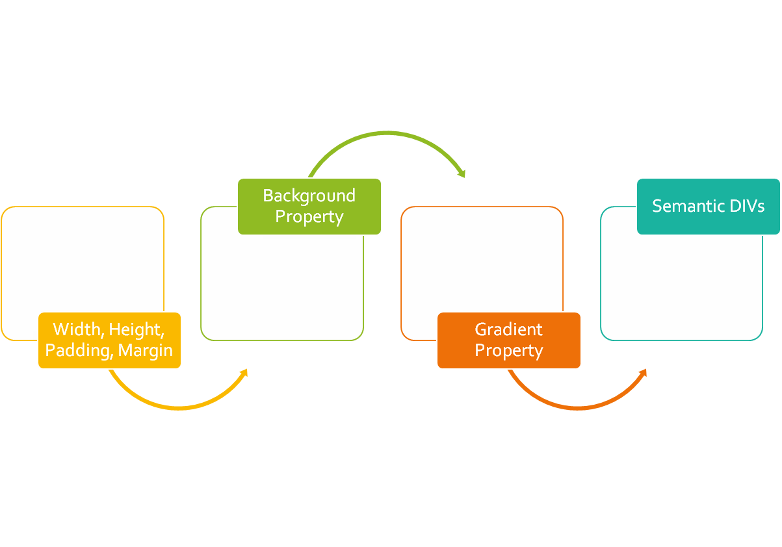
CLASS
OUTLINE

Slide 3
CSS BOX MODEL 2
The model describes the space of the content taken by an element. An element is represented by a box and each box has four edges

Slide 4
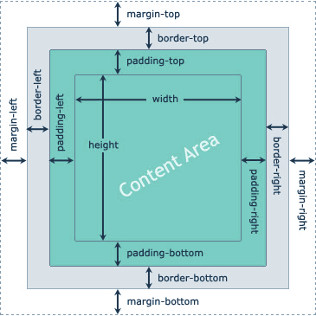
CSS BOX MODEL 2
The BOX Model describes the space of the content taken by an element. An element is represented by a box and each box has four edges
The width, height, padding, border, and margin CSS properties determines how much space an element can take on a web page
We can study all these properties using the box model.

Slide 5
BORDER PROPERTIES
The following are the properties used in affecting your border in CSS
border-style: double, dashed, solid, dotted, none
border-width: thin, medium, thick 1px thickness
border-color: rgb or hex or name
border-radius: used in creating rounded borders. Can be specified in px or %, eg 5px . To create a complete round box, the element must have equal width and height, border-radius must be 50%
Each of the properties can have up to 4 values for the top, right, bottom and left. See below* :
  border-right-style: double OR border-top-style: dashed
Notes:
If you do not specify the side, all the four sides will take the values.
To make a circle from a box
<p style="width:100px; height:100px; border:1px solid red; border-radius:50%"></p>

Slide 6
BORDER SHORTCUT- combining all border properties in “border”
We can specify border using the CSS border property. This property needs three values to display border properly. They are: The width of the border, style (solid, dashed, dotted, double) of the border and the color of the border.
All elements have some imaginary border ; specifying the border style allows you to make the imaginary border “Real” hence the most important property is the style. If you omit it, colors , width etc wont work – you would be trying to color an invisible border!

Slide 7
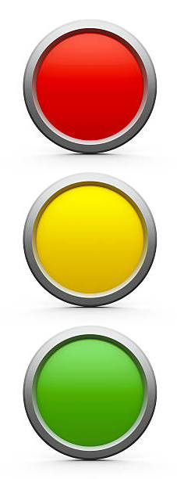
EXERCISE – 7 mins
Teach a 4-year old the concept of traffic light
Objectives:
  Understand how to use the border properties especially the border-radius.
  Demonstrate the use of id and class, css external files, background color property
Achieve as close as possible. The picture shown is an image hence output may not exactly look like this

Slide 8
MARGIN & PADDING
Recall that Margin is the space around an element [tags] while padding is the space around contents
We can also apply a different amount of margin on different sides using the margin-left, margin-top, margin-right, margin-bottom properties.
The shorthand margin property combines for all sides as .box{margin: 100px 150px 100px 80px;} representing top, right, bottom, left
A missing value makes use of the adjacent value. Example: margin:100px 50px uses 100px for the top and bottom, while it uses 50px for the right and left.
Similar principles apply to padding

Slide 9
More on Width: Tips for calculating the width
Important:
When you set the width and height properties of an element with CSS, you just set the width and height of the content area.
To calculate the full size of an element, you must also add padding, borders and margins.
The total width of an element should be calculated like this:
Total element width = width + left padding + right padding + left border + right border + left margin + right margin
Assume we want to style a <div> element to have a total width of 350px:
Here is the calculation: 320px (width) + 20px (left + right padding) + 10px (left + right border)
+ 0px (left + right margin) = 350px

Slide 10
More on Width: Box-sizing
Defines how the width and height of an element are calculated
Allows you to specify that the entire with of an element is made up of the padding and border.
Box-sizing:border-box | content-box
If you apply box-sizing: border-box as above to your element, it means that if you specify a width and then some padding, the padding will not lead to an effective increase width, the padding will be deducted from the total width.

Slide 11
MORE ON WIDTH AND HEIGHT
Recall that when you do not set the height property of an element, its contents will determine the height.
Also remember that when you give an element a fixed height and the content is not up to the height, the element will take up the space anyway
When you set a height and the content is much than the set height, what happens? *
Min-height can be used to specify the minimum height [or starting height] of an element.
#mydiv{min-height:400px}
The above rule implies that the minimum height mydiv can be is 400px, if the contents requires more than height of 400px, mydiv will grow to accommodate the contents.
The same is applicable to min-width
Notes:
*the contents overflow

Slide 12
MORE ON WIDTH AND HEIGHT
Likewise, min-width specifies the starting width of an element, if the contents requires more width, the element will grow to accommodate the width of the contents
Max-height and max-width are used to specify the maximum height and maximum width an element can ever have.
Note :The min-height property always overrides both height and max-height, same for min-width
Notes:
*the contents overflow

Slide 13
NEGATIVE MARGIN
#content {margin-top:-100px;}
Negative margin moves the element in the opposite direction
It does not break the flow of the page if applied to elements without floats. It means that if you use a negative margin to nudge an element upwards, all succeeding elements will be nudged as well.
Best used on elements that are not floated
Supported by major browsers.

Slide 14
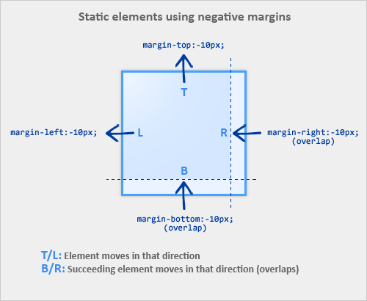
Negative Margin
Notes:
Source:https://www.smashingmagazine.com

Slide 15

See:
Sample Application of Negative Margin

Slide 16
The display property
The display property can be used to convert inline element to a block level and vice versa. **
To convert inline element like span to a block level element, use display:block
To convert block element like p to an inline element, use display:inline
Recall that inline elements can not respond to width and height, there is a 3rd value of display that allows you to specify width and height on inline element.
display:inline-block;
Inline-block makes the element behaves like a typical inline element in terms of just occupying the space it needs but will respond to width and height
We can leverage on this property to create an appropriate navigation bar
Notes:
There is also display:none which will hide the element completely

Slide 17
The display property: creating a search-engine friendly navigation bar
By convention, navigations are usually placed within a <ul>…<li> tag.
<ul>
<li> <a href=“”>Home</a></li>
<li> <a href=“”>About Us</a></li>
<li> <a href=“”>Contact Us</a></li>
</ul>
Since <li>… is a block level element, we can use the display:inline-block ; property to make each of them turn to horizontal menu bar

Slide 18
CSS BACKGROUND PROPERTIES

Slide 19
Styling Your Page Background
The background of your webpage is the part underneath the webpage contents area*
The CSS background properties are used to define the background effects.
background-color: Sets a solid color for the background.
background-image: Specifies a background image to appear in the background of the element.
Notes:
Background doesn’t sit on the margin since the margin is an area outside the content of the element *
When using a background image, use an image that does not disturb the text

Slide 20
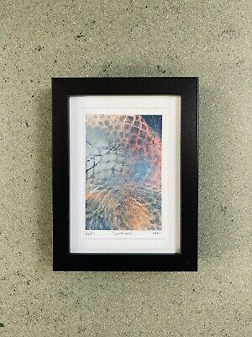
Background-image vs img
Background Image
Image
With background-image, other elements can sit on the background
An image (img) can even sit on the background!

Slide 21
Background Properties
background-repeat: Specifies whether the background should be repeated (tiled) or not. Can be applied to repeat tiled background
background-position: Specifies the position that the background should appear inside the element background.
background-attachment: Specifies the behavior of an element's background when its content scrolls. (Scroll with content or fixed?)
background-size: Specifies the dimension of the background image within the container cover|contain | width and height
Notes:
The background image can be a static file, or a generated gradient.
The background color by default is transparent
Good to set background color as a fallback when using background-image property

Slide 22
BACKGROUND PROPERTY
The CSS background properties are used to define the background effects for elements.
The background shorthand property sets all the background properties in one declaration.
CSS background properties are:
background-color
background-image
background-repeat
background-attachment
background-position
background-size
Example:
background: violet url("img_tree.gif") no-repeat fixed center;
It does not matter if one of the property values is missing, as long as the other ones are in this order.

Slide 23
background-color
The background-color property specifies the background color of an element
In the example below, the <h1> and <p>elements have different background colors:
h1 {
background-color: tomato;
}
p {
background-color: violet;
}
Syntax:
background-color: color|transparent

Slide 24
Background-image
The background-image property specifies an image to use as the background of an element.
By default, the image is repeated so it covers the entire element.
Example:
body {
background-image: url("paper.gif");
}
Note: When using a background image, use an image that does not disturb the text.

Slide 25
Background-repeat
By default, the background-image property repeats an image both horizontally and vertically.
Some images should be repeated only horizontally or vertically, or they will look strange:
Example:
body {
background-image: url(“alumni.png");
background-repeat: repeat-x;
}
Tip: To repeat an image vertically, set background-repeat: repeat-y;
Also, background image can only be shown once.
background-image: url(“alumni.png");
background-repeat: no-repeat;
Syntax:
background-repeat: repeat|repeat-x|repeat-y|no-repeat

Slide 26
Background-position
The position of the image is specified by the background-position property:
Background-position: top | bottom | center (optionally combined with left | right)
Example:
body {
background-image: url("img_tree.png");
background-repeat: no-repeat;
background-position: right top;
}

Slide 27
Background-attachment
The background-attachment property specifies that the background image should be fixed (i.e. will not scroll with the rest of the page)
Example:
body {
background-image: url("img_tree.png");
background-repeat: no-repeat;
background-position: right top;
background-attachment: fixed;
}
Syntax:
background-attachment: scroll|fixed

Slide 28
Background-size
The background-size property specifies the size of the background image.
Example:
body {
background-image: url("img_tree.png");
background-repeat: no-repeat;
background-attachment: fixed;
background-size: 700px 500px;
}
background-size: contain;
Syntax:
Background-size: auto | cover | contain | width height

Slide 29
Background Shorthand
background-color
background-image
background-position
background-repeat
[background-attachment]
Background-size: cover | contain
body{
background: #ffffff url("tree.png") no-repeat right top;
}
Notes:
It does not matter if one of the property values is missing, as long as the other ones are in this order.

Slide 30

ASSIGNMENT - Create something similar to the following: a part of a real website:

Slide 31
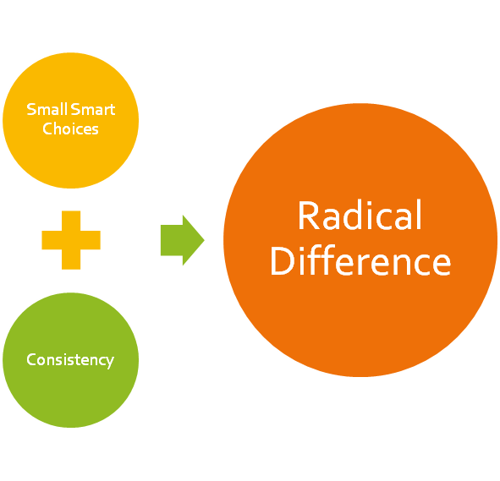
Catch up with all outstanding!
Remember!
Victories aren't born on the field. You create them during practice.

