Slide 1
Using of Software Testing Tools.

Slide 2
HELLO! …
Ovie Rahaman Sheikh - 011201306
Nuren Akter - 011201291

Slide 3
TABLE OF CONTENTS.
Introduction of Tool
Target Software
Test Suite
Test Case Flow Chart
Test Steps And Result

Slide 4

Gatling
01

Slide 5
What is Gatling?
Gatling is an open-source performance testing tool designed for load and performance testing of web applications.
It is often used by developers to simulate a large number of users accessing a web application simultaneously.

Slide 6
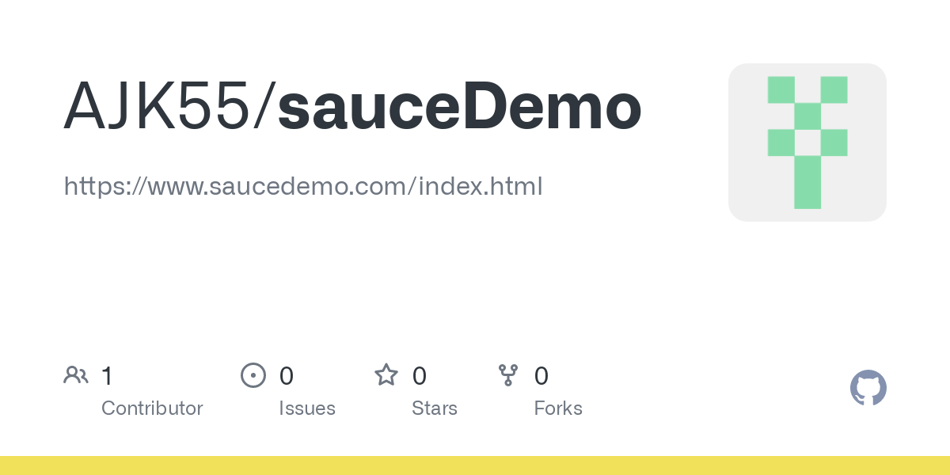
Target Software: Swag Labs
Swag Labs is designed to showcase various features typically found on e-commerce sites. It's a good place to practice end-to-end testing scenarios, including login, product browsing, and checkout.

Slide 7
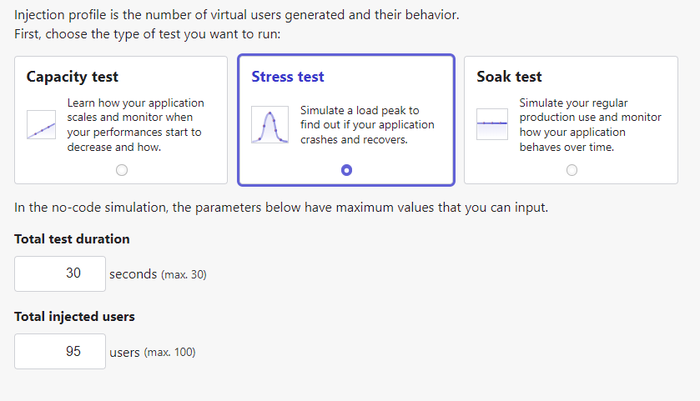
Test Suite:

Slide 8
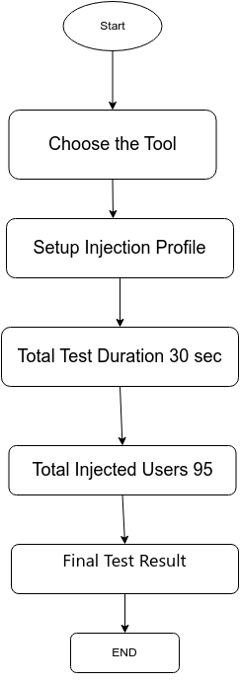
Test Case Flow Chart:

Slide 9
Test Step:
Step 1: Setup Injection Profile
Step 2: Total 30 sec
Step 3: Total Injected Users 95
Step 4: Final Test Result

Slide 10
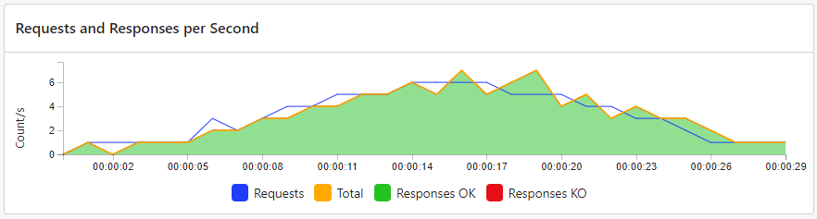
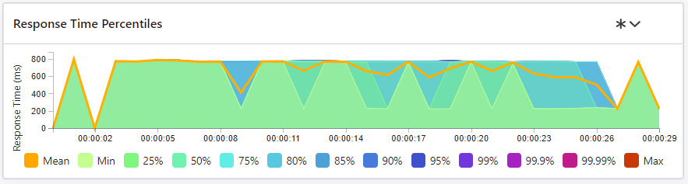
Test Results:

Slide 11
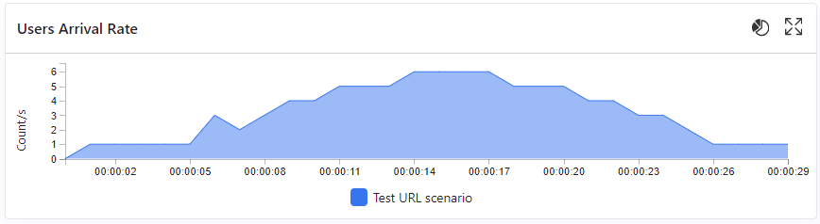
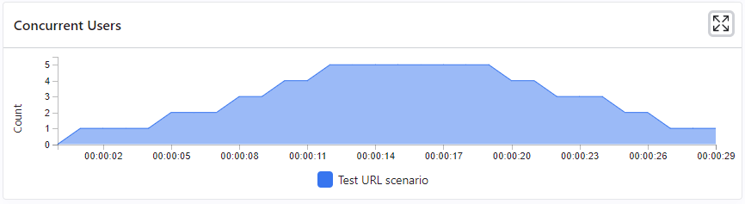
Test Results:

Slide 12
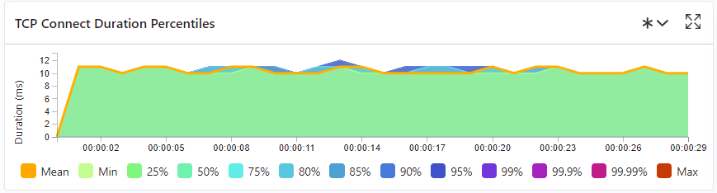
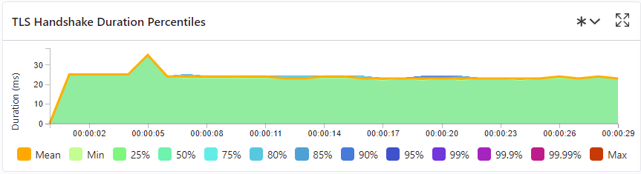
Test Results:

Slide 13
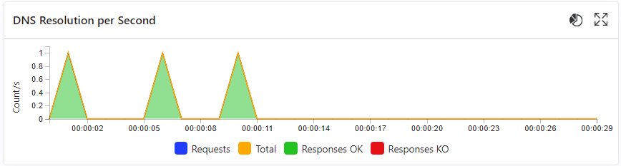
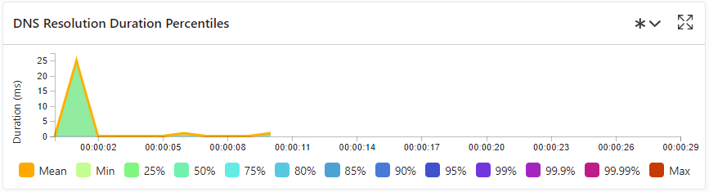
Test Results:

Slide 14
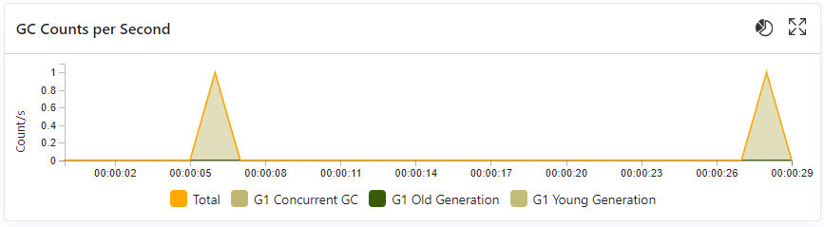
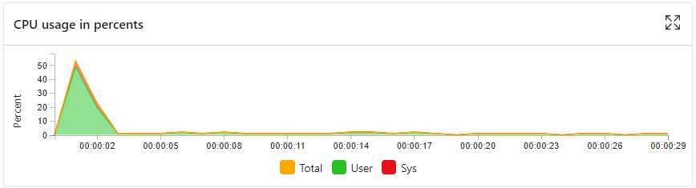
Test Results:

Slide 15

Selenium WebDriver
02

Slide 16




What is Selenium WebDriver?
Selenium WebDriver is a popular open-source tool used for automating web browsers.
Selenium WebDriver is a web framework that permits us to execute cross-browser tests. Parallel test execution is also supported
Selenium WebDriver supports multiple programming languages, including Java, Python, C#, and JavaScript, making it a versatile in different platforms.

Slide 17
Target Software: Swag Labs
Swag Labs is designed to showcase various features typically found on e-commerce sites. It's a good place to practice end-to-end testing scenarios, including login, product browsing, and checkout.

Slide 18
Environment:
Java
Java JRE
IntelliJ IDEA
Selenium Server(Grid)
Chrome Server

Slide 19
Test Suite:
Swag Labs
Log In
Product Select
Add to cart
Confirm Purchase
1 Suite and 4 Test case

Slide 20
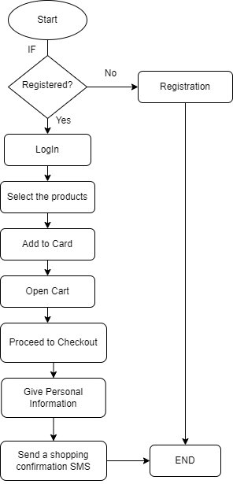
Test Case Flow Chart:

Slide 21
Test Step:
Step 1: Login
Step 2: Click on a Product
Step 3: Add to Card
Step 4: Open Cart
Step 5: Proceed to checkout
Step 6: Give Personal Information
Step 7: Confirm Purchase

Slide 22
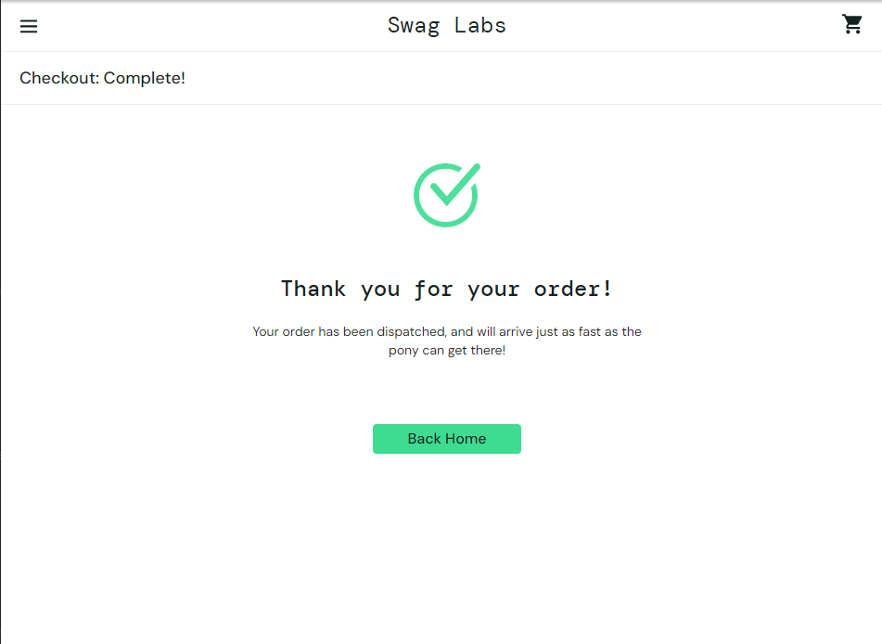
Test Result:

Slide 23
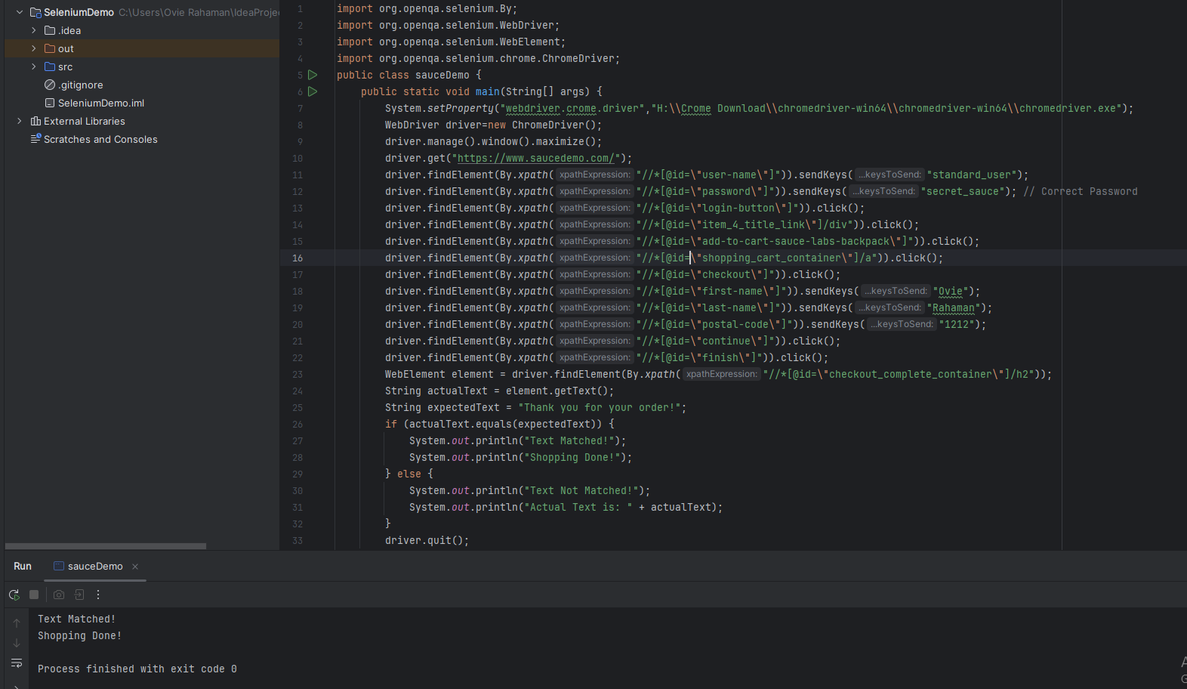
Test Case:
Expected Text Matched
Shopping Complete

Slide 24
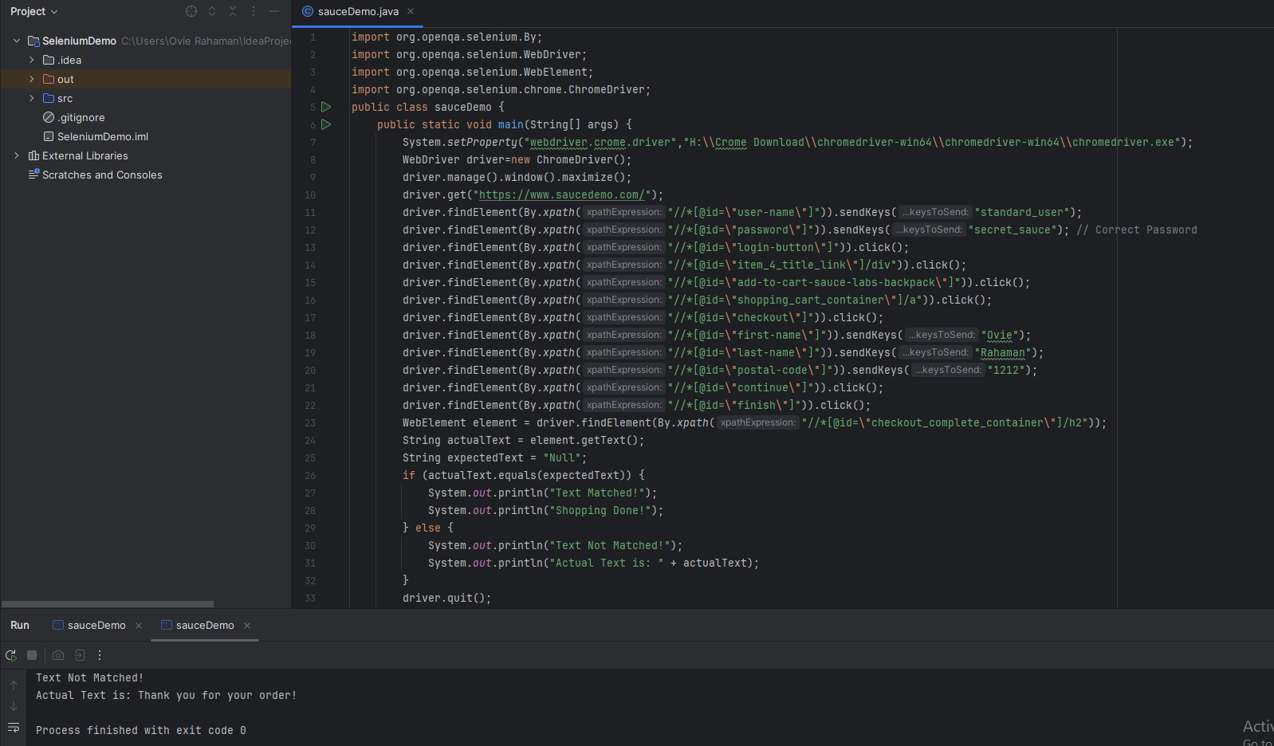
Test Case:
Expected Text Didn’t Match
Shopping Unsuccessful.

Slide 25
THANK YOU!
Do you have any questions?

