Slide 1
Using of Software Testing Tools.

Slide 2
HELLO! …
Ovie Rahaman Sheikh - 011201306
Nuren Akter - 011201291

Slide 3
TABLE OF CONTENTS.
Introduction of Tool
Introduction the Interface
Target Software
Test Case & Result

Slide 4

Gatling
01

Slide 5
What is Gatling?
Gatling is an open-source performance testing tool designed for load and performance testing of web applications.
It is often used by developers to simulate a large number of users accessing a web application simultaneously.

Slide 6

Target Software: BlazeDemo
BlazeDemo is a demo website that you can use for load testing and stress testing. It's a simple online store with features like product browsing, adding items to the cart, and checking out.

Slide 7
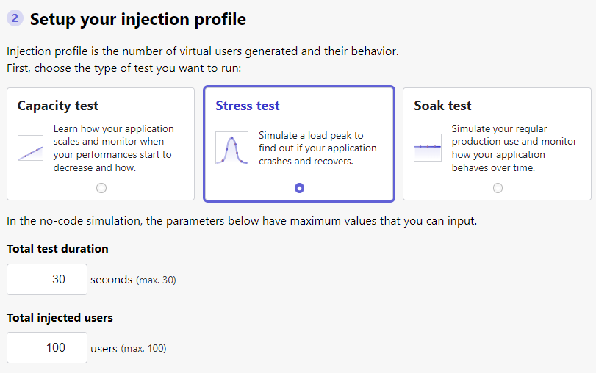
Test Case:

Slide 8
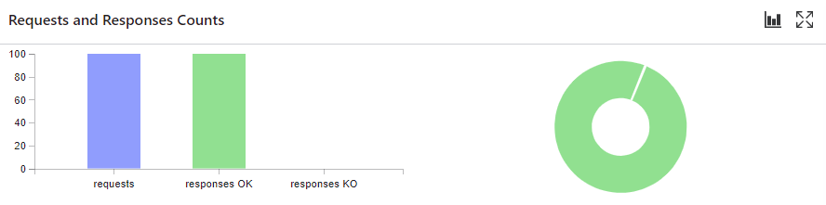
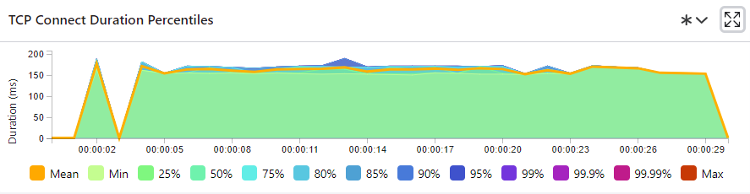
Test Results:

Slide 9
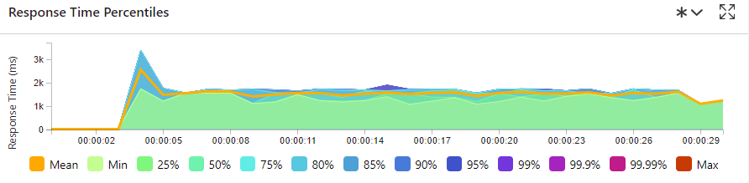
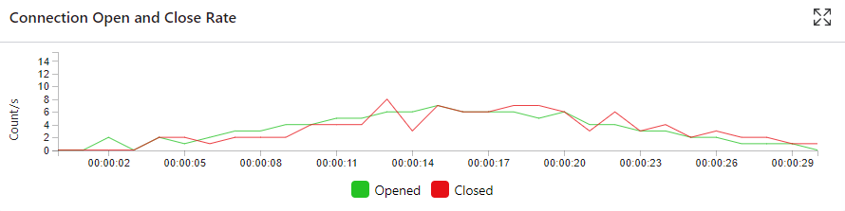
Test Results:

Slide 10
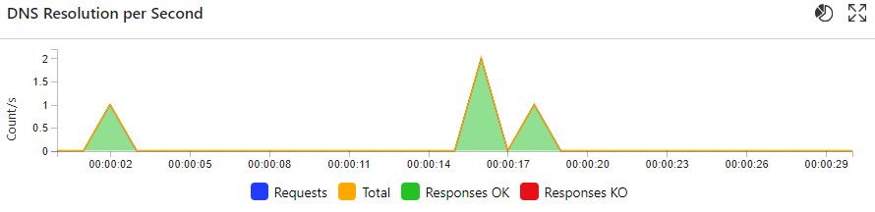
Test Results:

Slide 11
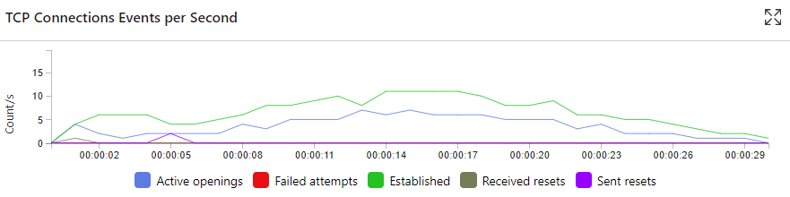
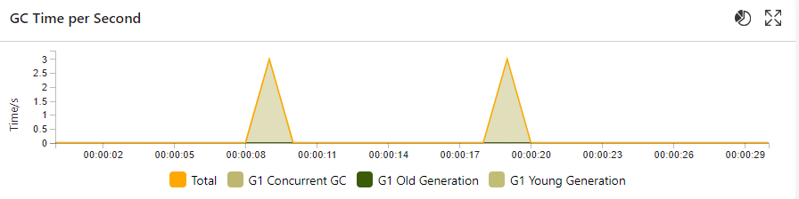
Test Results:

Slide 12

Selenium WebDriver
02

Slide 13
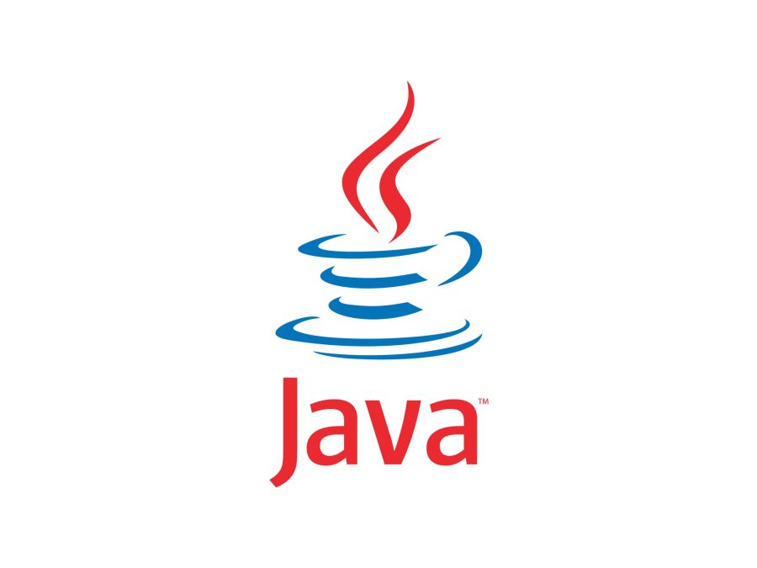
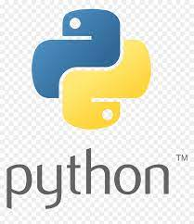
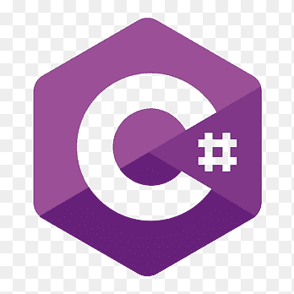

What is Selenium WebDriver?
Selenium WebDriver is a popular open-source tool used for automating web browsers.
Selenium WebDriver is a web framework that permits us to execute cross-browser tests. Parallel test execution is also supported
Selenium WebDriver supports multiple programming languages, including Java, Python, C#, and JavaScript, making it a versatile in different platforms.

Slide 14
Introduction the Interface:
Java
Java JRE
IntelliJ IDEA
Selenium Server(Grid)
Chrome Server

Slide 15

Target Software
OrangeHRM is an open source HR Management Software.

Slide 16
Test Case:
OrangeHRM An Open Source HR Management.
Username & Password Check.

Slide 17
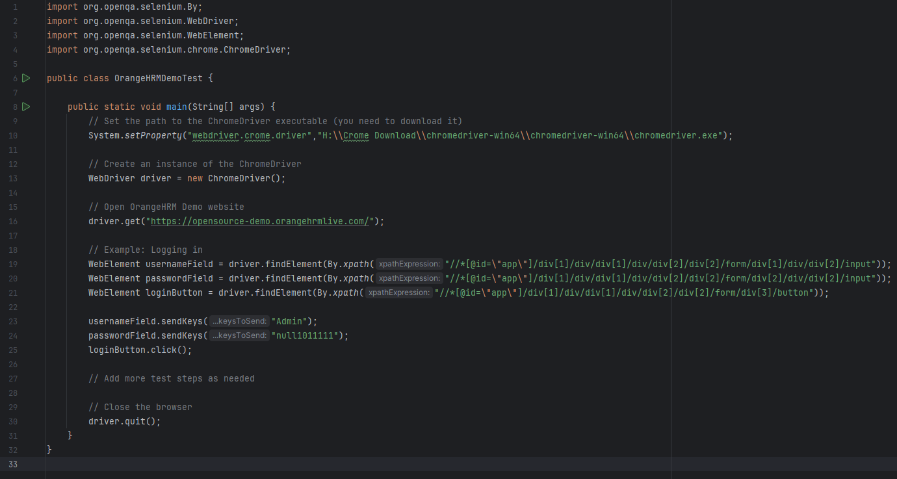
Test Case:
Incorrect Password Login Failed

Slide 18
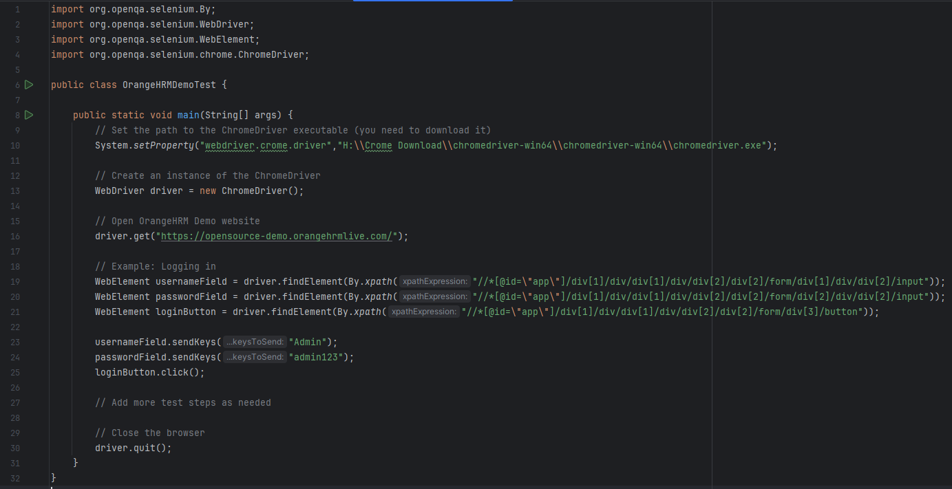
Test Case:
Correct Password Successfully Login

Slide 19
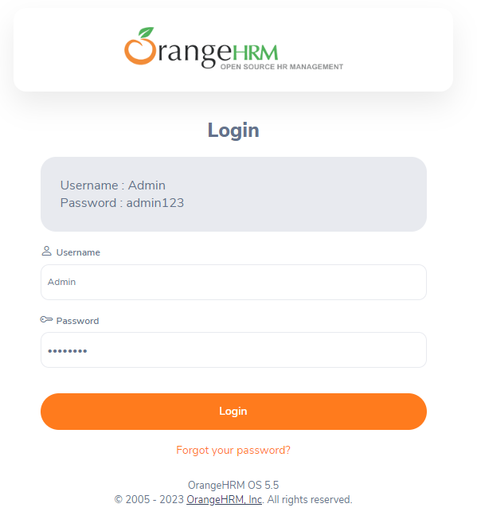
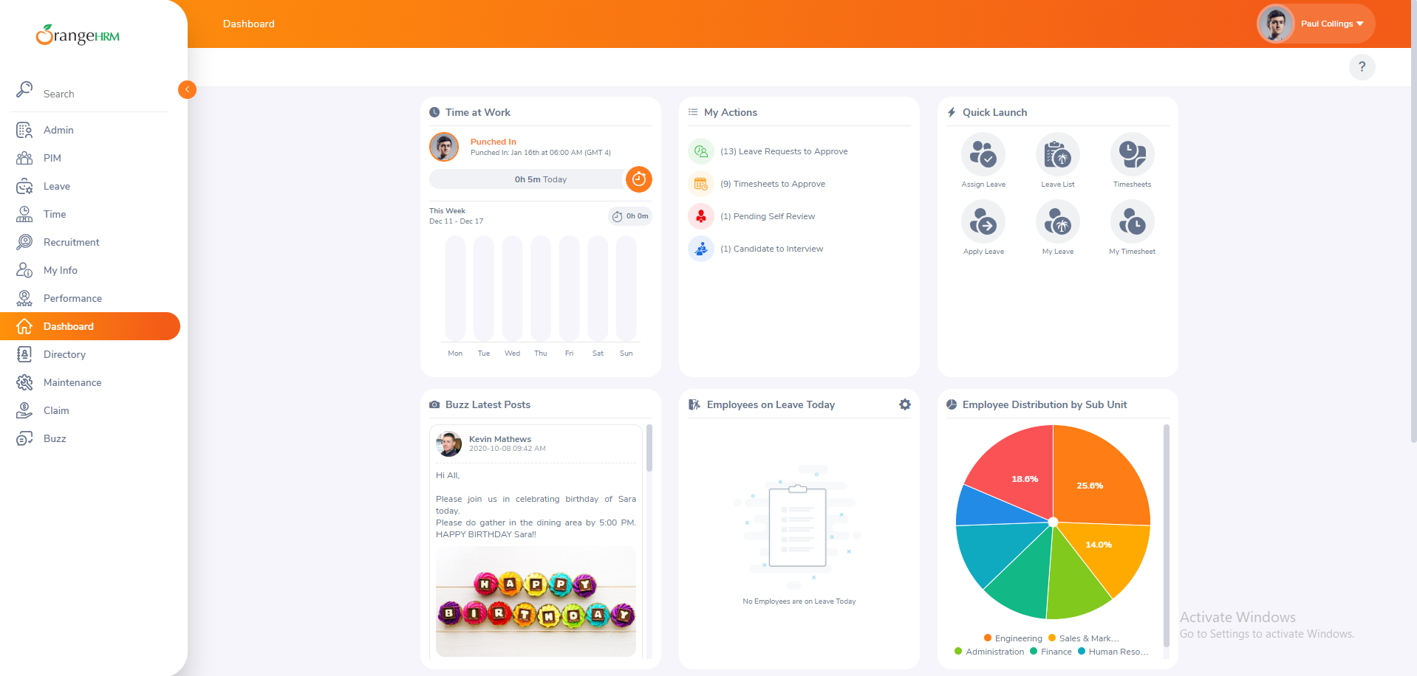

Slide 20
THANK YOU!
Do you have any questions?

