Slide 1
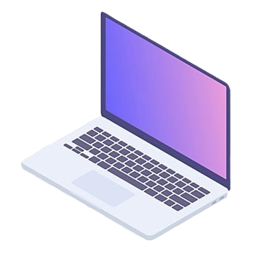
Computer Feature, ADVANTAGE AND DISADVANTAGE
Exploring the Impact of Computers in Our Lives

Slide 2
Computer Feature, ADVANTAGE AND DISADVANTAGE
Exploring the Impact of Computers in Our Lives

