Slide 1
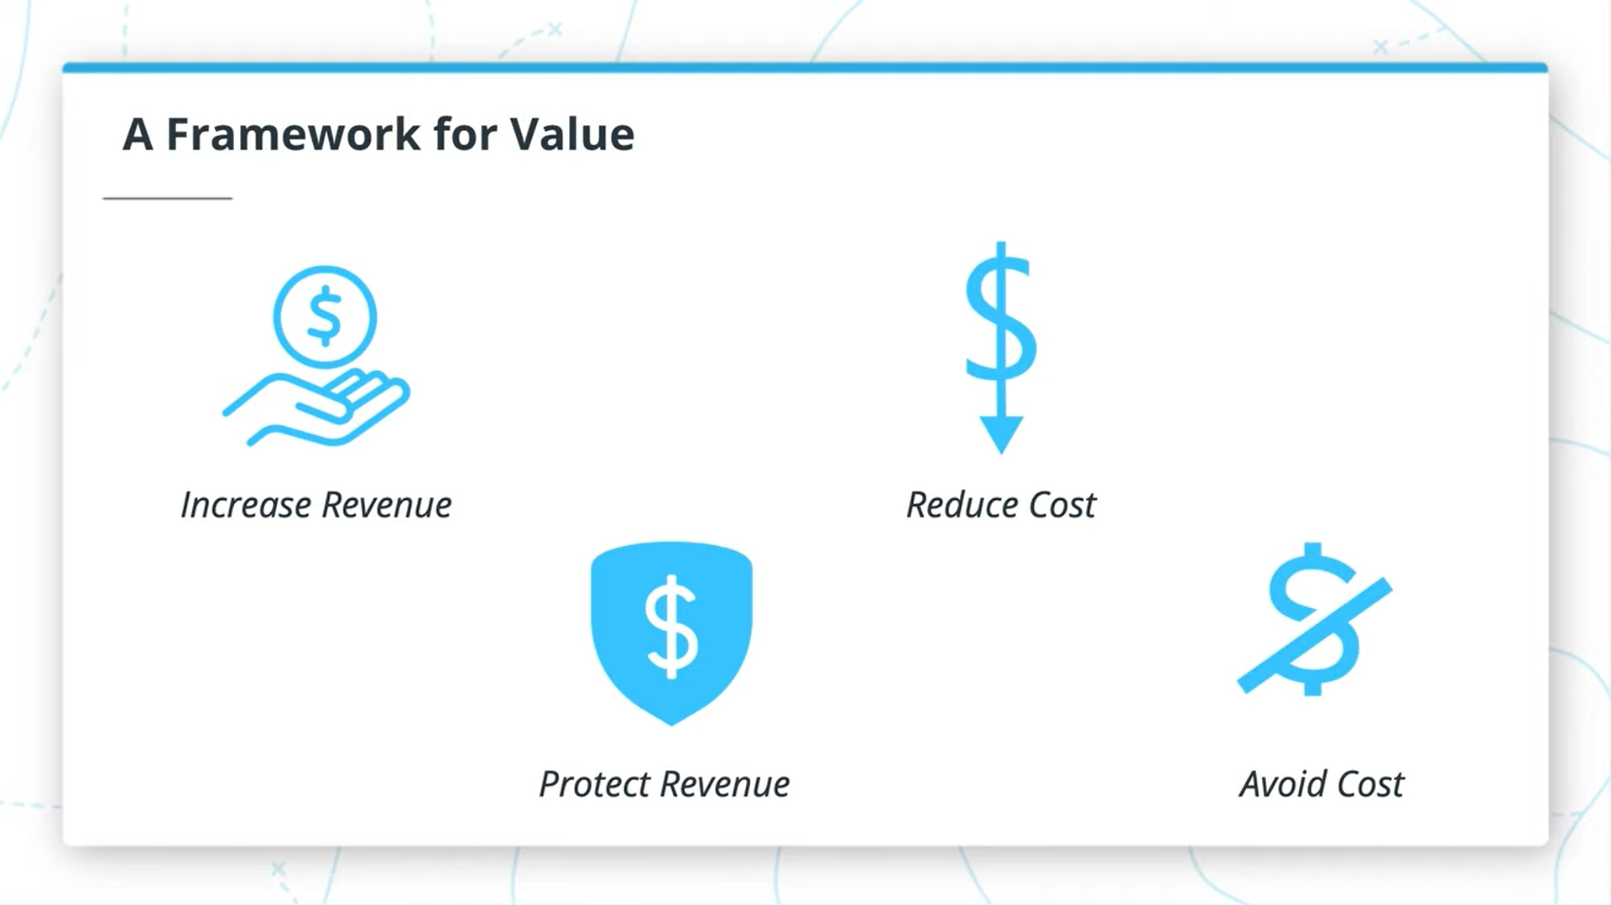
CI/CD Benefits for us

Slide 2
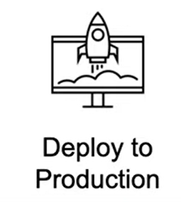
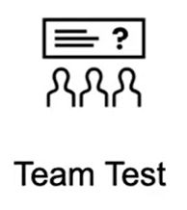

Faster and More Frequent Production Deployments
New value-generating features released more quickly
Deploy to Production Without Manual Checks
Less time to market

Slide 3
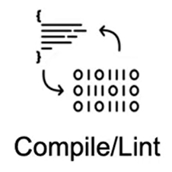

Catch Compile Errors After Merge
Less developer time on issues from new developer code
Automate Infrastructure Cleanup
Less infrastructure costs from unused resources

Slide 4
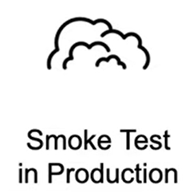
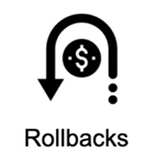
Automated Smoke Tests
Reduced downtime from a deploy-related crash or major bug
Automated Rollback Triggered by Job Failure
Quick undo to return production to working state

Slide 5
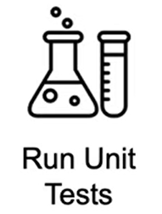

Catch Unit Test Failures
Less bugs in production and less time in testing
Detect Security Vulnerabilities
Prevent embarrassing or costly security holes

