Slide 1
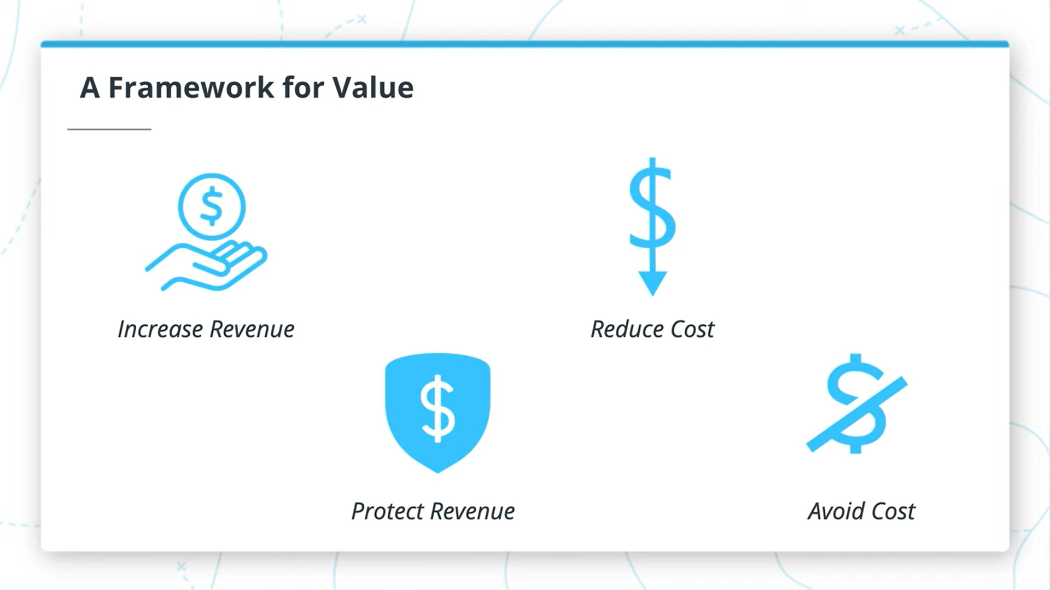
CI/CD Benefits for us

Slide 2
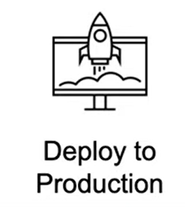
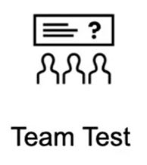

Deploy more, deploy fast to Production
Generate more value quickly releasing the new features
No more manual check when deploying
Decrease features time to market

Slide 3
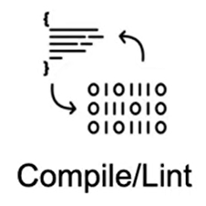

Quickly catch and fix compile errors
Spend less time on new code bugs
Cleanup automatically infrastructure after deploy
Reduce infrastructure costs by deleting the unused resources

Slide 4
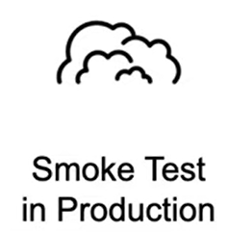
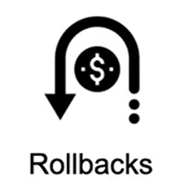
Automate your Smoke Tests
Prevent crashes after deployments
Rollback automatically after Jobs fail
Revert your changes if checks fail

Slide 5
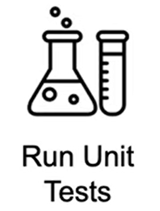

Automatically run Unit Tests
Deploy less code with bugs in production and
reduce testing time
Check for Vulnerabilities in your projects
Avoid security issues and PR stunts

