Slide 2
API Management and the API Economy
BRK3708
Vlad Vinogradsky
Principal PM Manager
vlvinogr@Microsoft.com
@vladvino

Slide 3
quick audience poll

Slide 4
an IT Pro
or
a developer
or
neither?

Slide 5
actively involved with apis?

Slide 6
heard of API Management?

Slide 7








The rise of APIs
Cloud platforms and apps
“Untethered” life and work
API-centric architectures

Slide 8
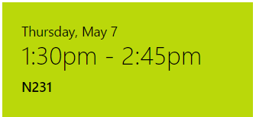
Azure API Apps Talk
Azure API Apps
API Backends for Enterprise Web, Mobile, and Logic Apps
Speaker: Mohit Srivastava
Easily build and host enterprise API backends
Include your own APIs, on-prem connectors and SaaS connectors
Leverage platform features such as auth, SSO, CORS and microservices architecture enablers
Expose APIs to Logic Apps designer
Expose APIs to pro devs with code generation
Publish APIs to the Azure Marketplace
Use with API Management for a complete E2E API development + management story

Slide 9

APIs are the engines of growth
Monetize data or services
Make product into a platform
Innovate faster
Open new channels

Slide 10



Common scenarios
Mobile enablement
Partner ecosystem
Business agility
Optimize and secure backend
Authorize and throttle requests
Get visibility into usage and health
Drive developer adoption
Modernize legacy backends
Package APIs into tiers
Enforce usage limits
Provide support and receive feedback
Normalize legacy backends
Build the catalog of APIs
Accept organizational ID
Respect org structure

Slide 11
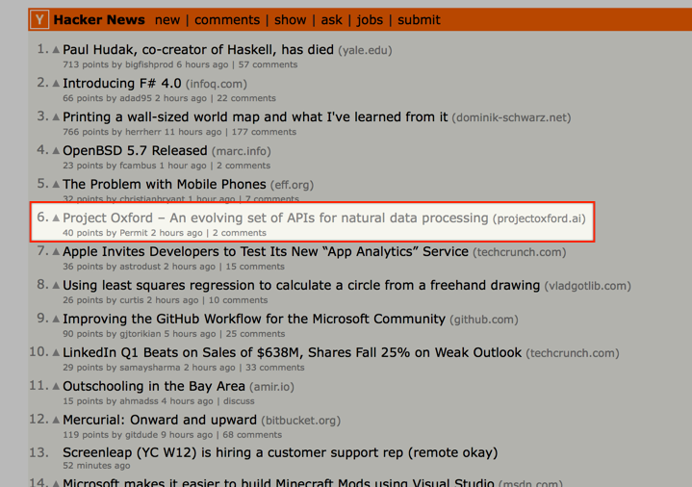
http://www.projectoxford.ai
https://www.microsoft.com/photodna

Slide 12
Why API Management
Establish a single API “front door”
Build an API façade for existing backend services
Add new capabilities to the APIs, such as response caching
Reliably protect published APIs from misuse and abuse
Package and publish APIs to developers and partners
On-board developers via a self-service portal
Ramp-up developers with docs, samples, and API console
Gain insights into API usage and health from analytics reports

Slide 13



AZURE API
MANAGEMENT
APP DEVELOPERS
Developer Portal
BACKEND
SERVICES
APPS
Proxy
Hosted anywhere.
Developed using any technology.
API PUBLISHERS
Publisher portal

Slide 14
A year at a glance
Feb 2014
May 2014
Sep 2014
Jan 2014
Mar 2014
PRIVATE PREVIEW
PUBLIC PREVIEW
GENERAL AVAILABILITY
PREMIUM
PREVIEW
PREMIUM
GA

Slide 15

A year at a glance
Customers in every one of the 15 regions!

Slide 16
A year at a glance
CUSTOMERS
CALLS / MONTH
PORTAL VISITS / MONTH
DEVELOPERS
3.2K+
1.1B+
470K+
31K+

Slide 17
A year at a glance
Management API
Static VIP
OAuth 2.0
Backup & restore
Mutual certificate authentication
"Root" APIs
Subscription-less products
HTTP support
Subscription per app
Performance improvements
Multi-region deployment
Developer portal delegation
Custom subscription keys
Azure VPN support
Azure Active Directory support
API import from Swagger 2.0
Improved response caching
Improved API import
Improved console and documentation
Check Header policy
Validate JWT policy
Set backend policy
Set body policy
Control flow policy
Set context variable policy
Policy expressions
and more...

Slide 18
Azure API Management tour

Slide 19
Looking ahead
Lean product development
No long term plan
Customer- and data-informed prioritization
Feature flighting
Weekly releases

Slide 20
Looking ahead
Service configuration via Git
Deeper developer portal customization
Log to Event Hub policy
Run custom code policy
PowerShell cmdlets and SDKs for management API
We’d love your feedback!

Slide 21
Sneak peek: DevOps via Git

Slide 22
How to get started
Try API Management
http://aka.ms/apimrocks
Ask a question or request a demo
mailto:apimgmt@microsoft.com
Resources
Product information
http://aka.ms/apimrocks
Documentation
http://aka.ms/apimdocs
Videos
http://aka.ms/apimvideos
Forum
http://aka.ms/apimforum
Changelog
http://aka.ms/clog

Slide 23


Please evaluate this session
Your feedback is important to us!
Visit Myignite at http://myignite.microsoft.com or download and use the Ignite Mobile App with the QR code above.

