Slide 1


M.Tech/MCA Program
Advanced Industry Integrated Programs
Jointly offered by University and LTIMindTree
Review II
Temporal‑to‑Semantic Embedding for Predictive Maintenance
Explainable RUL Prediction using Contrastive Learning
Team Member
Oviya Ragothaman – T9941
Knowledge partner | Implementation partner

Slide 2
Temporal‑to‑Semantic Embedding for Predictive Maintenance
Introduction
Raw sensor data is hard to interpret and hard to align with textual maintenance reports
Predictive maintenance needs Remaining Useful Life (RUL) estimates and clear reasons behind them
Idea: To embed the sensor time-series and maintenance text into one shared semantic space
A multi-agent layer turns the aligned embeddings into explainable recommendations

Slide 3
Temporal‑to‑Semantic Embedding for Predictive Maintenance
Objective
Convert multivariate sensor time-series into embeddings
Convert maintenance text into embeddings
Align both using contrastive learning (InfoNCE / Triplet loss)
Predict Remaining Useful Life (RUL) with explainable output
Integrate a multi-agent system for monitoring, diagnosis and recommendation

Slide 4
Temporal‑to‑Semantic Embedding for Predictive Maintenance
Module: Multi-Agent System
Monitoring → watches sensor embeddings for anomalies
Retrieval → finds similar maintenance reports in the semantic space
Diagnosis → infers the likely fault and RUL
Verification → cross-checks the diagnosis against evidence
Recommendation → suggests a maintenance action with explanation

Slide 5
Temporal‑to‑Semantic Embedding for Predictive Maintenance
Methodology / Modeling Plan
Problem → Raw sensor data is hard to interpret and align with textual maintenance reports.
Solution → Convert sensor time-series and text into embeddings, then align both using contrastive learning.
Outcome → Explainable predictive maintenance with Remaining Useful Life (RUL) prediction.

Slide 6
Temporal‑to‑Semantic Embedding for Predictive Maintenance
Data preprocessing & EDA
Dataset → NASA C-MAPSS (multivariate sensor readings + maintenance logs)
Preprocessing → normalization, time-window segmentation, handling missing values
EDA → plot sensor trends, visualize anomalies, check correlations between sensor features and failures

Slide 7
Temporal‑to‑Semantic Embedding for Predictive Maintenance
Approach / Algorithms / Tools
Time-series encoder → LSTM / Transformer for sensor embeddings
Text encoder → Sentence Transformer (BERT / DistilBERT) for text embeddings
Contrastive alignment → InfoNCE / Triplet loss to align the two embeddings
Multi-agent system → monitoring, retrieval, diagnosis, verification, recommendation

Slide 8
Temporal‑to‑Semantic Embedding for Predictive Maintenance
Project plan / milestones progress
Week 1–2
Dataset preprocessing & EDA
Week 3–4
Build sensor encoder + text transformer
Week 5–6
Train contrastive alignment model
Week 7
Integrate multi-agent system
Week 8
Evaluation & PPT preparation

Slide 9
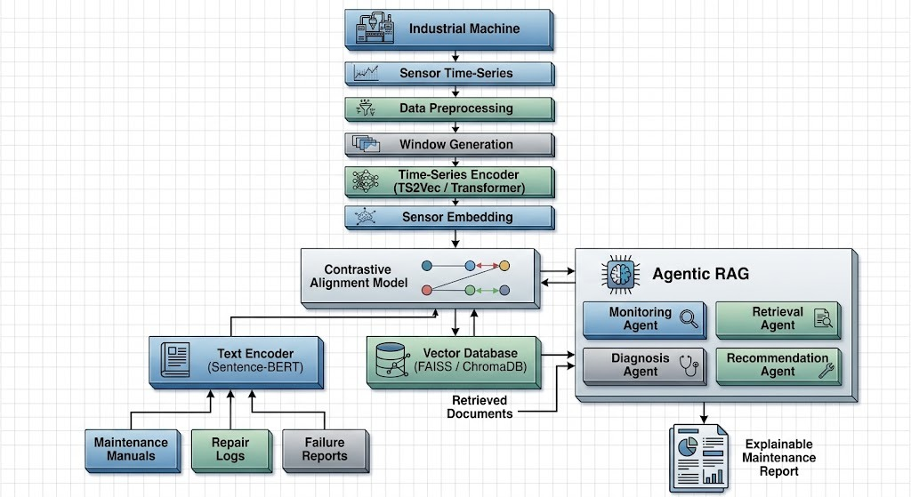
Temporal‑to‑Semantic Embedding for Predictive Maintenance
Pipeline structure

Slide 10
Temporal‑to‑Semantic Embedding for Predictive Maintenance
Outcome
Impact
Explainable predictive maintenance: sensor behaviour and maintenance text share one semantic space, so RUL predictions come with reasons engineers can act on.

Slide 11
M.Tech/MCA Program
Advanced Industry Integrated Programs
Jointly offered by University and LTIMindTree
Review II
Self‑Learning Digital Twin for CSTR
Adaptive, Uncertainty-Aware Twin using RL and MLOps
Team Member
Oviya Ragothaman- T9941
Knowledge partner | Implementation partner

Slide 12
Self‑Learning Digital Twin for CSTR
Introduction
Traditional digital twins are static and do not adapt as the process changes
They also give no confidence score, so predictions are hard to trust
Idea: A twin of a Continuous Stirred Tank Reactor (CSTR) that keeps learning
Reinforcement learning + uncertainty estimation make it adaptive and trustworthy

Slide 13
Self‑Learning Digital Twin for CSTR
Objective
Build an adaptive digital twin of a CSTR using reinforcement learning (PPO)
Attach a confidence level to every prediction using Monte Carlo Dropout
Detect drift and retrain automatically with an MLOps pipeline
Deploy on the cloud with Docker, Kubernetes, Prometheus and Grafana

Slide 14
Self‑Learning Digital Twin for CSTR
Module: Uncertainty & MLOps Layer
Keeping the twin trustworthy
MC Dropout → confidence score for every prediction
Drift detection → flags when reactor behaviour shifts
Retraining → updates the twin automatically
Monitoring → Prometheus + Grafana dashboards
Deployment → Docker + Kubernetes on the cloud

Slide 15
Self‑Learning Digital Twin for CSTR
Methodology / Modeling Plan
Problem → Traditional digital twins are static and do not provide confidence scores.
Solution → Build an adaptive twin using reinforcement learning + uncertainty estimation.
Outcome → A trustworthy, adaptive twin that reports confidence levels.

Slide 16
Self‑Learning Digital Twin for CSTR
Data preprocessing & EDA
Dataset → generated from a CSTR simulation
Preprocessing → normalize features (temperature, concentration, flow rates, control actions)
EDA → plot reactor dynamics, visualize stability regions, analyze control actions vs outcomes

Slide 17
Self‑Learning Digital Twin for CSTR
Approach / Algorithms / Tools
Reinforcement learning → PPO learns optimal control strategies
Uncertainty estimation → Monte Carlo Dropout for confidence scores
MLOps pipeline → drift detection + retraining
Cloud deployment → Docker, Kubernetes, Prometheus, Grafana

Slide 18
Self‑Learning Digital Twin for CSTR
Project plan / milestones progress
Week 1–2
Simulation setup + data preprocessing
Week 3–4
RL agent training (PPO)
Week 5
Add uncertainty estimation
Week 6
Build MLOps pipeline
Week 7
Cloud deployment
Week 8
Evaluation & PPT preparation

Slide 19
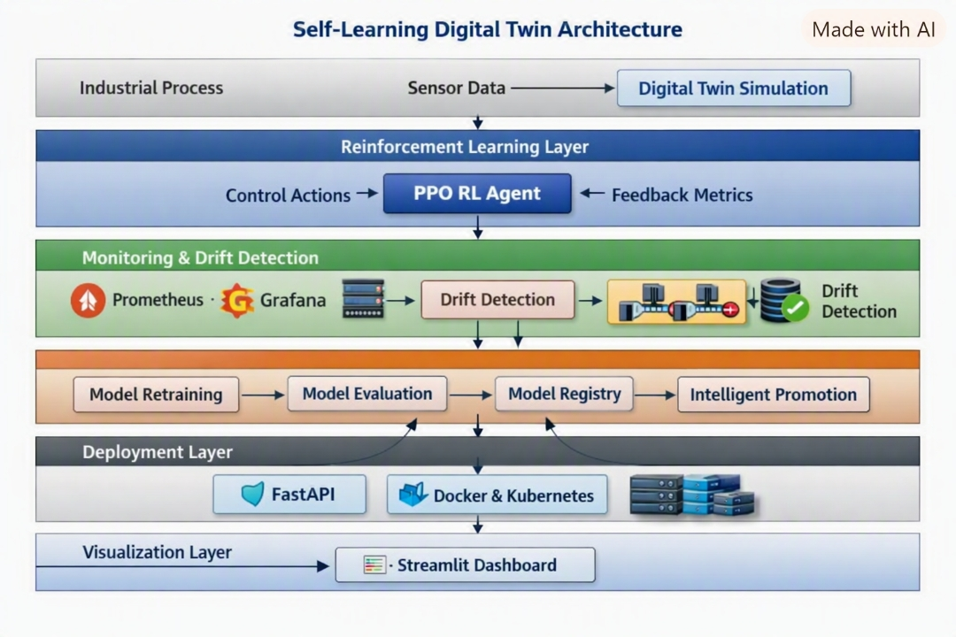
Self‑Learning Digital Twin for CSTR
Pipeline structure

Slide 20
Self‑Learning Digital Twin for CSTR
Outcome
Impact
A trustworthy, self-adapting digital twin that reports how confident it is in every prediction.

