Slide 1
ZENER DIODE
VILASHINI PL
727821TUEE152

Slide 2
Objectives
After completing this chapter, you will be able to:
  Describe the function and characteristics of a zener diode
  Draw and label the schematic symbol for a zener diode
  Explain how a zener diode operates as a voltage regulator

Slide 3
Zener Diode Characteristics
Zener diode
  Operates at voltages that exceed breakdown voltage
  Manufactured with a specific breakdown voltage (E_{Z})
  Packaged like PN junction diodes
Power dissipation
  Based on temperature and lead lengths

Slide 4
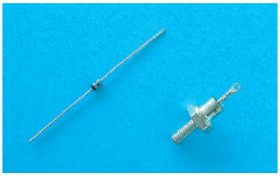
Zener Diode Characteristics
Zener diode regulators provide a constant output voltage despite changes in the input voltage or output current
To determine whether a zener diode is regulating at the proper voltage, a regulation test must be performed

Slide 5
Zener Diode Characteristics
2. Schematic symbol for a zener diode.
A zener diode operating in breakdown acts as a voltage regulator because it maintains a nearly constant voltage across its terminals over a specified range of reverse-current values.
A minimum value of reverse current, IZK, must be maintained in order to keep the diode in breakdown for voltage regulation.

Slide 6
Zener Diode Ratings
Positive zener voltage-temperature coefficient
  Breakdown voltage increases as temperature increases
Negative zener voltage-temperature coefficient
  Breakdown voltage decreases as temperature increases

Slide 7
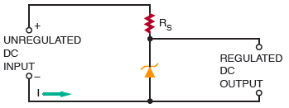
Voltage Regulation with
Zener Diodes
Typical zener diode regulator circuit.

Slide 8
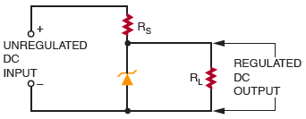
Voltage Regulation with
Zener Diodes
Zener diode voltage regulator with load.

Slide 9
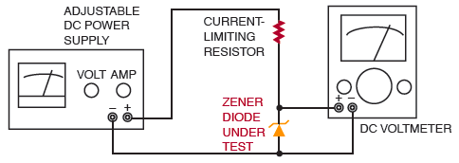
Testing Zener Diodes
Setup for testing zener diode regulation.

Slide 10
Summary
Zener diodes are designed to operate at voltages greater than the breakdown voltage (peak reverse voltage)
The breakdown voltage of a zener diode is determined by the resistivity of the diode
Zener diodes are used to stabilize or regulate voltage

