Slide 1
Details..☺
STUDENT NAME : OVIYA V
REGISTER NUMBER : 24132090500122019
DEPARTMENT : BCA
COLLEGE NAME /UNIVERSITY : RAJESWARI COLLEGE OF ARTS AND SCIENCE FOR WOMEN / ANNAMALAI UNIVERSITY

Slide 2
STUDENT PORTFOLIO…

Slide 3
Agenda
Problem Statement
Project Overview
End User
Tools and Technologies
Portfolio Design & Layout
Features and Functionality
Result and Screenshots
Conclusion
GitHub Link

Slide 4
1. Problem Statement
Students often struggle to present their skills, projects, and interests in a visually appealing and professional way. Traditional resumes lack interactivity and creativity, making it harder to stand out. Hence, there is a need for a simple yet creative portfolio website that showcases skills, projects, and achievements in an engaging manner.

Slide 5
2. Project Overview
This project is a student portfolio website built with only HTML and CSS (no frameworks). It serves as a personal branding tool where students can highlight their skills, quick facts, academic background, and contact details. The portfolio is responsive, creative, and modern, with a dark/light theme toggle and smooth card-based layout.

Slide 6
3.END USER
Students who want to present their achievements, skills, and projects.
Recruiters and hiring managers looking for candidates for internships or job roles.
Peers and mentors interested in exploring the student’s work.

Slide 7
4.Tools and Technologies
HTML5 → Semantic structure and accessibility.
CSS3 → Styling, responsiveness, animations, and theme switching.
Responsive Design Techniques → Grid, flexbox, and media queries for mobile support.
No external frameworks used, making it lightweight and fast.

Slide 8
5.Portfolio Design & Layout
About Section: Brief student introduction and quick facts card.
Hero Section: Introduction with name, tagline, and call-to-action buttons.
About Section: Brief student introduction and quick facts card.
Skills Section: Radial meters (using conic-gradient) for skill visualization.
Contact Section: Contact form and external links (email, GitHub).
Footer: Year and credits.
Theme Switcher: Dark/Light mode toggle built using CSS-only checkbox hack.
Glassmorphism Style: Cards with blurred backgrounds and soft shadows.unds and soft shadows.

Slide 9
6. Features and Functionality
Responsive design across desktop, tablet, and mobile.
Dark/Light mode toggle.
Interactive skills progress rings.
Contact form with styled input fields.
Hover effects on buttons, links, and project cards.
Clean typography and smooth animations.

Slide 10
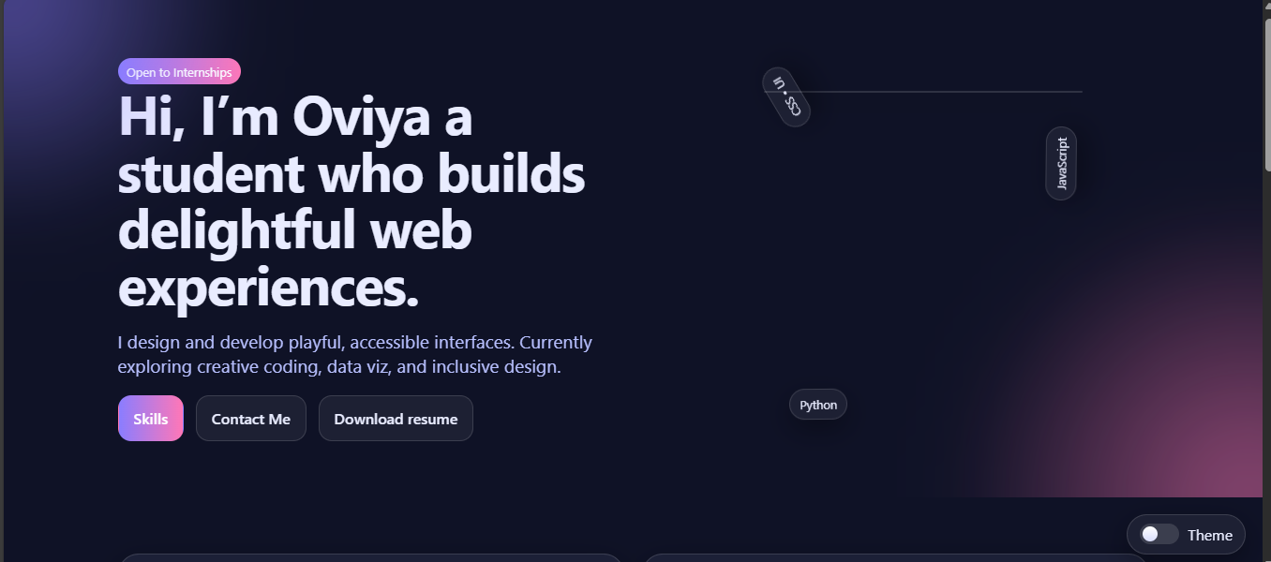
7. Result and Screenshots

Slide 11
8. Conclusion
This student portfolio demonstrates how creative design with simple HTML & CSS can result in a professional, visually engaging, and functional personal site. It helps students present themselves better to recruiters while learning modern web development techniques such as responsive grids, conic gradients, glassmorphism, and CSS-based theme toggling.

Slide 12
9.GitHub Link
https://github.com/oviya220507-crypto/OVIYA-.git

Slide 13
Thank you

