Slide 1
Block Cipher Modes Of Operations

Slide 2
MULTIPLE ENCRYPTION AND TRIPLE DES (
Background
DES uses a 56-bit key
Vulnerable to brute-force attacks
Modern computing makes exhaustive key search feasible
Two possible solutions
Design a new algorithm → AES
Strengthen DES using multiple encryption
This leads to Double DES and Triple DES

Slide 3
Concept of Multiple Encryption
Apply encryption more than once
Use multiple independent keys
Goal: increase effective key length C=E(K_{n}​,E(K_{n−1}​,…E(K₁​,P)))
Double DES
Simplest form of multiple encryption
Uses two DES encryptions
Uses two independent keys
Encryption C=E(K₂,E(K₁,P))
Decryption P=D(K₁,D(K₂,C))

Slide 4
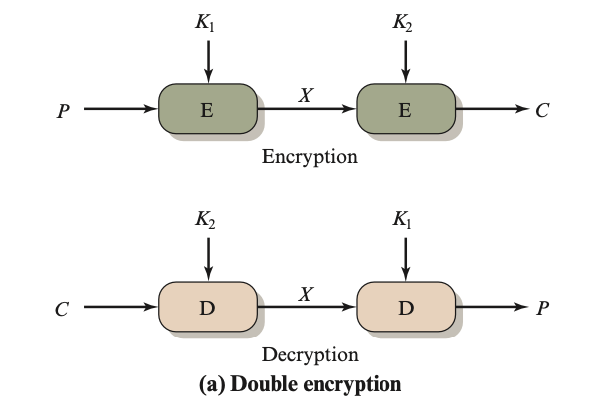
Strength of Double DES
DES key size = 56 bits
Double DES appears to use:
56×2=112 bits
Can Double DES Reduce to Single DES?
E(K₂​,E(K₁​,P))=E(K3​,P)
If true → Double DES = Single DES, Then multiple encryption is useless

Slide 5
Why
DES Characteristics
DES maps 64-bit plaintext → 64-bit ciphertext
Each key defines a unique permutation
Total possible permutations: (2⁶⁴)!c10³⁴⁷
Total DES mappings 2⁵⁶
Total possible permutations: (2⁶⁴)!≈10³⁴⁷
Total DES mappings 2⁵⁶ ≈ 7.2*10¹⁶ ≈ 10¹⁷
Double DES likely creates mappings not achievable by single DES

Slide 6
But Double DES Is Still Weak
Even though Double DES ≠ Single DES…
It is vulnerable to a generic attack
Does not depend on DES internals
This attack is called: Meet-in-the-Middle Attack
Given: C=E(K₂,E(K₁,P)),
Define intermediate value:
X=E(K₁,P)=D(K₂,C) ->Attack meets in the middle (X)

Slide 7
Meet-in-the-Middle Attack
Given one known plaintext–ciphertext pair (P, C)
Encrypt P with all 2⁵⁶ values of K₁​, Store X=E(K₁,P)
Decrypt C with all 2⁵⁶ values of K_{2,},Compute X=D(K₂,C)
Look for matches of X
Test candidate key pairs using another (P, C)
Time complexity:2⁵⁶+2⁵⁶≈2⁵⁷
Storage required: 2⁵⁶ entries
Only slightly more expensive than breaking DES

Slide 8
Effective Security of Double DES
Nominal key size: 112 bits, Effective security: ~56 bits
Meet-in-the-Middle removes expected advantage
Double DES is NOT secure
Problems with Double DES
Vulnerable to MITM attack
Insufficient security gain
Solution
Use three stages of encryption
Carefully choose encryption–decryption structure

Slide 9
Why Triple DES
Single DES → key size = 56 bits → broken by brute force
Double DES → looks like 112 bits, but broken by meet-in-the-middle attack
Triple DES (3DES) → introduced to defeat meet-in-the-middle while still using DES hardware
Key sizes
2-key 3DES → 112 bits
3-key 3DES → 168 bits
Resistant to Meet-in-the-Middle
Backward compatible with DES

Slide 10
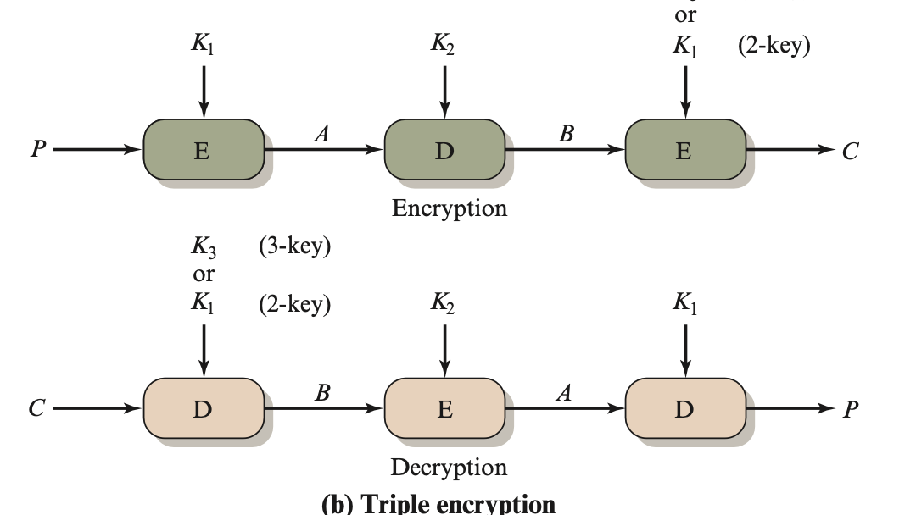

Slide 11
Two-key Triple DES
Encryption: C=E(K₁,D(K₂,E(K₁,P)))
Encrypt with K1K1​
Decrypt with K2K2​
Encrypt again with K1K1​
This is called EDE (Encrypt–Decrypt–Encrypt).
Decryption: P=D(K₁,E(K₂,D(K₁,C))), Same steps, reversed. There is no cryptographic significance to the use of decryption for the second stage.

Slide 12
Backward compatibility
If: K₁=K₂​Then:
C=E(K₁,D(K₁,E(K₁,P)))=E(K₁,P)
So Triple DES behaves exactly like Single DES.
✔ Old DES systems can still decrypt ✔ New systems get stronger security
That’s the only reason for the D in the middle.
brute force is infeasible.
Merkle–Hellman attack - Uses a clever meet-in-the-middle–style idea
Requires:
2⁵⁶ computations
2⁵⁶chosen plaintext–ciphertext pairs
Two-key 3DES is theoretically vulnerable, but safe in practice.

Slide 13
Three-key Triple DES
C=E(K₃,D(K₂,E(K₁,P)))
Now, Keys: K1,K2,K3K1​,K2​,K3​
Nominal key size: 56×3=168 bits
Effective security: ~112 bits (due to advanced attacks)
Still extremely secure.
Used in
PGP
S/MIME
Banking systems
Financial key management standards

Slide 14
Block Cipher Modes Of Operations
Direct use of a block cipher is in advisable
Enemy can build up “code book” of plaintext/cipher text equivalents
Beyond that, direct use only works on messages that is multiple of the cipher block size in length
Solution: five standard Modes of Operation:
Electronic Code Book (ECB),
Cipher Block Chaining (CBC),
CipherFeedback(CFB),
Output Feedback (OFB), and
Counter(CTR).

Slide 15
Electronic Code Book
Direct use of the block cipher (like DES or AES)
Takes fixed-size blocks (e.g., 64 bits for DES, 128 bits for AES)
Encrypts one block at a time
Very weak if used for general-purpose encryption; never use it for a file or a message.
Attacker can build codebook; no semantic security
We write {P}k → C to denote “encryption of plaintext P with key k to produce cipher text C”

Slide 16
Observation
codebook:
Same word → same code
Same input → same output
Identical plaintext blocks → identical ciphertext blocks
Patterns in the plaintext remain visible
An attacker can build a codebook:
Where
Encrypting small, random values like:
Cryptographic keys
Nonces
Never use ECB for: Files, Images, Messages, Databases
(Image outline remains same), Colors change, patterns remain

Slide 17
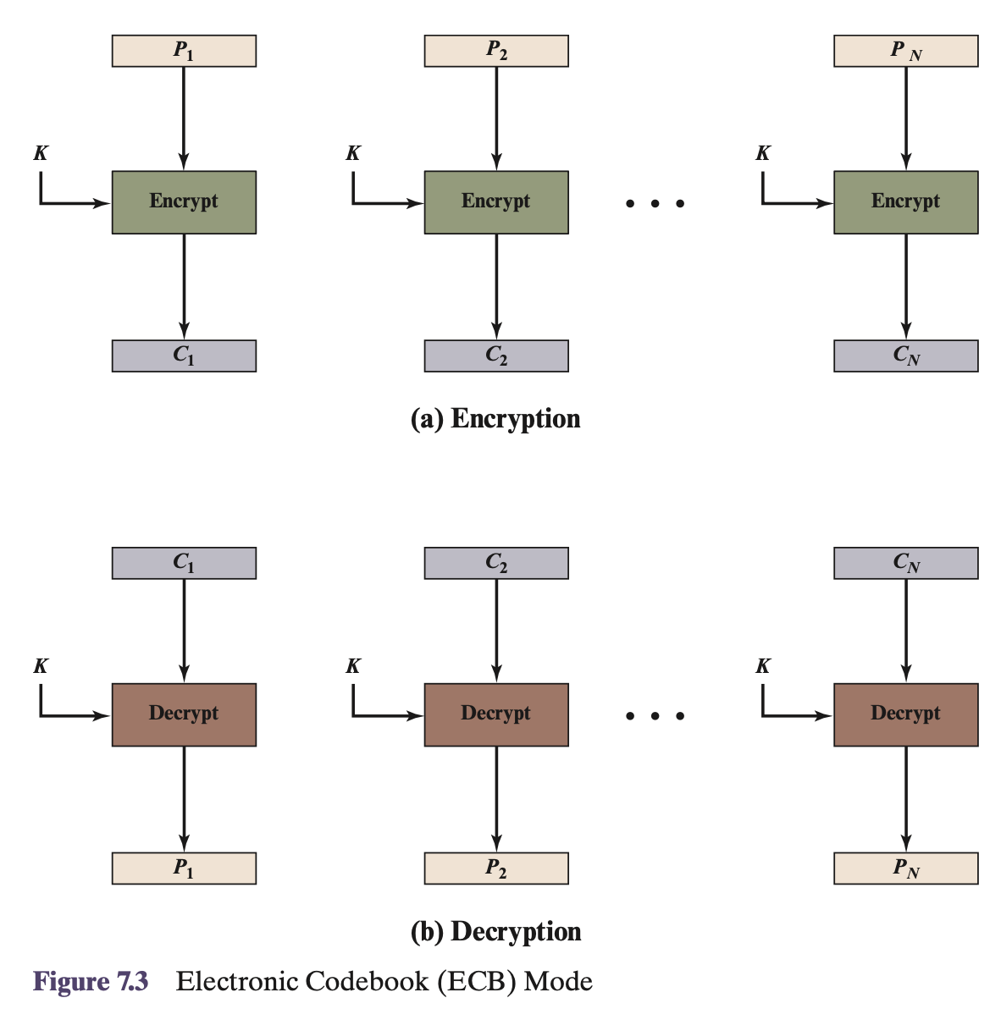

Slide 18
Cipher Block Chaining
We would like that same plaintext blocks produce different cipher text blocks.
Cipher Block Chaining allows this by XORing each plaintext with the Cipher text from the previous round (the first round using an Initialisation Vector (IV)).
As before, the same key is used for each block.
C1 = E(K, P1 ⊕ IV)
Ci = E(K, Pi ⊕ Ci−1)
Decryption works as shown in the figure because of the properties of the XOR operation, i.e. IV ⊕ IV ⊕ P = P where IV is the Initialisation Vector and P is the plaintext.
Obviously the IV needs to be known by both sender and receiver and it should be kept secret along with the key for maximum security.

Slide 19
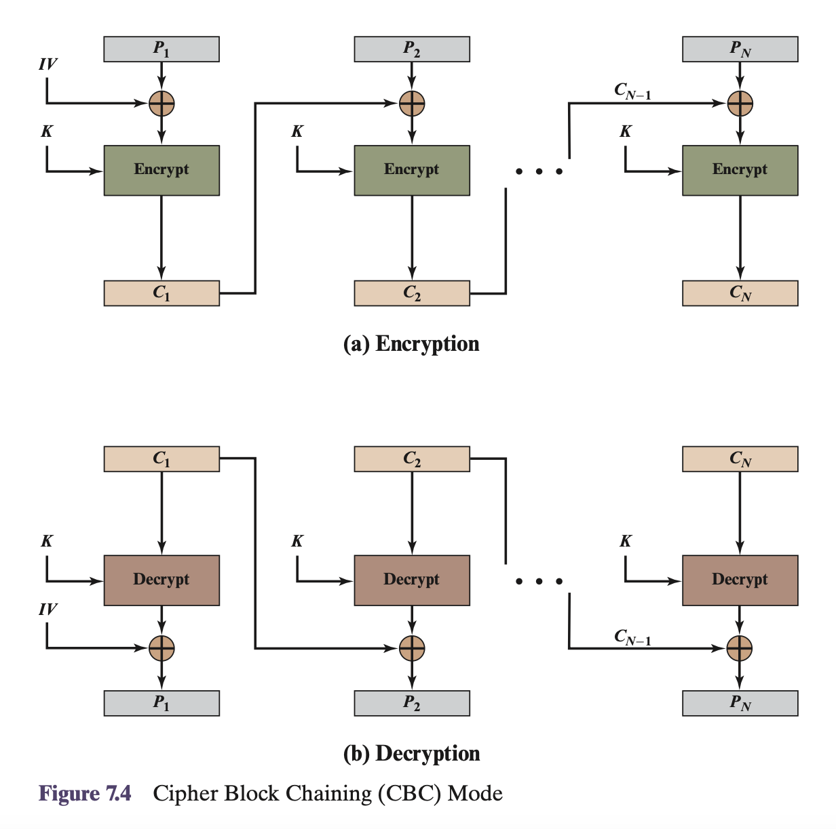

Slide 20
Cipher Feedback (CFB) Mode
The Cipher Feedback and Output Feedback allows a block cipher to be converted into stream cipher.
Ci = Pi ⊕ E(K, Ci−1)
This eliminates the need to pad a message to be an integral number of blocks. It also can operate in real time.
it assumed that the unit of transmission is s bits; a common value is s =8.
As with CBC, the units of plaintext are chained together, so that the ciphertext of any plaintext unit is a function of all the preceding plaintext
The input to the encryption function is a shift register equal in length to the block cipher of the algorithm

Slide 21
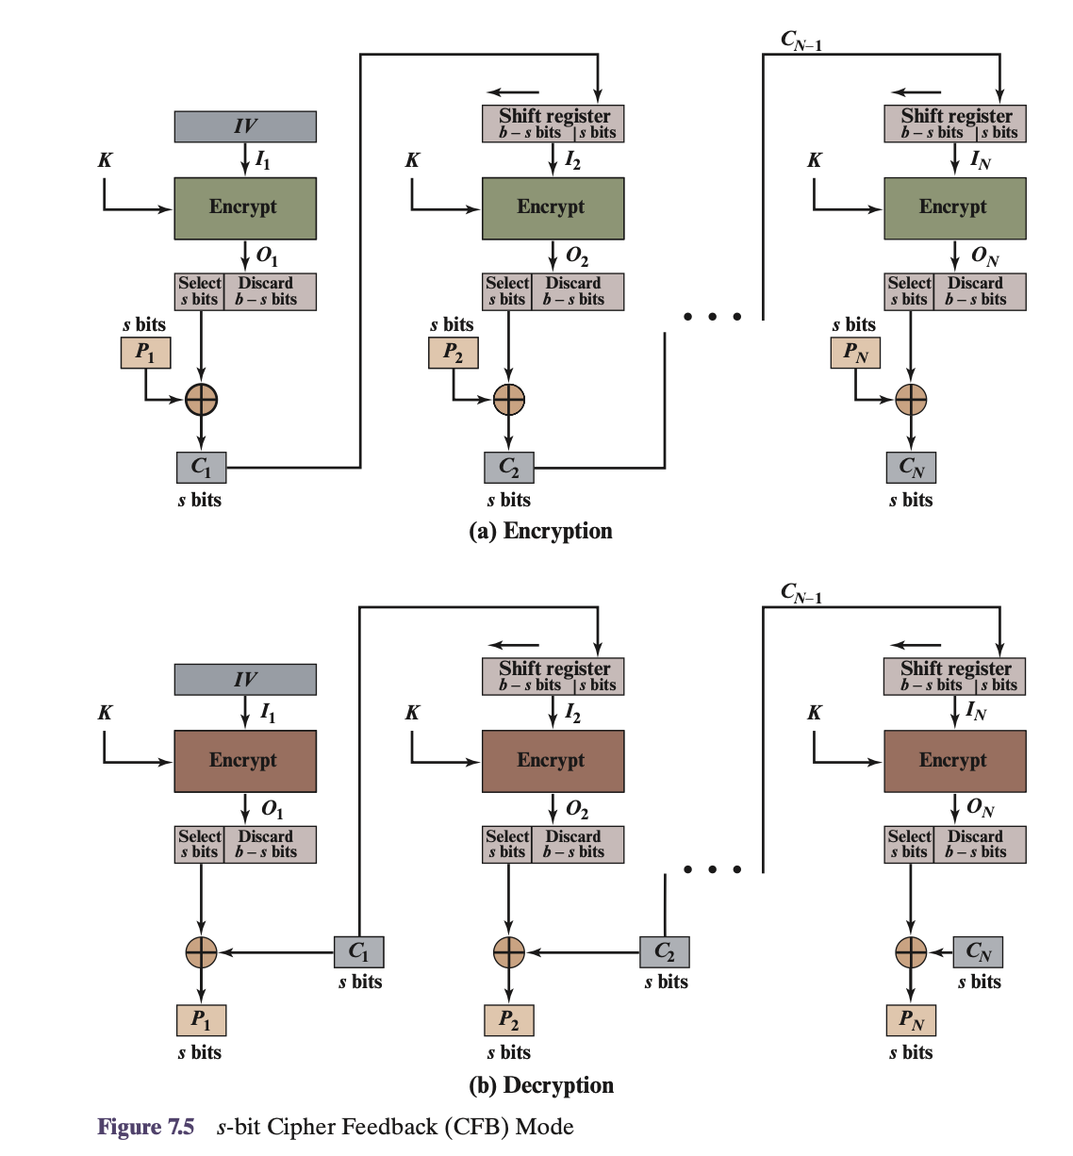

Slide 22
Output Feedback (OFB) Mode
The Output Feedback Mode is similar in structure to that of CFB
Oi = E(K, Oi−1)
Ci = Pi ⊕ Oi
The output of the encryption function that is fed back to the shift register in OFB, whereas in CFB the cipher text unit is fed back to the shift register.
One advantage of the OFB method is that bit errors in transmission do not propagate.
For example, if a bit error occurs in C1 only the recovered value of P1 is affected; subsequent plaintext units are not corrupted.
With CFB, C1 also serves as input to the shift register and therefore causes additional corruption downstream.

Slide 23
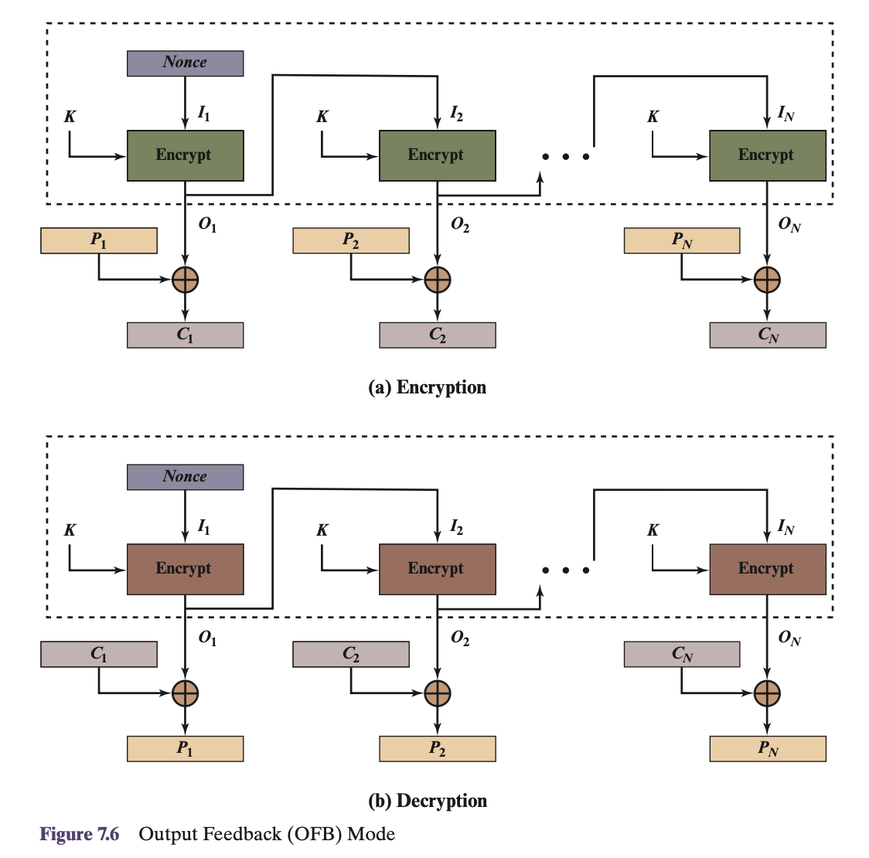

Slide 24
Counter Mode
Encrypts a counter value to generate keystream.
Ci = Pi ⊕ E(K, Counter + i)
Features
Fast
Fully parallel
No padding
Drawback
Counter reuse breaks security
Use
High-speed applications

Slide 25
