Slide 1

Computer & Network Security Concepts
Dr. Mana Khatua Assistant Professor
Dept. of CSE, IIT Guwahati
Email: manaskhatua@iitg.ac.in

Slide 2
Computer and Network Security
Computer and Network Security consists of:
“measures to deter, prevent, detect, and correct security violations that involve the transmission of information”
The NIST Computer Security Handbook
defines the term computer security as:
“the protection afforded to an automated information system in order to attain the applicable objectives of preserving the integrity, availability and confidentiality of information system resources”
(resources includes hardware, software, firmware, information/data, and telecommunications)
NIST: National Institute of Standards and Technology

Slide 3






Fundamental Security Objectives
Confidentiality
Data confidentiality
Assures that private or confidential information is not made available or disclosed to unauthorized individuals
Privacy
Assures that individuals control or influence what information related to them may be collected and stored and by whom and to whom that information may be disclosed
Integrity
Data integrity
Assures that information and programs are changed only in a specified and authorized manner
System integrity
Assures that a system performs its intended function in an unimpaired manner, free from deliberate or inadvertent unauthorized manipulation of the system
Availability
Assures that systems work promptly and service is not denied to authorized users

Slide 4
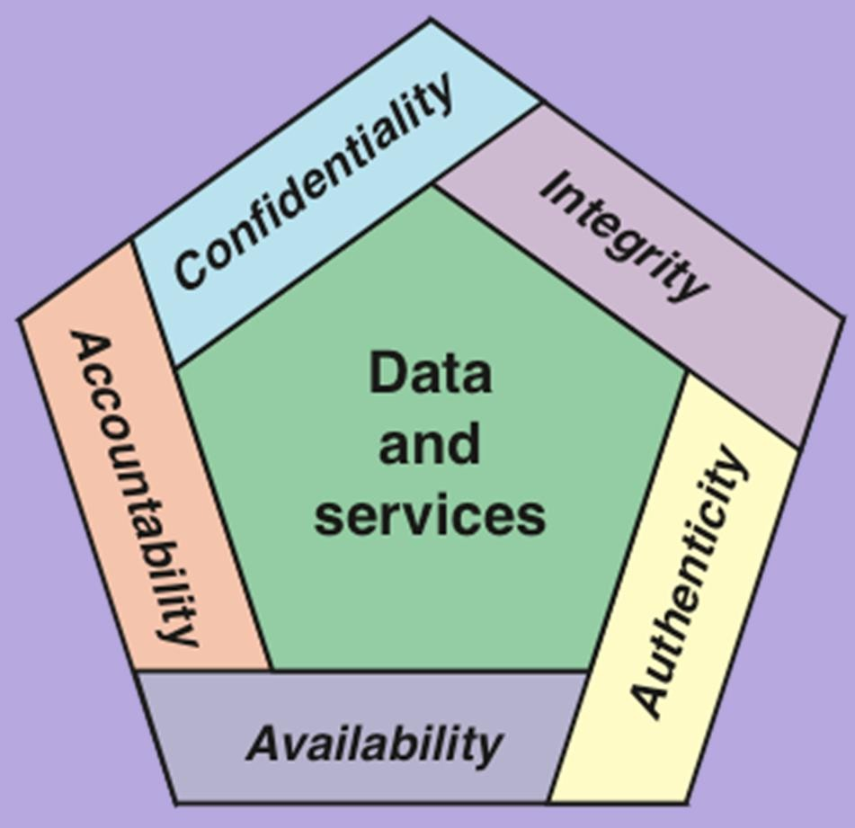
Essential Security Requirements
Authenticity
The property of being genuine and being able to be verified and trusted.
This means verifying that users are who they say they are and that each input arriving at the system came from a trusted source.
Accountability
The security goal that generates the requirement for actions of an entity to be traced uniquely to that entity.
Systems must keep records of their activities to permit later forensic analysis to trace security breaches or to aid in transaction disputes.

Slide 5
Computer Security Challenges
Security is not simple !
Potential attacks on the security features need to be considered
Security mechanisms typically involve more than a particular algorithm or protocol
Security is essentially a battle of wits between a perpetrator and the designer
It is necessary to decide where to use the various security mechanisms
Requires constant monitoring
Strong security is often viewed as an impediment to efficient and user-friendly operation

Slide 6
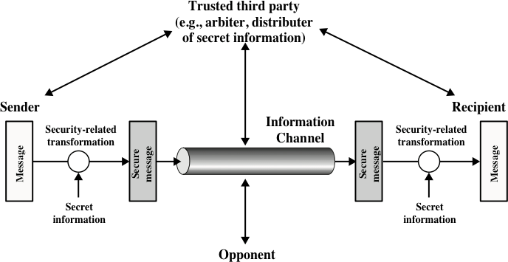
Network Security Model
All the techniques for providing security have two components:
A security-related transformation on the information to be sent
Some secret information shared by the two principals and, it is hoped, unknown to the opponent.
A message is to be transferred from one party to another across some sort of Internet service.

Slide 7
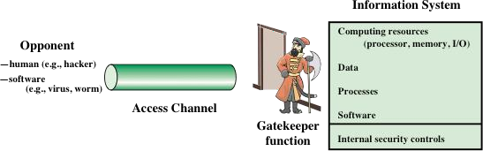
Network Access Security Model
The security mechanisms needed to cope with unwanted access fall into two broad categories:
Like gatekeeper function
(e.g. login procedure)
Variety of internal controls that monitor activity and analyze stored information
A general model which reflects a concern for protecting an information system from unwanted access.

Slide 8
OSI Security Architecture
Security attack
Any action that compromises the security of information owned by an organization
Security mechanism
A process (or a device incorporating such a process) that is designed to detect, prevent, or recover from
a security attack
Security service
A processing or communication service that enhances the security of the data processing systems and
the information transfers of an organization
Intended to counter security attacks, and they make use of one or more security mechanisms to provide the service

Slide 9
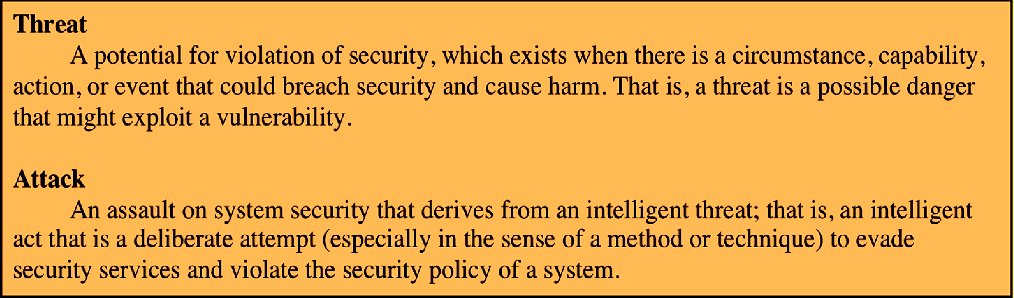
Threats and Attacks
the terms threat and attack are commonly used to mean more or less the same thing.
-- RFC 4949

Slide 10
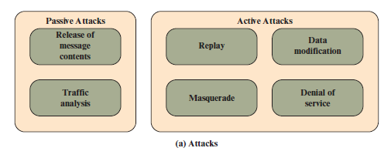

Slide 11
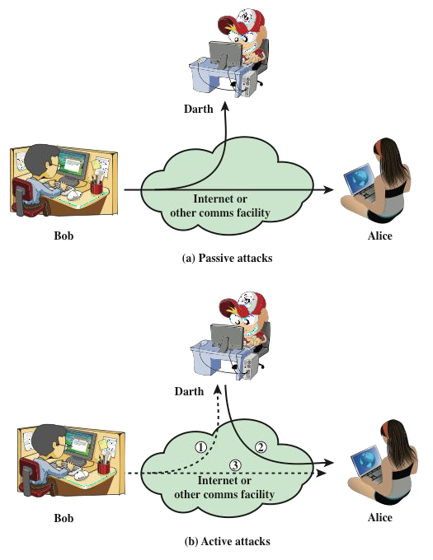
Security Attacks
A passive attack attempts to learn or make use of information from the system but does not affect system resources
Are in the nature of eavesdropping on, or monitoring
of, transmissions
Goal is to obtain information that is being transmitted
An active attack attempts to alter system resources or affect their operation
Goal is to do some modification of the data stream or the creation of a false stream

Slide 12
Types of Attacks
Types of passive attacks
The release of message contents
Release of sensitive or confidential
information.
Traffic analysis
observe the pattern of the messages
could observe the frequency and length of
messages being exchanged}}
Type of active attacks
Masquerade
Takes place when one entity pretends to be a different entity
Replay
Involves the passive capture of a data unit and its subsequent retransmission to produce an unauthorized effect
Modification of messages
Some portion of a legitimate message is altered, or messages are delayed or reordered to produce an unauthorized effect
Denial of Service (DoS)
Prevents or inhibits the normal use or management of communications facilities

Slide 13
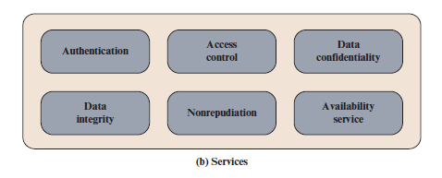

Slide 14
Security Services
AUTHENTICATION
The assurance that the communicating entity is the one that it claims to be.
Peer Entity Authentication
Used in association with a logical connection to provide confidence in the identity of the entities connected.
Data-Origin Authentication
In a connectionless transfer, provides assurance
that the source of received data is as claimed.
ACCESS CONTROL
The prevention of unauthorized use of a resource
(i.e., this service controls
who can have access to a resource,
under what conditions access can
occur, and
what those accessing the resource are allowed to do).

Slide 15
Security Services
DATA CONFIDENTIALITY
The protection of data from unauthorized disclosure.
Connection Confidentiality
The protection of all user data on a connection.
Connectionless Confidentiality
The protection of all user data in a single data block.
Selective-Field Confidentiality
The confidentiality of selected fields within the user data on a connection or in a single data block.
Traffic-Flow Confidentiality
The protection of the information that might be derived from observation of traffic flows.

Slide 16
Security Services
DATA INTEGRITY
The assurance that data received are exactly as sent by an authorized entity
(i.e., contain no modification, insertion,
deletion, or replay).
Connection Integrity with Recovery
Provides for the integrity of all user data on a connection and detects any modification, insertion, deletion, or replay of any data within an entire data sequence, with recovery attempted.
Connection Integrity without Recovery
As above, but provides only detection without
recovery.

Slide 17
Selective-Field Connection Integrity
Provides for the integrity of selected fields within the user data of a data block transferred over a connection and takes the form of determination of whether the selected fields have been modified, inserted, deleted, or replayed.
Connectionless Integrity
Provides for the integrity of a single connectionless data block and may take the form of detection of data modification. Additionally, a limited form of replay detection may be provided.
Selective-Field Connectionless Integrity
Provides for the integrity of selected fields within a single connectionless data block; takes the form of determination of whether the selected fields have been modified.

Slide 18
NONREPUDIATION
Provides protection against denial by one of the entities involved in a communication of having participated in all or part of the communication.
Nonrepudiation, Origin
Proof that the message was sent by the specified party.
Nonrepudiation, Destination
Proof that the message was received by the specified party.

Slide 19
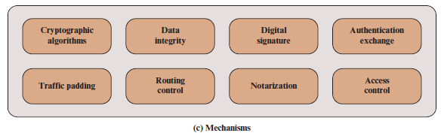

Slide 20
Security Mechanisms
SPECIFIC SECURITY MECHANISMS
May be incorporated into the appropriate protocol layer in order to provide some of the OSI security services.
Encipherment
The use of mathematical algorithms to transform data into a form that is not readily intelligible. The transformation and subsequent recovery of the data depend on an algorithm and zero or more encryption keys.
Digital Signature
Data appended to, or a cryptographic transformation of, a data unit that allows a recipient of the data unit to prove the source and integrity of the data unit and protect against forgery (e.g., by the recipient).
Access Control - A variety of mechanisms that enforce access rights to resources.

Slide 21
Data Integrity
A variety of mechanisms used to assure the integrity of a data unit or stream of data units.
Authentication Exchange
A mechanism intended to ensure the identity of an entity by means of information exchange.
Traffic Padding
The insertion of bits into gaps in a data stream to frustrate traffic analysis attempts.
Routing Control
Enables selection of particular physically secure routes for certain data and allows routing changes, especially when a breach of security is suspected.
Notarization
The use of a trusted third party to assure certain properties of a data exchange.

Slide 22
Security Mechanisms
PERVASIVE SECURITY MECHANISMS
Mechanisms that are not specific to any particular OSI security service or protocol layer.
Trusted Functionality
That which is perceived to be correct with respect to some criteria (e.g., as established by a security policy).
Security Label
The marking bound to a resource (which may be a data unit) that names or designates the security attributes of that resource.
Event Detection
Detection of security-relevant events.
Security Audit Trail
Data collected and potentially used to facilitate a security audit, which is an independent review and examination of system records and activities.
Security RecoveryDeals with requests from mechanisms, such as event handling and management functions, and takes recovery actions.

Slide 23
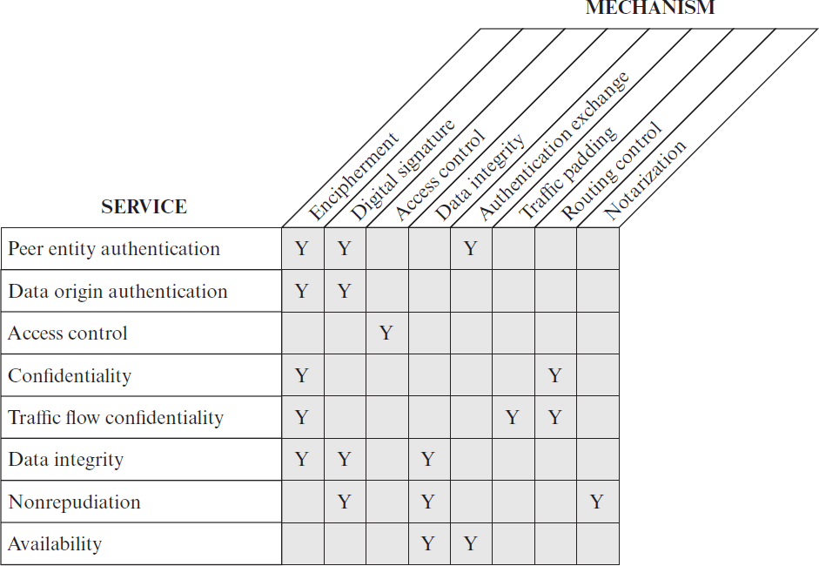
Relationship: Security Services and Mechanisms

Slide 24
Few Security related terms
Malware
Viruses, worms, Trojans, and bots are all part of a class of software called malware or malicious code (malcode).
It is code or software that is specifically designed to damage, disrupt, steal, or in general inflict some other “bad” or illegitimate action on data,
hosts, or networks.
Virus
a type of malware that propagates by inserting a copy of itself into and becoming part of another program. It spreads from one computer to another, leaving infections as it travels.
the virus may exist on a system but will not be active or able to spread until a user or operating system(OS) runs or opens the malicious host file or program.
Worms
they replicate functional copies of themselves and can cause the damage of the system.
To spread, worms either exploit a vulnerability on the target system or use some kind of social engineering to trick users into executing them.
Social Engineering
"any act that influences a person to take an action that may or may not be in their best interests.“ It is the psychological manipulation of people into performing actions .
e.g. Phishing SMS/Email: “your account is about to be suspended unless a link provided is clicked to update your card/account information”.

Slide 25
Few Security related terms
Trojan
It is a harmful piece of software that looks legitimate. Users are typically tricked into loading and executing it on
their systems.
Unlike viruses and worms, Trojans do not reproduce by infecting other files nor do they self-replicate. It creates back doors to give malicious users access to the system.
Backdoors
A back door is an undocumented way of accessing a system, bypassing the normal authentication mechanisms.
Exploit
Exploits are piece of software which are not always malicious in intent — they are sometimes used only as a way of demonstrating that a vulnerability exists.
Bots
Bots often automate tasks and provide information or services that would otherwise be conducted by a human being.
A malicious bot is self-propagating malware designed to infect a host and connect back to a central server or servers that act as a command and control (C&C) center for an entire network of compromised devices, or "botnet."

Slide 26


