Slide 1
Number Theory
Modular Arithmetic, Euclidean Algorithm, Fermat & Eulers Theorem

Slide 2
Introduction to Number Theory
Number Theory is the branch of mathematics that deals with properties of integers.
It focuses on divisibility, prime numbers, and modular arithmetic.
Ancient in origin, yet highly relevant in modern computing.
Forms the mathematical foundation of cryptography and security systems.
Used extensively in encryption, decryption, and key generation.
Helps solve problems involving remainders and congruences.
Essential for understanding algorithms such as RSA, Diffie–Hellman, and ECC.
Plays a key role in computer science, data security, and network security.

Slide 3
Divisibility & Division Algorithm
An integer a is divisible by b if b divides a exactly.
Notation: b | a
Example: 3 | 15, since 15 = 3 × 5
6 | 30 → True
4 | 18 → False
10 | 100 → True

Slide 4
Properties of Divisibility

Slide 6
The Division Algorithm

Slide 8
Applications
Used in:
• Modular arithmetic
• Cryptography
• Computer algorithms
• Error detection

Slide 9
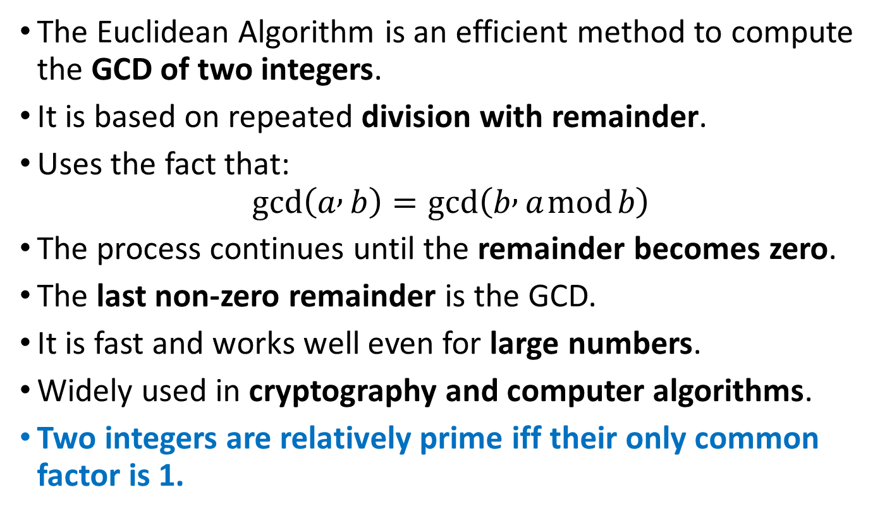
The Euclidean Algorithm
The Euclidean Algorithm is an efficient method to compute the GCD of two integers.
It is based on repeated division with remainder.
Uses the fact that:
$$gcd⁡\left(a , b\right)=gcd⁡\left(b , a mod b\right)$$
The process continues until the remainder becomes zero.
The last non-zero remainder is the GCD.
It is fast and works well even for large numbers.
Widely used in cryptography and computer algorithms.
Two integers are relatively prime iff their only common factor is 1.

Slide 10
Greatest Common Divisor (GCD)
The GCD of two integers is the largest positive integer that divides both numbers.
Denoted as gcd(a, b).
Example:
gcd(12, 18) = 6
If gcd(a, b) = 1, then a and b are coprime.
GCD plays an important role in:
Modular arithmetic
Cryptographic key generation
Simplifying fractions

Slide 11
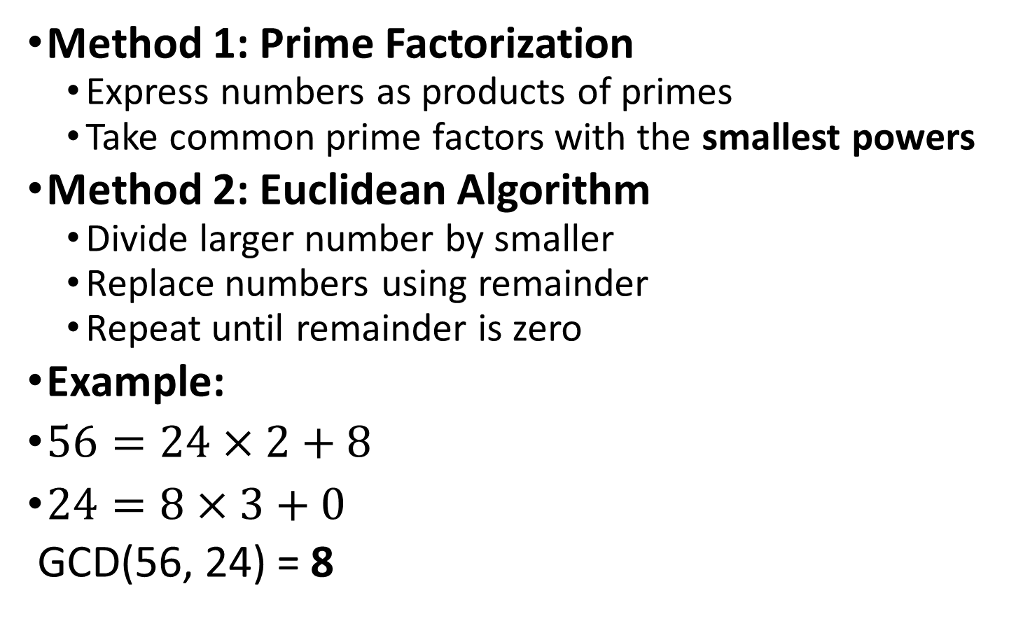
Finding the Greatest Common Divisor
Method 1: Prime Factorization
Express numbers as products of primes
Take common prime factors with the smallest powers
Method 2: Euclidean Algorithm
Divide larger number by smaller
Replace numbers using remainder
Repeat until remainder is zero
Example:
$56=24×2+8$
$24=8×3+0$
GCD(56, 24) = 8

Slide 12
formally, the positive integer c is said to be the greatest common divisor of a and b if
1. c is a divisor of a and of b.
2. any divisor of a and b is a divisor of c.
An equivalent definition is the following:
gcd(a, b) = max[k, such that k|a and k|b]
Because we require that the greatest common divisor be positive,
gcd(a, b) = gcd(a, -b) = gcd(-a, b) = gcd(-a, -b). In general, gcd(|a|, |b|) = gcd( a , b ).
gcd(60, 24) = gc
d(60, -24) = 12

Slide 13
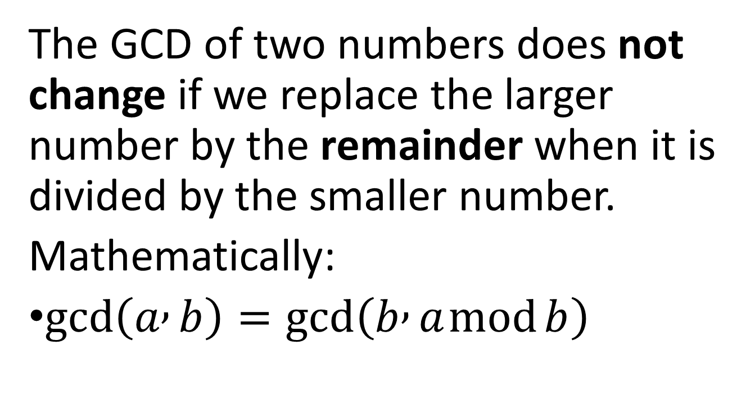
Key idea behind Euclidean Algorithm
The GCD of two numbers does not change if we replace the larger number by the remainder when it is divided by the smaller number.
Mathematically:
$gcd⁡\left(a , b\right)=gcd⁡\left(b , a mod b\right)$

Slide 16
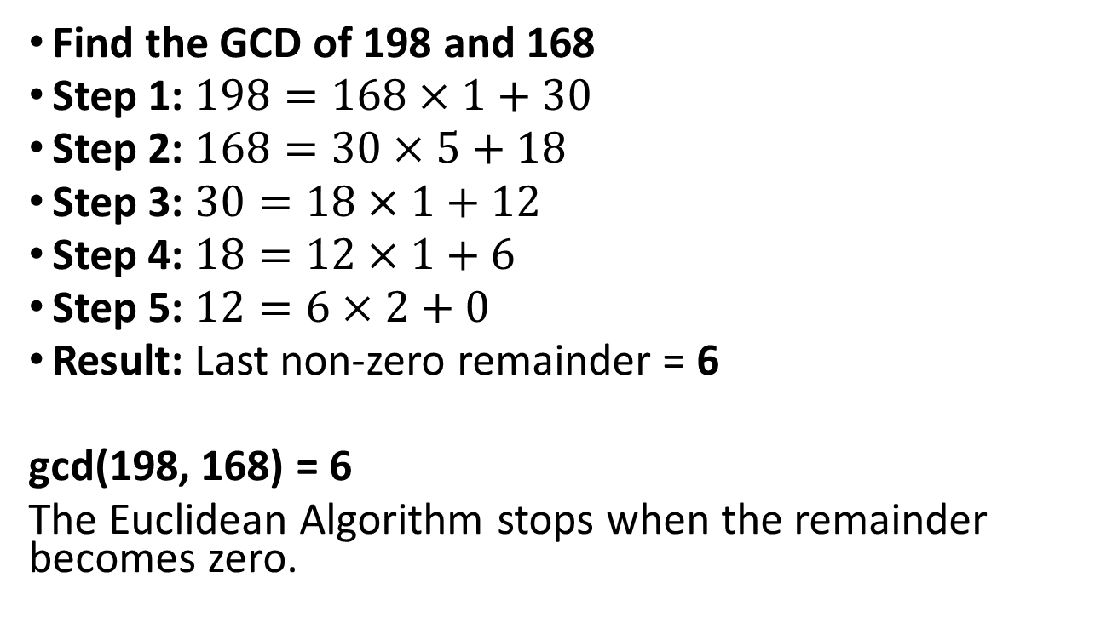
Euclidean Algorithm – Example
Find the GCD of 198 and 168
Step 1: $198=168×1+30$
Step 2: $168=30×5+18$
Step 3: $30=18×1+12$
Step 4: $18=12×1+6$
Step 5: $12=6×2+0$
Result: Last non-zero remainder = 6
gcd(198, 168) = 6
The Euclidean Algorithm stops when the remainder becomes zero.

Slide 17
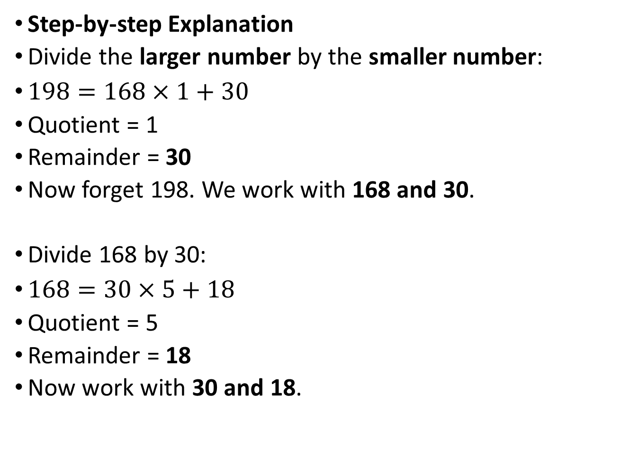
Step-by-step Explanation
Divide the larger number by the smaller number:
$198=168×1+30$
Quotient = 1
Remainder = 30
Now forget 198. We work with 168 and 30.
Divide 168 by 30:
$168=30×5+18$
Quotient = 5
Remainder = 18
Now work with 30 and 18.

Slide 18
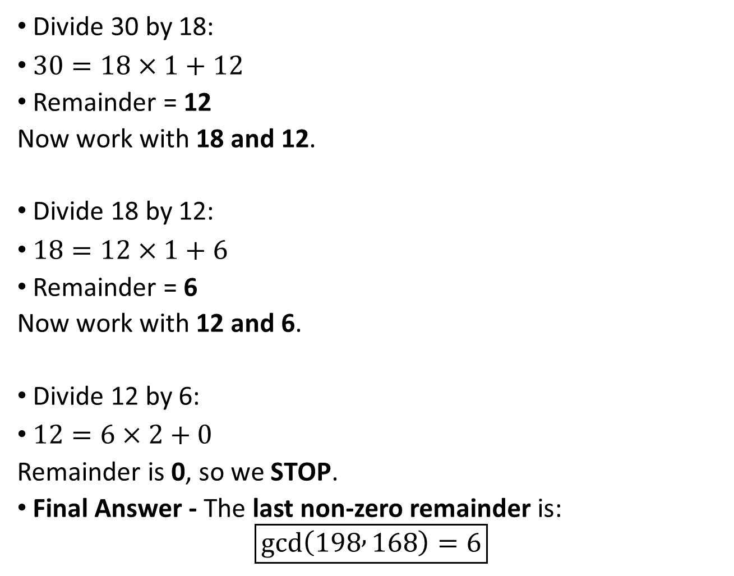
Divide 30 by 18:
$30=18×1+12$
Remainder = 12
Now work with 18 and 12.
Divide 18 by 12:
$18=12×1+6$
Remainder = 6
Now work with 12 and 6.
Divide 12 by 6:
$12=6×2+0$
Remainder is 0, so we STOP.
Final Answer - The last non-zero remainder is:
$$\boxed{gcd⁡\left(198 , 168\right)=6}$$

Slide 20
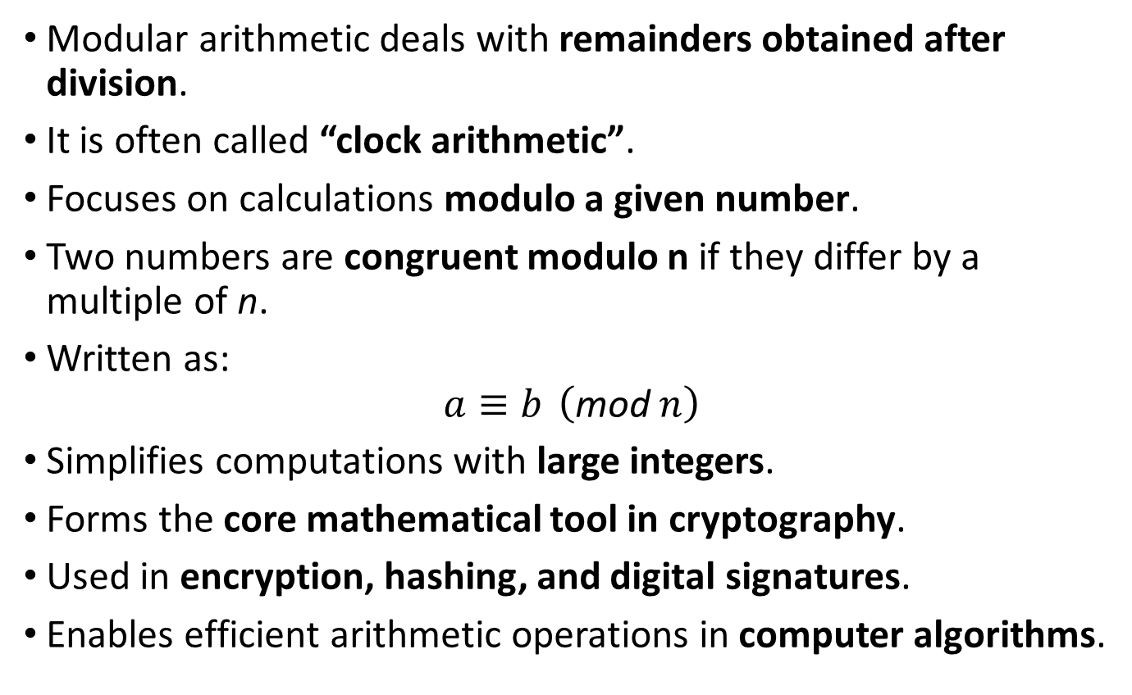
Introduction to Modular Arithmetic
Modular arithmetic deals with remainders obtained after division.
It is often called “clock arithmetic”.
Focuses on calculations modulo a given number.
Two numbers are congruent modulo n if they differ by a multiple of n.
Written as:
$$a≡b \left(\text{mod} n\right)$$
Simplifies computations with large integers.
Forms the core mathematical tool in cryptography.
Used in encryption, hashing, and digital signatures.
Enables efficient arithmetic operations in computer algorithms.

Slide 21
Modular Arithmetic
Modular Arithmetic
Let a,b,n be integer with n≠0,
a ≡ b (mod n) –> a is congruent to b mod n, if (a-b) is a multiple of n.
a ≡ b (mod n), if ‘a’ and ‘b’ differ by a multiple of n.
i.e., a = b + nk (for some positive or negative integer k)
(a-b) = nk, so a = b + nk

Slide 22
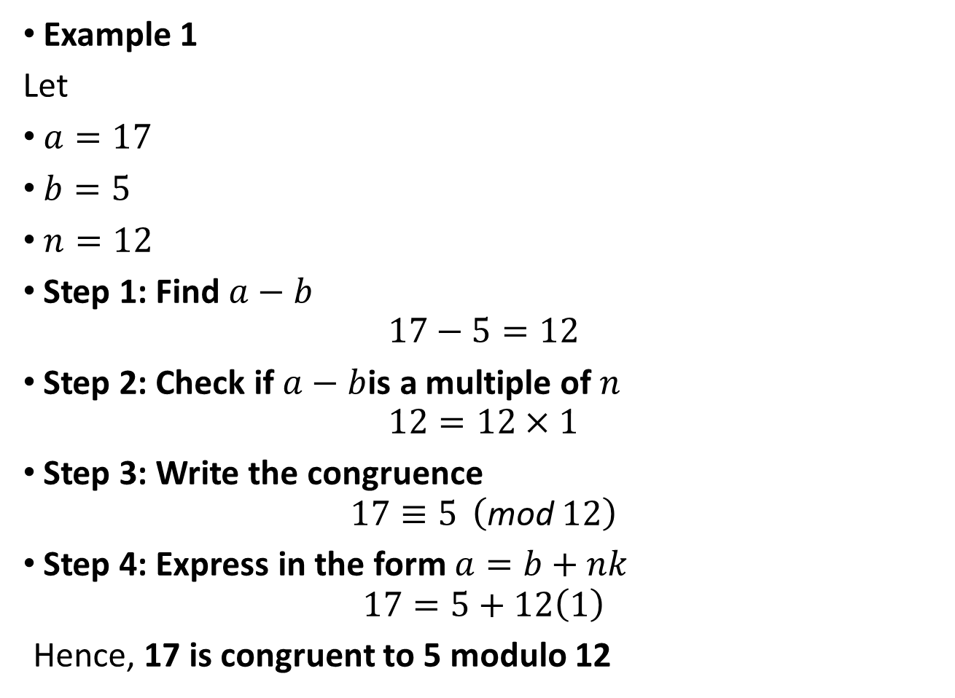
Example 1
Let
$a=17$
$b=5$
$n=12$
Step 1: Find $a−b$
$$17−5=12$$
Step 2: Check if $a−b$is a multiple of $n$
$$12=12×1$$
Step 3: Write the congruence
$$17≡5 \left(\text{mod} 12\right)$$
Step 4: Express in the form $a=b+nk$
$$17=5+12\left(1\right)$$
Hence, 17 is congruent to 5 modulo 12

Slide 24
Modular Arithmetic
Properties of congruences:

Slide 25
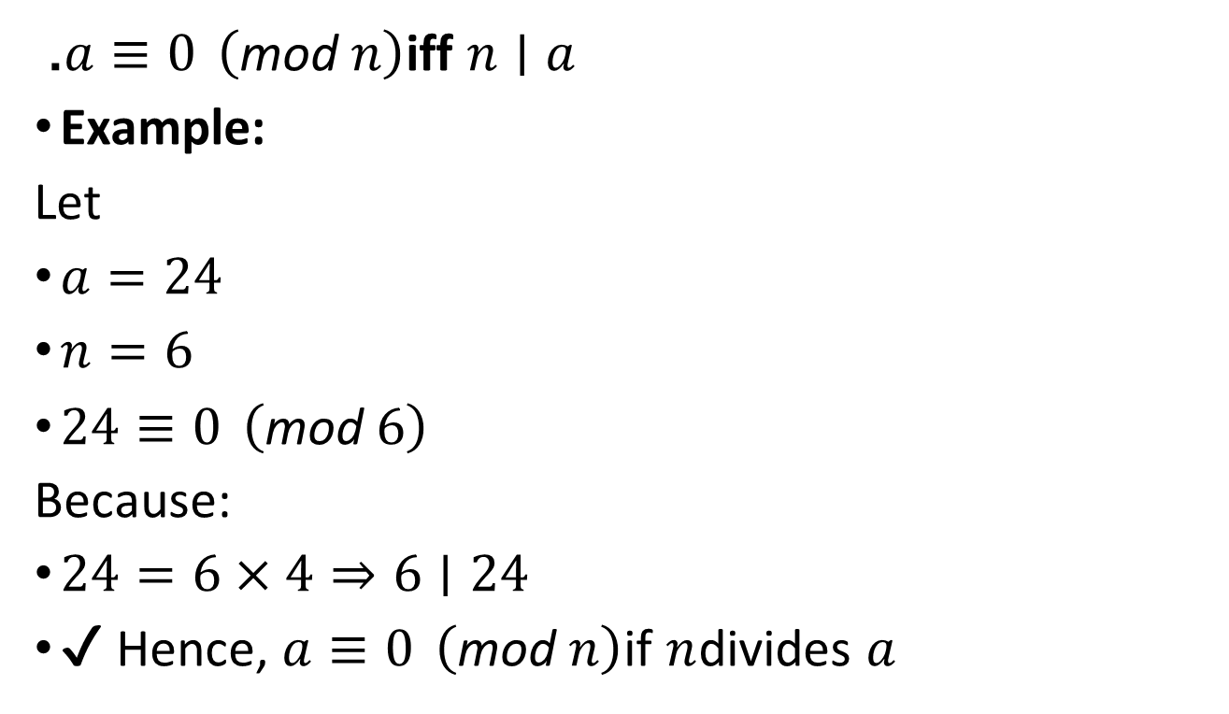
. $a≡0 \left(\text{mod} n\right)$iff $n∣a$
Example:
Let
$a=24$
$n=6$
$24≡0 \left(\text{mod} 6\right)$
Because:
$24=6×4⇒6∣24$
✔ Hence, $a≡0 \left(\text{mod} n\right)$if $n$divides $a$

Slide 26
Modular Arithmetic
Modular Arithmetic Operations:
[(a mod n) + (b mod n)] mod n = (a + b) mod n
[(a mod n) - (b mod n)] mod n = (a - b) mod n
[(a mod n) x (b mod n)] mod n = (a x b) mod n
Other Properties:
Let a,b,c,d,n be integers with n≠0 and suppose a ≡ b (mod n), c ≡ d (mod n) then,
a + c ≡ b + d (mod n), a - c ≡ b - d (mod n), ac ≡ bd (mod n)

Slide 27
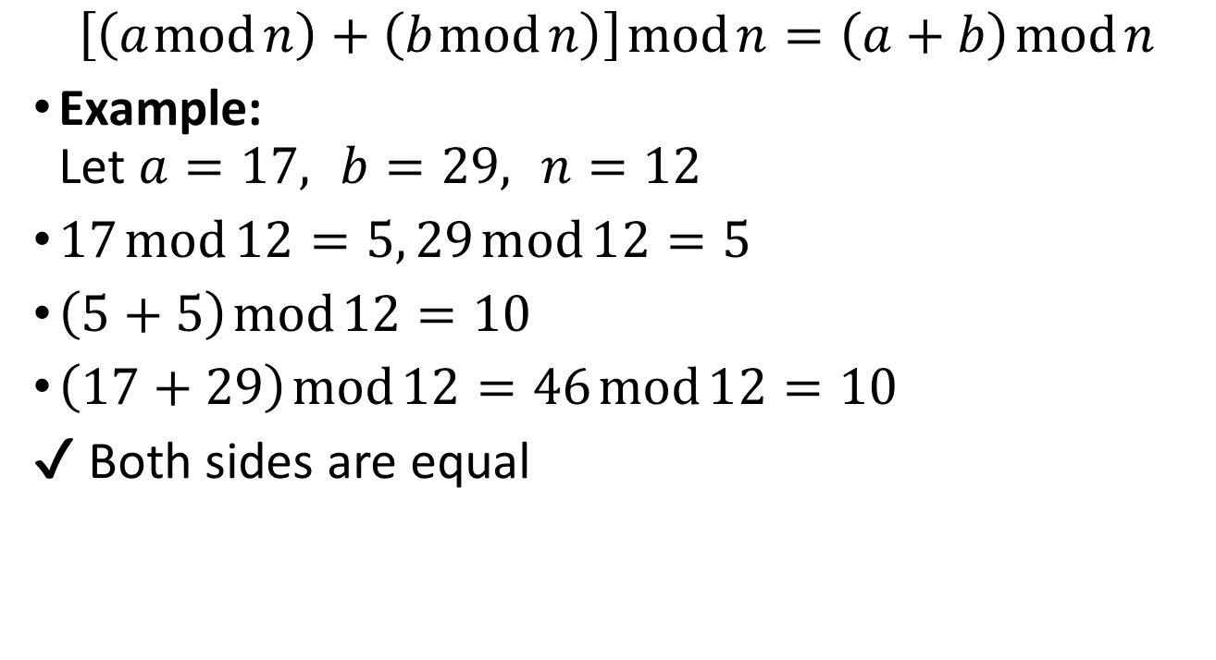
1. Addition
$$\left[\left(a mod n\right)+\left(b mod n\right)\right] mod n=\left(a+b\right) mod n$$
Example: Let $a=17, b=29, n=12$
$17 mod 12=5, 29 mod 12=5$
$\left(5+5\right) mod 12=10$
$\left(17+29\right) mod 12=46 mod 12=10$
✔ Both sides are equal

Slide 28
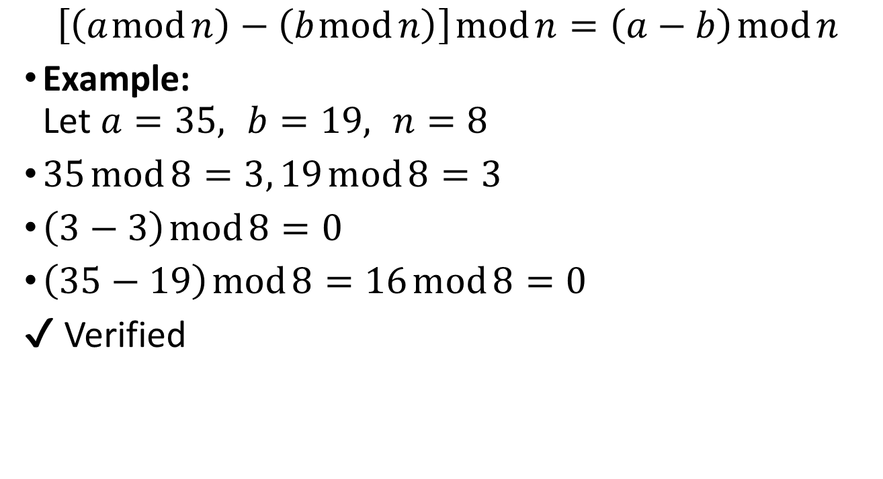
Subtraction
$$\left[\left(a mod n\right)−\left(b mod n\right)\right] mod n=\left(a−b\right) mod n$$
Example: Let $a=35, b=19, n=8$
$35 mod 8=3, 19 mod 8=3$
$\left(3−3\right) mod 8=0$
$\left(35−19\right) mod 8=16 mod 8=0$
✔ Verified

Slide 29
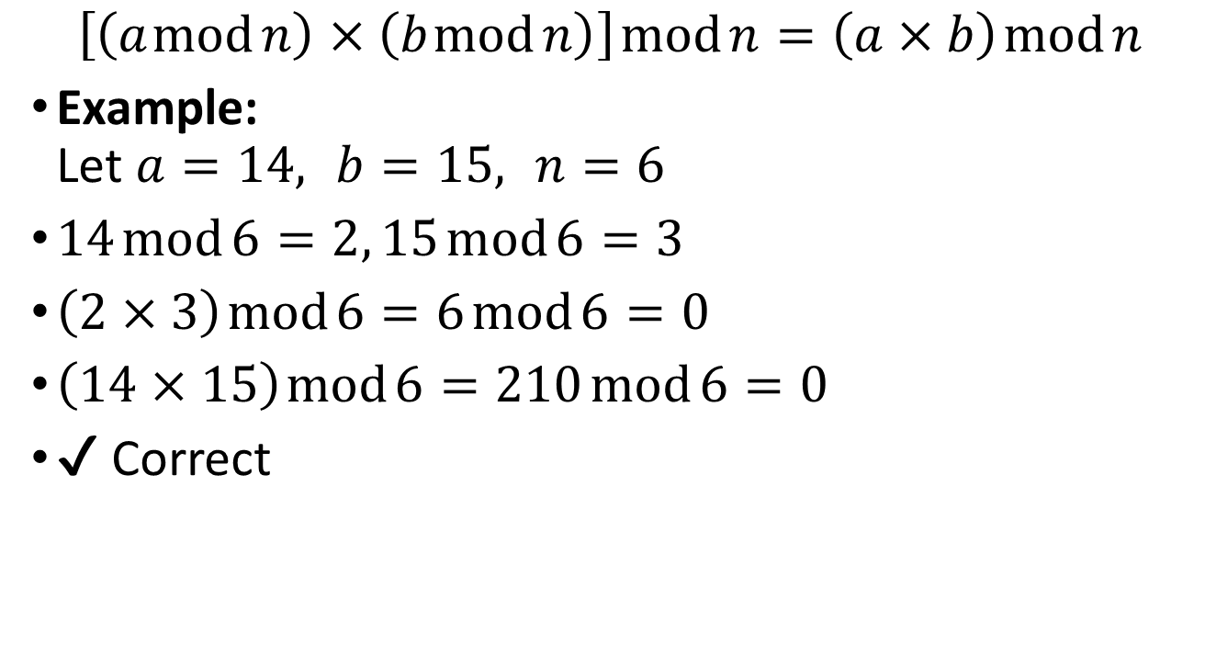
Multiplication
$$\left[\left(a mod n\right)×\left(b mod n\right)\right] mod n=\left(a×b\right) mod n$$
Example: Let $a=14, b=15, n=6$
$14 mod 6=2, 15 mod 6=3$
$\left(2×3\right) mod 6=6 mod 6=0$
$\left(14×15\right) mod 6=210 mod 6=0$
✔ Correct

Slide 30
Modular Arithmetic
Modular Arithmetic Properties:
Set of residues (or) residue class
Z_{n} as the set of nonnegative integers less than n:
Z_{n} = {0, 1, ...., (n - 1)}
each integer in Z_{n} represents a residue class
The residue classes (mod n) can be labeled as [0], [1], [2], …, [n - 1], where, [r] = {a: a is an integer, a ≡ r (mod n)}

Slide 31
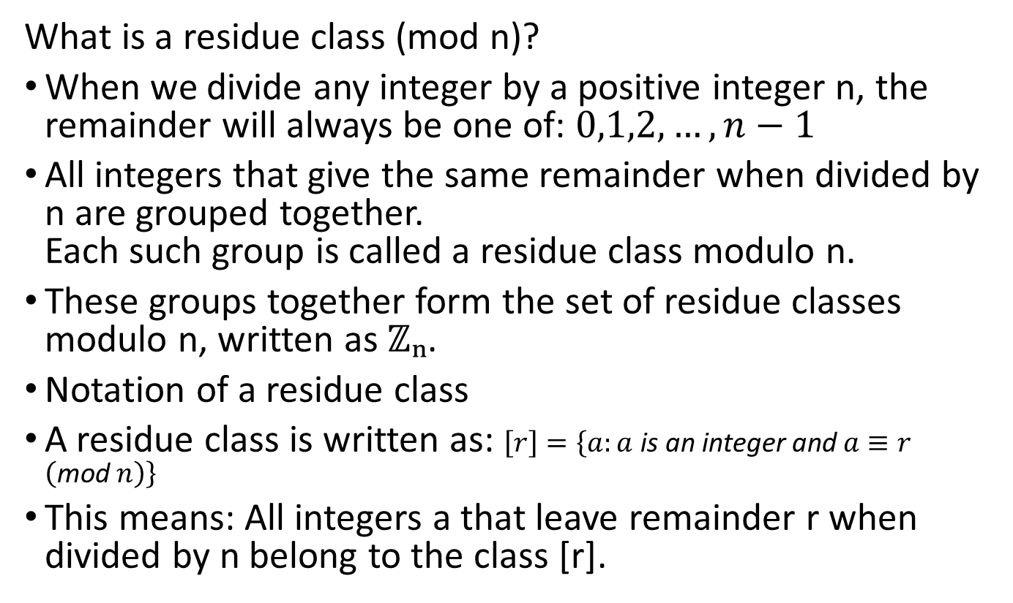
Residue Classes (Modulo n)
What is a residue class (mod n)?
When we divide any integer by a positive integer n, the remainder will always be one of: $0,1,2,…,n−1$
All integers that give the same remainder when divided by n are grouped together. Each such group is called a residue class modulo n.
These groups together form the set of residue classes modulo n, written as ℤₙ.
Notation of a residue class
A residue class is written as: $\left[r\right]=\left\{a:a \text{is} \text{an} \text{integer} \text{and} a≡r \left(\text{mod} n\right)\right\}$
This means: All integers a that leave remainder r when divided by n belong to the class [r].

Slide 32
Smallest non-negative representative
For each residue class, the smallest non-negative integer is chosen as its representative.
Example:
Class [−5] (mod 4) → smallest non-negative integer is 3
So, −5 ≡ 3 (mod 4)
This process is called reducing k modulo n.

Slide 33
Properties of ℤₙ
When we perform modular arithmetic in ℤₙ:
Addition and multiplication are closed
There is an additive identity (0)
Every element has an additive inverse
Multiplication has an identity element (1)
Hence, ℤₙ forms a commutative ring with identity.

Slide 34
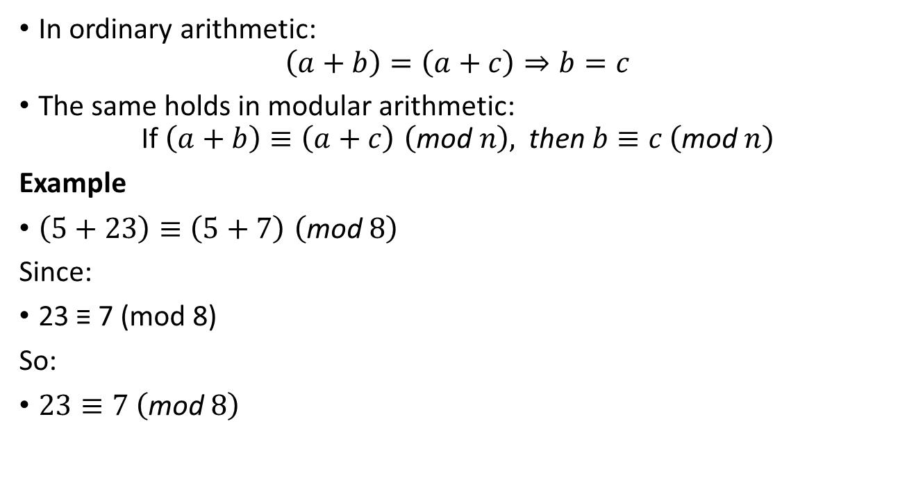
Special property of modular arithmetic
In ordinary arithmetic:
$$\left(a+b\right)=\left(a+c\right)⇒b=c$$
The same holds in modular arithmetic:
$$\text{If} \left(a+b\right)≡\left(a+c\right) \left(\text{mod} n\right), \text{then} b≡c \left(\text{mod} n\right)$$
Example
$\left(5+23\right)≡\left(5+7\right) \left(\text{mod} 8\right)$
Since:
23 ≡ 7 (mod 8)
So:
$23≡7 \left(\text{mod} 8\right)$

Slide 35
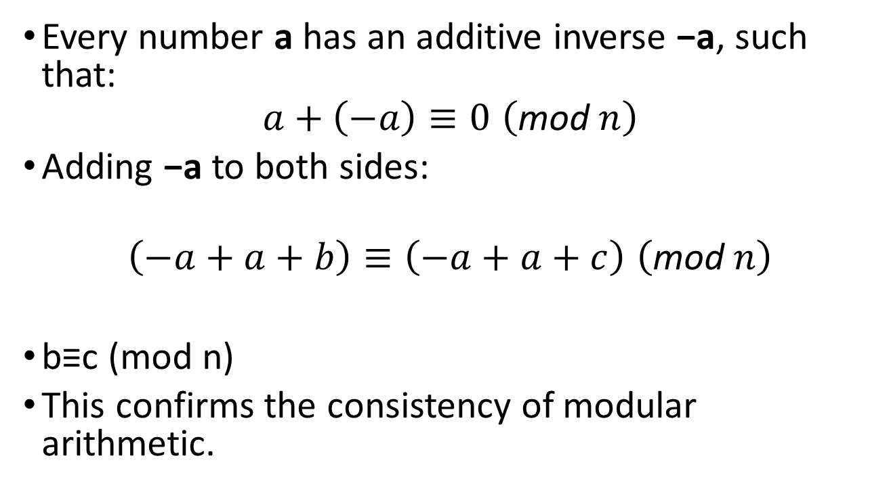
Additive inverse explanation
Every number a has an additive inverse −a, such that:
$$a+\left(−a\right)≡0 \left(\text{mod} n\right)$$
Adding −a to both sides:
$$\left(−a+a+b\right)≡\left(−a+a+c\right) \left(\text{mod} n\right)$$
b≡c (mod n)
This confirms the consistency of modular arithmetic.

Slide 36
Modular Arithmetic
Modular Arithmetic
Properties of Modular Arithmetic for Integers in Z_{n}:

Slide 37
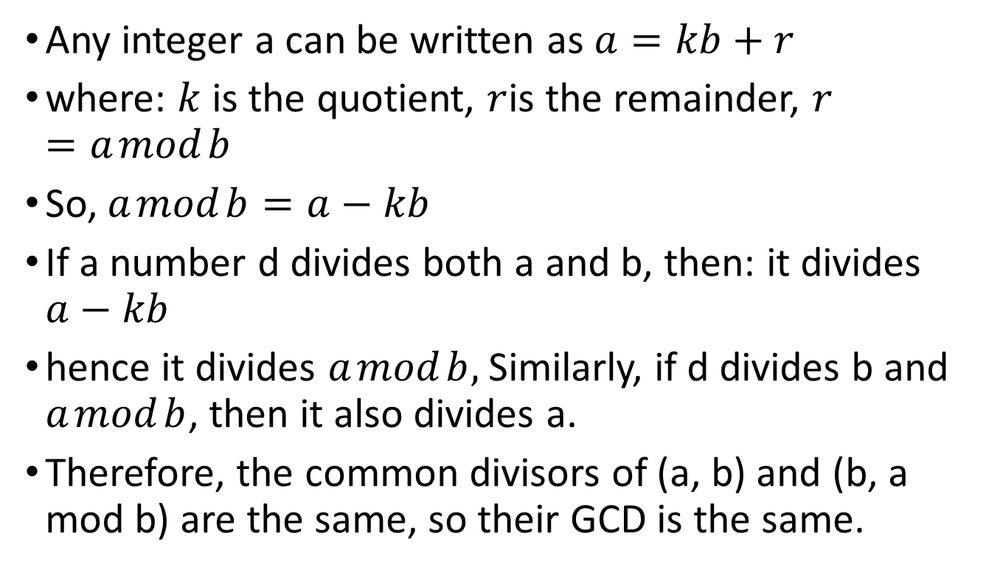
How it works?
Any integer a can be written as $a=kb+r$
where: $k$is the quotient, $r$is the remainder, $r=a mod b$
So, $a mod b=a−kb$
If a number d divides both a and b, then: it divides $a−kb$
hence it divides $a mod b,$Similarly, if d divides b and $a mod b$, then it also divides a.
Therefore, the common divisors of (a, b) and (b, a mod b) are the same, so their GCD is the same.

Slide 38
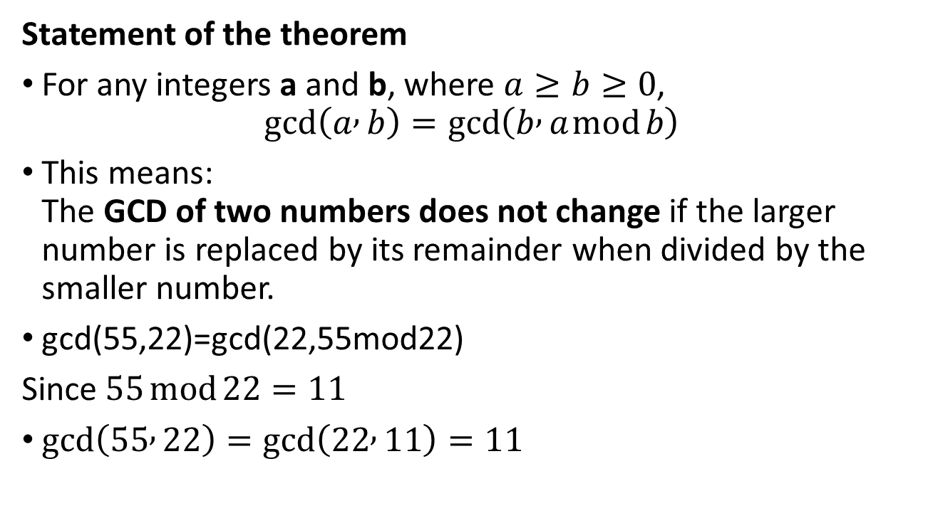
Euclidean Algorithm - Revisited
Statement of the theorem
For any integers a and b, where $a≥b≥0$,
$$\gcd\left(a , b\right)=\gcd\left(b , a mod b\right)$$
This means: The GCD of two numbers does not change if the larger number is replaced by its remainder when divided by the smaller number.
gcd(55,22)=gcd(22,55mod22)
Since$55 mod 22=11$
$gcd⁡\left(55 , 22\right)=gcd⁡\left(22 , 11\right)=11$

Slide 39
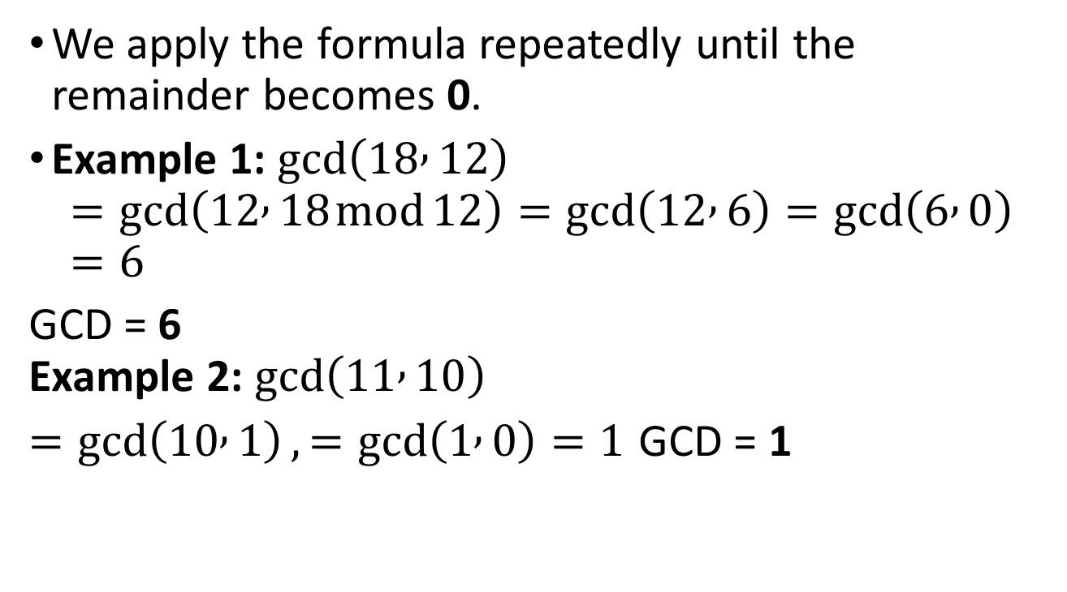
Examples
We apply the formula repeatedly until the remainder becomes 0.
Example 1: $\gcd\left(18 , 12\right)$
$$=\gcd\left(12 , 18 mod 12\right)=\gcd\left(12 , 6\right)=gcd⁡\left(6 , 0\right)=6$$
GCD = 6 Example 2: $gcd⁡\left(11 , 10\right)$
$=\gcd\left(10 , 1\right), =\gcd\left(1 , 0\right)=1$ GCD = 1

Slide 40
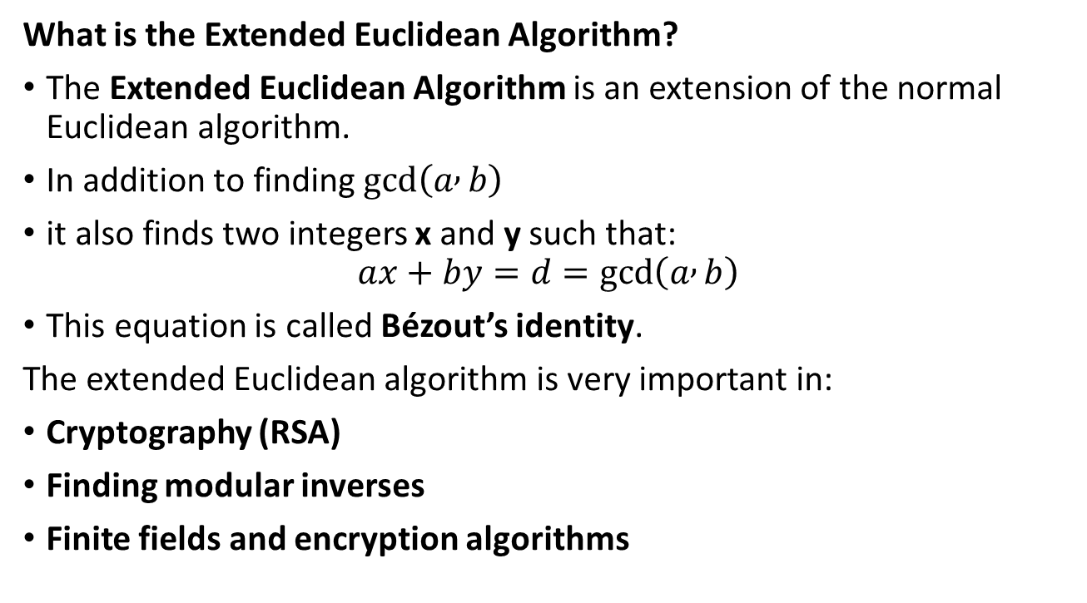
Extended Euclidean Algorithm
What is the Extended Euclidean Algorithm?
The Extended Euclidean Algorithm is an extension of the normal Euclidean algorithm.
In addition to finding $gcd⁡\left(a , b\right)$
it also finds two integers x and y such that:
$$ax+by=d=gcd⁡\left(a , b\right)$$
This equation is called Bézout’s identity.
The extended Euclidean algorithm is very important in:
Cryptography (RSA)
Finding modular inverses
Finite fields and encryption algorithms

Slide 41
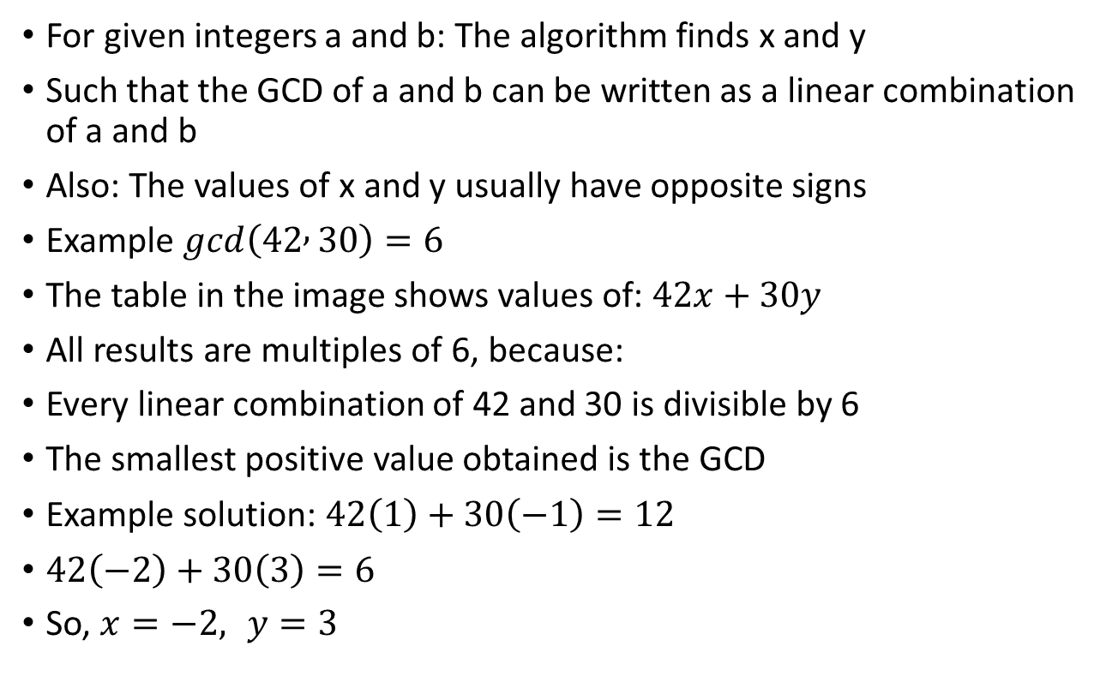
Key idea
For given integers a and b: The algorithm finds x and y
Such that the GCD of a and b can be written as a linear combination of a and b
Also: The values of x and y usually have opposite signs
Example $gcd⁡\left(42 , 30\right)=6$
The table in the image shows values of: $42x+30y$
All results are multiples of 6, because:
Every linear combination of 42 and 30 is divisible by 6
The smallest positive value obtained is the GCD
Example solution: $42\left(1\right)+30\left(−1\right)=12$
$42\left(−2\right)+30\left(3\right)=6$
So, $x=−2, y=3$

Slide 42
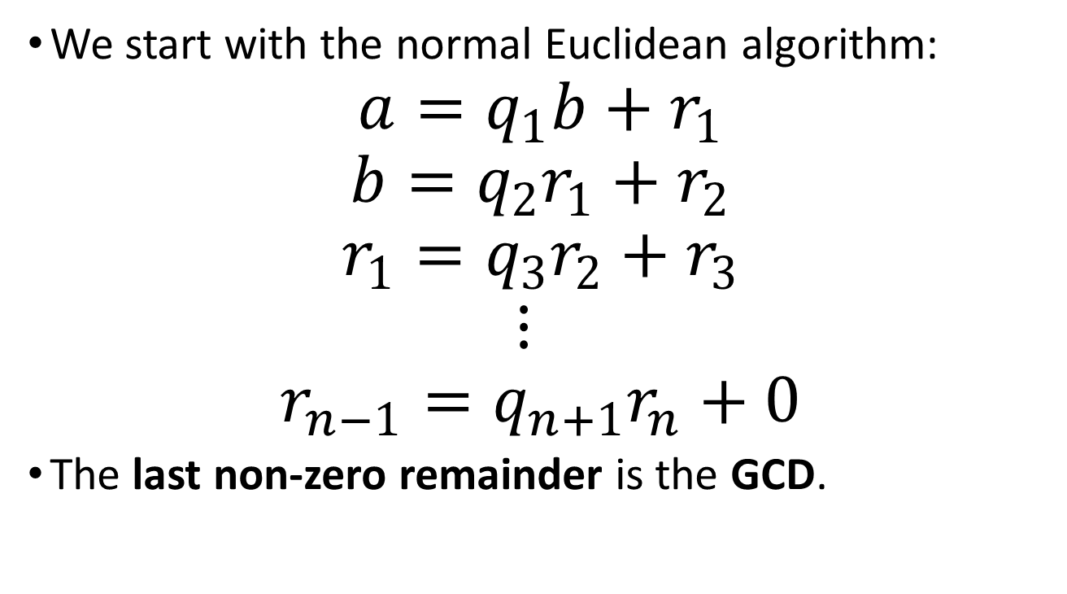
How the algorithm works (step-by-step idea)
We start with the normal Euclidean algorithm:
$$a=q_{1}b+r_{1}$$
$$b=q_{2}r_{1}+r_{2}$$
$$r_{1}=q_{3}r_{2}+r_{3}$$
$$⋮$$
$$r_{n−1}=q_{n+1}r_{n}+0$$
The last non-zero remainder is the GCD.

Slide 43
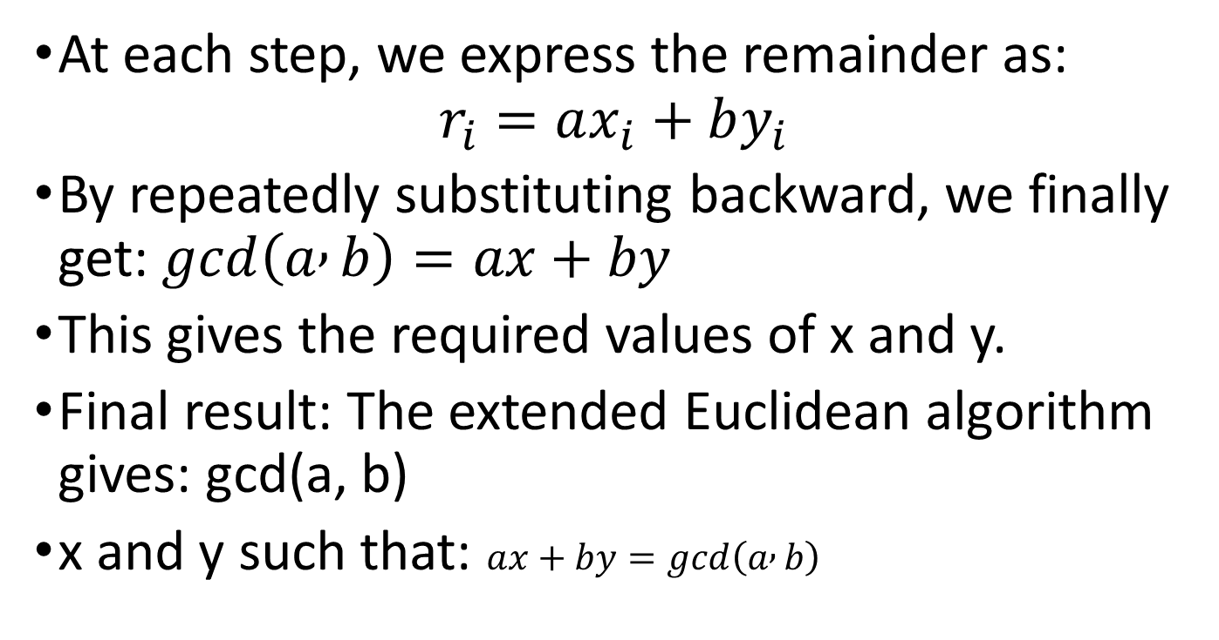
Extension idea
At each step, we express the remainder as:
$$r_{i}=ax_{i}+by_{i}$$
By repeatedly substituting backward, we finally get: $gcd⁡\left(a , b\right)=ax+by$
This gives the required values of x and y.
Final result: The extended Euclidean algorithm gives: gcd(a, b)
x and y such that: $ax+by=gcd⁡\left(a , b\right)$

Slide 44
Prime Numbers
An integer p > 1 is called a prime number if its only divisors are ±1 and ±p.
Examples of prime numbers: 2, 3, 5, 7, 11, 13, 17, …
Numbers that are not prime are called composite numbers.
A composite number is the product of two or more prime numbers.
Example: 6 = 2 × 3 12 = 2 × 2 × 3
Importance of prime numbers
Prime numbers are the building blocks of number theory.
Many cryptographic techniques depend on the properties of primes.
Primes appear frequently in number theory and encryption algorithms.

Slide 45
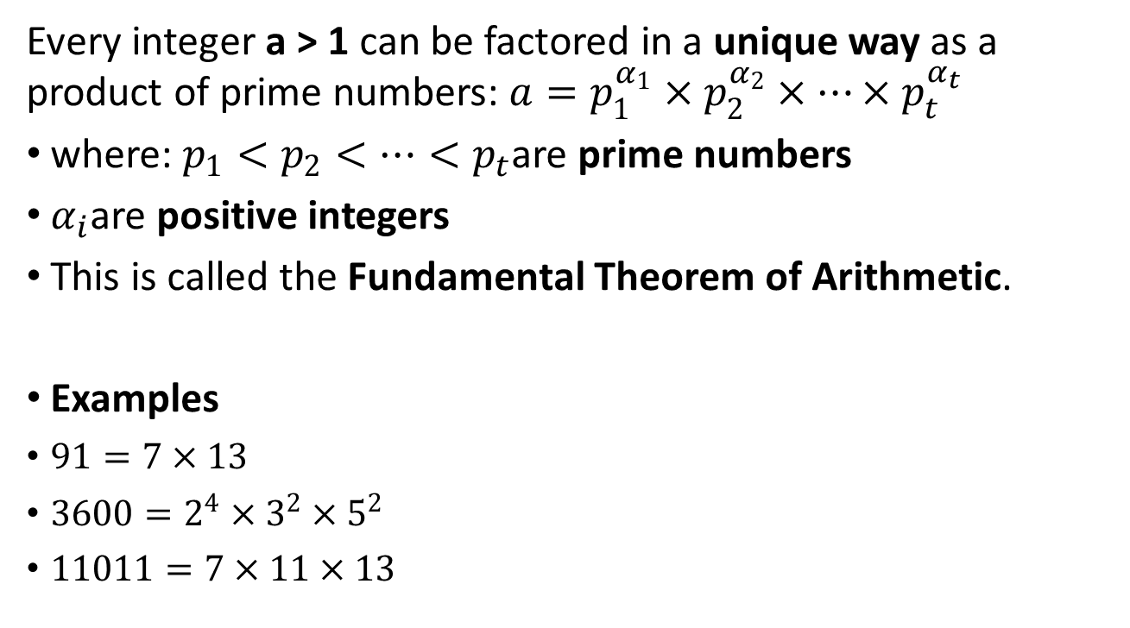
Unique factorization of integers
Every integer a > 1 can be factored in a unique way as a product of prime numbers: $a=p_{1}^{α_{1}}×p_{2}^{α_{2}}×⋯×p_{t}^{α_{t}}$
where: $p_{1}<p_{2}<⋯<p_{t}$are prime numbers
$α_{i}$are positive integers
This is called the Fundamental Theorem of Arithmetic.
Examples
$91=7×13$
$3600=2^{4}×3^{2}×5^{2}$
$11011=7×11×13$

Slide 46
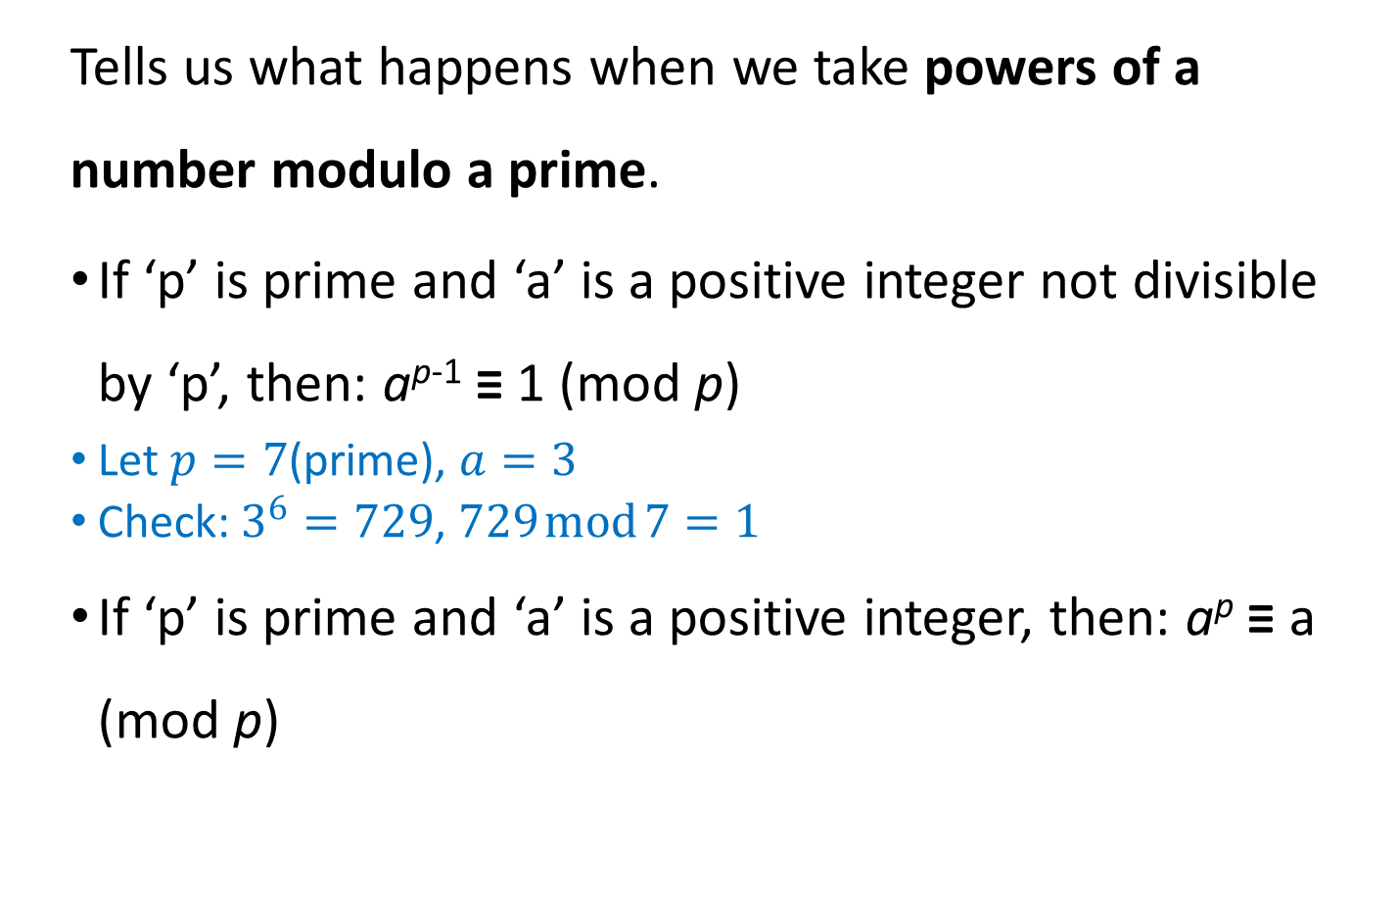
Fermat’s Theorem
Tells us what happens when we take powers of a number modulo a prime.
If ‘p’ is prime and ‘a’ is a positive integer not divisible by ‘p’, then: a^{p-1} ≡ 1 (mod p)
Let $p=7$(prime), $a=3$
Check: $3^{6}=729$, $729 mod 7=1$
If ‘p’ is prime and ‘a’ is a positive integer, then: a^{p} ≡ a (mod p)

Slide 47
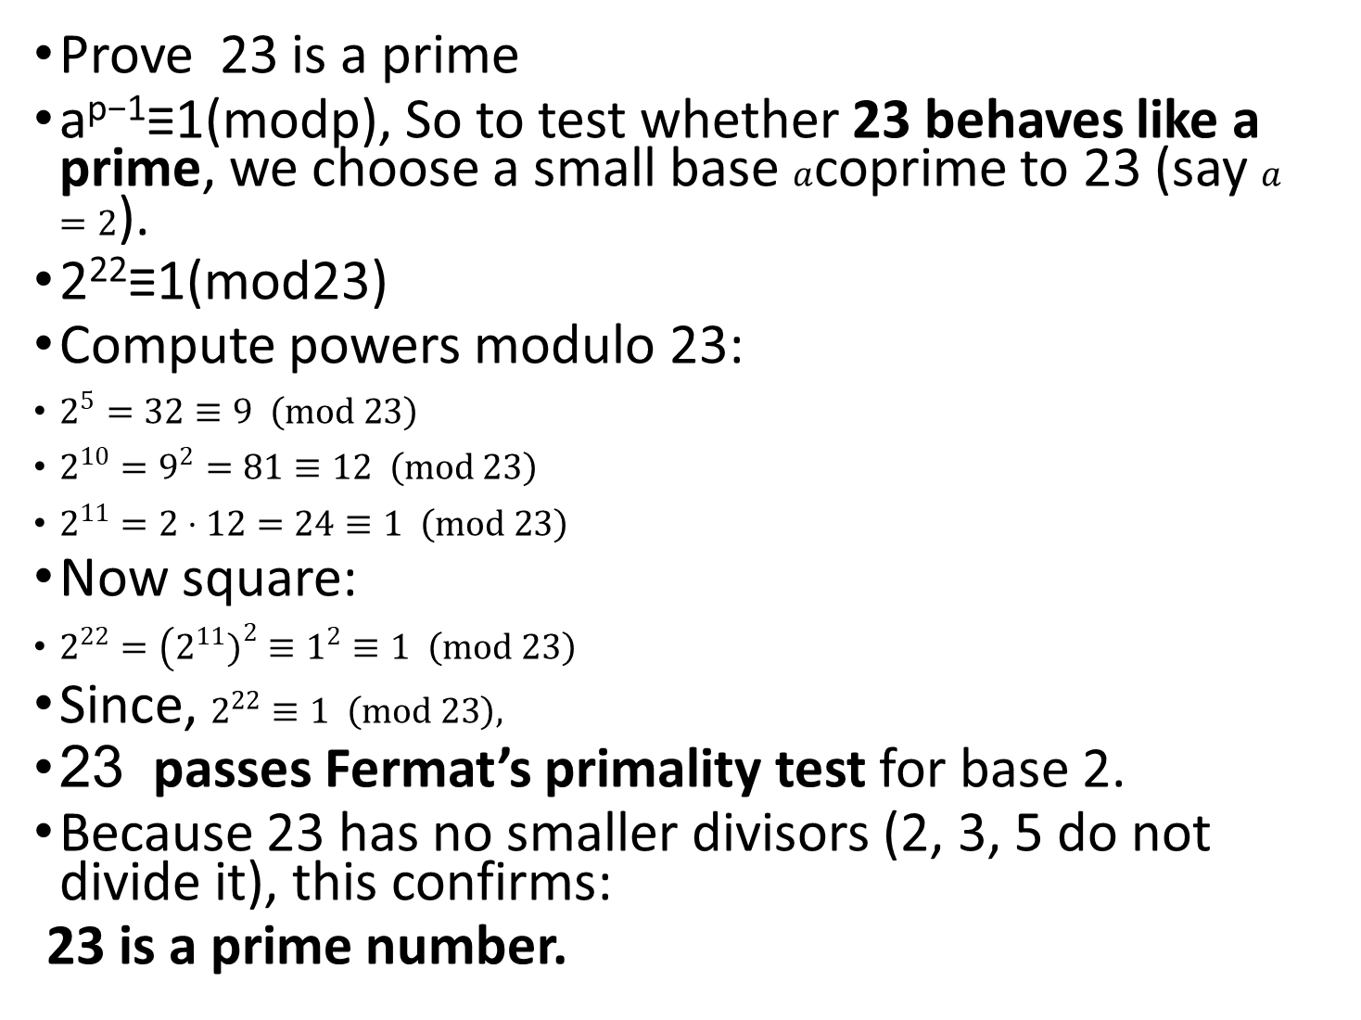
Prove 23 is a prime
a^{p−1}≡1(modp), So to test whether 23 behaves like a prime, we choose a small base $a$coprime to 23 (say $a=2$).
2²²≡1(mod23)
Compute powers modulo 23:
$2^{5}=32≡9 \left(mod 23\right)$
$2^{10}=9^{2}=81≡12 \left(mod 23\right)$
$2^{11}=2⋅12=24≡1 \left(mod 23\right)$
Now square:
$2^{22}=\left(2^{11}{\left.)\right.}^{2}≡1^{2}≡1 \left(mod 23\right)\right.$
Since, $2^{22}≡1 \left(mod 23\right),$
23 passes Fermat’s primality test for base 2.
Because 23 has no smaller divisors (2, 3, 5 do not divide it), this confirms:
23 is a prime number.

Slide 48
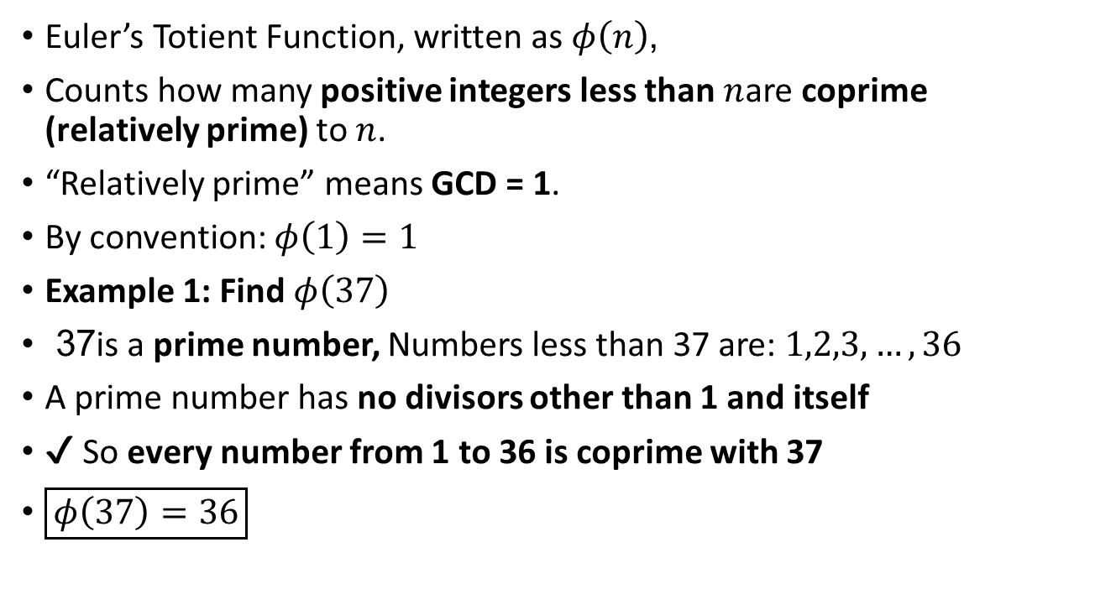
Euler’s Totient Function
Euler’s Totient Function, written as $φ\left(n\right)$,
Counts how many positive integers less than $n$are coprime (relatively prime) to $n$.
“Relatively prime” means GCD = 1.
By convention: $φ\left(1\right)=1$
Example 1: Find $φ\left(37\right)$
37 is a prime number, Numbers less than 37 are: $1,2,3,…,36$
A prime number has no divisors other than 1 and itself
✔ So every number from 1 to 36 is coprime with 37
$\boxed{φ\left(37\right)=36}$

Slide 49
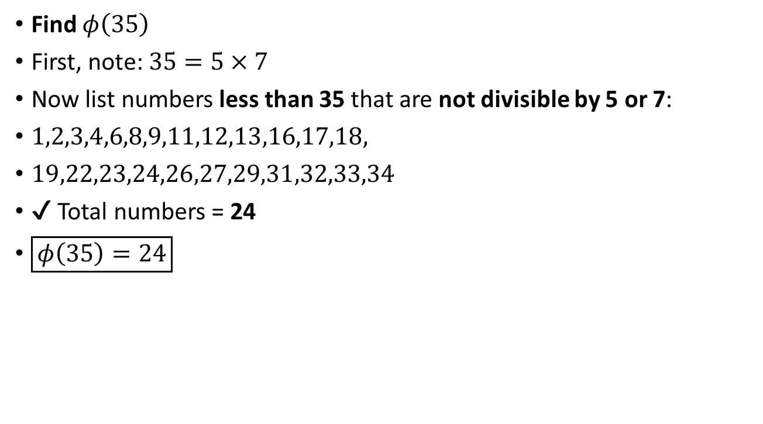
Euler’s Totient Function
Find $φ\left(35\right)$
First, note: $35=5×7$
Now list numbers less than 35 that are not divisible by 5 or 7:
$1,2,3,4,6,8,9,11,12,13,16,17,18,$
$19,22,23,24,26,27,29,31,32,33,34$
✔ Total numbers = 24
$\boxed{φ\left(35\right)=24}$

Slide 50
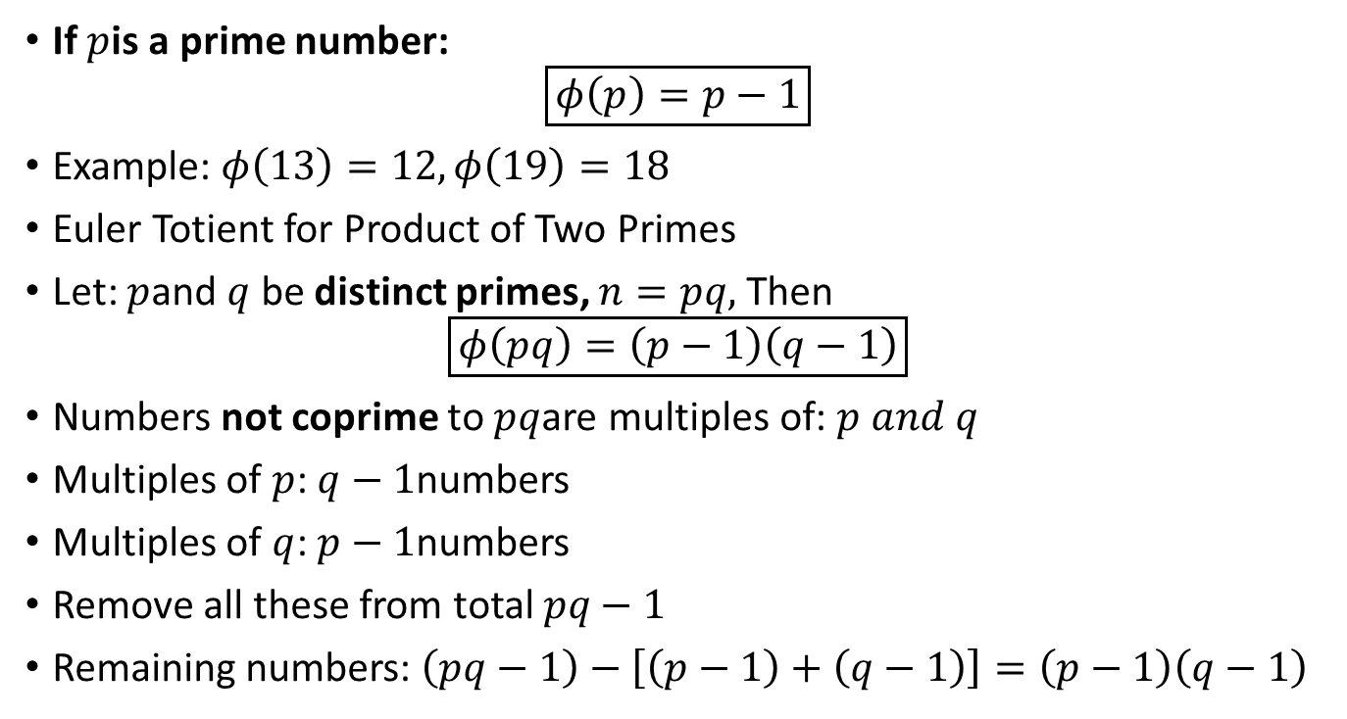
Important Property
If $p$is a prime number:
$$\boxed{φ\left(p\right)=p−1}$$
Example: $φ\left(13\right)=12, φ\left(19\right)=18$
Euler Totient for Product of Two Primes
Let: $p$and $q$ be distinct primes, $n=pq,$Then
$$\boxed{φ\left(pq\right)=\left(p−1\right)\left(q−1\right)}$$
Numbers not coprime to $pq$are multiples of: $p and q$
Multiples of $p$: $q−1$numbers
Multiples of $q$: $p−1$numbers
Remove all these from total $pq−1$
Remaining numbers: $\left(pq−1\right)−\left[\left(p−1\right)+\left(q−1\right)\right]=\left(p−1\right)\left(q−1\right)$

Slide 51
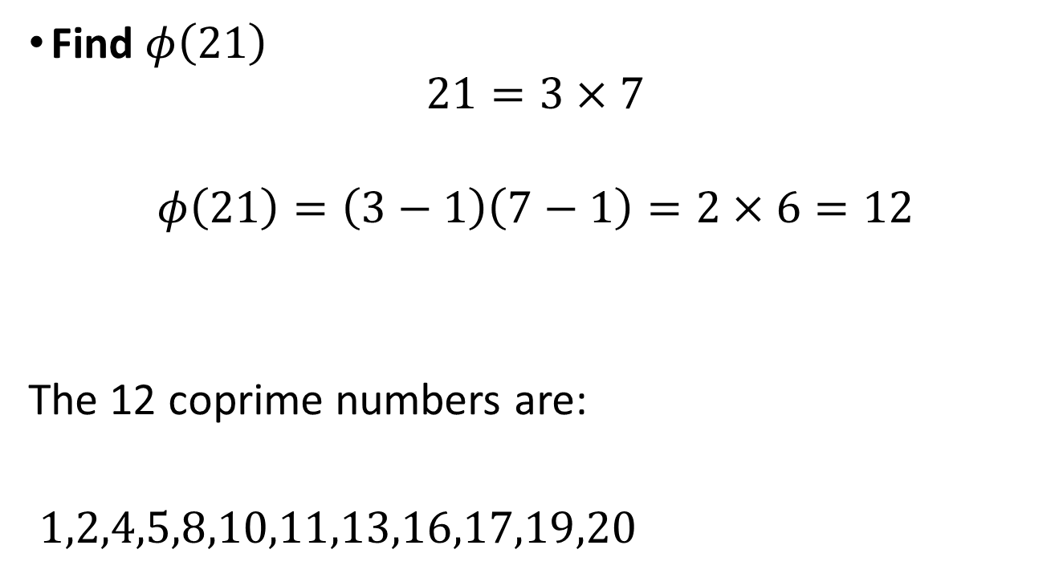
Find $φ\left(21\right)$
$$21=3×7$$
$$φ\left(21\right)=\left(3−1\right)\left(7−1\right)=2×6=12$$
The 12 coprime numbers are:
$1,2,4,5,8,10,11,13,16,17,19,20$

Slide 52
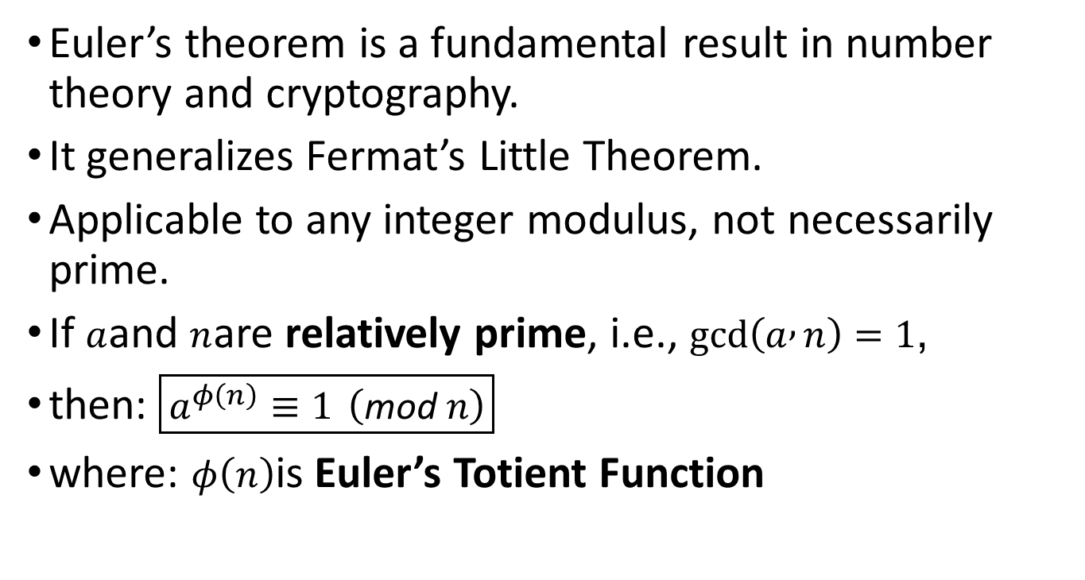
Euler’s Theorem
Euler’s theorem is a fundamental result in number theory and cryptography.
It generalizes Fermat’s Little Theorem.
Applicable to any integer modulus, not necessarily prime.
If $a$and $n$are relatively prime, i.e., $gcd⁡\left(a , n\right)=1$,
then: $\boxed{a^{φ\left(n\right)}≡1 \left(\text{mod} n\right)}$
where: $φ\left(n\right)$is Euler’s Totient Function

Slide 53
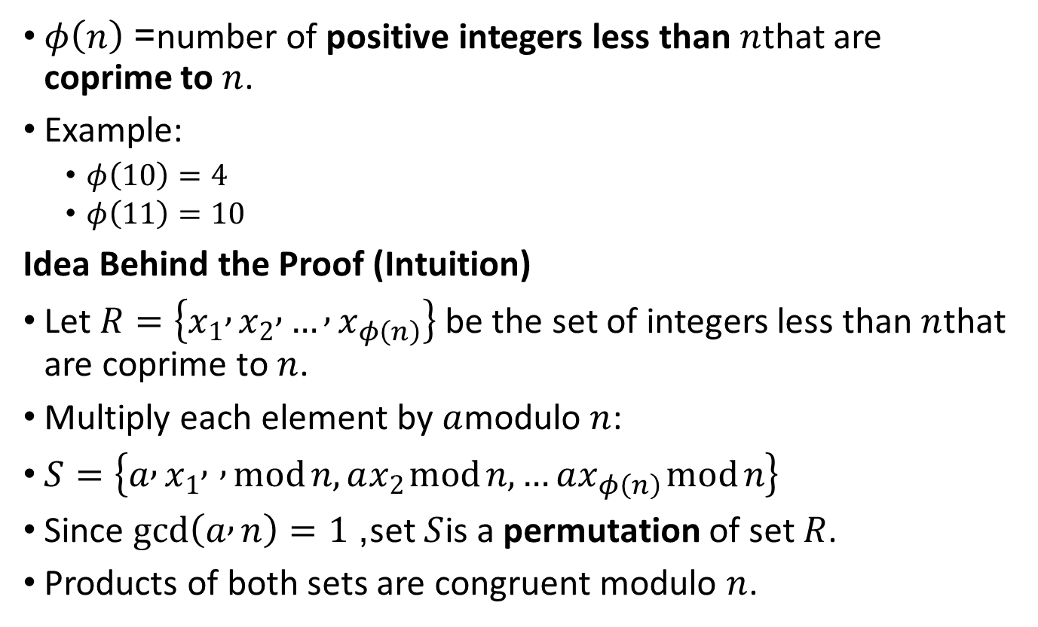
Euler’s Totient Function
$φ\left(n\right)$= number of positive integers less than $n$that are coprime to $n$.
Example:
$φ\left(10\right)=4$
$φ\left(11\right)=10$
Idea Behind the Proof (Intuition)
Let $R=\left\{x_{1} , x_{2} , … , x_{φ\left(n\right)}\right\}$ be the set of integers less than $n$that are coprime to $n$.
Multiply each element by $a$modulo $n$:
$S=\left\{a , x_{1} , , mod n,ax_{2} mod n,…ax_{φ\left(n\right)} mod n\right\}$
Since $gcd⁡\left(a , n\right)=1$, set $S$is a permutation of set $R$.
Products of both sets are congruent modulo $n$.

Slide 54
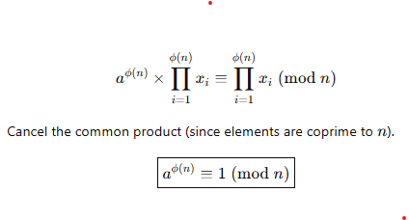
Proof

Slide 55
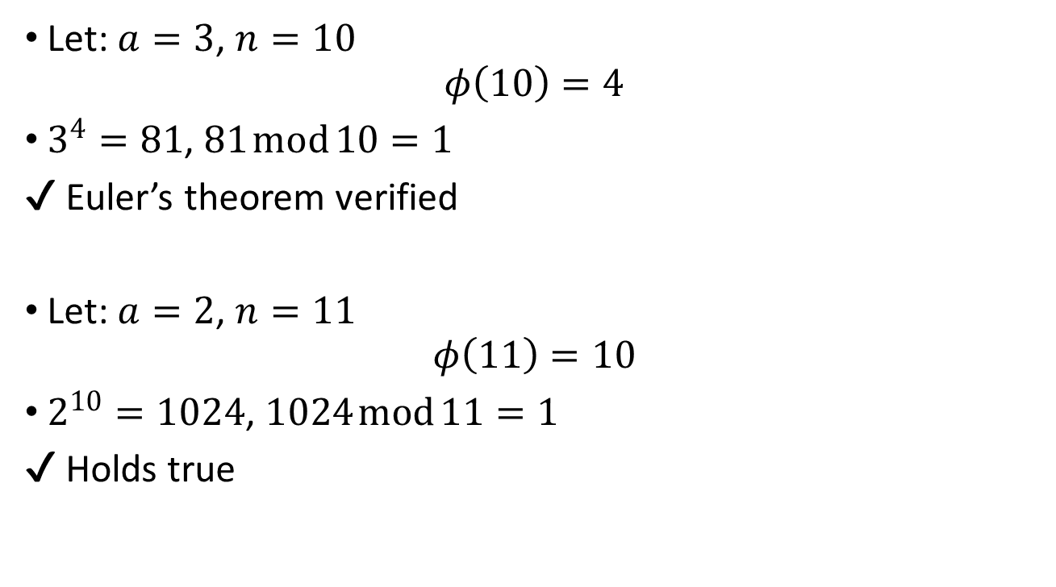
Example
Let: $a=3$, $n=10$
$$φ\left(10\right)=4$$
$3^{4}=81$, $81 mod 10=1$
✔ Euler’s theorem verified
Let: $a=2$, $n=11$
$$φ\left(11\right)=10$$
$2^{10}=1024$, $1024 mod 11=1$
✔ Holds true

Slide 56
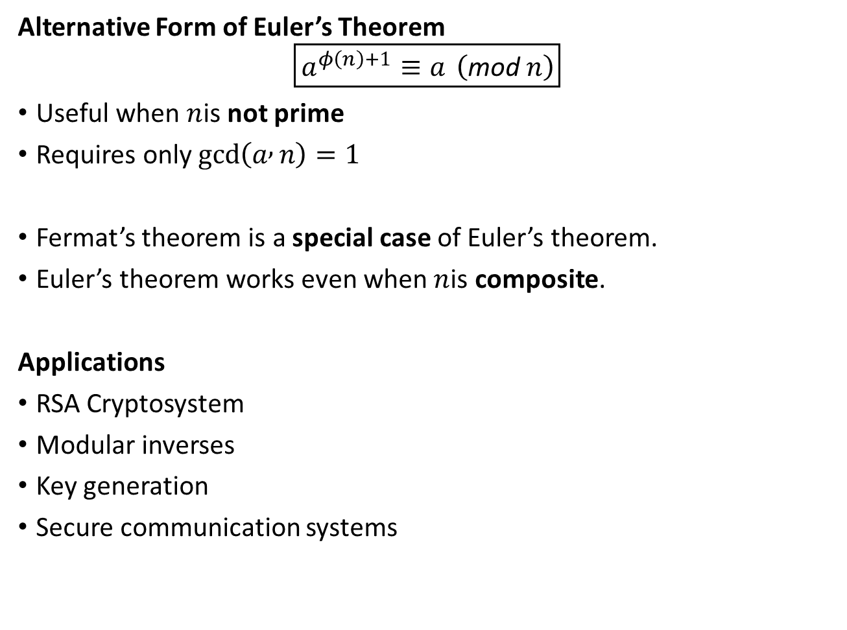
Alternative Form of Euler’s Theorem
$$\boxed{a^{φ\left(n\right)+1}≡a \left(\text{mod} n\right)}$$
Useful when $n$is not prime
Requires only $gcd⁡\left(a , n\right)=1$
Fermat’s theorem is a special case of Euler’s theorem.
Euler’s theorem works even when $n$is composite.
Applications
RSA Cryptosystem
Modular inverses
Key generation
Secure communication systems

Slide 57
Testing for Primality – Introduction
Cryptographic algorithms require very large prime numbers.
Prime numbers are essential for:
Key generation
Encryption and decryption
Determining whether a large number is prime is a non-trivial task.
No simple deterministic method is efficient for very large numbers.
Hence, probabilistic primality tests are commonly used.

Slide 58
Need for Primality Testing
Randomly generated numbers may not always be prime.
Efficient primality testing ensures:
Security of cryptographic systems
Feasible computation time
A number that passes certain tests is said to be “almost certainly prime.”

Slide 59
Miller–Rabin Primality Test
Miller–Rabin is a probabilistic algorithm.
Widely used in:
Cryptographic libraries
Key generation algorithms
It can quickly identify composite numbers.
If a number passes multiple rounds, it is very likely prime.

Slide 60
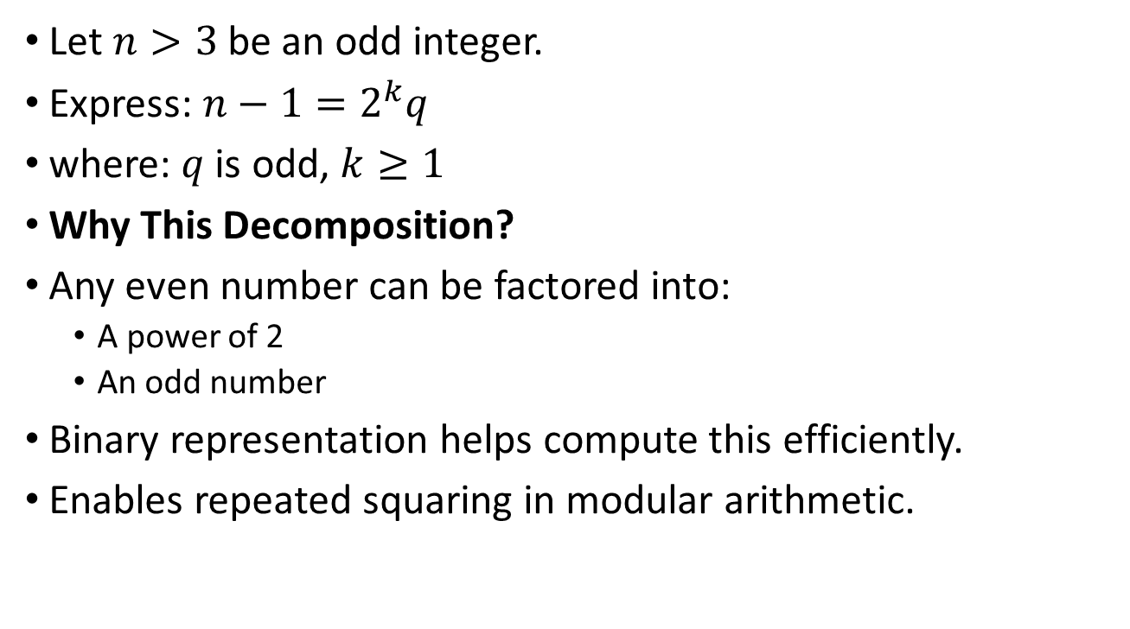
Preprocessing Step
Let $n>3$be an odd integer.
Express: $n−1=2^{k}q$
where: $q$ is odd, $k≥1$
Why This Decomposition?
Any even number can be factored into:
A power of 2
An odd number
Binary representation helps compute this efficiently.
Enables repeated squaring in modular arithmetic.

Slide 61
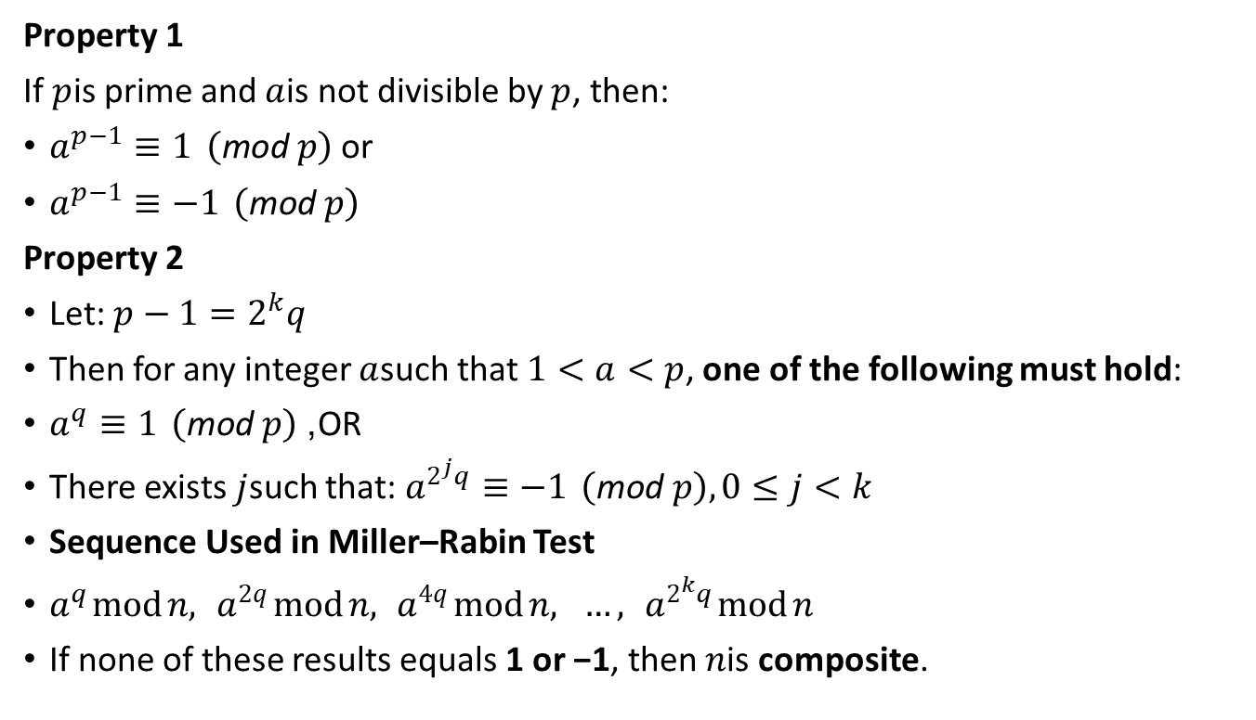
Two Properties of Prime Numbers
Property 1
If $p$is prime and $a$is not divisible by $p$, then:
$a^{p−1}≡1 \left(\text{mod} p\right)$ or
$a^{p−1}≡−1 \left(\text{mod} p\right)$
Property 2
Let: $p−1=2^{k}q$
Then for any integer $a$such that $1<a<p$, one of the following must hold:
$a^{q}≡1 \left(\text{mod} p\right)$, OR
There exists $j$such that: $a^{2^{j}q}≡−1 \left(\text{mod} p\right), 0≤j<k$
Sequence Used in Miller–Rabin Test
$a^{q} mod n, a^{2q} mod n, a^{4q} mod n, …, a^{2^{k}q} mod n$
If none of these results equals 1 or −1, then $n$is composite.

Slide 62
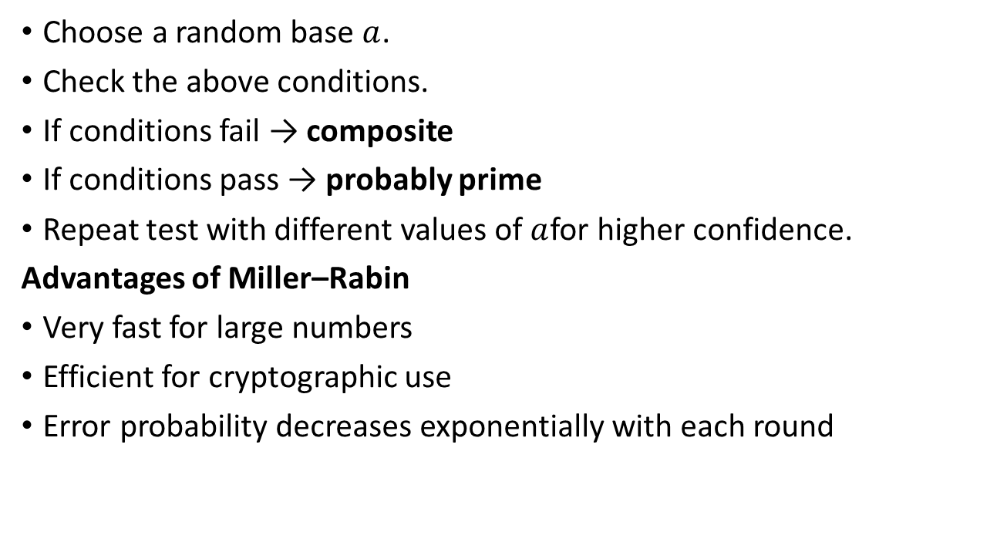
Key Idea of Miller–Rabin Test
Choose a random base $a$.
Check the above conditions.
If conditions fail → composite
If conditions pass → probably prime
Repeat test with different values of $a$for higher confidence.
Advantages of Miller–Rabin
Very fast for large numbers
Efficient for cryptographic use
Error probability decreases exponentially with each round

Slide 63
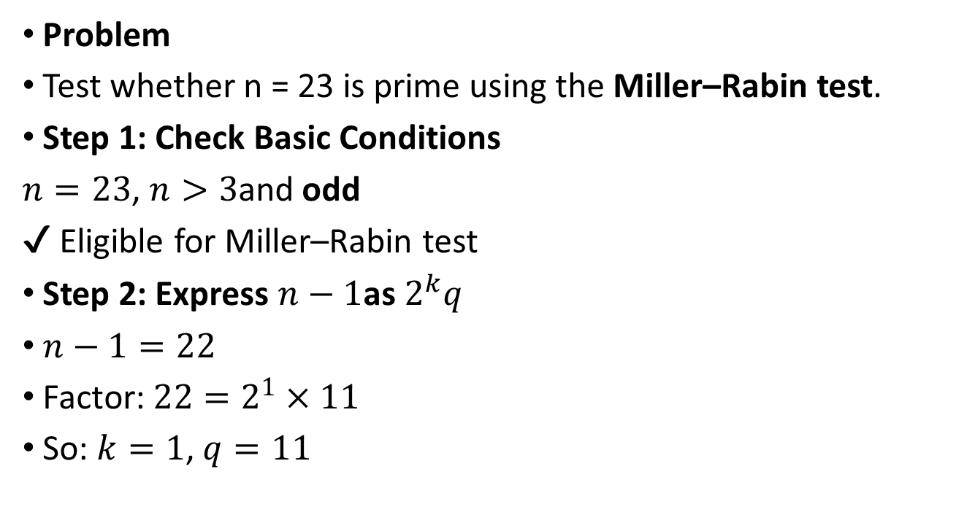
Miller–Rabin Primality Test – Prime Example
Problem
Test whether n = 23 is prime using the Miller–Rabin test.
Step 1: Check Basic Conditions
$n=23$, $n>3$and odd
✔ Eligible for Miller–Rabin test
Step 2: Express $n−1$as $2^{k}q$
$n−1=22$
Factor: $22=2^{1}×11$
So: $k=1$, $q=11$

Slide 64
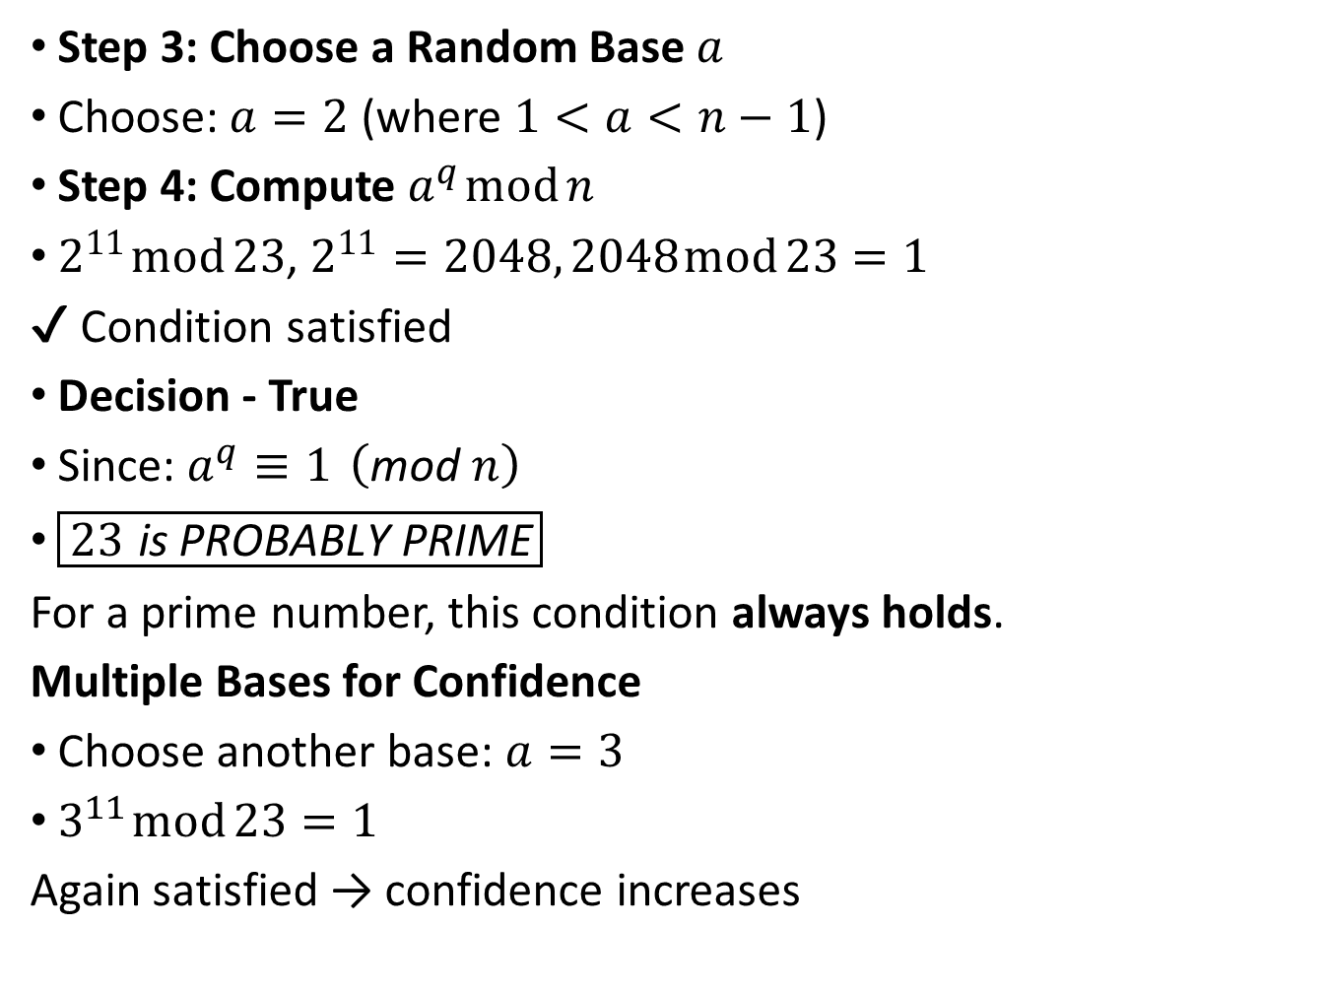
Step 3: Choose a Random Base $a$
Choose: $a=2$ (where $1<a<n−1$)
Step 4: Compute $a^{q} mod n$
$2^{11} mod 23$, $2^{11}=2048, 2048 mod 23=1$
✔ Condition satisfied
Decision - True
Since: $a^{q}≡1 \left(\text{mod} n\right)$
$\boxed{23 \text{is} \text{PROBABLY} \text{PRIME}}$
For a prime number, this condition always holds.
Multiple Bases for Confidence
Choose another base: $a=3$
$3^{11} mod 23=1$
Again satisfied → confidence increases

Slide 65

Miller–Rabin Primality Test – Example
Test whether $n=113$ is prime using the Miller–Rabin test.

Slide 66
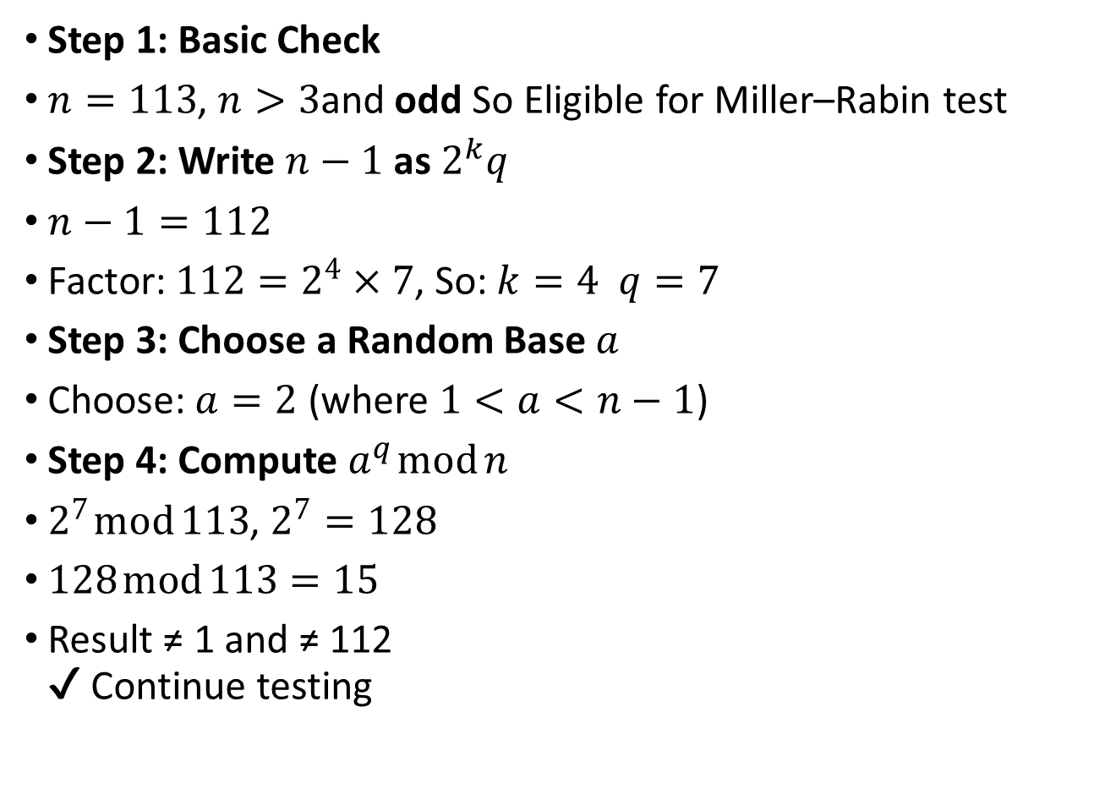
Step 1: Basic Check
$n=113$, $n>3$and odd So Eligible for Miller–Rabin test
Step 2: Write $n−1$ as $2^{k}q$
$n−1=112$
Factor: $112=2^{4}×7$, So: $k=4 q=7$
Step 3: Choose a Random Base $a$
Choose: $a=2$ (where $1<a<n−1$)
Step 4: Compute $a^{q} mod n$
$2^{7} mod 113$, $2^{7}=128$
$128 mod 113=15$
Result ≠ 1 and ≠ 112 ✔ Continue testing

Slide 67
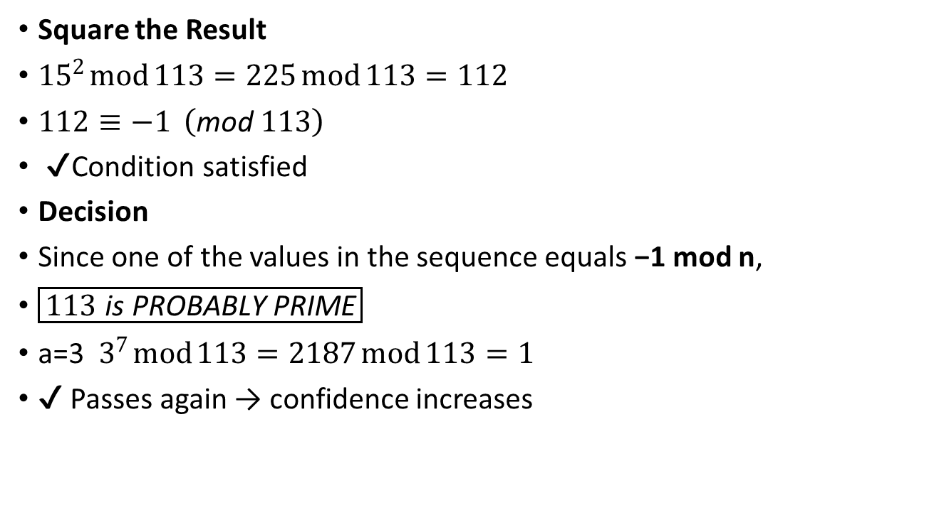
Square the Result
${15}^{2} mod 113=225 mod 113=112$
$112≡−1 \left(\text{mod} 113\right)$
✔ Condition satisfied
Decision
Since one of the values in the sequence equals −1 mod n,
$\boxed{113 \text{is} \text{PROBABLY} \text{PRIME}}$
a=3 $3^{7} mod 113=2187 mod 113=1$
✔ Passes again → confidence increases

