Slide 1
Legendre Jacobi Symbol

Slide 2
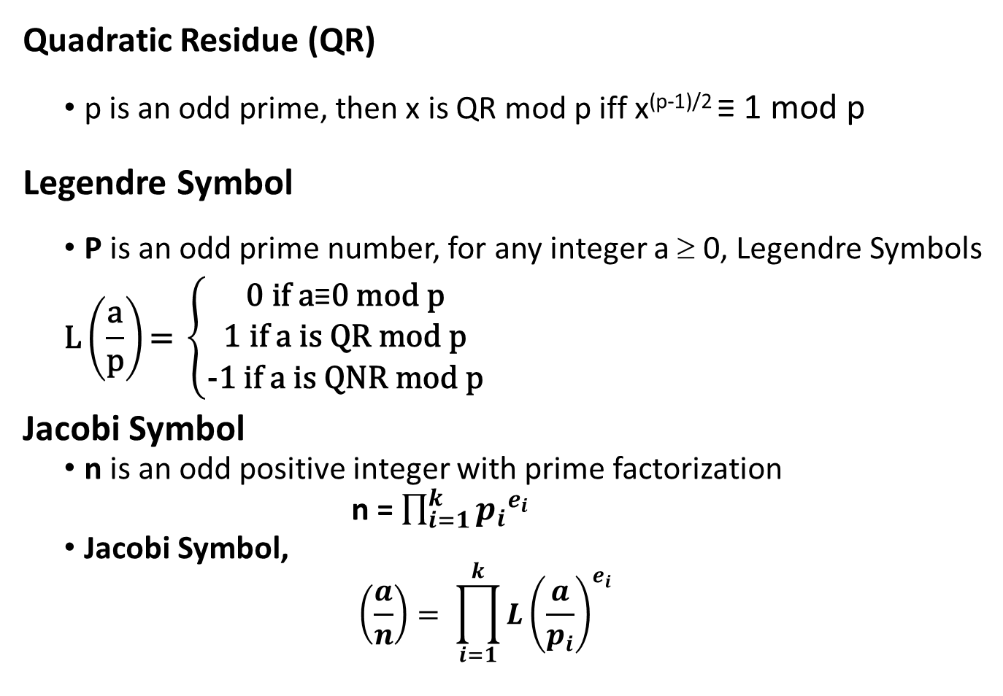
Legendre Jacobi Symbol
Quadratic Residue (QR)
p is an odd prime, then x is QR mod p iff x^{(p-1)/2} ≡ 1 mod p
Legendre Symbol
P is an odd prime number, for any integer a ≥ 0, Legendre Symbols
$$\text{L}\left(\frac{\text{a}}{\text{p}}\right)\text{= }\left\{\begin{aligned}\text{0 }\text{if} \text{a}\text{≡}\text{0 }\text{mod} \text{p} \\ \text{1 }\text{if} \text{a} \text{is} \text{QR} \text{mod} \text{p} \\ \text{−}\text{1 }\text{if} \text{a} \text{is} \text{QNR} \text{mod} \text{p}\end{aligned}\right.$$
Jacobi Symbol
n is an odd positive integer with prime factorization
n = $\prod_{i=1}^{k}{{p_{i}}^{e_{i}}}$
Jacobi Symbol,
$$\left(\frac{a}{n}\right)= \prod_{i=1}^{k}{{L\left(\frac{a}{p_{i}}\right)}^{e_{i}}}$$

Slide 3
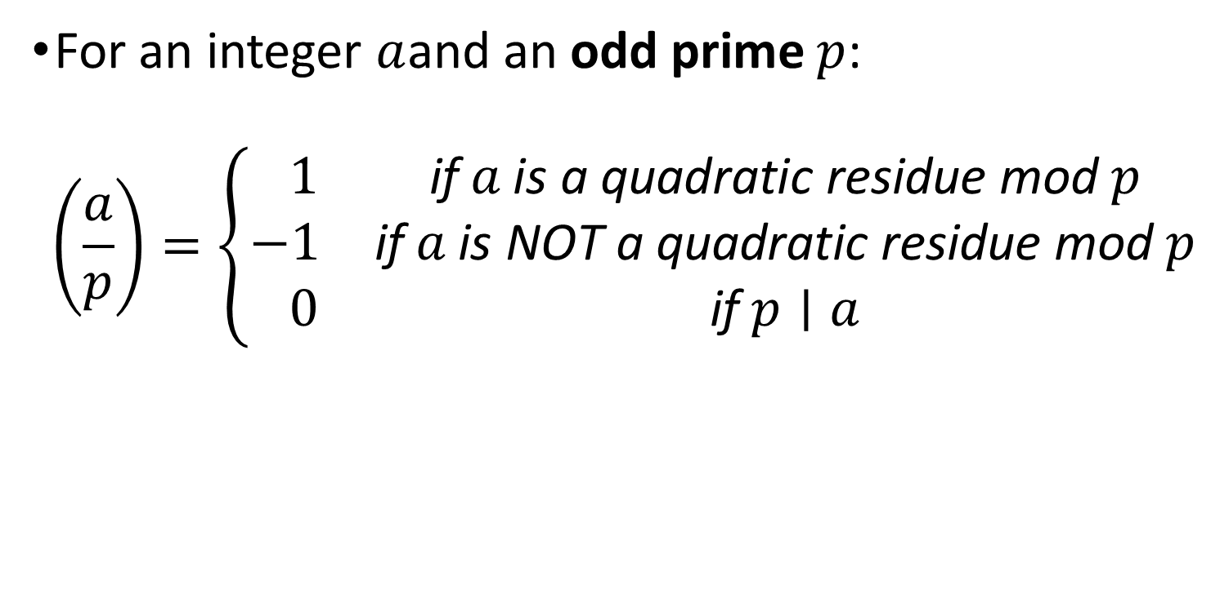
Legendre Symbol
For an integer $a$and an odd prime $p$:
$$\left(\frac{a}{p}\right)=\left\{\begin{matrix} 1 & \text{if} a \text{is} \text{a} \text{quadratic} \text{residue} \text{mod} p \\ −1 & \text{if} a \text{is} \text{NOT} \text{a} \text{quadratic} \text{residue} \text{mod} p \\ 0 & \text{if} p∣a\end{matrix}\right.$$

Slide 4
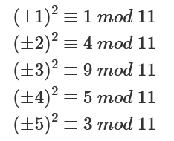
Legendre Jacobi Symbol
Quadratic Residue (QR)
Given an odd prime p and an integer a such that 0 ≤ y ≤ p-1.
x² ≡ a (mod p) has a solution y ∈ Z_{p}
If yes, a is QR mod p otherwise a is QNR mod p. If a ≡ 0 mod p, a is not QR mod p
E.g., p=11
x ∈ {1,3,4,5,9}, x is QR mod p

Slide 5
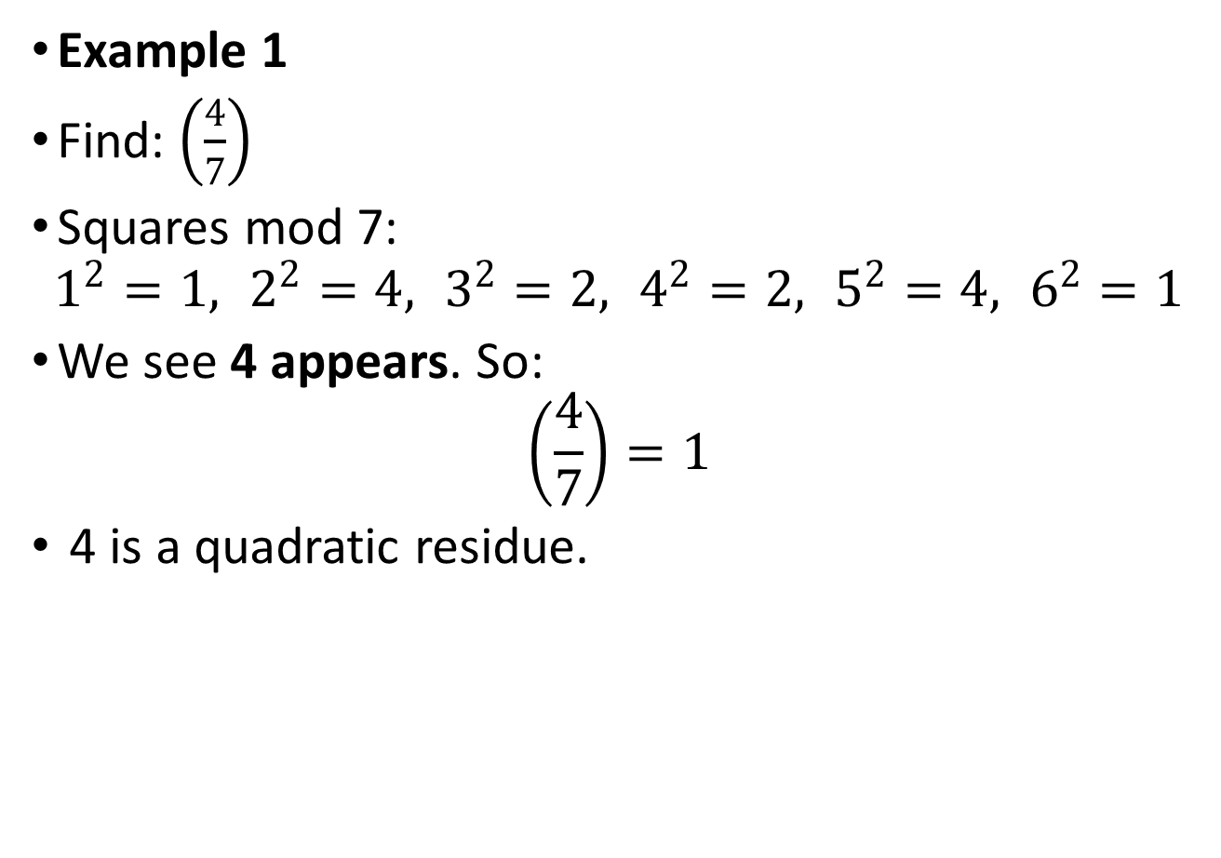
Example 1
Find: $\left(\frac{4}{7}\right)$
Squares mod 7:
$$1^{2}=1, 2^{2}=4, 3^{2}=2, 4^{2}=2, 5^{2}=4, 6^{2}=1$$
We see 4 appears. So:
$$\left(\frac{4}{7}\right)=1$$
4 is a quadratic residue.

Slide 6
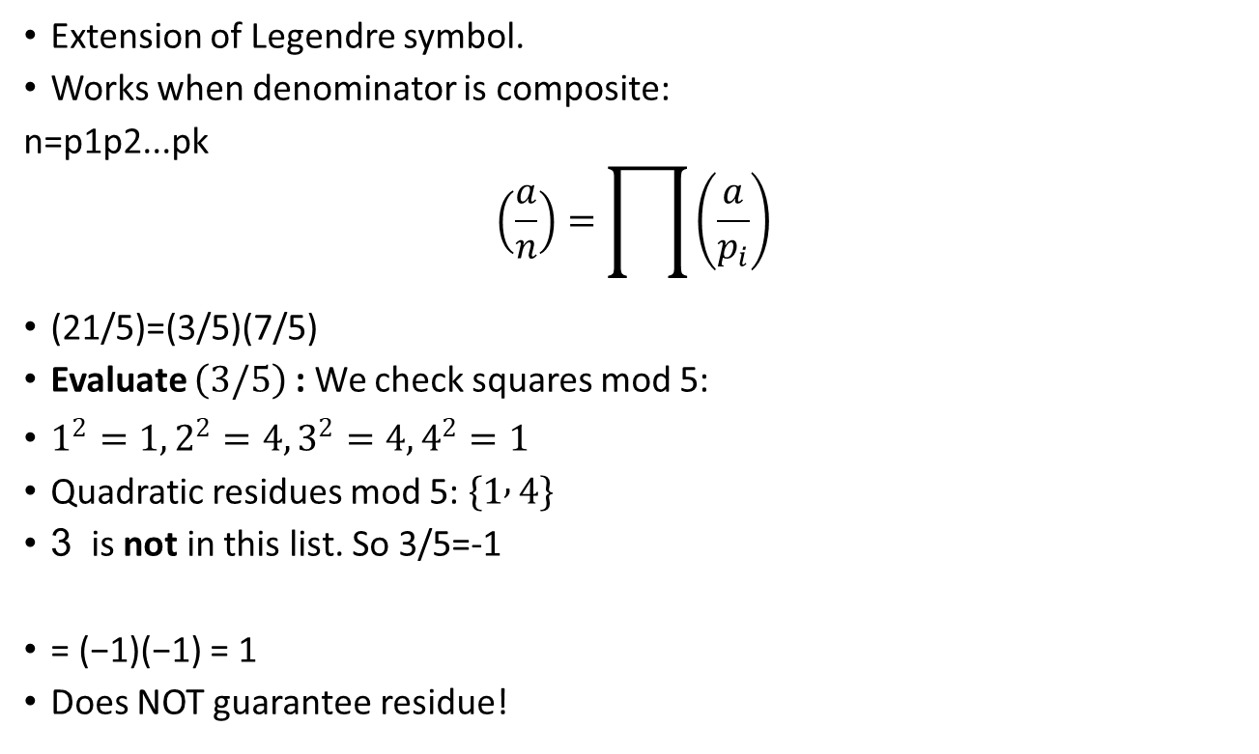
Jacobi Symbol
Extension of Legendre symbol.
Works when denominator is composite:
n=p1​p2​...pk​
$$\left(\frac{a}{n}\right)=\prod{\left(\frac{a}{p_{i}}\right)}$$
(21/5​)=(3/5​)(7/5​)
Evaluate $\left(3/5\right)$ : We check squares mod 5:
$1^{2}=1, 2^{2}=4, 3^{2}=4, 4^{2}=1$
Quadratic residues mod 5: $\left\{1 , 4\right\}$
3 is not in this list. So 3/5=-1
= (−1)(−1) = 1
Does NOT guarantee residue!

Slide 7
Jacobi Symbol
Extension of Legendre symbol.
Works when denominator is composite:
n=p1​p2​...pk​
$$\left(\frac{a}{n}\right)=\prod{\left(\frac{a}{p_{i}}\right)}$$
(21/5​)=(3/5​)(7/5​)
Evaluate $\left(3/5\right)$ : We check squares mod 5:
$1^{2}=1, 2^{2}=4, 3^{2}=4, 4^{2}=1$
Quadratic residues mod 5: $\left\{1 , 4\right\}$
3 is not in this list. So 3/5=-1
= (−1)(−1) = 1
Does NOT guarantee residue!

Slide 8
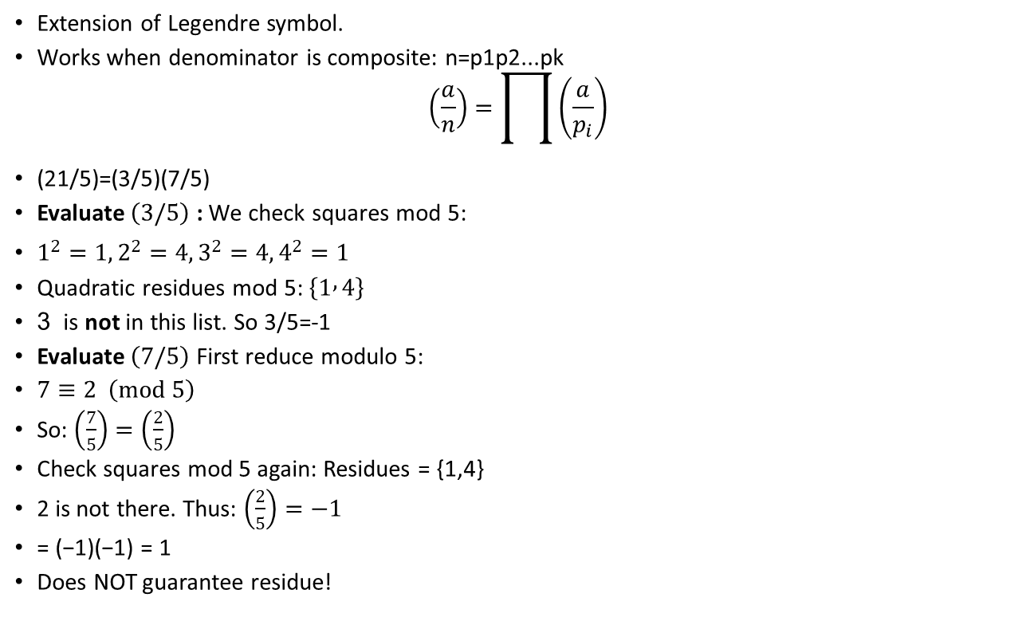
Jacobi Symbol
Extension of Legendre symbol.
Works when denominator is composite: n=p1​p2​...pk​
$$\left(\frac{a}{n}\right)=\prod{\left(\frac{a}{p_{i}}\right)}$$
(21/5​)=(3/5​)(7/5​)
Evaluate $\left(3/5\right)$ : We check squares mod 5:
$1^{2}=1, 2^{2}=4, 3^{2}=4, 4^{2}=1$
Quadratic residues mod 5: $\left\{1 , 4\right\}$
3 is not in this list. So 3/5=-1
Evaluate $\left(7/5\right)$ First reduce modulo 5:
$7≡2 \left(mod 5\right)$
So: $\left(\frac{7}{5}\right)=\left(\frac{2}{5}\right)$
Check squares mod 5 again: Residues = {1,4}
2 is not there. Thus: $\left(\frac{2}{5}\right)=−1$
= (−1)(−1) = 1
Does NOT guarantee residue!

