Slide 1
Contents
What?
How?

Slide 2
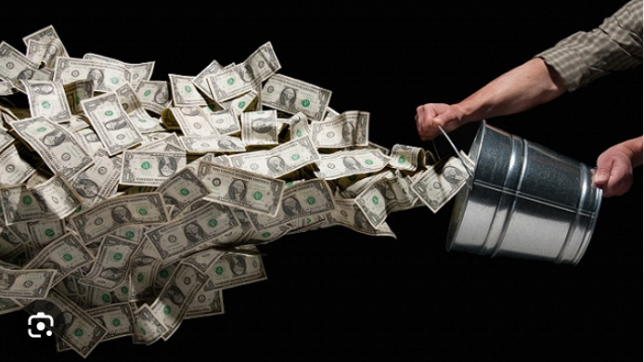
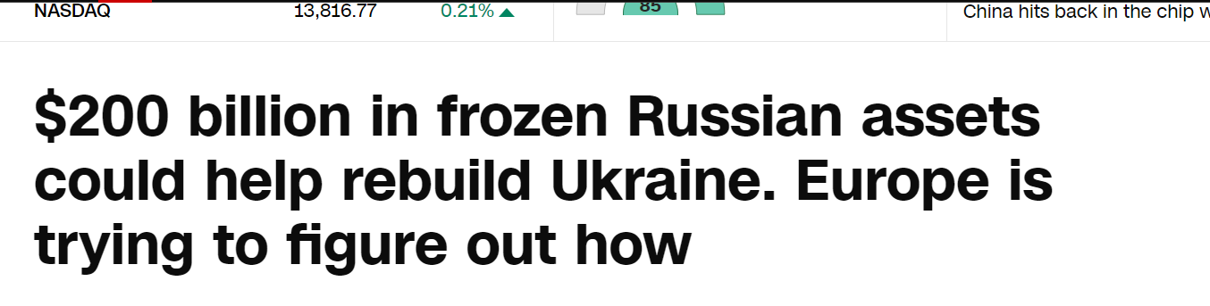
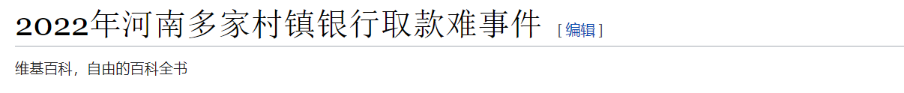
Current(cash, pay online, e-cash)
Centralized bank
Motive: 2008 Financial Crisis
Recent:
Banks control everything!!! Will you trust bank completely???

Slide 3
History
An American software engineer (Laszler) paid 10,000 bitcoins for a $25 pizza. Since then, May 22 has been called Bitcoin Pizza Day
Satoshi Nakamoto released the first bitcoin mining software and performed the first mining in human history.
2009.1.3
2010.5.22
2008.10
2009.1.3 18:15:05 PM
Satoshi Nakamoto(中本聪) published the paper "Bitcoin: a peer to peer electronic cash system"
The first bitcoin block was dug out and Satoshi Nakamoto received a reward of 50 bitcoins.
Who is Satoshi Nakamoto???
Hal Finney? Dorian Nakamoto? Nick Szabo?
三星(Samsung) 东芝(Toshiba) 中道(Nakamichi) 摩托罗拉(Motorola)?
No one knows except himself

Slide 4
Bitcoin
De-centralize
Anonymous
Encryption digital currency
Only 21 million bitcoin in market, no inflation
Safety and easy to use(only need private key)
immutable and traceable, so it is possible to quickly and reliably verify that the trade exist.
Every transaction and address has a completely unique identifier, and it is public for quick verification.
Although the transaction information is open and transparent, but without any other personal information.
Easy to pay(the smallest unit: one Satoshi = 0.00000001 BTC)
Basic on network, no government restriction

Slide 5



No Need Bank anymore
Bill
Amy: -10
Bob: +10
Amy: -10
Bob: +10
Amy: -10
Bob: +10
Amy: -10
Bob: +10
Amy: -10
Bob: +10
Message: Bob give Amy $10
Message: Pay finish
A Sheep
Bob
Amy
A Sheep
Bob
Amy

Slide 6

What’s the bill??
Only store transaction information.
The bill is public. If there is any other need, the current complete bill can be obtained. The bill records all transaction records from the creation to the current.

Slide 7
Basic concept: Hash and Encryption
Hash
Target text
Hash function
Random string
Encrypt
Encryption key
Decryption key
Clear text
Encryption function
ciphertext
Decryption function
Clear text

Slide 8
Basic concept: Asymmetric Cryptography
The ciphertext obtained by encrypting the plaintext with one of the keys can only be decrypted with the corresponding other key to obtain the original plaintext

Slide 9




Basic concept: Digital Signature
Merge
File
Digital Digest
Digital signature
File
Send
Hash
Private key encrypt
Internet
Same
Public key decrypt
File
File
Not same
Split
Hash
Digital Digest

Slide 10
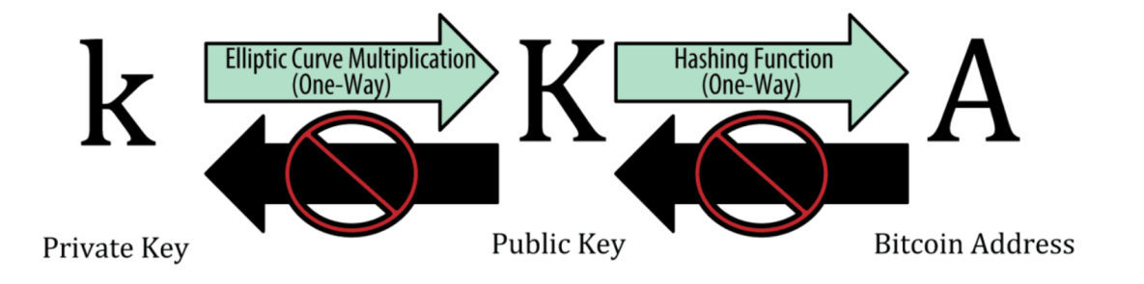
Transaction – Bitcoin account
Everyone need to apply a bitcoin account.
Private key ➔ bank card password
256 binary numbers
64 hex numbers
WIF&WIF-compressed
Public key
Generated by private(SECP256K1)
Bitcoin address ➔ Bank card number
Generated by public key
Everything is ok, ready for transaction!

Slide 11


Transaction
Bitcoin Network
Bob give Tom 5 BTC
Amy give Tom 10 BTC
Address: AAA
Address: BBB
Address: CCC
Public key
Public key
Public key
private key
private key
private key
Amy
Bob
Tom

Slide 12
Transaction
Verify signature with BBB’s public key
BBB -> CCC: 5BTC
BBB’s public key
Network
BBB -> CCC: 5BTC
BBB’s public key
BBB -> CCC: 5BTC
BBB’s public key
Confirm the trans from BBB!
Signature of BBB’s private key
Signature of BBB’s private key
Bob
Tom
Tom can only confirm the sender of the bill and whether the content has been modified, Unable to confirm whether there is 5 BTC in the BOB’s account!

Slide 13
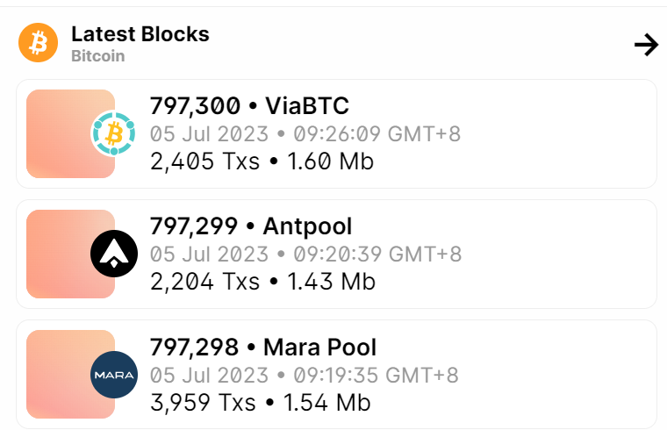
Block
A collection of all transaction information within 10(nearly) minutes.

Slide 14
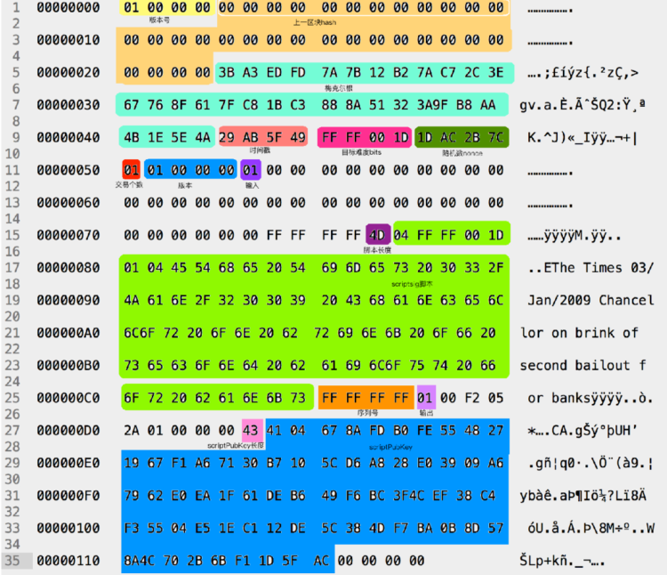
Block
version
4
Previous block hash
32
Transaction list header
Transaction1
Merkle root
Transaction2
32
Transaction3
Transaction4
time
Transaction5
4
Target bits
4
Transaction List
nonce
4
Block Header

Slide 15
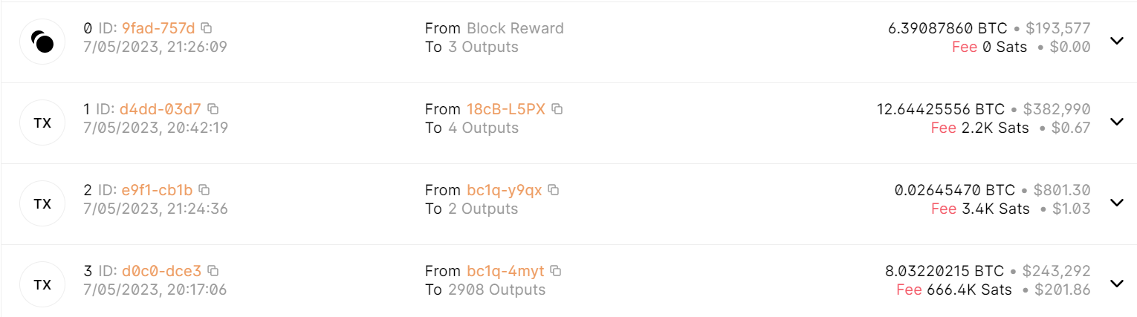
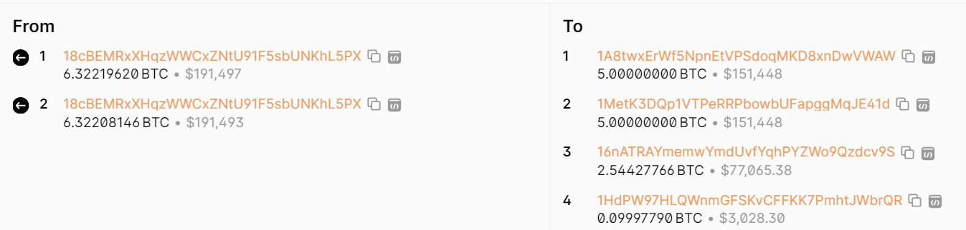
Block -- Transaction

Slide 16
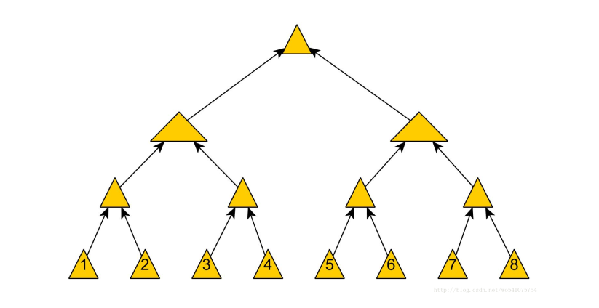
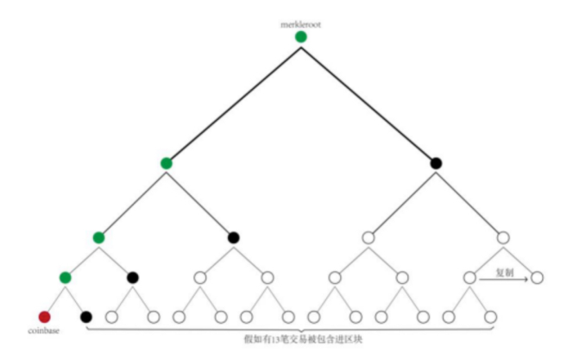
Merkle Root
Prevent transaction info being modified.
A tree to store hash values.
Not all transactions generated with in 10min will be packaged, it depends on the number of bytes per transaction.
Max block size ≈ 1M, ≈ 4200 transactions
Each transaction has a hash value, two by one groups are hashed and a root hash is finally calculated, if there is an odd number, copy itself and then hash.
Coinbase is the reward to the miners for this block.

Slide 17
Merkle Root
trans 1: 16f0eb42cb4d9c2374b2cb1de4008162c06fdd8f1c18357f0c849eb423672f5f
convert: 5f2f6723b49e840c7f35181c8fdd6fc0628100e41dcbb274239c4dcb42ebf016
trans 2: cce2f95fc282b3f2bc956f61d6924f73d658a1fdbc71027dd40b06c15822e061
convert: 61e02258c1060bd47d0271bcfda158d6734f92d6616f95bcf2b382c25ff9e2cc
Stitch: 5f2f6723b49e840c7f35181c8fdd6fc0628100e41dcbb274239c4dcb42ebf01661e02258c1060bd47d0271bcfda158d6734f92d6616f95bcf2b382c25ff9e2cc
Hash twice: 525894ddd0891b36c5ff8658e2a978d615b35ce6dedb5cb83f2420dbcd40a0c7
Convert: c7a040cddb20243fb85cdbdee65cb315d678a9e25886ffc5361b89d0dd945852

Slide 18
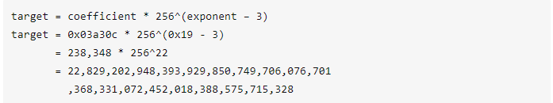
Target Bits
Dynamically adjust the bit entrance to generate a block nearly 10 minutes
Height 277316 bits: 0x1903a30c
The first byte: 0x19, exponent(幂)
The next 3 bytes: 0x03a30c, coefficient(系数)
Hex value:
0x0000000000000003a30c00000000000000000000000000000000000000000000
Real value:
0x0000000000000001b6b9a13b095e96db41c4a928b97ef2d944a9b31b2cc7bdc4

Slide 19
Mining
Confirm Merkle Root is correct.
Confirm transaction digital signature is correct.
PoW(Proof of work) mechanism

Slide 20
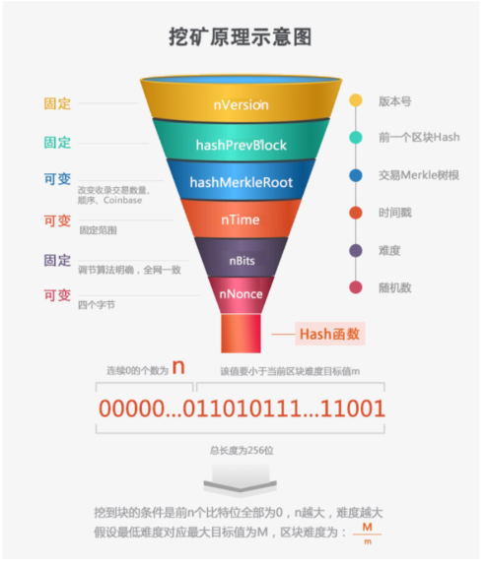
Mining
Block header 80 bytes:
Versions + prev block + merkle root + ntime + nbits + nonce(0x00000000 – 0xffffffff)
Hash twice
Find valid nonce
Get the hash value, compare with target bits
No valid nonce
Get reward(bitcoin)
Simply alter versions, ntime, even if merkle root hash(update sequence of transaction, re-generate merkle root)

Slide 21
Reward
The number of mining rewards is not fixed, and the rewards for every 210,000 blocks are halved
The maximum generation of Bitcoin blocks is about 10 minutes, and each generation of 210,000 blocks takes a maximum of ab
The reward from block 0 to block 209999 is 50 BTC, the reward from block 210,000 to block 419999 is 25 BTC, and the reward from block 420,000 The initial reward is 12.5BTC. As of now, the reward for each block dug is 6.75 bitcoins.
If all bitcoins are rewarded, a fee will be collected from each transaction to the miner.

Slide 22





Overall
Bob
Miners
Generate transaction, propagation to bitcoin network
Miners validate the transaction, ensuring that Bob has sufficient funds, once validated, the transaction is included in a new block.
Miners start to find valid nonce value.
Once one of these miners find a valid value, then propagation to all network
Miner verify the nonce value is correct
New block is confirmed.
Propagation to network, include Bob
Recipient get BTC and miner get reword.
Trans
1
block
3
2
4
7
block
5
Trans end
6

Slide 23
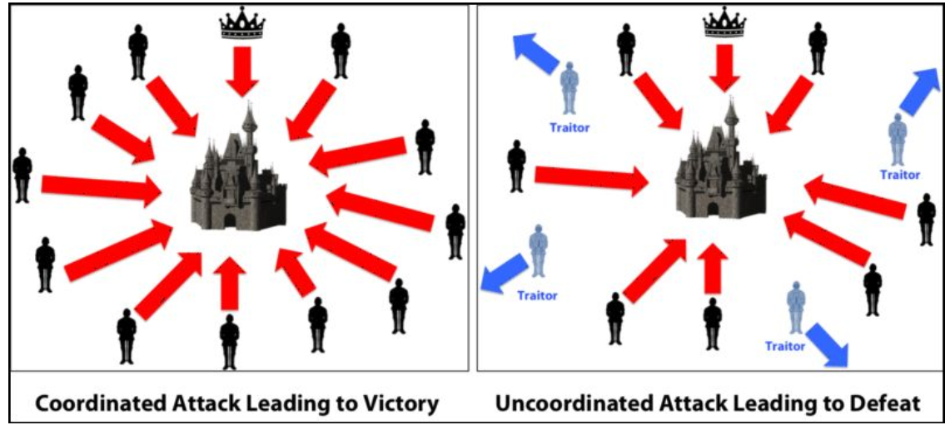
POW(共识机制)
最简单的方法：投票
每个将军把自己的命令发给其他8个将军，然后每个将军会有9张命令，少数服从多数。
问题：如果将军中有叛徒怎么办？叛徒会给其他将军们发送不同的命令。

Slide 24
POW(共识机制)
可行的方法(PBFT)：
每个将军把自己的命令发给其他8个将军，然后每个将军会有9张命令(包括自己)，但是将军不确定自己手上有没有叛徒发出的不一致的命令，所以他把自己手上的9张命令广播给所有人，确认是不是自己手上的和其他8个将军收到的命令是一模一样。
结论：叛徒不能多余三分之一，否则无解。
Bitcoin的方法(digital signature)：
每个将军把自己的命令(含自己签名)发给其他8个将军，然后每个将军会有9张命令(包括自己)，然后每个将军把这个9张命令做成一个chain，再广播给所有人，所有人收到后再和自己本地的验证，就能确定是哪个将军是叛徒。
问题：
如果叛徒故意不回复，或者将军的消息在路上丢失。
解决不回复的难度远远大于解决回复作假的问题

Slide 25
POW(共识机制)
挖矿+奖励机制：
国王下令：每个将军可以在十分钟之内去挖矿，挖到了就广播给其他人并且如果其他人都确认你的工作，就可以得到奖励。
挖矿本身这个工作并无意义，挖矿的目的是为了避免“不回复”的问题
“劳动成本+竞争+激励”来鼓励所有人都忠诚的回复。

Slide 26
POW(共识机制)
工作量证明机制在社会中的应⽤用非常广泛。例例如：毕业证、学位证、律师证等证书都是⼯作量量证明，拥有证书即表明在过去付出了努⼒。
试想一下，如果每个人都可以像学信网一样可以验证其他所有人证书的真假，那如何造假且让人相信？只有一种方法，就是让超过%50的人都认可假的。
中本聪认为这根本不可能！

Slide 27
Some reference website
Bitcoin explorer
https://blockchain.info
Bitcoin wallet
https://bitcoin.org
Online hash tool
https://www.fileformat.info/tool/hash.htm

