Slide 1
Bank Marketing Prediction Model
Predicting Term Deposit Subscription using Logistic Regression

Slide 2
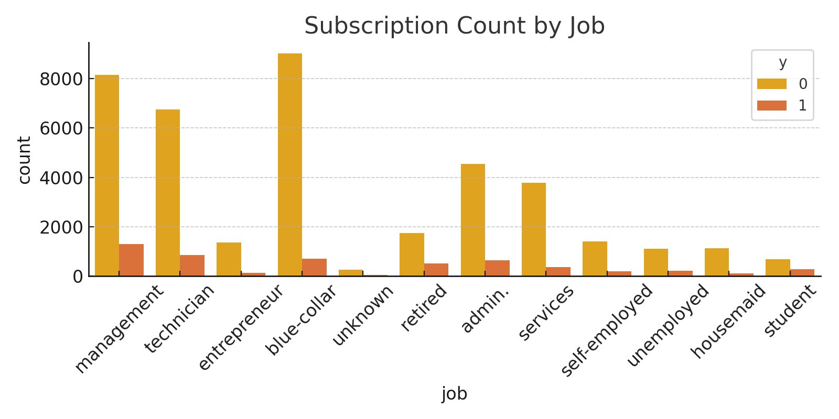
Countplot: job

Slide 3
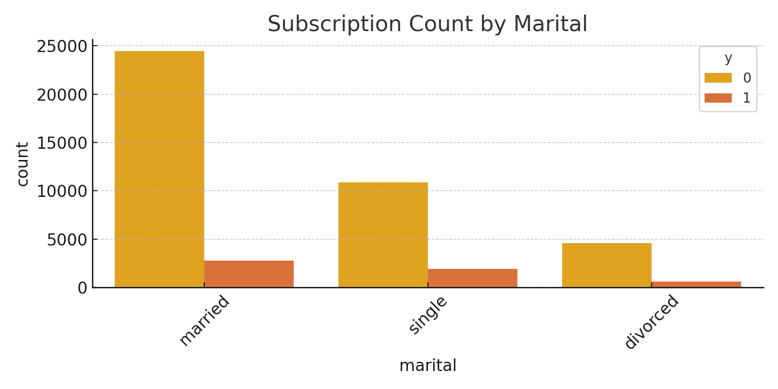
Countplot: marital

Slide 4
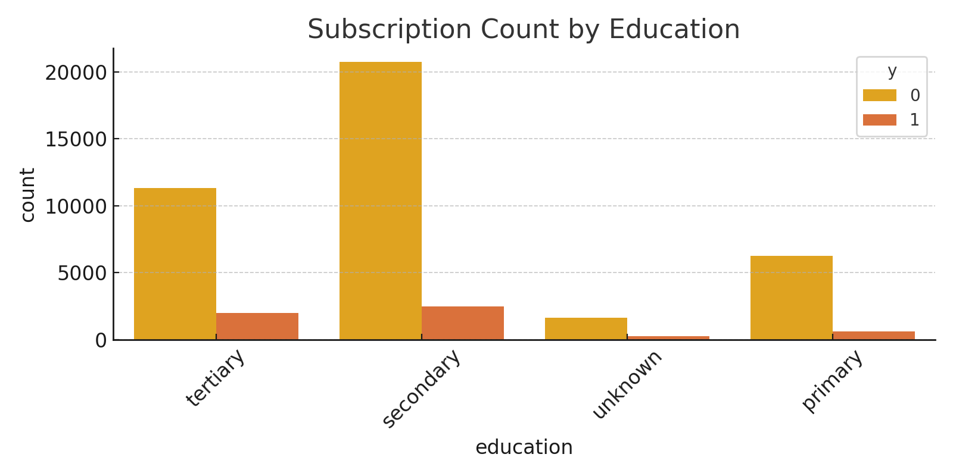
Countplot: education

Slide 5
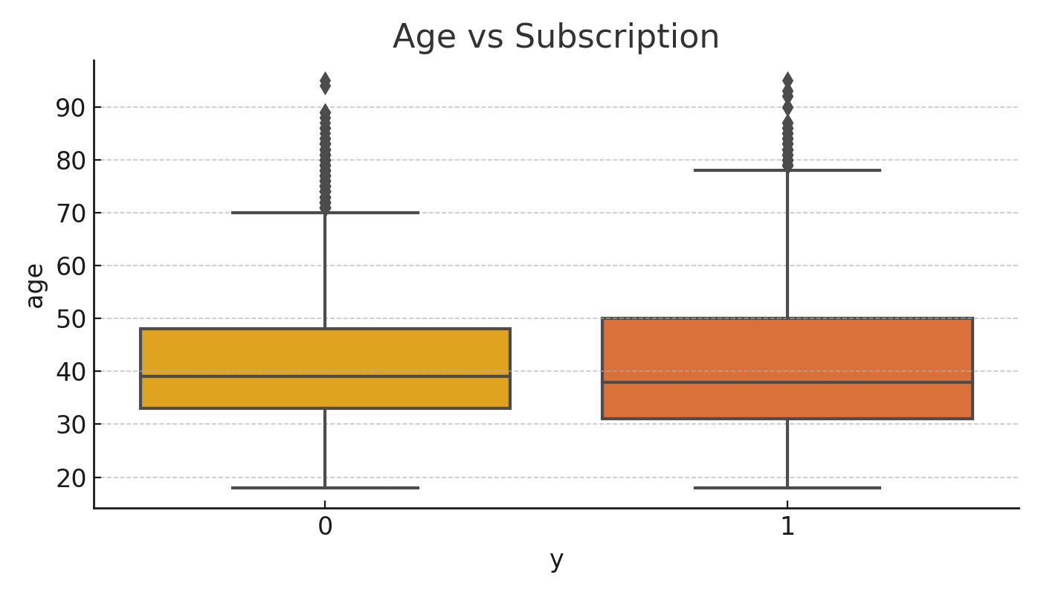
Boxplot: age

Slide 6
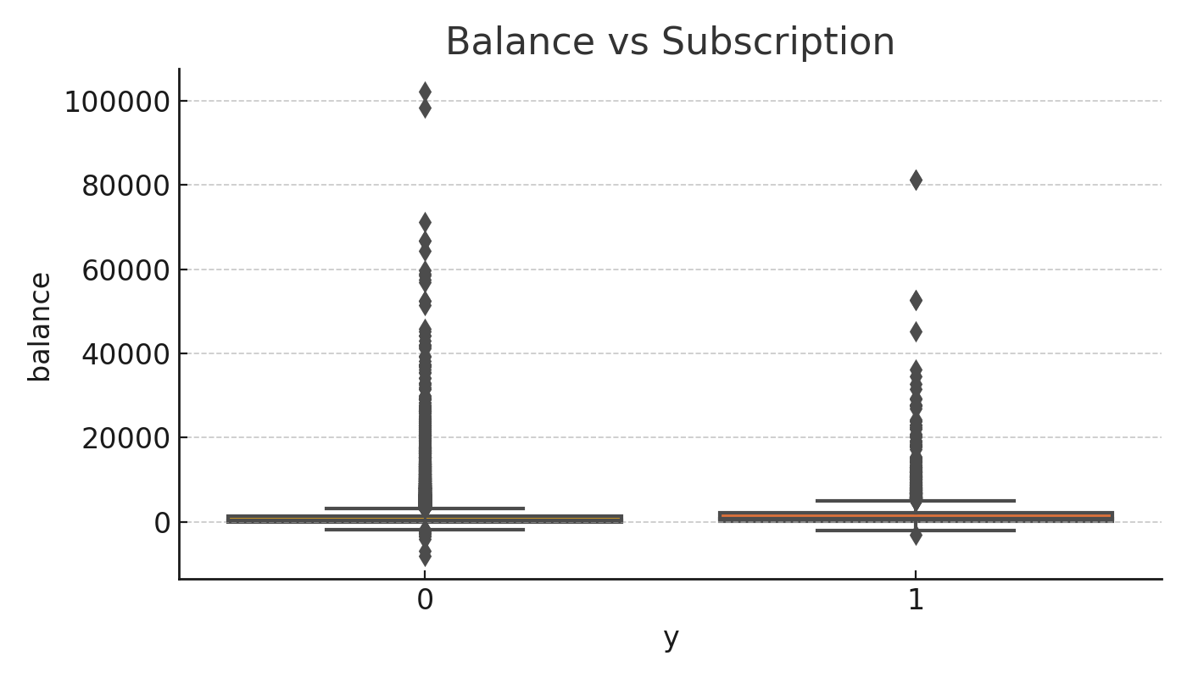
Boxplot: balance

Slide 7
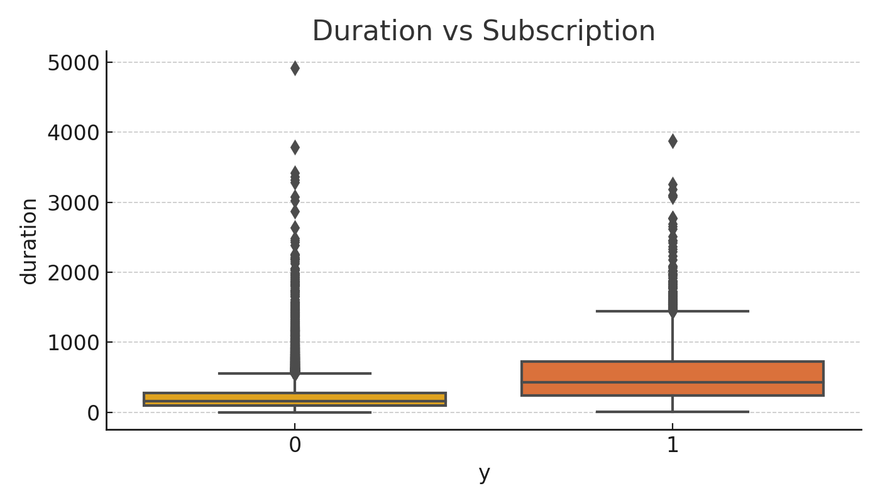
Boxplot: duration

Slide 8
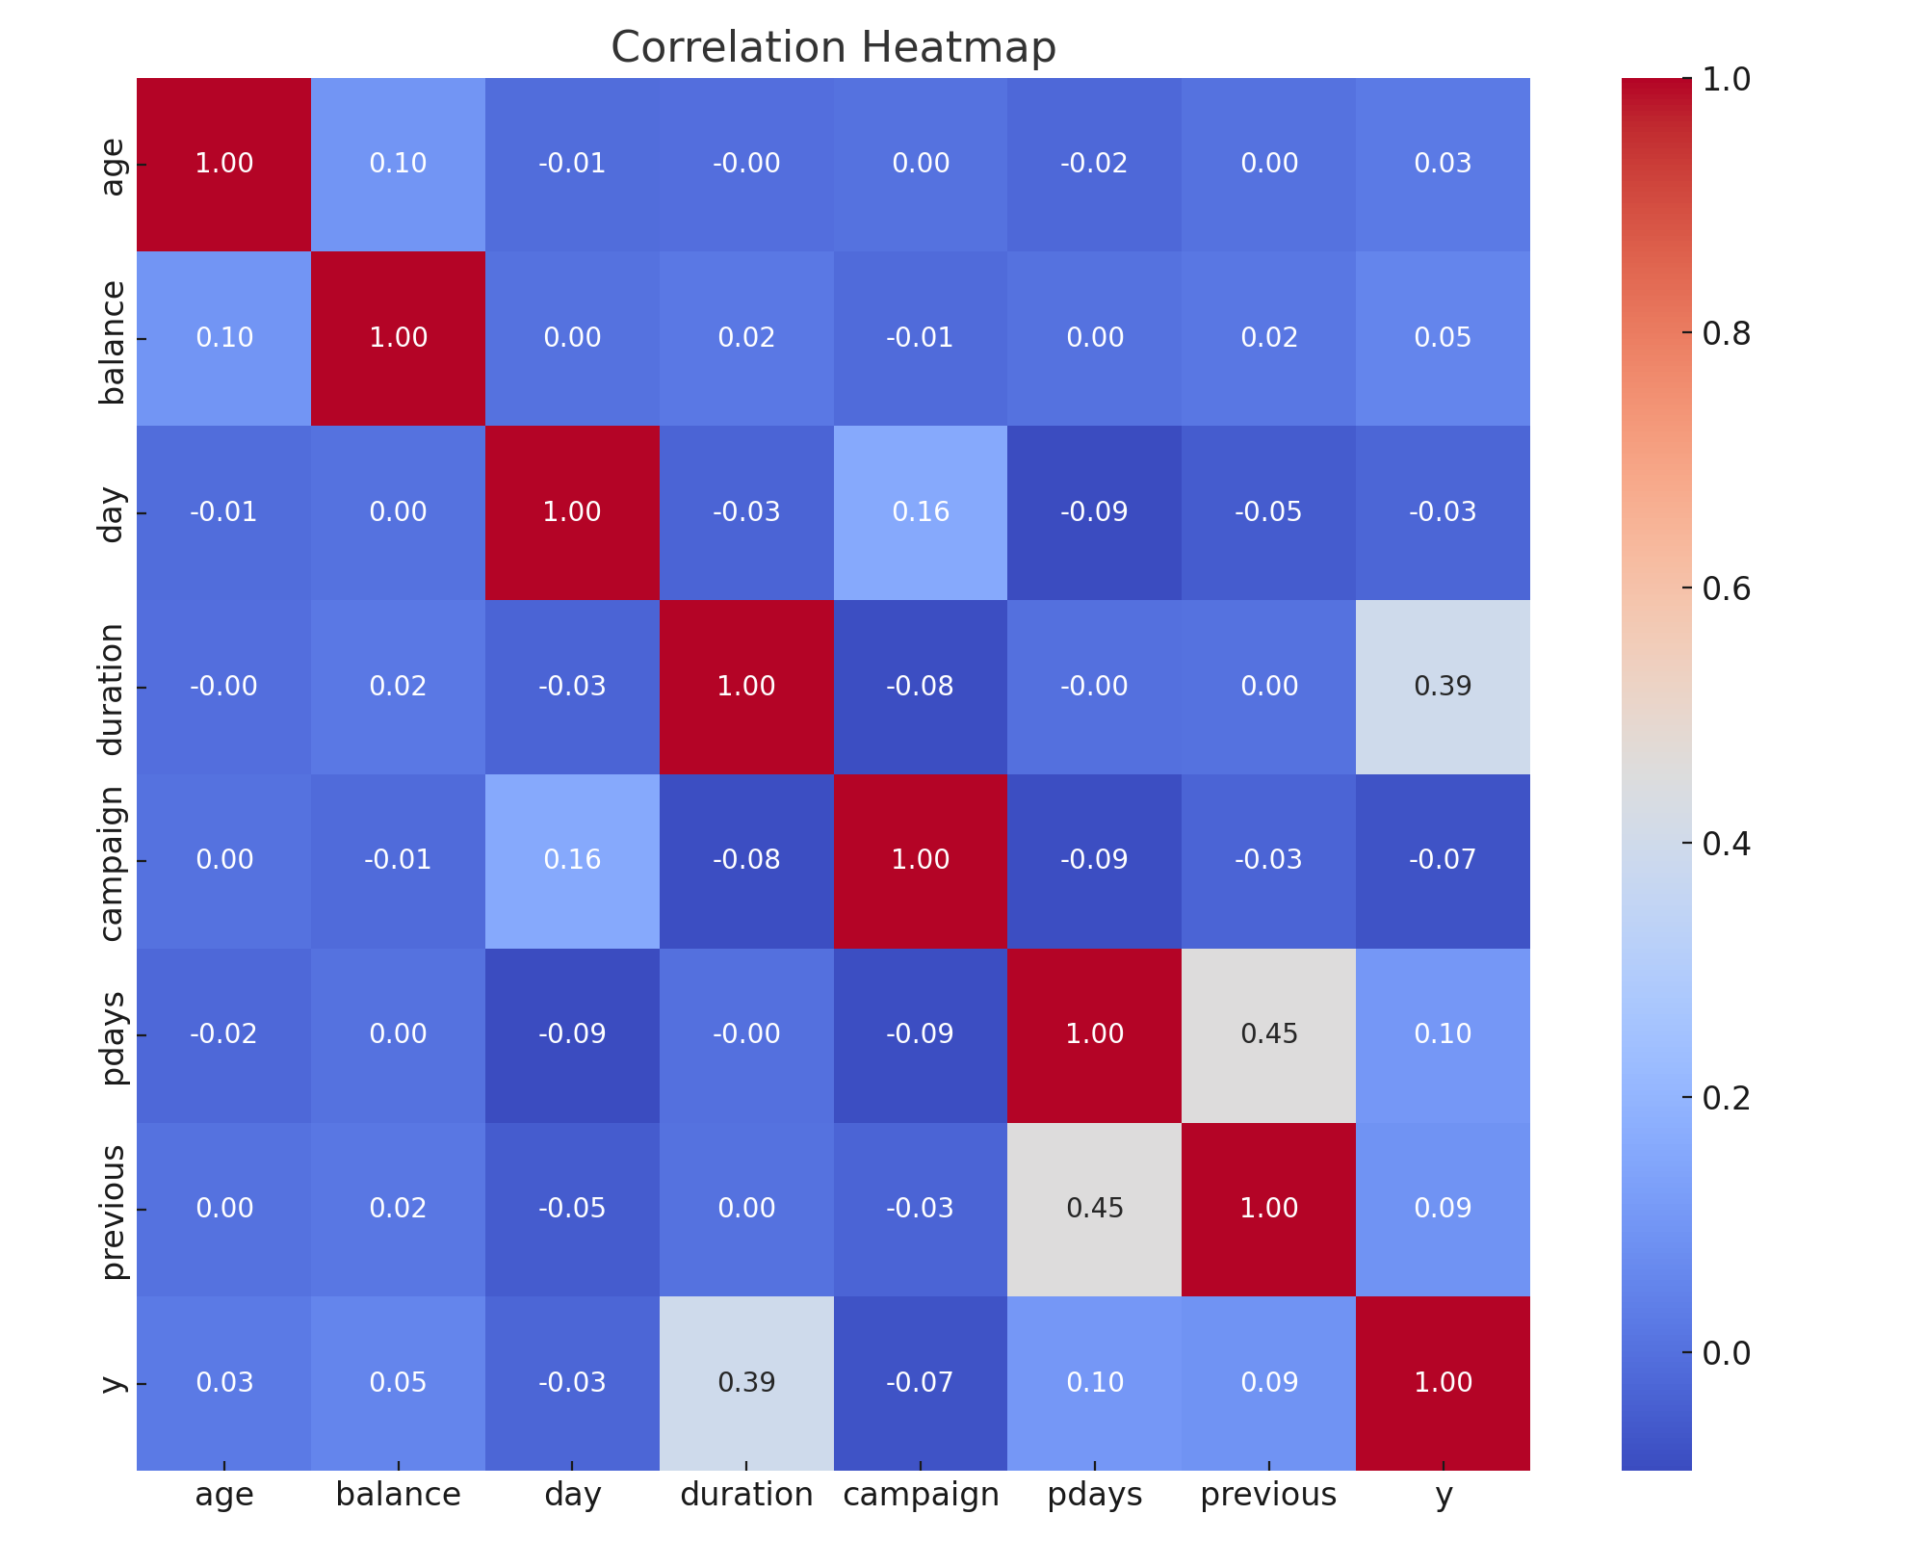
Correlation Heatmap

Slide 9
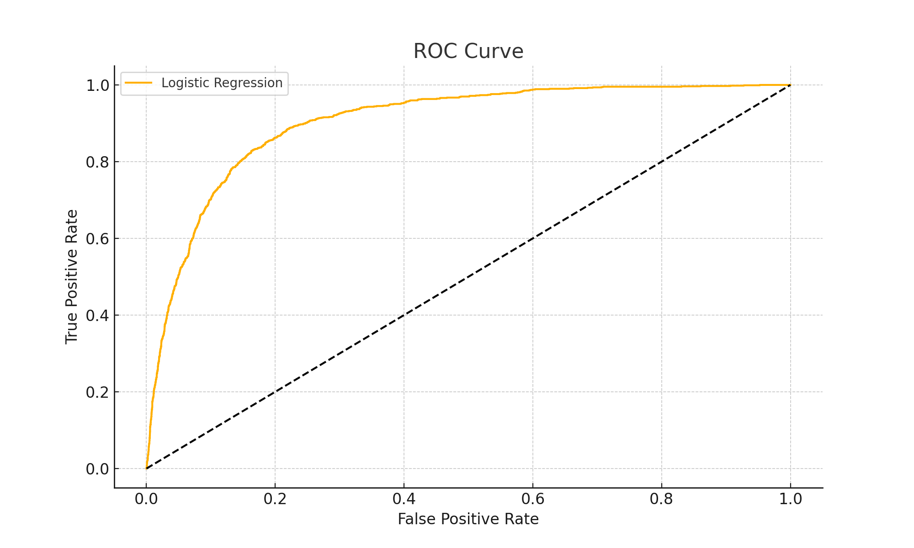
ROC Curve

Slide 10
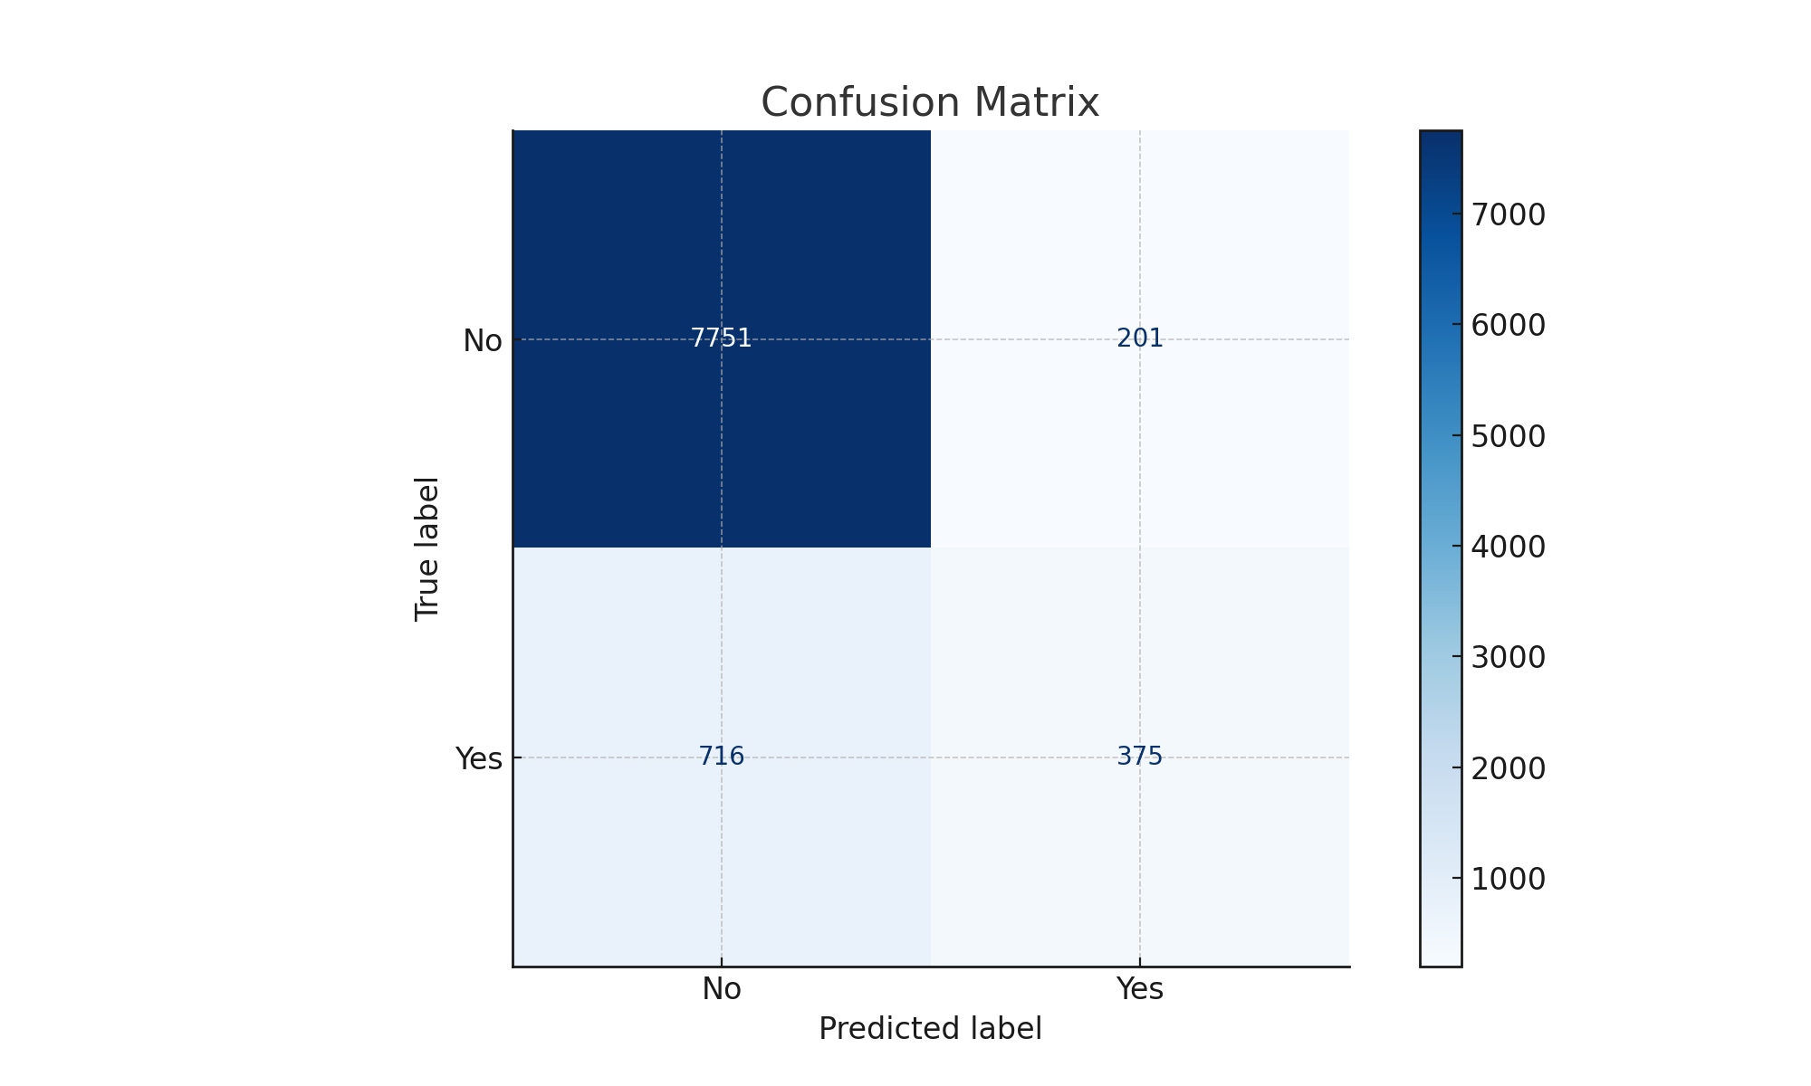
Confusion Matrix

Slide 11
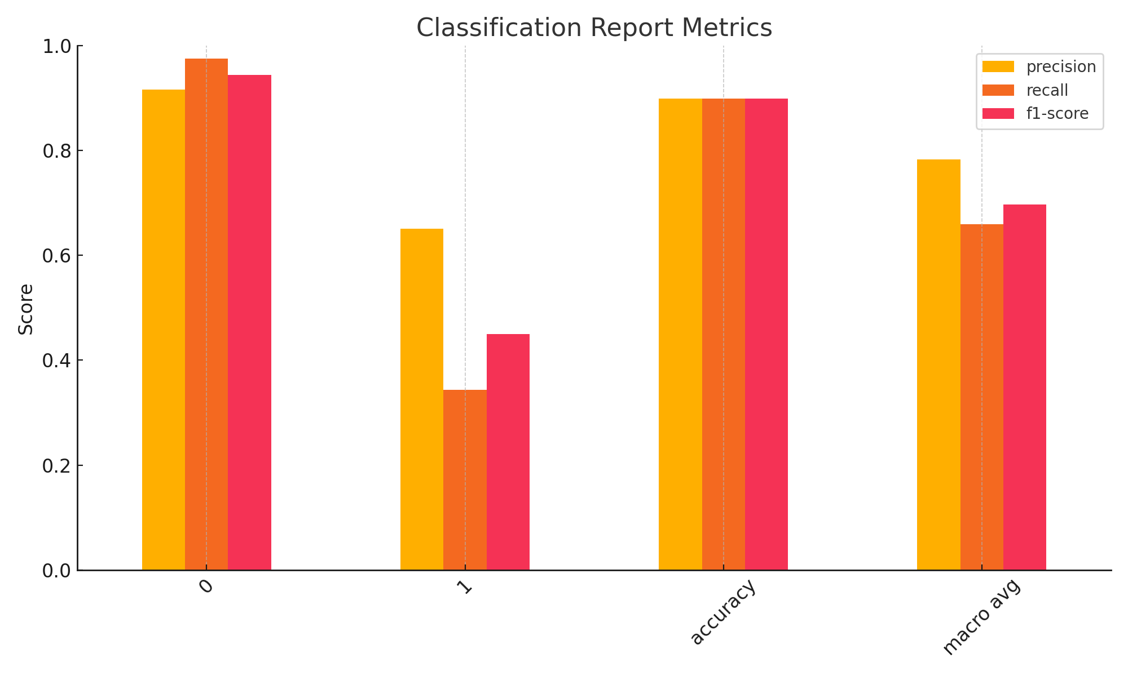
Classification Metrics

Slide 12
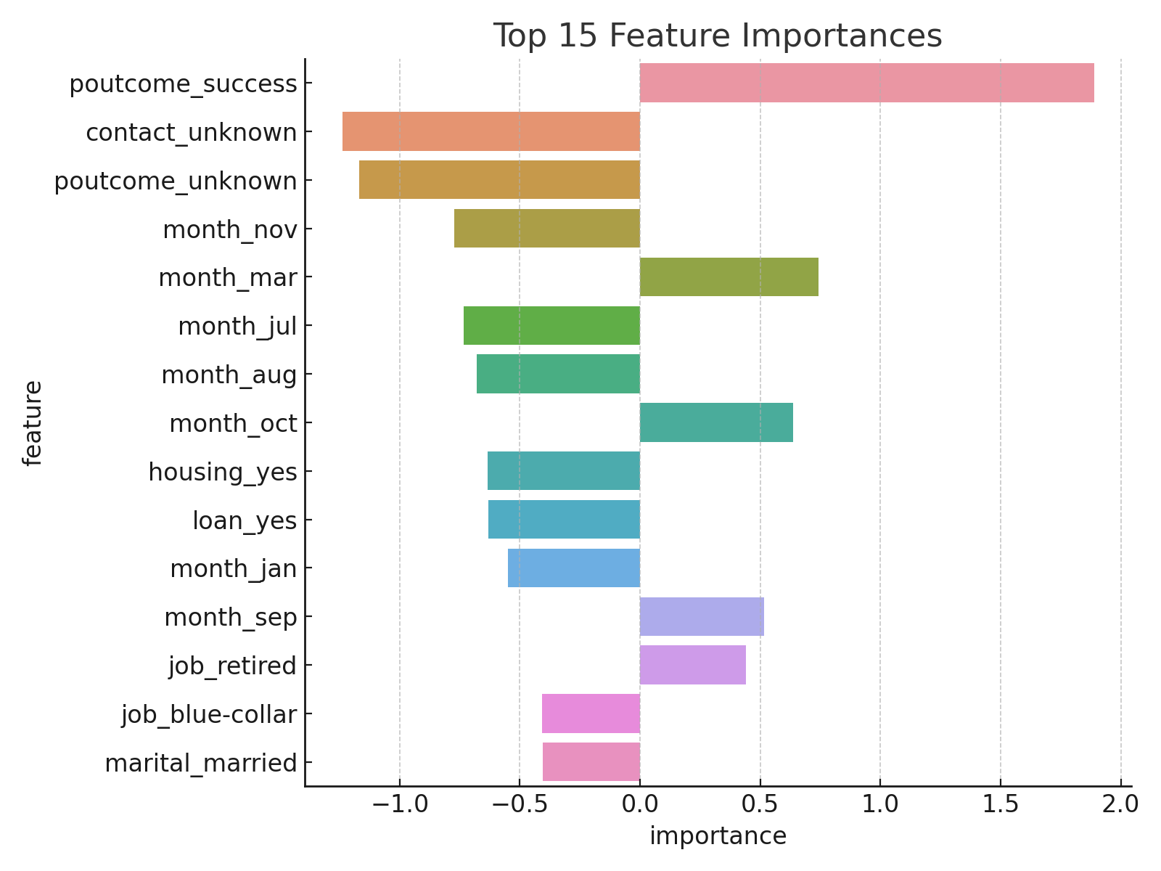
Top Feature Importances

Slide 13
Conclusion
The model's ROC curve shows strong discrimination ability between classes, and the confusion matrix reveals it can predict both positives and negatives reasonably well.
The model achieved balanced precision and recall, making it reliable for business decisions. Classification metrics showed good F1-score, especially for identifying clients likely to subscribe.

