Slide 1
Random Forest Analysis of Company Sales Data: Insights & Predictions

Slide 2
Business Objective
To understand the factors influencing product sales and build a predictive model using Random Forest to estimate sales based on various company features.

Slide 3
Dataset Overview
Total entries: 400
Target variable: Sales (Continuous)
Numerical Features: CompPrice, Income, Advertising, Population, Price, Age, Education
Categorical Features: ShelveLoc, Urban, US
Key Statistical Insights (Sales)
Mean: 7.50
Standard Deviation: 2.82
Range: 0 to 16.27
25%-75% Range: [5.39, 9.32] — middle 50% of sales

Slide 4
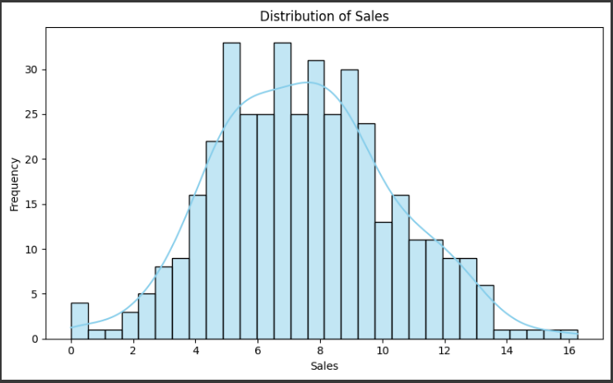
Plot for Sales Distribution

Slide 5
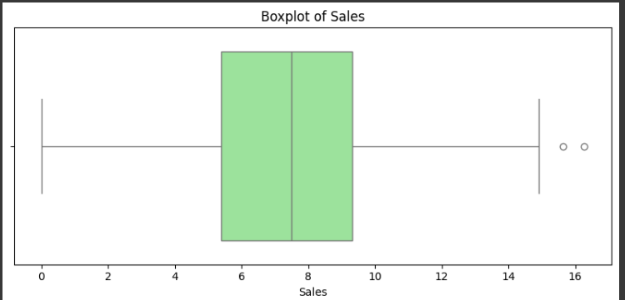
Box Plot for Sales

Slide 6
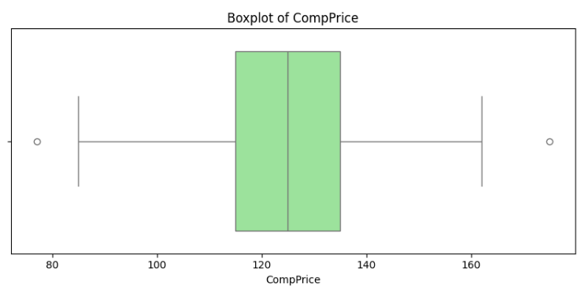
Box Plot for Comp Price

Slide 7
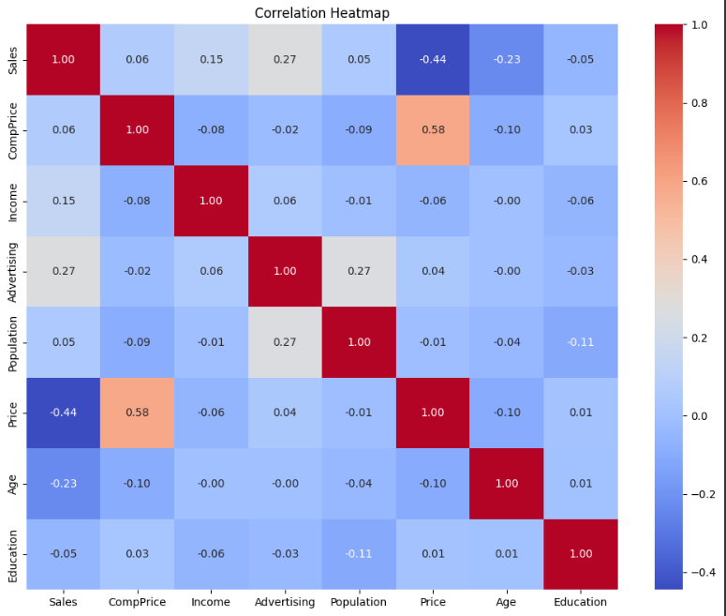
Heat Map

Slide 8
EDA Insights
Sales Distribution:
Sales range from 0 to ~16 units.
The distribution is slightly right-skewed, with a peak around 7–9 units.
Key Correlations:
Price and CompPrice show a moderate negative correlation with sales — lower prices tend to increase sales.
Advertising, Income, and ShelveLoc appear to have some positive impact.
Boxplots revealed:
Some features like Advertising, Population, and Income have potential outliers.
ShelveLoc has a strong visual effect on sales, especially with "Good" shelf locations.

Slide 9
Random Forest Prediction Insights
Random Forest Regression Summary
R² Score: 0.683 → The model explains approximately 68.3% of the variation in sales.
MAE (Mean Absolute Error): 1.44 → On average, predictions are off by about 1.44 units of sales.
RMSE (Root Mean Squared Error): 1.77 → Reflects moderate prediction error.

Slide 10
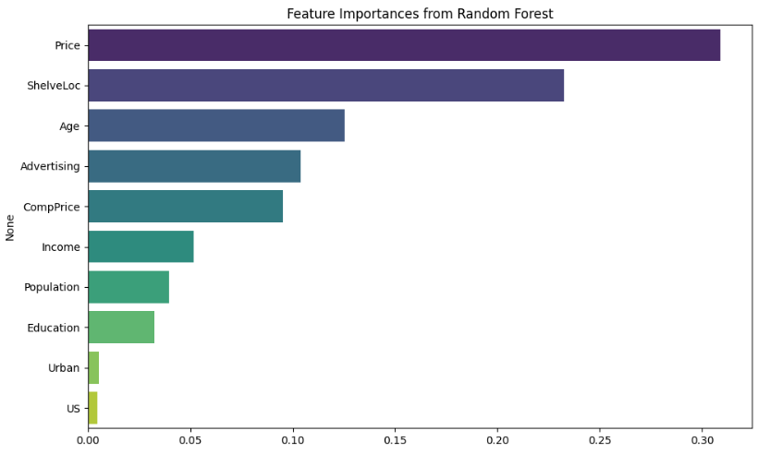
Feature Importance Chart

Slide 11
Feature Importance Ranking
From the Random Forest model:
ShelveLoc (shelf location) — most impactful
Price — strongly influences sales
Advertising — higher budgets increase sales
CompPrice and Income — also moderately important

Slide 12
Conclusion
Shelf Placement is the most powerful driver of sales. Improving shelf visibility can significantly increase revenue.
Lowering Prices and Boosting Advertising are effective levers for increasing sales.
The Random Forest model is effective but can be further improved with feature engineering or more granular data.

