Slide 1
Salary Prediction using Regression
Based on Employee Levels and Experience

Slide 2
Objective
To predict the salary for a new employee using historical salary data based on job level and role.
Use Linear and Polynomial Regression Models
Evaluate accuracy using R², MAE, MSE, RMSE
Visualize the model performance
Make predictions for a new case (Level 6.5)

Slide 3
Dataset Overview
Dataset contains job positions, corresponding levels, and salaries.
10 data points
Columns: Position, Level, Salary
Small structured dataset (no missing values)

Slide 4
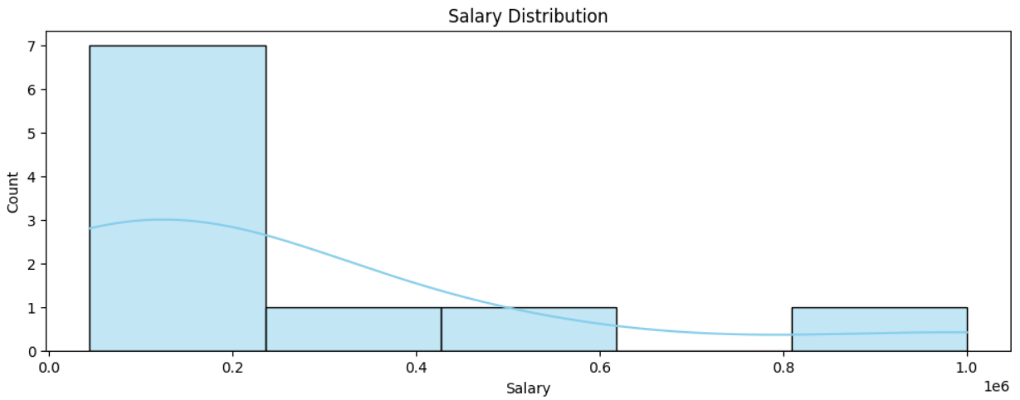
Chart for Salary Distribution

Slide 5
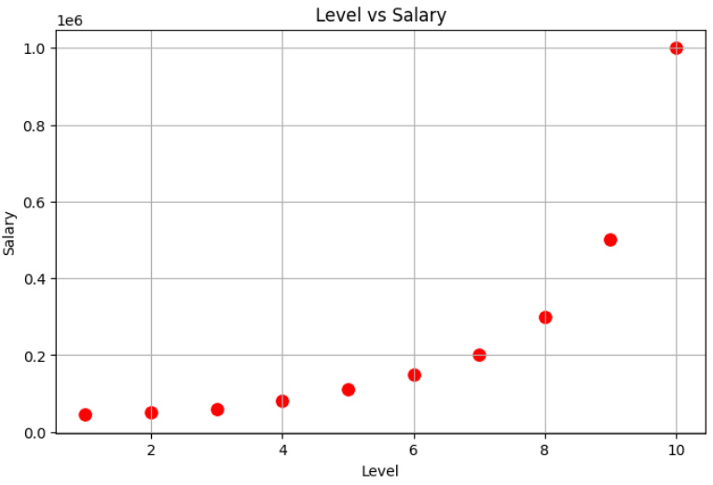
Scatter Plot For Salary and Level

Slide 6
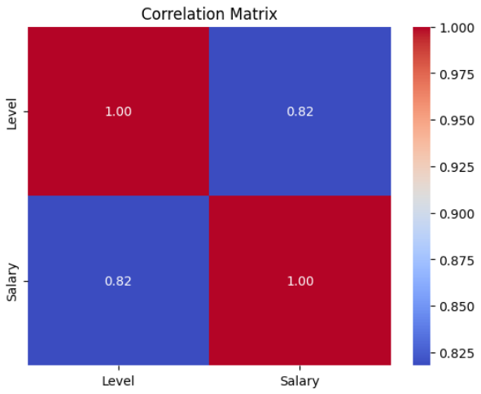
Correlation Heat Map

Slide 7
Exploratory Data Analysis
Key insights from the data distribution and relationships:
Salary increases with level (non-linear trend)
No missing values or anomalies
Strong correlation between Level and Salary

Slide 8
Model Building
Two models were built and trained:
Linear Regression
Polynomial Regression (Degree 4)
All data used for training due to small size

Slide 9
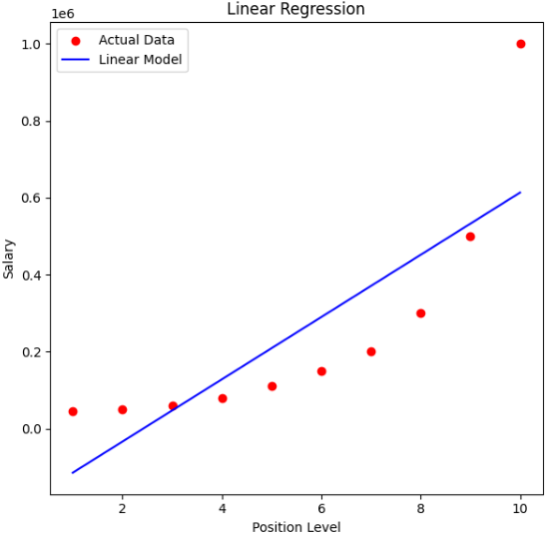
Scatter Plot for Linear Regression

Slide 10
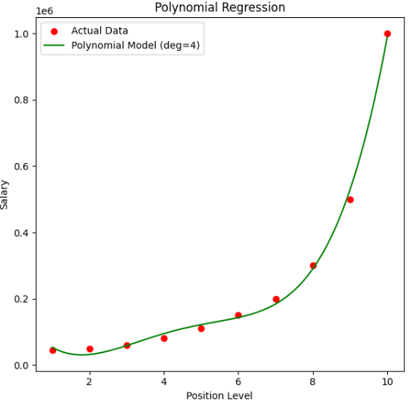
Scatter Plot for Polynomial Regression

Slide 11
Model Predictions
Predicted salary for a Level 6.5 employee:
Linear Regression: ₹330,378.79
Polynomial Regression: ₹158,862.45
Polynomial captures non-linearity better

Slide 12
Model Evaluation
Diagnostic metrics used for evaluation:
Linear Regression: R² = 0.669, RMSE ≈ ₹163K
Polynomial Regression: R² = 0.997, RMSE ≈ ₹14.5K
Polynomial Model is more accurate

Slide 13
Conclusion
Key findings and recommendations:
Polynomial Regression fits the data well
Recommended salary for Level 6.5: ₹158,862
Linear regression is too simplistic for this case

