Slide 1
ITP4501
Programming Techniques for Mobile Systems
Assignment

Slide 2
UI design

Slide 3
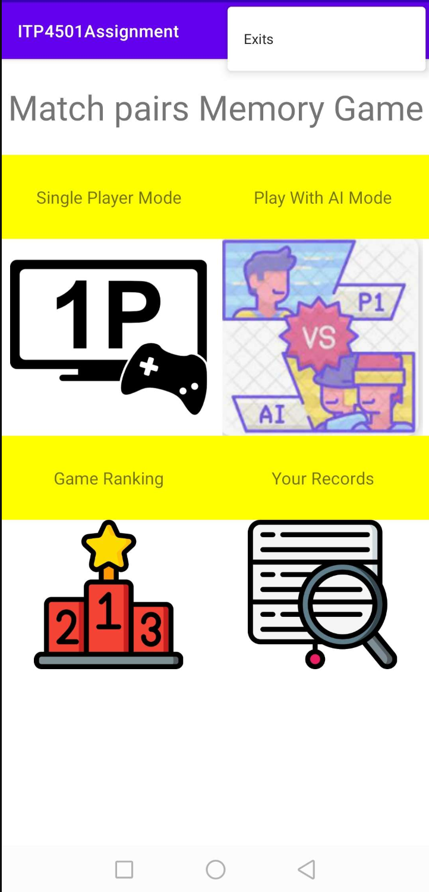
initial login page
Single Player Mode
Play with AI Mode
Game Ranking
Your Records
Exits
menu in the top right corner of every page. The menu has an Exit button, which allows users to directly leave the app.

Slide 4
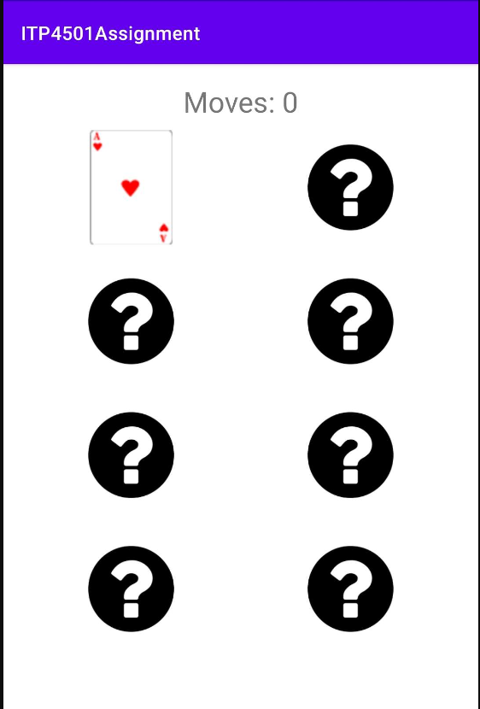
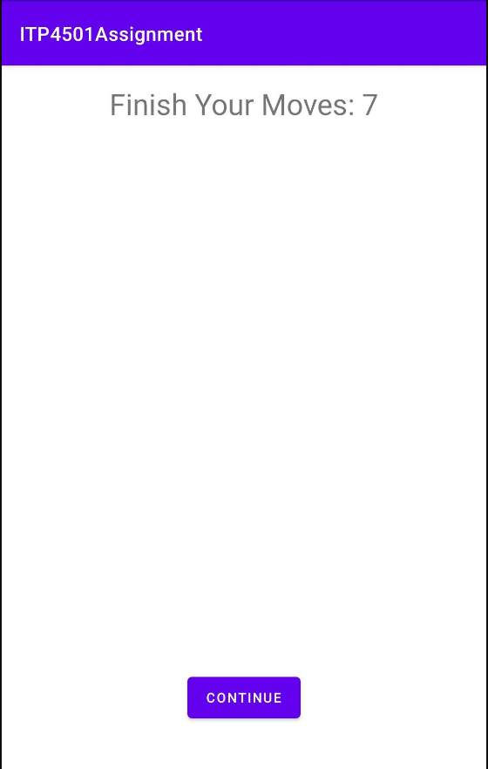
start
end
Single player mode
4x2 matching pairs game
Show the player's step count
Image pairing
Continue button after the game ends

Slide 5
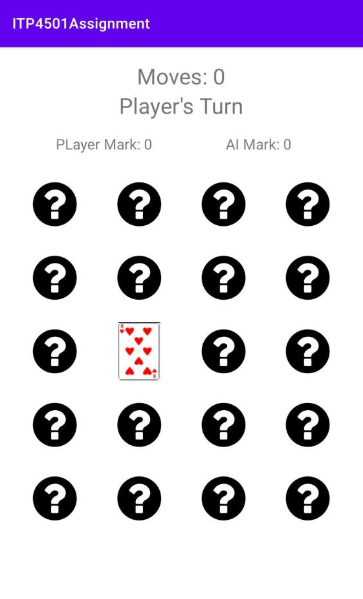
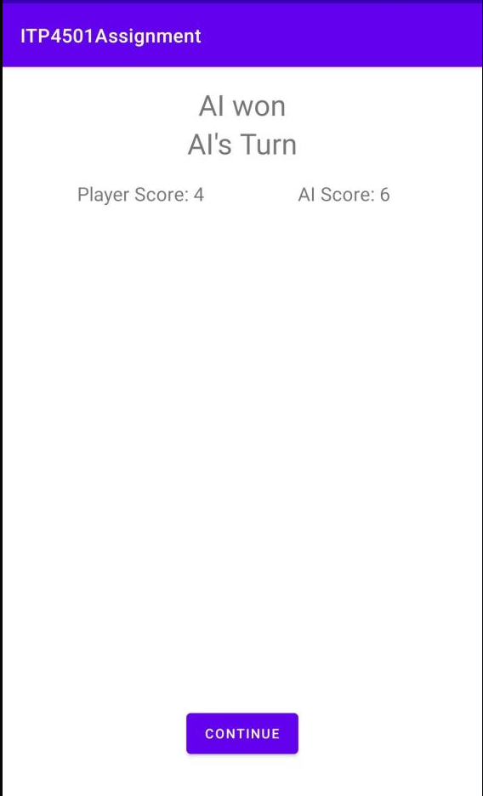
Play with Ai mode
start
end
5x4 matching pairs game
Show the player's step count
Image pairing
Continue button after the game ends

Slide 6
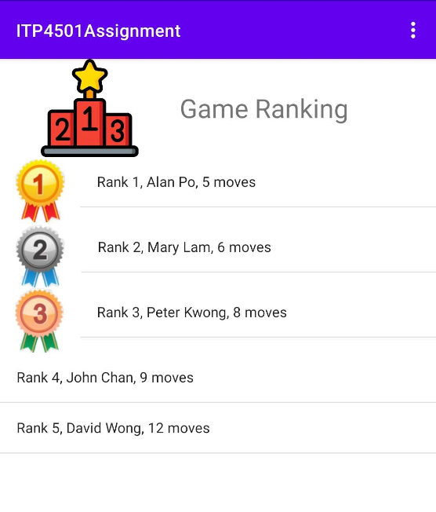
Game ranking
Medals for the top three players on the leaderboard
- Gold, silver, and bronze medals are displayed next to the names of the top three players

Slide 7
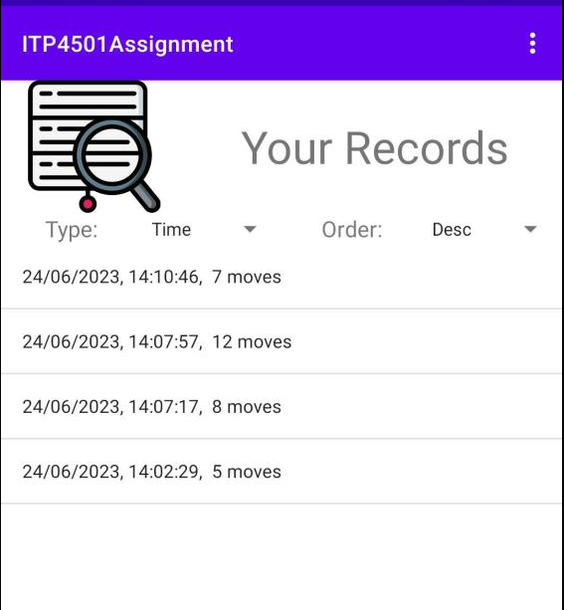
Your records
Display of playtime and number of steps in Single Player Mode:
- The UI shows the player's total playtime and steps taken in the mode
Sorting options for time and moves:
- Players can sort their statistics by time and moves, both in ascending and descending order

Slide 8
game development

Slide 9
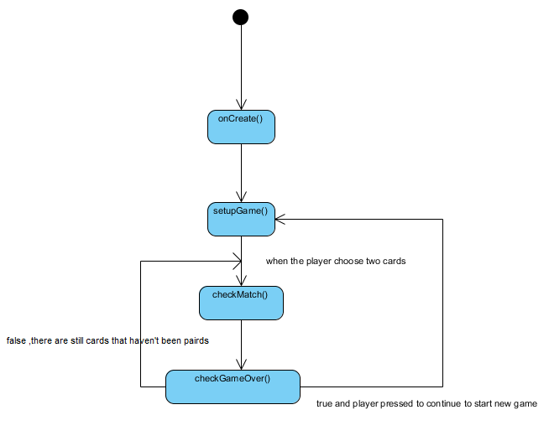
Single player mode

Slide 10
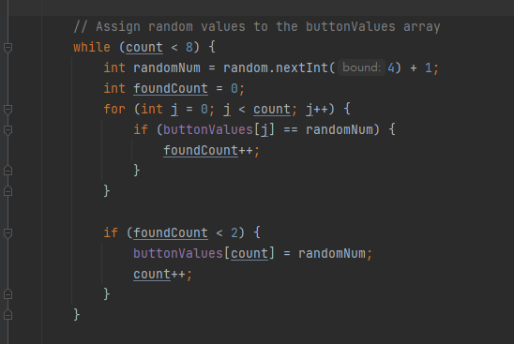
Single player mode
Randomly assign values

Slide 11
Play with Ai mode
The AI's card memory uses a HashMap.
Eg:
keys | 1 | 2 | 5 | 6
Values | 5 | 6 | 5 | 9
If AI uses memory:
Randomly select a card index from memory as the first choice.
Search memory for a matching card to the first one.
If a match is found:
Set the second index to the matching card's index
If no match is found:
Randomly select a second card index

Slide 12

Game ranking
The game ranking uses four ListView because I don't know how to obtain the height of each row in an array adapter and then adjust the image size accordingly.
1
sort
2
3
Fetch JSON values line by line, add them to an ArrayList, and then sort based on the "moves" value.
4

Slide 13
Your records
Use SQL to sort

