Slide 1
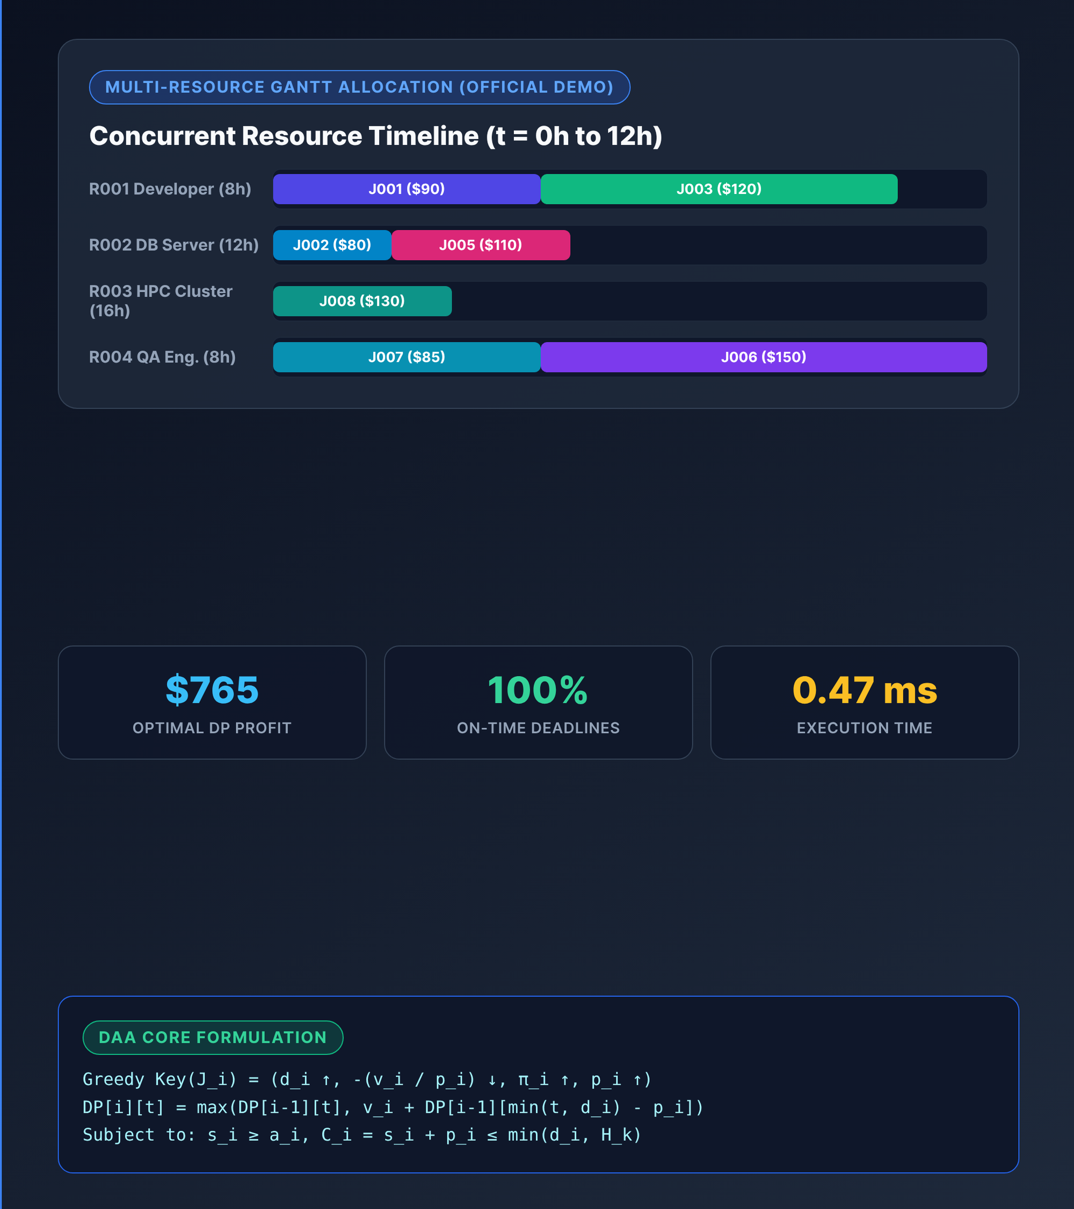
DESIGN AND ANALYSIS OF ALGORITHMS | 5TH SEMESTER
Job Scheduling System
Greedy Heuristic and Dynamic Programming Optimization Under Resource Constraints
Student & Enrollment | Om Prajapati (12402080601098)
Student & Enrollment | Om Patel (12402080601099)
Course: DAA (5th Sem) | Student: Om Prajapati | Slide 1 of 15

Slide 2
SLIDE 2 | PROBLEM STATEMENT
Allocating Jobs Across Heterogeneous Resources to Maximize Total Profit
Input & Output Model
Candidate Jobs: Set of n tasks with arrival a_i, burst p_i, deadline d_i, and profit v_i.
Resource Pool: Set of m heterogeneous machines or staff with shift cap H_k.
Expected Output: Disjoint schedule S mapping jobs to start/end windows.
System Constraints
Strict Deadlines: Scheduled tasks finish by deadline (C_i = s_i + p_i <= d_i).
Shift Capacity: Total work on resource R_k stays within available hours H_k.
Exclusivity: Matching resource type required with zero interval overlap.
System Objective
Maximize Profit: Maximize cumulative reward sum(v_i) across all resources.
High Utilization: Pack compatible timelines while minimizing missed jobs.
Dual Evaluation: Benchmark fast Greedy heuristics vs. exact DP optimization.
Problem Statement: Multi-Resource Deadline-Constrained Job Scheduling | Slide 2 of 15

Slide 3
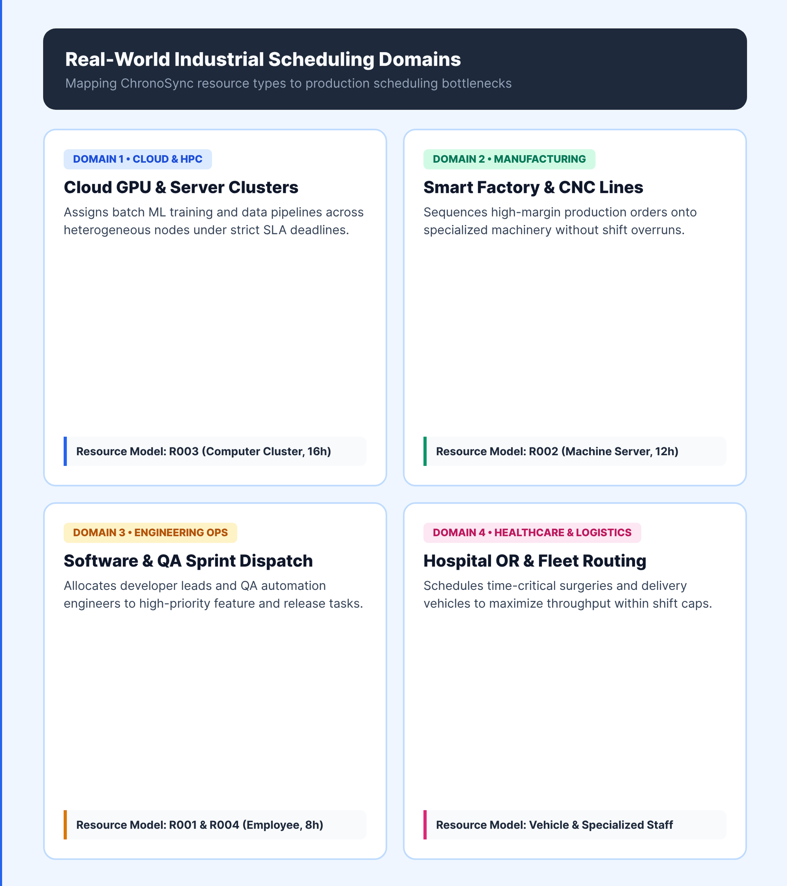
SLIDE 3 | MOTIVATION & REAL-WORLD APPLICATION
Resource Contention Under Deadlines
Why It Matters: Over-subscribed clusters lose revenue when high-value tasks miss deadlines.
Combinatorial Scale: Exhaustive O(2^n) search fails on large queues; FIFO drops top-profit jobs.
Cloud & HPC Nodes: Assigns GPU/CPU batch workloads (R003) to maximize cluster revenue.
Factory & DevOps: Schedules CNC machinery (R002), QA engineers (R004), and CI/CD pipelines.
Who Benefits: Cloud operators, factory floor planners, hospital OR teams, and IT ops.
Motivation & Real-World Applications | Slide 3 of 15

Slide 4
SLIDE 4 | PROJECT OBJECTIVES
Six Measurable Objectives Grounded in Algorithm Design and Analysis
Algorithmic Design
Dual Optimizers: Implement Greedy O(N log N + NM) and Exact DP O(N*T) engines.
Constraint Safety: Enforce 8 scheduling invariants with 100% deadline compliance.
Empirical Rigor
Controlled Trials: Evaluate identical seeded inputs (N = 10, 50, 100, 500) over 5 runs.
Precision Timing: Measure pure algorithmic runtime via time.perf_counter() timers.
Visual & Analytical
Glass-Box Trace: Render interactive 2D DP tables DP[i][t] and Gantt timelines.
Asymptotic Study: Contrast theoretical Big-O bounds against practical scaling limits.
Project Objectives: Algorithmic Design, Benchmarking & Verification | Slide 4 of 15

Slide 5
SLIDE 5 | EXISTING APPROACH & BACKGROUND
Traditional Single-Rule Schedulers Miss Multi-Resource Profit Optima
Basic OS Approaches: Classical FCFS, SJF, and Priority rank tasks by a single static attribute.
Uniprocessor Limit: Standard textbook Job Sequencing assumes unit bursts (p_i = 1) on one machine.
Blind to Density: Single-rule dispatchers ignore reward-to-duration ratio (v_i / p_i) and types.
Myopic Local Trap: Greedy single-pass choices commit early, blocking higher-profit combinations.
Proposed Need: Pair fast multi-key Greedy heuristics with exact Multi-Resource DP.
Comparison on Official 8-Job Multi-Resource Demo Dataset (J001-J008) | Slide 5 of 15

Slide 6
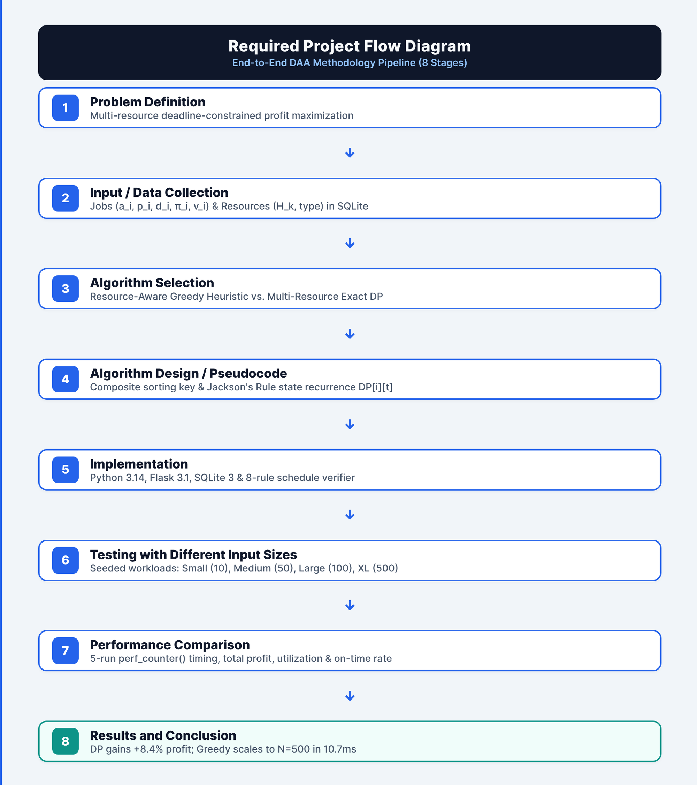
SLIDE 6 | PROPOSED APPROACH & SOLUTION FLOW
Eight-Stage DAA Methodology Pipeline
1-2. Problem & Data: Formulate job tuples (a_i, p_i, d_i, v_i) and seed SQLite workloads.
3-4. Algorithm Design: Pair composite Greedy heuristic sorting with Jackson's Rule DP recurrence.
5. Implementation: Build modular Python engines (greedy.py, dynamic_programming.py) & verifier.
6. Multi-Size Testing: Evaluate identical datasets across Small (10), Medium (50), Large (100), XL (500).
7-8. Analysis & Results: Compare 5-run mean perf_counter() timing, total profit, and scalability.
Proposed Approach & Required 8-Stage Project Flow | Slide 6 of 15

Slide 7
SLIDE 7 | ALGORITHMS USED & DATA STRUCTURES
Complementary Greedy and Dynamic Programming Algorithms Implemented
Algorithm Implemented | Core Algorithmic Idea | Why Selected for Project | Relevant Data Structures
1. Resource-Aware Greedy (greedy.py) | Sorts jobs by composite key (d_i, -v_i/p_i, priority, p_i); assigns earliest feasible gap on compatible resource. | Provides ultra-fast O(N log N + N*M) scheduling that scales cleanly to N >= 500 jobs in ~10 ms. | Sorted job array, resource hash map (res_pool), sorted interval list [(s, e)].
2. Multi-Resource Exact DP (dynamic_programming.py) | Orders jobs by deadline (Jackson's Rule); computes optimal profit over state tuples (t_1..t_m) & 2D grid DP[i][t]. | Guarantees global profit optimality across overlapping multi-job trade-offs where Greedy is suboptimal. | State dictionary (dp_dict), 2D matrix DP[N+1][T+1], backtracking history list.
3. Weighted Interval & 0/1 Knapsack DP | Uses binary search (bisect_right) for non-conflicting predecessor p[j] and capacity table DP[i][w]. | Establishes theoretical uniprocessor baseline ($360 single timeline vs $765 multi-resource). | Sorted finish-time array, predecessor index array p[1..n], boolean take_decision.
Algorithms Implemented: Greedy Heuristic, Multi-Resource DP & Interval Baselines | Slide 7 of 15

Slide 8
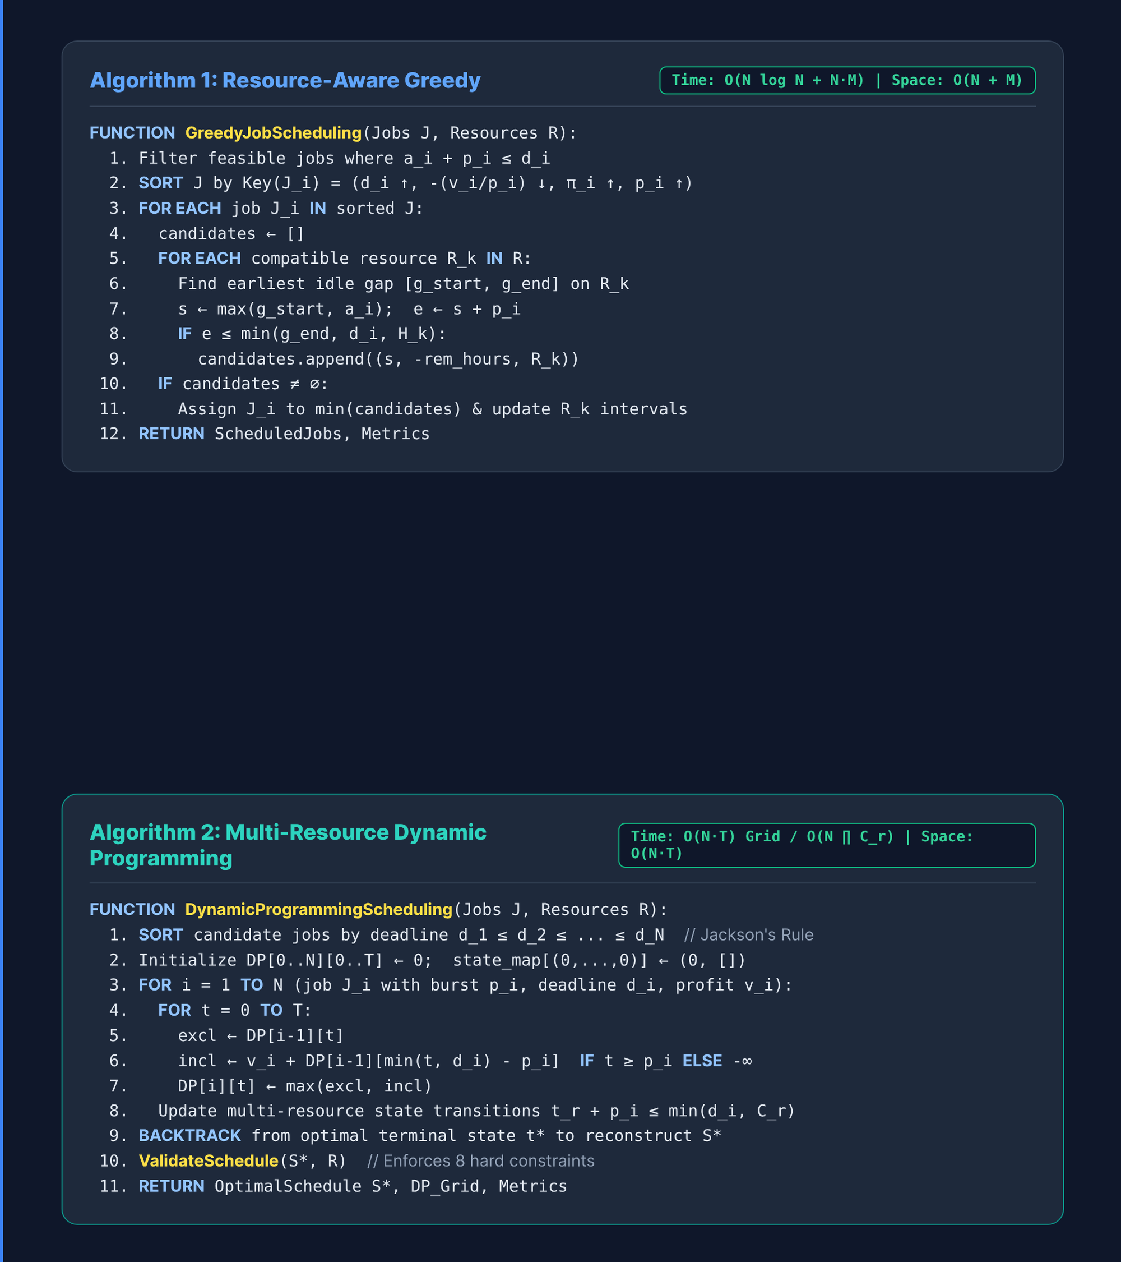
SLIDE 8 | ALGORITHM & PSEUDOCODE
Greedy Heuristic Versus DP Recurrence
Greedy Sorting Key: Sorts feasible jobs by (d_i asc, -v_i/p_i desc, priority asc) in O(N log N).
Earliest-Gap Scan: Scans compatible resource R_k for earliest idle window [s, s+p_i] <= min(d_i, H_k).
Greedy Complexity: Executes in O(N log N + N*M) time and O(N + M) linear auxiliary space.
DP Jackson Ordering: Sorts candidate tasks by deadline d_1 <= ... <= d_N for optimal substructure.
DP State Recurrence: DP[i][t] = max(DP[i-1][t], v_i + DP[i-1][min(t, d_i) - p_i]); backtracks from t*.
Algorithm Steps, Recurrence & Complexity Bounds | Slide 8 of 15

Slide 9
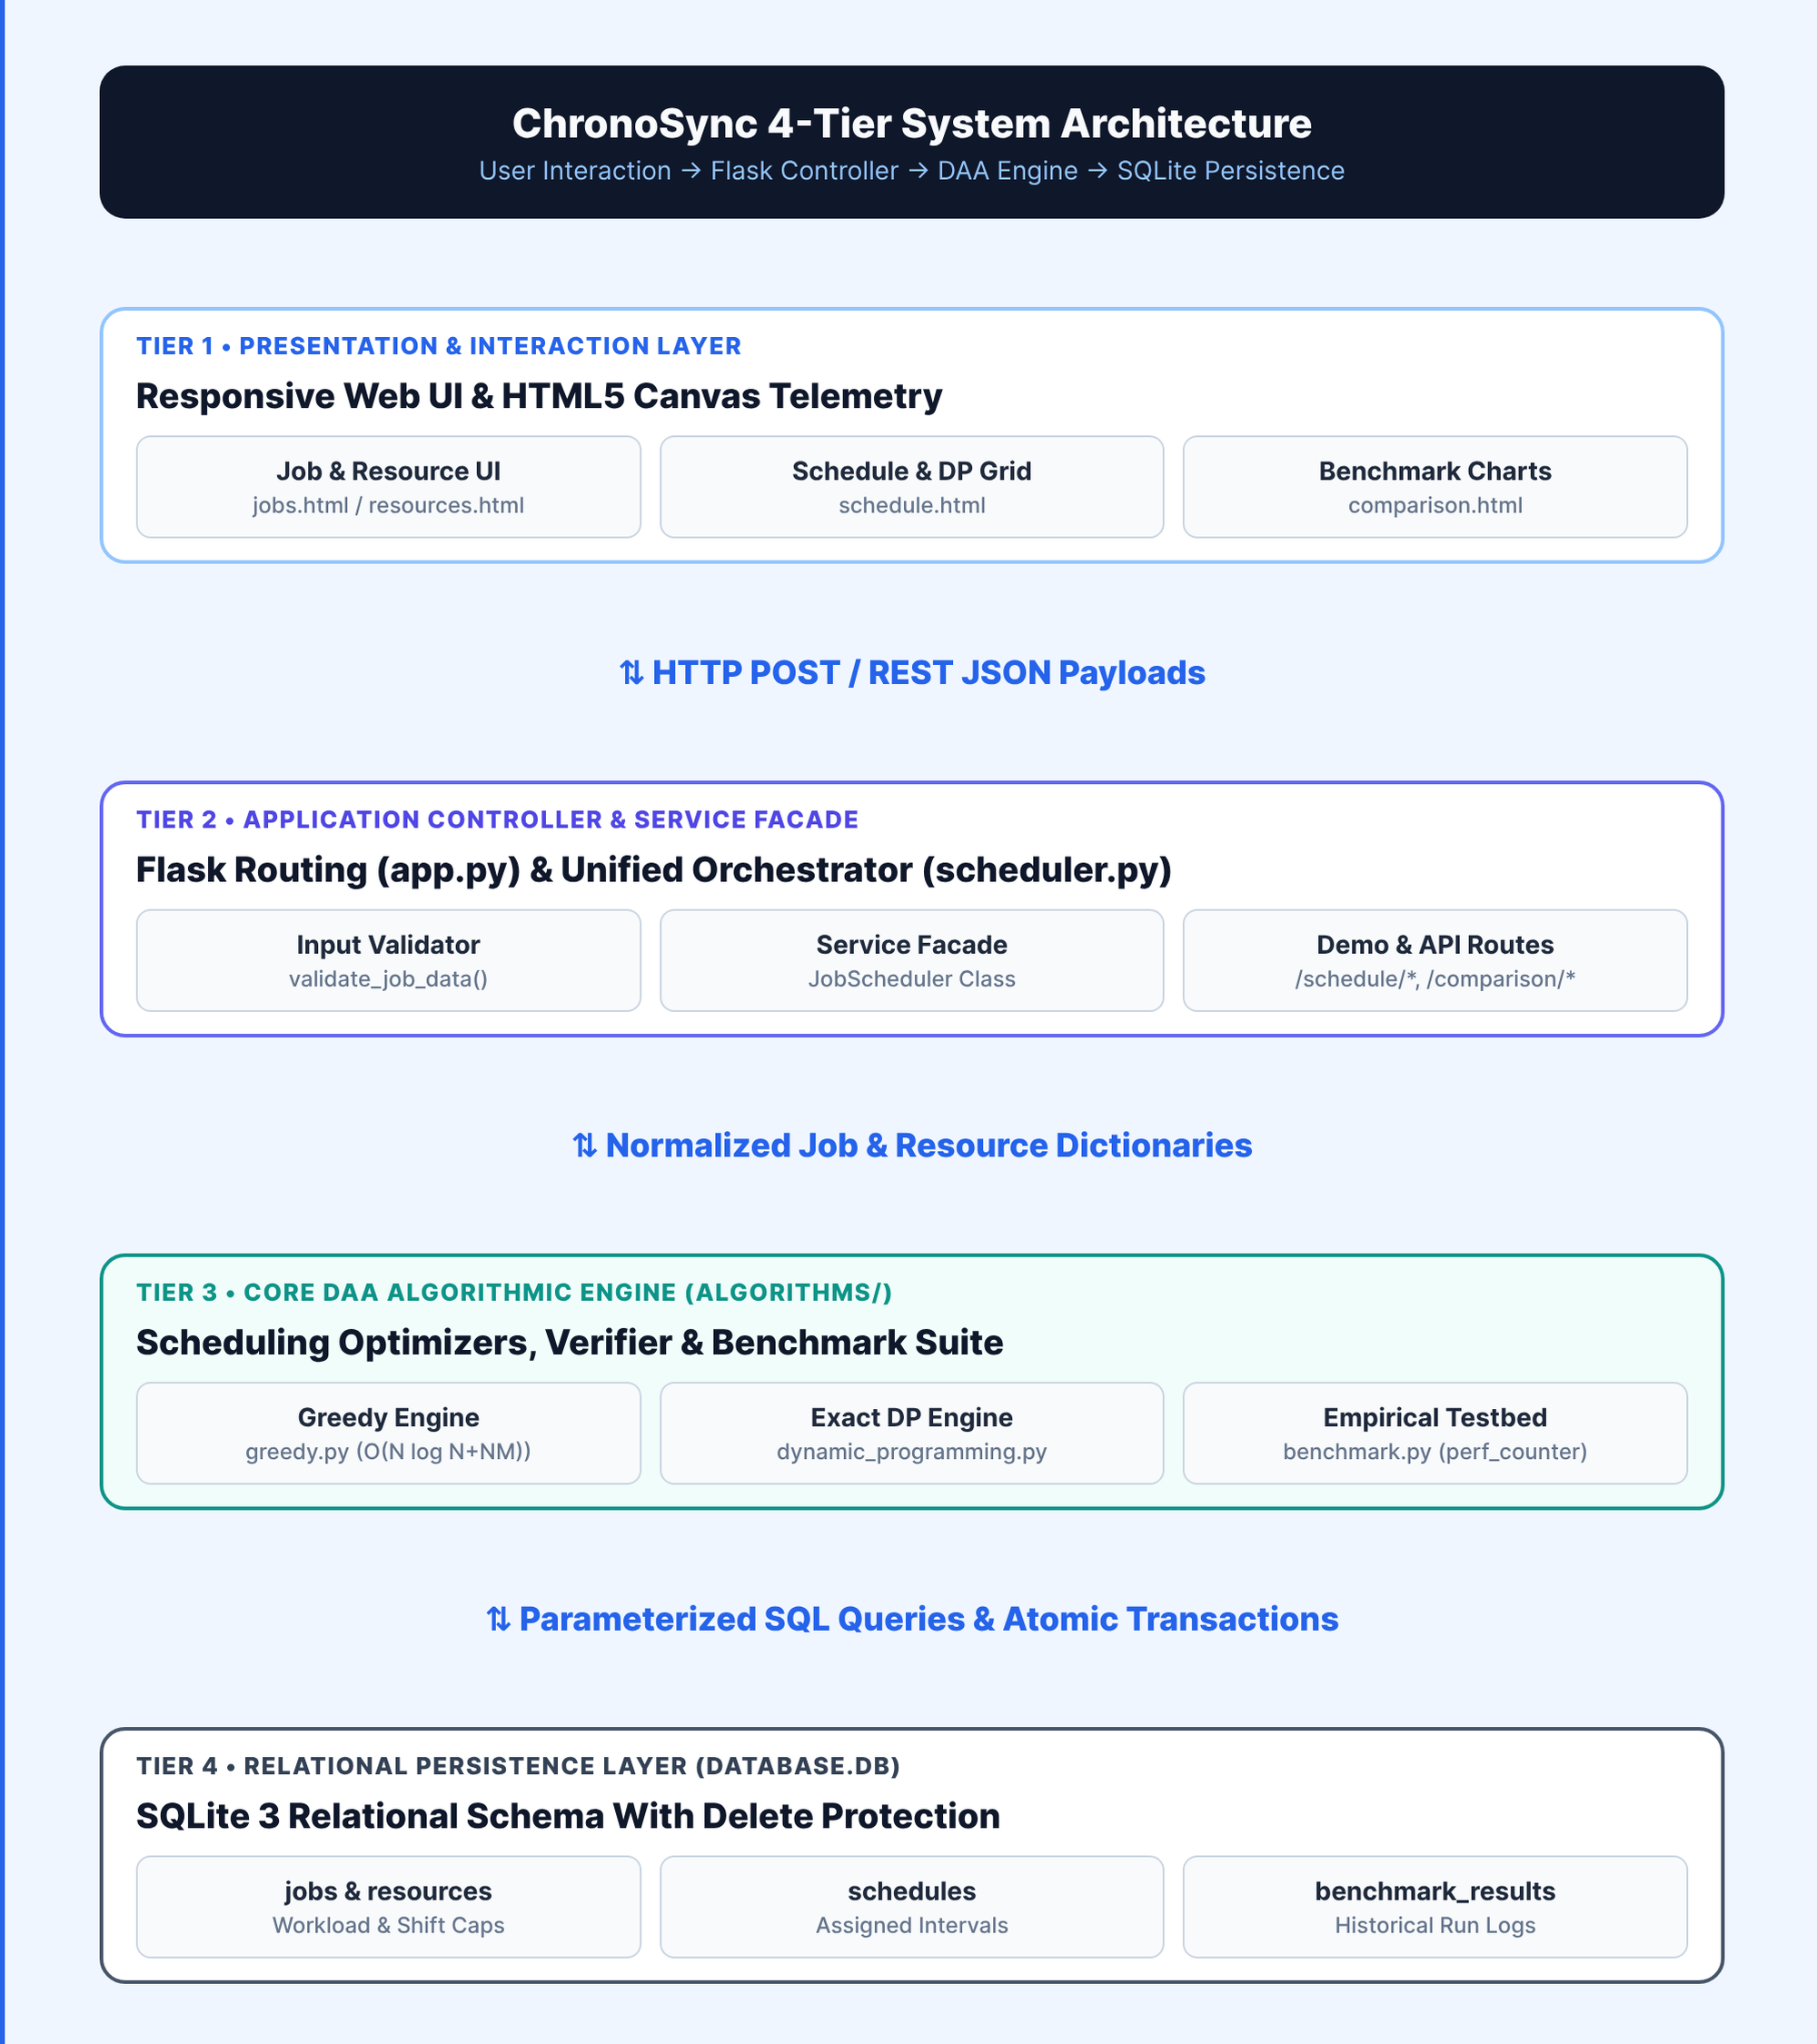
SLIDE 9 | SYSTEM DESIGN & ARCHITECTURE
Four-Tier Modular System Architecture
Presentation Layer: HTML5/CSS3 glassmorphism views and Canvas charts render schedules and DP grids.
Controller Layer (app.py): Flask routes validate inputs, manage demo presets, and serve REST JSON APIs.
Orchestrator (scheduler.py): JobScheduler facade normalizes DB rows, invokes optimizers, and logs telemetry.
Core DAA Layer: Pure Python modules (greedy.py, dynamic_programming.py, benchmark.py) run in-memory.
Persistence (database.db): SQLite 3 stores jobs, resources, schedules, execution_history, and benchmarks.
System Design & Component Interaction Architecture | Slide 9 of 15

Slide 10
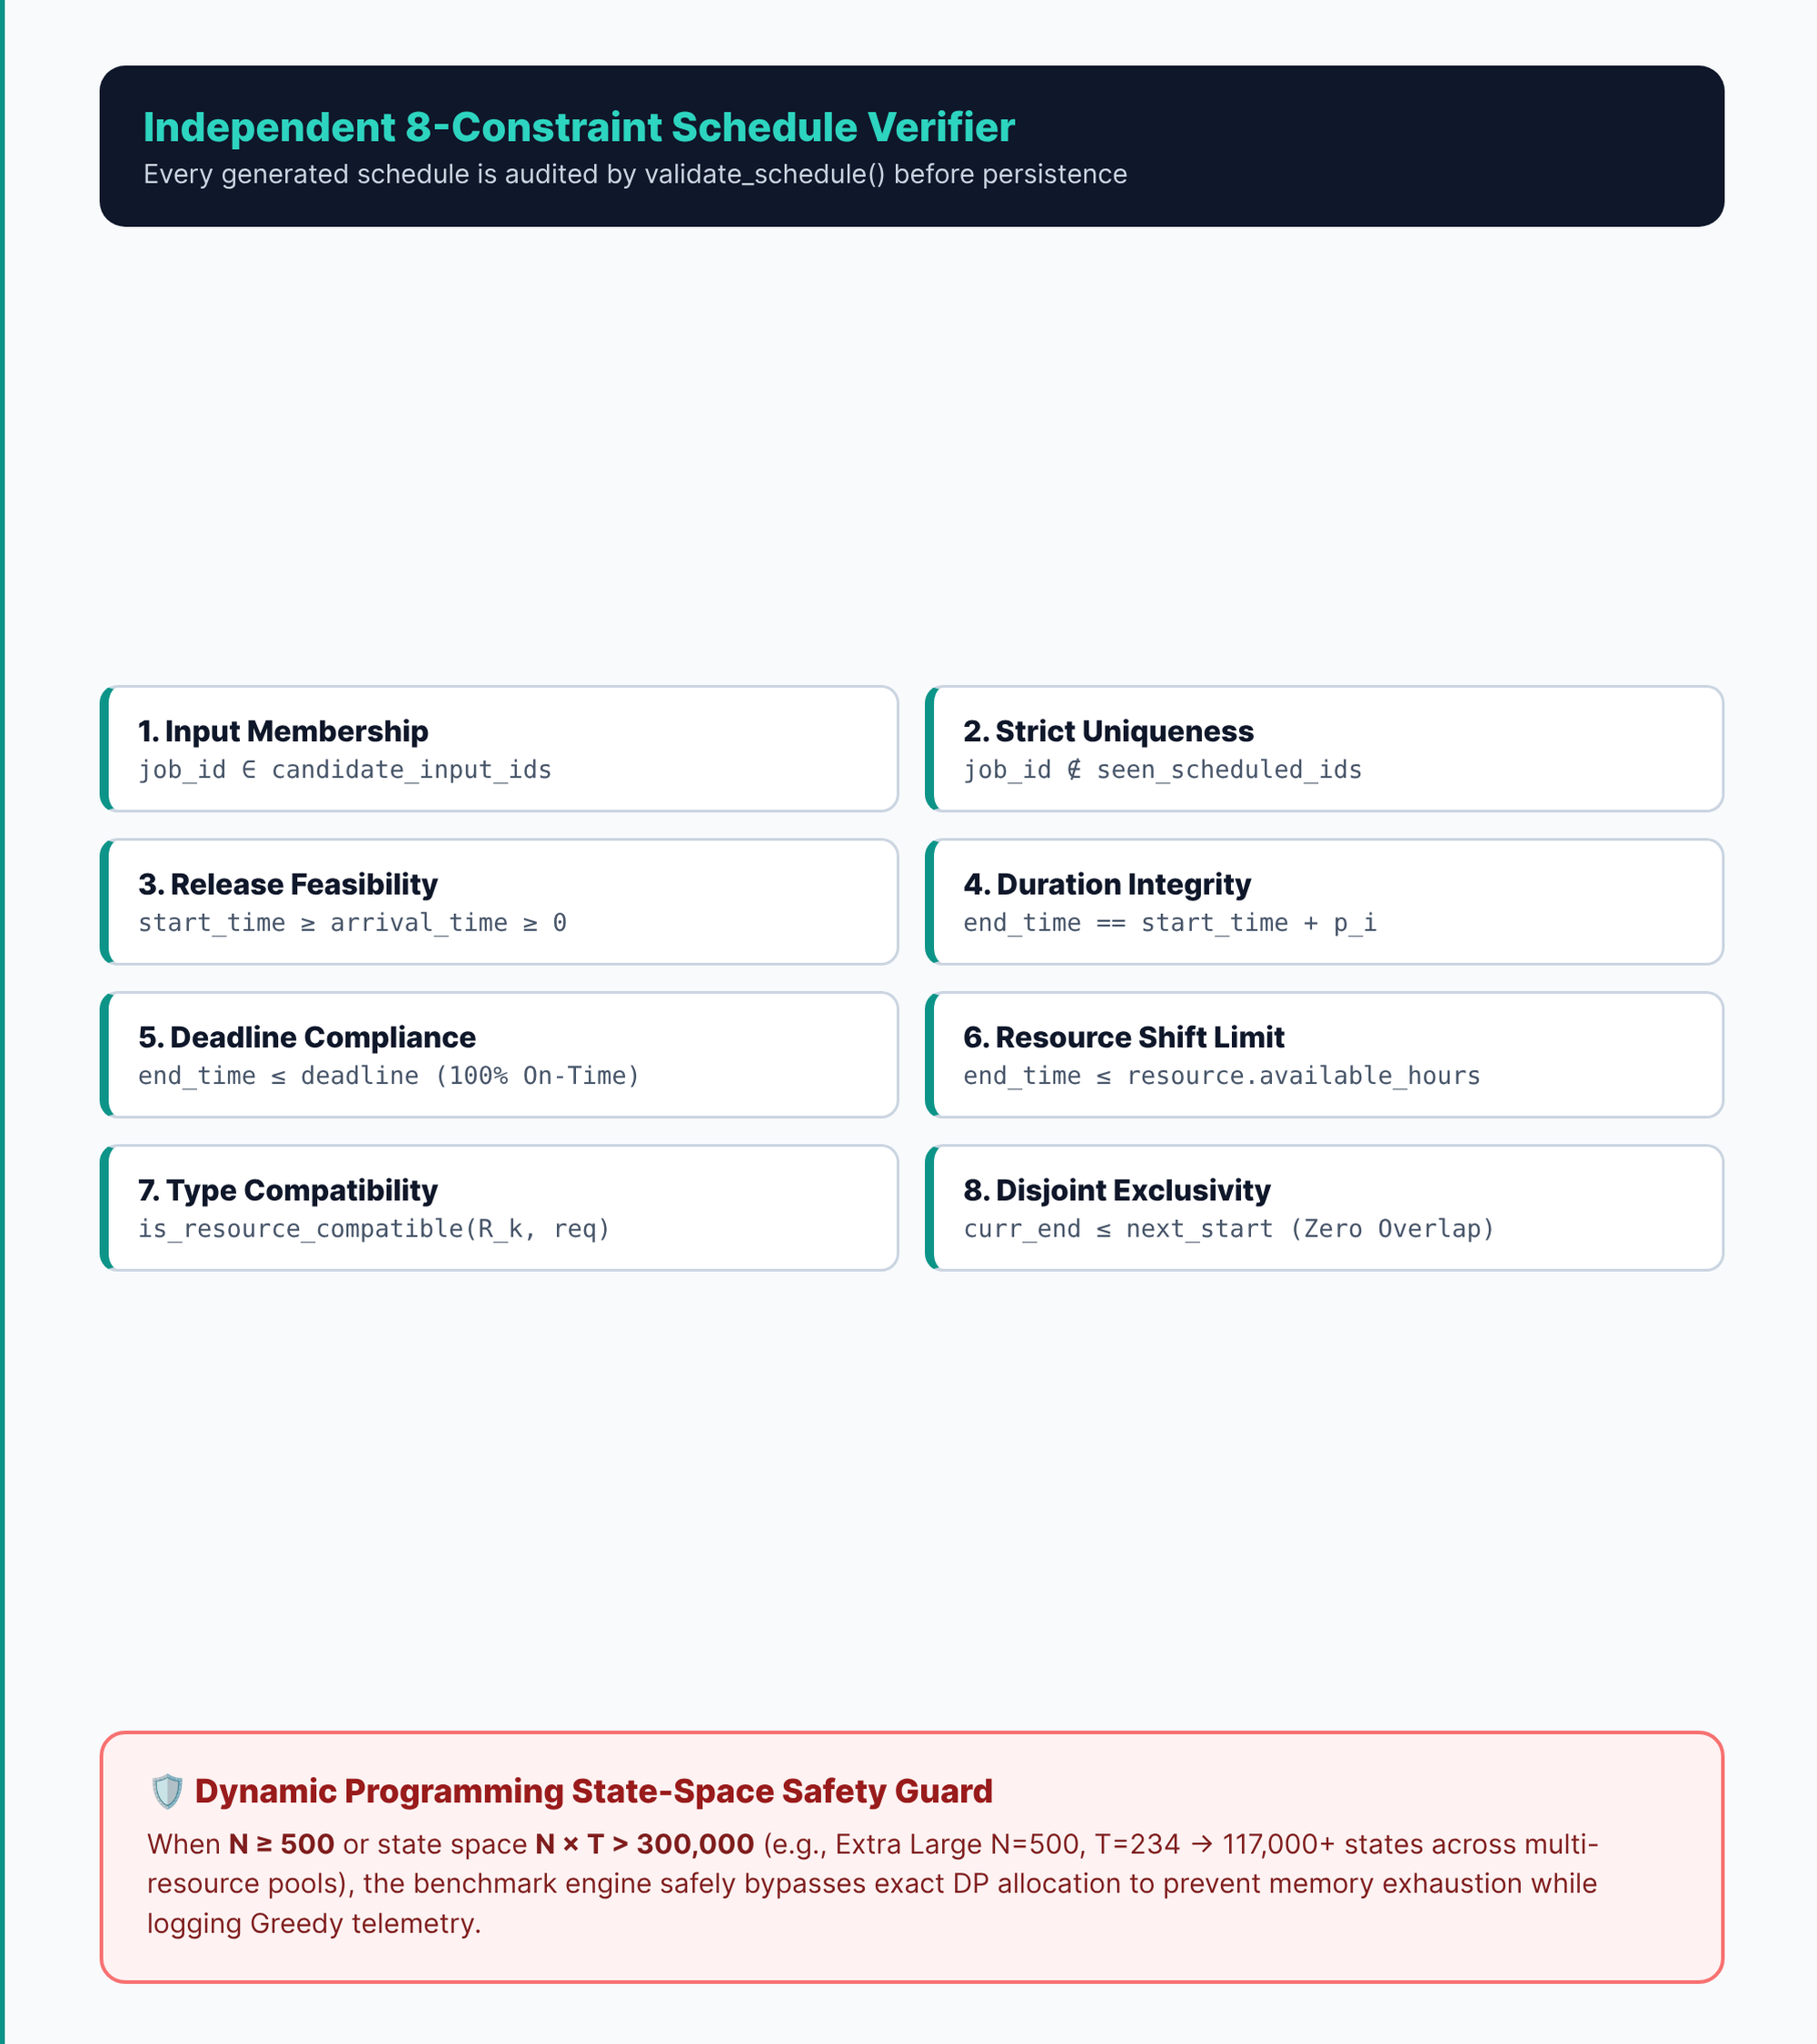
SLIDE 10 | IMPLEMENTATION
Python Stack & Eight-Rule Verifier
Language & Stack: Built with Python 3.14, Flask 3.1, SQLite 3, HTML5/CSS3, and Vanilla JS Canvas.
Key Modules: greedy.py (gap allocator), dynamic_programming.py (exact DP), benchmark.py (testbed).
Data Structures: Hash maps (res_pool, dp_dict), 2D matrices DP[N+1][T+1], and interval tuples.
8-Point Verifier: validate_schedule() audits every schedule for deadlines, shift caps, and zero overlap.
DP Safety Guard: Bypasses exact DP when N >= 500 or N*T > 300,000 to prevent memory exhaustion.
Implementation Stack, Modules & Verification Guards | Slide 10 of 15

Slide 11
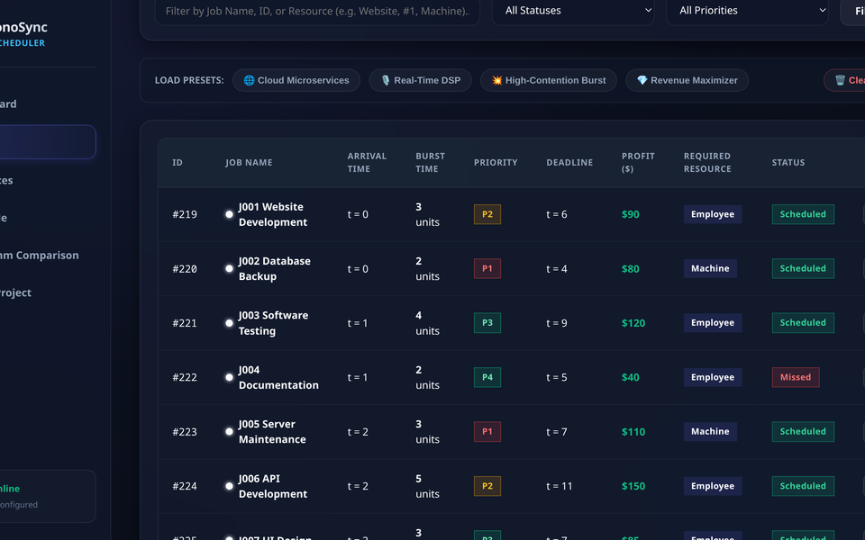
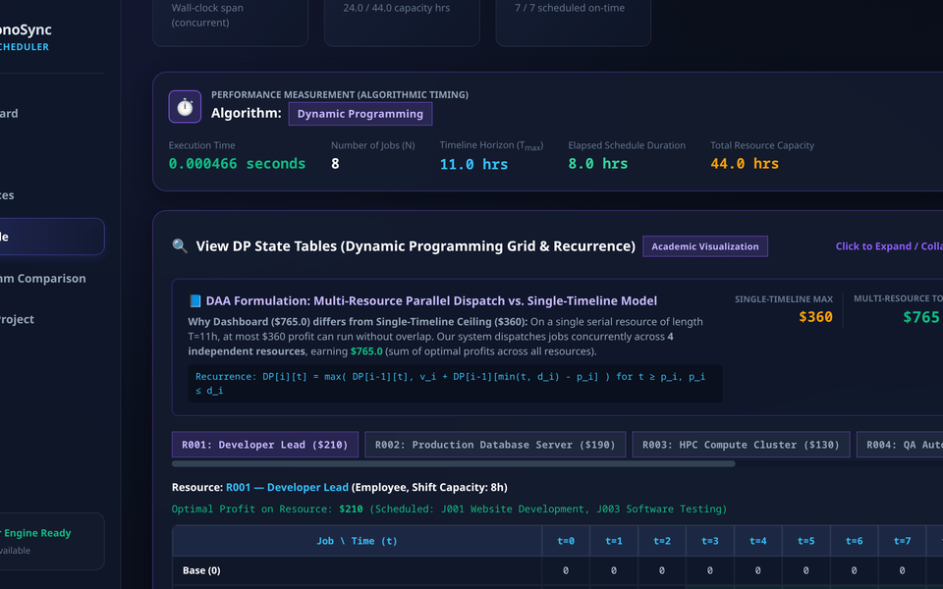
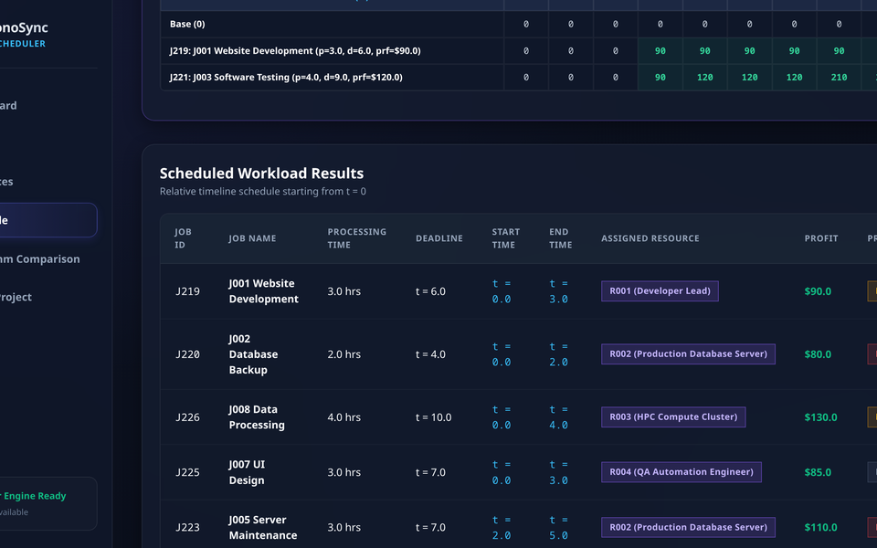
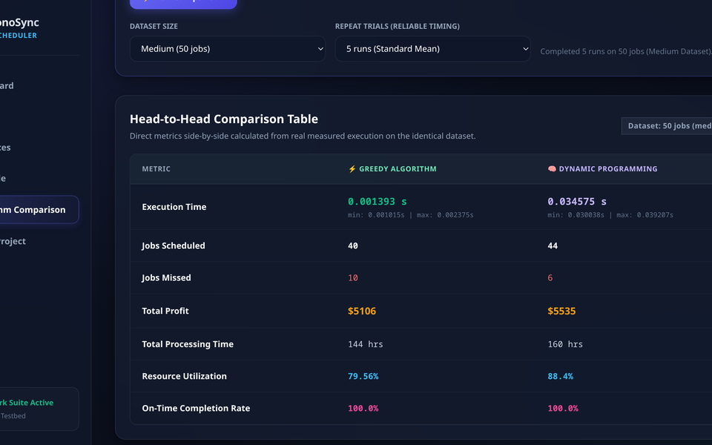
SLIDE 11 | PROJECT SCREENSHOTS
Actual Project Screenshots From Job Input to Benchmark Telemetry
1. Actual Input (/jobs)
Official 8-job workload (J001-J008) with arrival, burst, priority, deadline, profit ($), and required resource type.
2. Algorithm Processing (/schedule)
Interactive 2D DP State Table (DP[i][t]) showing step-by-step recurrence transitions and per-resource optimal profit.
3. Actual Output Schedule (/schedule)
Generated non-overlapping schedule across R001-R004 achieving $765 total profit and 100% on-time deadline compliance.
4. Result & Performance (/comparison)
Head-to-head benchmark suite comparing Greedy (1.39ms, $5,106) vs. DP (34.58ms, $5,535) on 50 identical jobs.
Screenshots Captured Directly From Group's ChronoSync Implementation | Slide 11 of 15

Slide 12
SLIDE 12 | EXPERIMENTAL RESULTS & COMPARISON
Dynamic Programming Gains 8.4% Profit While Greedy Scales to 500 Jobs
Input Size | Algorithm 1: Greedy | Algorithm 2: Dynamic Prog.
10 Jobs (M=3) | 0.33 ms | $721 (5 sched) | 0.78 ms | $779 (6 sched, +8.0%)
50 Jobs (M=7) | 1.08 ms | $5,106 (40 sched) | 39.60 ms | $5,535 (44 sched, +8.4%)
100 Jobs (M=10) | 2.72 ms | $11,082 (72 sched) | 4,632.70 ms | $11,466 (80 sched)
500 Jobs (M=10) | 10.74 ms | $17,869 (77 sched) | Bypassed (Guard: N*T = 117,000)
Datasets: Seeded deterministic workloads (10, 50, 100, 500 jobs), 5-trial mean timing | Slide 12 of 15

Slide 13
SLIDE 13 | COMPLEXITY ANALYSIS
Asymptotic Complexity Bounds Compared With Practical Performance
Algorithm | Best Case | Average Case | Worst Case | Space Complexity
Algorithm 1: Resource Greedy | O(N log N) | O(N log N + N*M) | O(N log N + N^2) | O(N + M)
Algorithm 2: Multi-Res / Grid DP | O(N log N + N*T) | O(N log N + N*T) | O(N * prod(C_r)) | O(N * T)
Algorithm 3: Weighted Interval DP | O(N log N) | O(N log N) | O(N log N) | O(N)
Theoretical vs. Practical: Greedy scales near-linearly from 0.33 ms (N=10) to 10.74 ms (N=500), matching O(N log N + N*M).
Pseudo-Polynomial Growth: DP runtime scales with timeline horizon T and resource state combinations (0.78 ms at N=10 to 4.63 s at N=100).
Complexity Analysis: Best, Average, Worst & Space Bounds (N=Jobs, M=Resources, T=Horizon) | Slide 13 of 15

Slide 14
SLIDE 14 | ADVANTAGES, LIMITATIONS & FUTURE SCOPE
Balancing Provable Profit Optimality With Industrial Scalability
Key Advantages
Dual-Engine Choice: Pairs exact DP profit gain (+8.4%) with sub-11ms Greedy speed.
Strict Safety Audit: 8-point verifier ensures 100% deadline and shift compliance.
Visual Traceability: Exposes step-by-step Greedy logs and 2D DP tables in UI.
Realistic Limitations
State Space Growth: Exact multi-resource DP grows with horizon T (N <= 200).
Non-Preemptive Core: Multi-resource engine assigns contiguous blocks without preemption.
Batch Assumption: Requires job durations and deadlines before scheduling.
Future Scope
Branch-and-Bound: Prune dominated DP states to scale exact search past N = 1,000.
DAG Dependencies: Add task precedence graphs (J_a -> J_b) and job migration.
Online Streaming: Support dynamic arrivals with rolling-horizon re-optimization.
Advantages, Limitations & Future Improvements | Slide 14 of 15

Slide 15
SLIDE 15 | CONCLUSION & REFERENCES
Conclusion and Academic References
Dual-engine scheduler unifies Greedy scalability with Dynamic Programming profit optimality.
Section | Summary of Findings & Reference Sources
Problem & Solution | Formulated multi-resource deadline-constrained job scheduling in Python/Flask using Resource-Aware Greedy O(N log N + NM) and Exact DP O(N*T).
Key Findings | DP achieves +8.0% higher profit on N=10 ($779 vs $721) and +8.4% on N=50 ($5,535 vs $5,106) with 100% on-time rate; Greedy scales to N=500 in 10.74 ms.
Books & Papers | 1. Cormen et al., Introduction to Algorithms (CLRS), 4th Ed., MIT Press. 2. Kleinberg & Tardos, Algorithm Design, Pearson. 3. Jackson (1955), Naval Res. Logist.
Docs & Datasets | 4. Python 3.14 (time.perf_counter, sqlite3, bisect) & Flask 3.1 Documentation. 5. ChronoSync Official Demo (J001-J008) & Seeded Benchmark Suite (N=10..500).
ChronoSync DAA Mini Project | Thank You | Slide 15 of 15

