Slide 1
PREDICTIVE & PRESCRIPTIVE ANALYTICS MODELLING
Stanley Kwadzo Ovulley

Slide 2

About the Data
The dataset contains all the statistics and playing attributes of all the players in the Full version of FIFA 18.
Content
Every player featuring in FIFA 18
70+ attributes
Player and Flag Images
Playing Position Data
Attributes based on actual data of the latest EA's FIFA 18 game
Attributes include on all player style statistics like Dribbling, Aggression, GK Skills etc.
Player personal data like Nationality, Photo, Club, Age, Wage, Salary etc.
For the purpose of this project, the focus will be on the Player personal data and Their attributes

Slide 3

Data Cleaning & Feature Engineering
The two datasets were joint by a common column, that is, “ID”
A new column was then created to categorize the overall ratings into Excellent, Average and Below Average.
Excellent 100-80, Average 79-60, Below Average 59-0
Selected variables was then change into numeric value to allow for it to be use in the model
The feature engineering done on this data includes removing highly correlated variable (0.9) and normalizing the data.
The data was then Partition into training (0.70) and testing(0.30)
The new Column Class Rate is factorize as follows
1- Excellent
2- Average
3- Below Average

Slide 4

Predictive Models
The machine learning Models use in this Project intend to build a predictive model that can predict the class of their Overall rating base on predictors such as
Acceleration, Aggression, Agility, Ball.control, Composure, Curve, Dribbling, Finishing, Free.kick.accuracy, Heading.accuracy, Interceptions, Sliding.tackle, Marking, Stamina, Standing.tackle, Balance, Penalties, Positioning, Reactions,Short.passing, Shot.power, Sprint.speed, Strength, Vision, Long.passing, Long.shots,Jumping
The Dependent variable use in this model is
Rate_Class
The models used in this project includes Random Forest, KNN and Decision Tree

Slide 5
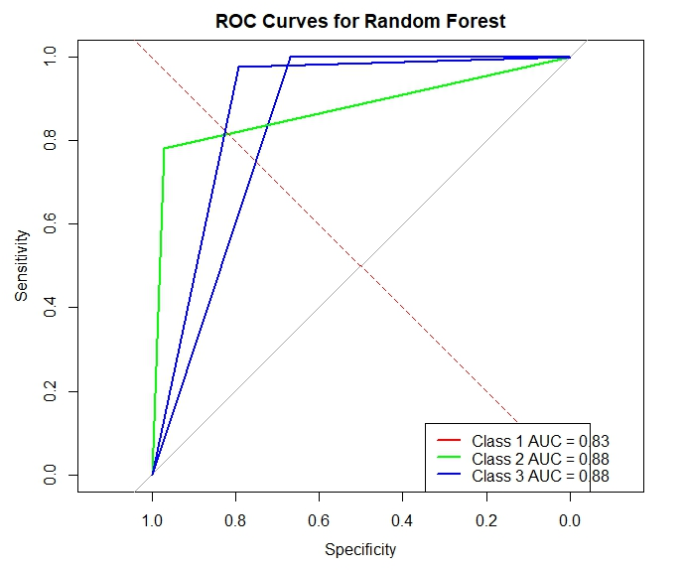
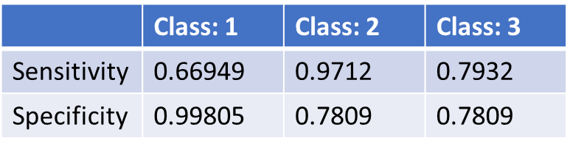
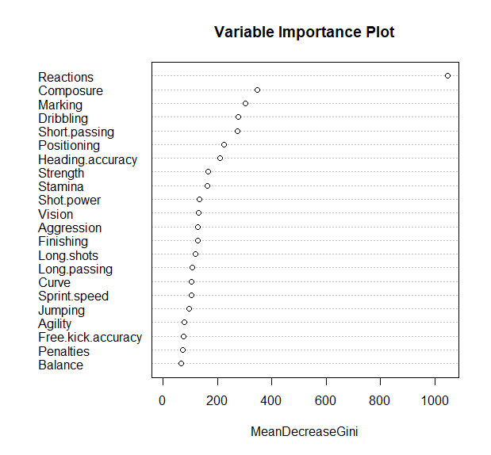
Logistic Regression Model
Class 1 (Excellent):
Sensitivity: Approximately 66.95% of the actual class 1 instances were correctly classified as class 1 by the model.
Specificity: Approximately 99.81% of the actual non-class 1 instances were correctly classified as non-class 1 by the model.
Class 2 (Average):
Sensitivity: Approximately 97.12% of the actual class 2 instances were correctly classified as class 2 by the model.
Specificity Approximately 78.09% of the actual non-class 2 instances were correctly classified as non-class 2 by the model.
Class 3: (Below Average)
Sensitivity: Approximately 79.32% of the actual class 3 instances were correctly classified as class 3 by the model.
Specificity: Approximately 97.44% of the actual non-class 3 instances were correctly classified as non-class 3 by the model.
OOB estimate of error rate: 7.01%
which means the model is expected to have an accuracy of approximately 92.99%

Slide 6
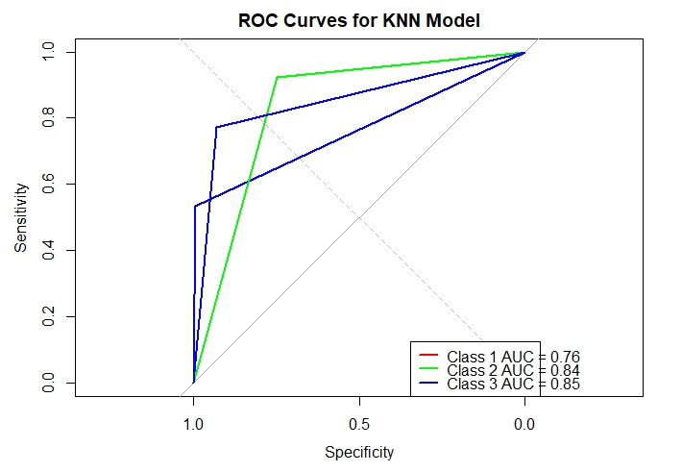
K Nearest Neighbors (KNN)
Actuals
 | 1 | 2 | 3
1 | 63 | 27 | 0
2 | 55 | 3745 | 241
3 | 0 | 287 | 823
From the confusion matrix, we have
True Positive: 63+3745+823 =4631
False Positive: : (55+0) + (27+287) + (0+241)=610
False Negative: : (27+0) + (55+241) + (0+287) =610
True Negative: 0
The Accuracy of this Model is 0.88361 indicates that the model is performing reasonably well, correctly classifying the majority of instances in the dataset

Slide 7
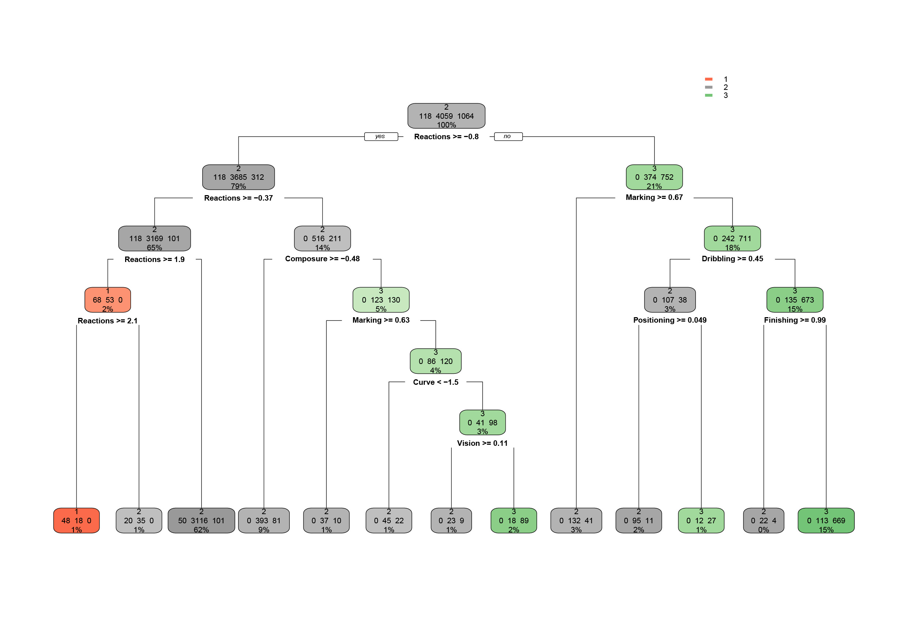
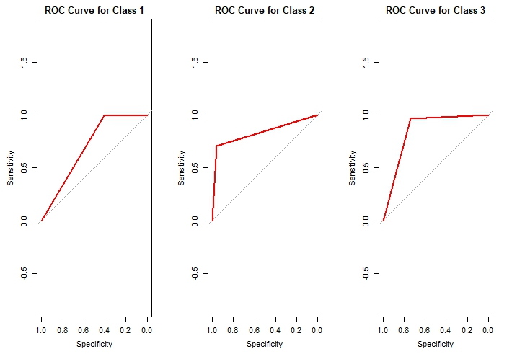
DECISION TREE
Actuals
 | 1 | 2 | 3
1 | 48 | 18 | 0
2 | 70 | 3898 | 279
3 | 0 | 143 | 785
Predictions
True Positive: 48+3898+279 =4225
#False Positive: : (70+0) + (18+143) + (0+279)=374
False Negative: : (18+0) + (70+279) + (0+143) =374
True Negative: 0
The Accuracy of this Model is 0.9026903 indicates that the model is performing reasonably well, correctly classifying the majority of instances in the dataset
ROC CURVE

Slide 8

COMPARISION OF THE MODELS
The Models used in this project includes Logistics Regression, K nearest neighbour(KNN) and Decision.
The accuracy of the models is given as;
Logistics regression – 0.9299
KNN – 0.8836
Decision Tree – 0.9026903
The accuracies of these three Models use in this project prove to be useful in predictions when it comes to this dataset.
Looking at the accuracies of these Models, Logistics regression Model is a better model .

Slide 9
Conclusion
Other Models could be use to see how well they perform comparing to these three used in this project.
Since this data set contain all players including goal keepers, In future projects, Key predictors relating to the goal keeping position could be added to the preditors use in this project.
In general , the three models used in this project performed well predicting the Class of the overall ratings of the players

Slide 10
Data Source
The data is scraped from the website https://sofifa.com by extracting the Player personal data and Player Ids and then the playing and style statistics.
FIFA 18 Complete Player Dataset | Kaggle

