Slide 1

VA LOAN
CLOSING COSTS AND
UNALLOWABLE FEES

Slide 2
Lenders who work with the Veterans Administration to help veterans buy homes must observe several rules regarding closing costs.

Slide 3
All lenders are required to provide an estimate of what the closing costs will be on the home you have chosen.

Slide 4
This estimate is known as a "Good Faith Estimate."

Slide 5

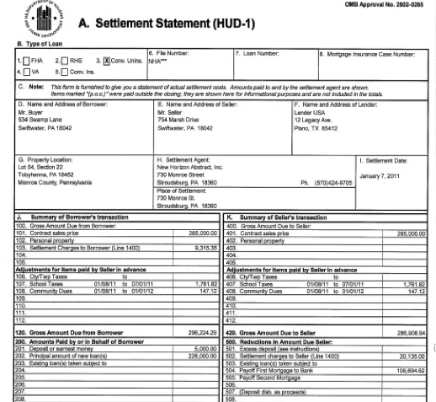
The HUD-1 form contains all the financial information for the sale, including actual closing costs.

Slide 6
Ask your lender about any costs that do not seem logical.

Slide 7
CLOSING COSTS
THAT CANNOT BE ASSESSED TO VETERANS

Slide 8
Veterans who take advantage of the VA Home Loan Guaranty program can never be charged for the following costs:
HUD/FHA inspection fees for builders.
Inspection for termites or other pests.
Attorney fees that benefit the lender.

Slide 9
Veterans who take advantage of the VA Home Loan Guaranty program can never be charged for the following costs:
Fees charged by a mortgage broker.
Realtor commission.
Prepayment penalties.

Slide 10
CLOSING COSTS
THAT THE LENDER CAN REQUIRE VETERANS TO PAY

Slide 11

Lenders can charge up to 1 percent of the amount being borrowed to cover their costs in processing the loan.

Slide 12
This is called the loan's "origination fee."

Slide 13
If the fee is less than 1 percent, the lender can add fees not listed above that otherwise would not be allowed …

Slide 14
… until the total of those fees and the origination fee amounts to 1 percent of the loan.

Slide 15
The following costs are always allowed, regardless of whether the 1 percent origination fee is charged:

Slide 16
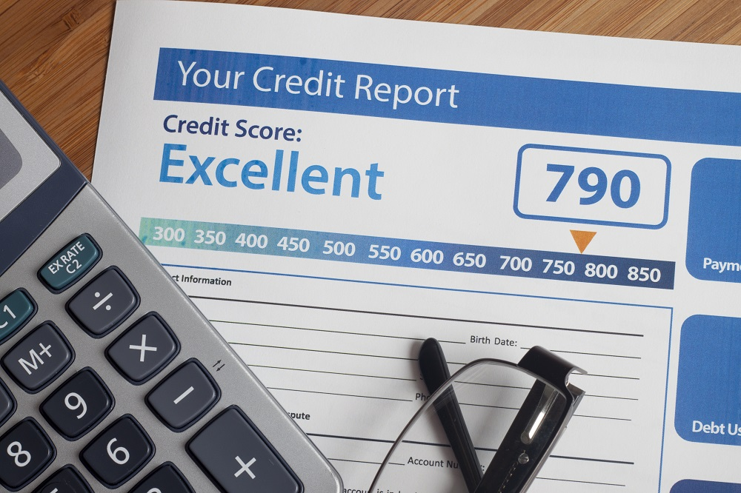
CREDIT REPORT
Only actual costs to obtain the report are allowed.

Slide 17

SURVEY AND PLOT PLAN
A plot plan confirms that structures thought to lie on a particular piece of property actually are within its boundaries.

Slide 18
SURVEY AND PLOT PLAN
Surveys provide more extensive information, including a map of the metes and bounds of a particular parcel as well as any existing easements and improvements.

Slide 19

APPRAISAL TO DETERMINE CURRENT MARKET VALUE
The fee paid by a veteran must not exceed the maximum for that state as shown on the VA's appraisal fee schedule.

Slide 20

COMPLIANCE INSPECTION
Costs are allowed if the Notice of Value, issued by the VA after the appraisal is reviewed, requires such an inspection.

Slide 21
SEPTIC SYSTEM AND WATER WELL INSPECTION

Slide 22

COSTS TO ENSURE CLEAR TITLE TO THE PROPERTY AND PROTECT AGAINST ADVERSE CLAIMS

Slide 23
Title searches and title insurance that includes an environmental protection lien endorsement are examples.

Slide 24

DISCOUNT POINTS, ALSO CALLED A "LOAN DISCOUNT"
Each point is equivalent to 1 percent of the amount of the loan.

Slide 25
The loan discount is a one-time charge that is added to the mortgage principal in exchange for a lower interest rate on the total sum being borrowed.

Slide 26
FILING FEES FOR RECORDING DEEDS AND OTHER DOCUMENTS

Slide 27
TAXES AND STAMPS

Slide 28
PRORATED TAX AND INSURANCE ESCROW

Slide 29
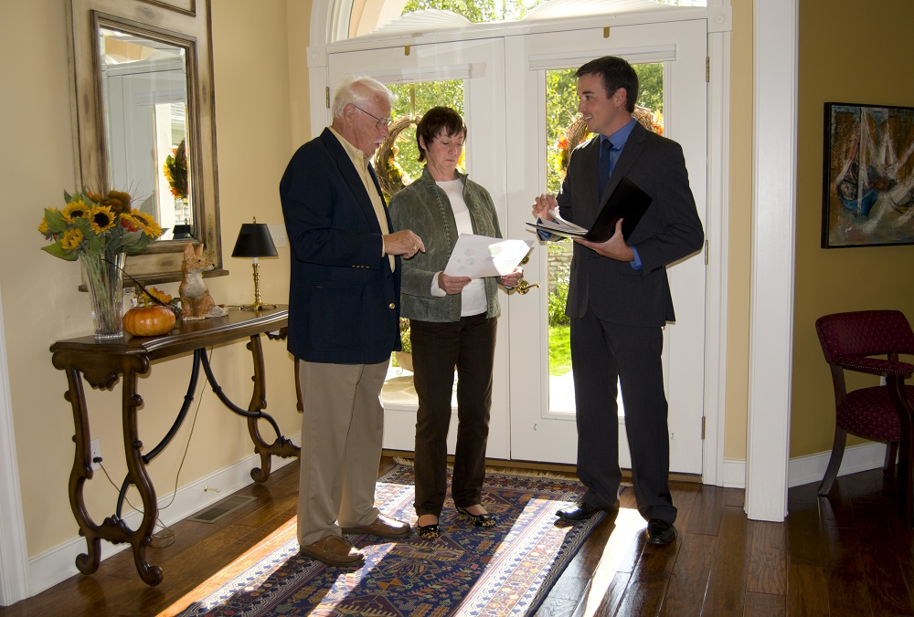
HAZARD INSURANCE
This cost is allowable if the veteran did not already pay out of pocket.

Slide 30
The insurance protects against property damage resulting from natural events that are specifically named in the policy, such as fire, wind and hail.

Slide 31
VA FUNDING FEE

Slide 32
This mandatory fee is a percent of the mortgage principal that goes to the Veterans Administration to reduce the costs of administering the VA Home Loan Guaranty program for veterans.

Slide 33
CLOSING PROTECTION LETTER

Slide 34
Also referred to as "CPL," this letter becomes a binding contract that gives added protection to the buyer regarding the title insurer's actions.Interthinx DISSCO fraud protection report.

Slide 35
MERS FEE
Mortgage Electronic Registration Systems, or "MERS," provides a way to keep track of residential mortgages and make title transfers easier.

Slide 36
Jimmy Vercellino, VA Loan Specialist helps veterans obtain the loans they
are entitled to.

Slide 37
He served in the United States
Marine Corps, and now devotes himself to the Veteran home buyer
in the Phoenix area …

Slide 38
… fulfilling a passion of his while at the same time helping others achieve home ownership.

Slide 39
Be a proud homeowner today.

Slide 40

For more details call 480-351-5904 or visit the site www.valoansforvets.com

Slide 41
VA Loans for Vets
7702 E. Doubletree Ranch Road,
Suite 220
Scottsdale, AZ 85258
Phone: (480) 351-5904
Email: jimmyv@fcbmtg.com

