Slide 1


FinShareGuard: A Privacy-Preserving Data Sharing System using AI & Zero Trust
Presented by:
1) Atharva Wagh
2) Onkar Waghmode
3) Shripad Wattamwar
4) Aditya Zite
5) Vaibhav Zendage

Slide 2
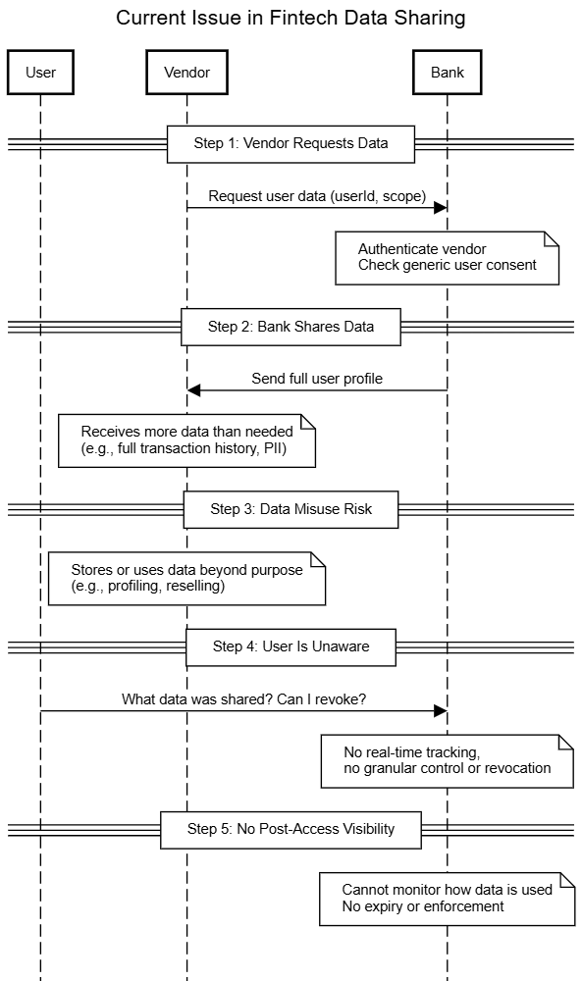

Problem Statement

Slide 3
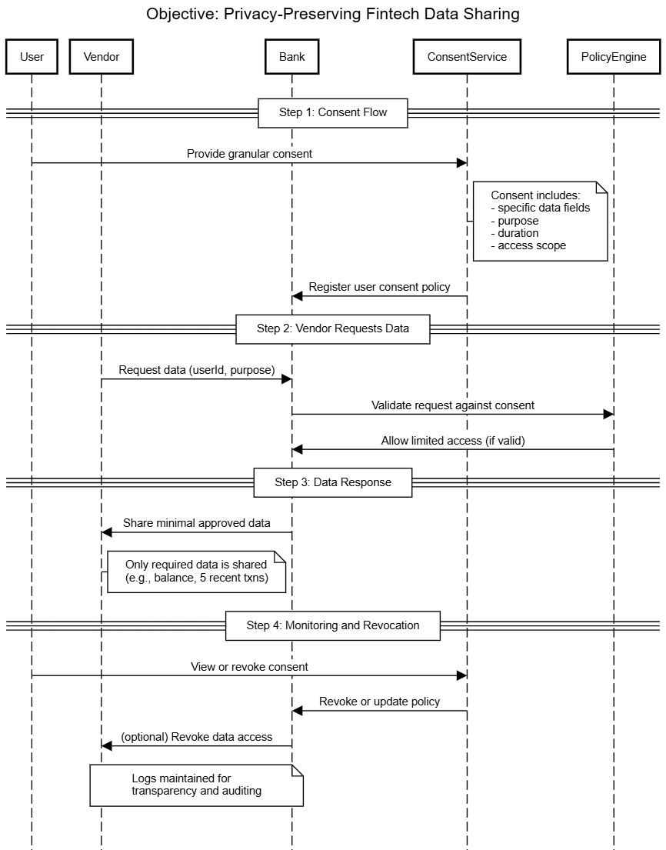
Objective
Objectives

Slide 4
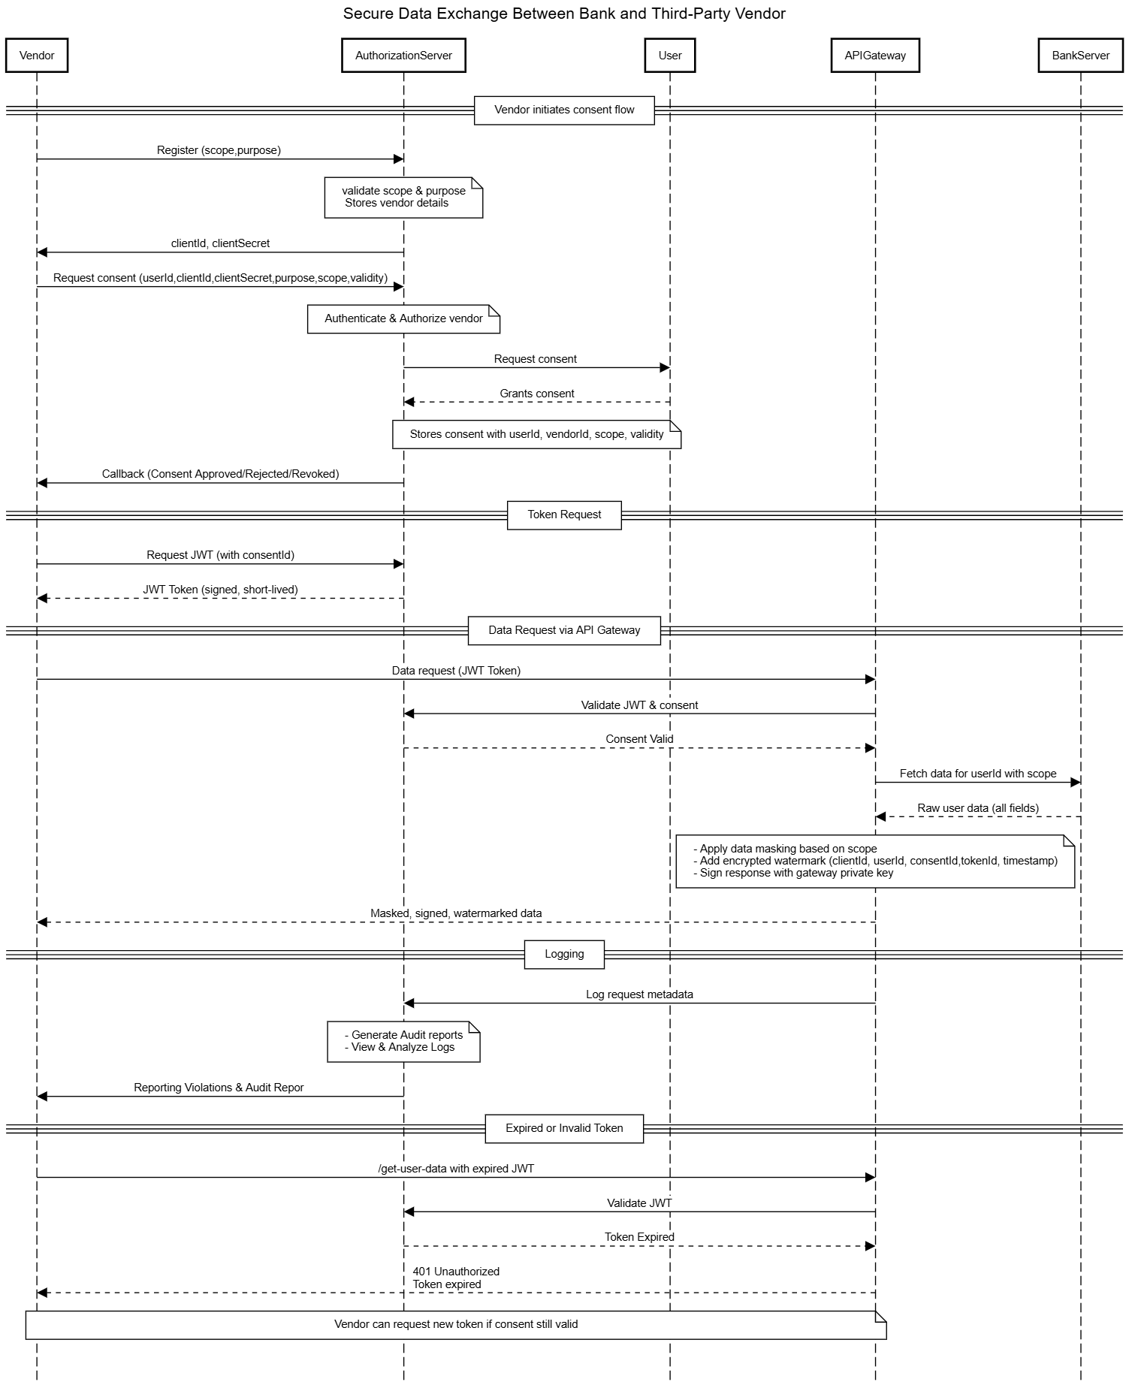
System Architecture

Slide 5











Tech Stack

Slide 6

THANK YOU

