Slide 1



SMART INDIA HACKATHON 2024
Problem Statement ID – SIH1647
Problem Statement Title – Development of AI-ML based models for predicting prices of Agri-horticultural commodities such as pulses and vegetables
Theme – Agriculture, FoodTech & Rural Development
PS Category – Software
Team ID – 146
Team Name – Epic Innovators

Slide 2

Problem Statement
The task is to develop a solution that leverages daily price monitoring data collected from various markets to predict prices of agri-horticultural commodities such as pulses (e.g., gram, moong) and vegetables (e.g., onion, potato). The solution should use AI-ML techniques to analyze historical trends, seasonality, and market intelligence, enhancing the accuracy of price forecasts.
The goal is to build a scalable system that provides insights for price stabilization, efficiently handling large datasets while adapting to factors like weather and market demand. This ensures better management of agri-horticultural commodity prices.

Slide 3
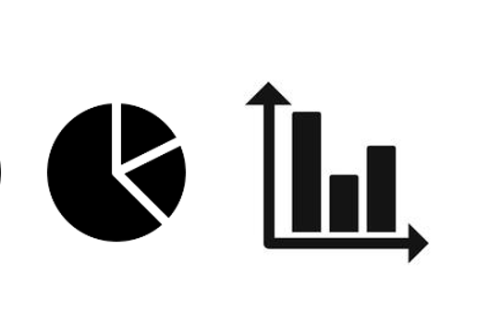
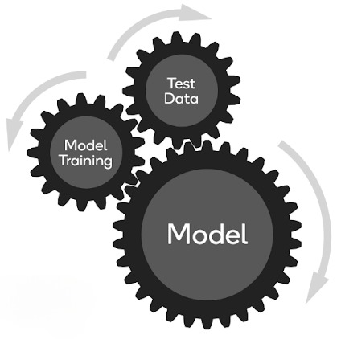
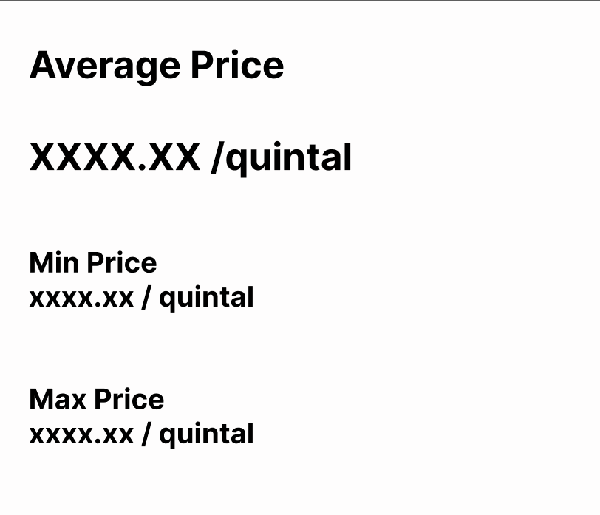

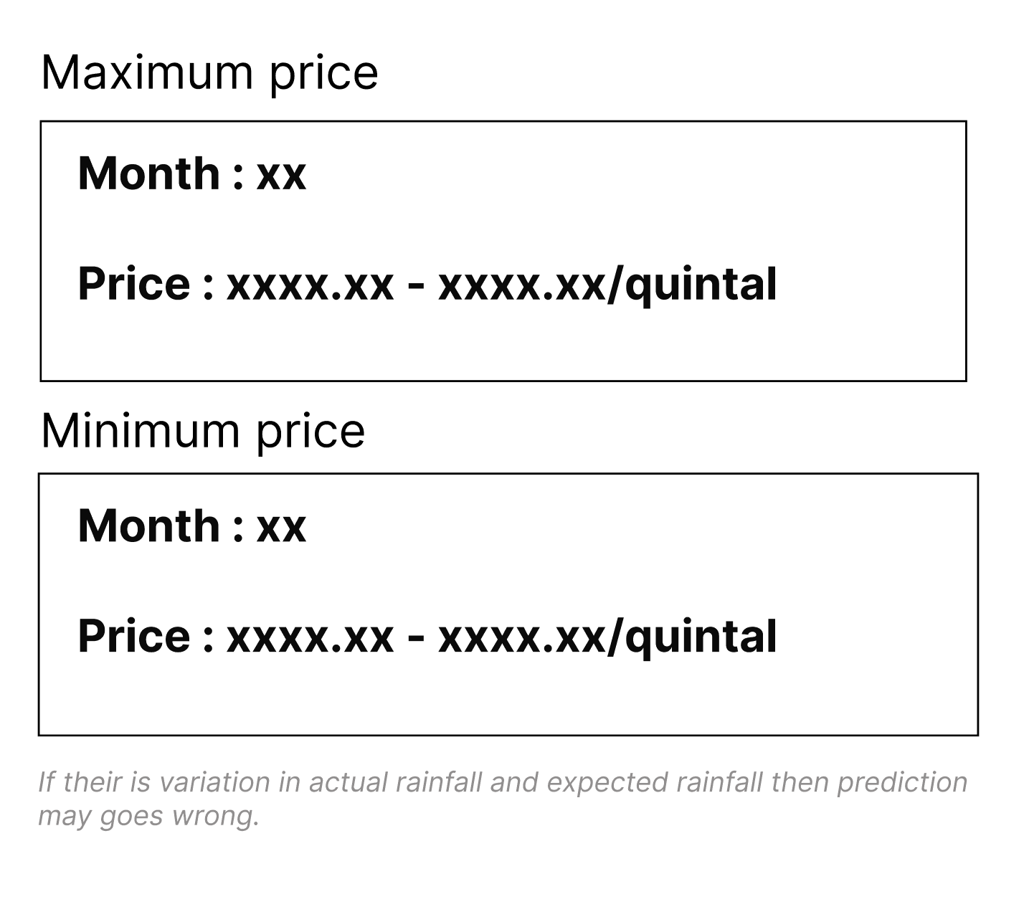
System Overview
1. Dashboard for visualizing Result
Crop Name
State
Input
Market
Year
User
Month
2. Predicted Crop Price
Rainfall(mm)
3. Expected Crop Price Peaks and Troughs in current year

Slide 4

Technical Approach
Data Preprocessing
Training diverse ML(RF,DT) models
CSV files Source: Ministry of agriculture, data.gov.in
Data Collection
Evaluating & selecting optimal model
Input Preprocessing
User Inputs
Crop name
Dataset features –
Crop Name
Market
Year
Month
Arrival date
rainfall
Arrivals (Tonnes)
Modal Price(Rs./Quintal)
Integrating with
Web (Flask)
Structured input
Rainfall data (Weather25)
Trained Model
Chart.js
Trained Model
Launch
Future Price Trend Analytics Dashboard
Predicted crop price

Slide 5
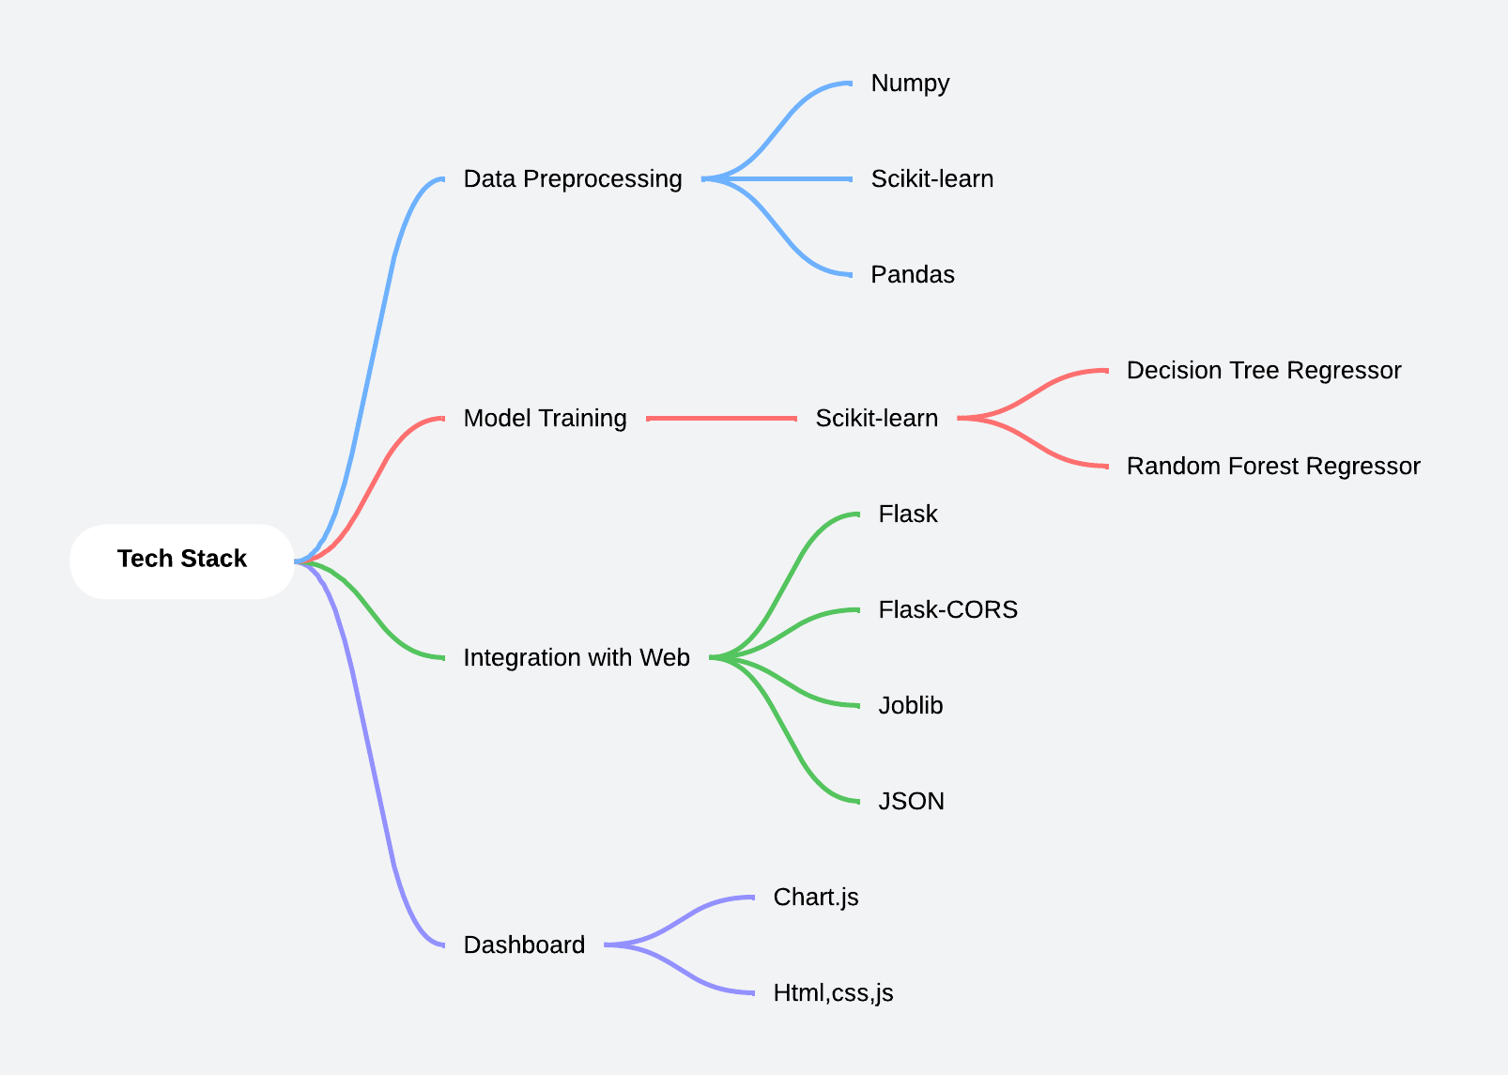
Tech Stack & Dependencies & Revenue Model
Dependencies
Data Dependency
Internet Access Dependency
Revenue Model
Subscription-Based Model:
Free Access: Users can access the app's basic features, such as crop price prediction.
Premium Plan: In addition to the basic features available with free access, this plan includes Future Price Trend Analytics.

Slide 6

Results & Discussions
Graph 1. 2024 Jowar actual and predicted Monthly Price Trend 2024
The graph above clearly illustrates that the maximum price difference between the predicted and actual values is ₹454, and we achieved an accuracy of 96% in this prediction.

Slide 7
Innovation & Impact
Root Cause Analysis
Innovative Approach
Impact: We incorporated market dynamics and crop yield data into our model training process to ensure accurate predictions. Additionally, our system provides future trends for crop prices, offering valuable insights to support informed decision-making in agriculture.
User Centric Dashboard
Impact: The development of a user-friendly, interactive dashboard empowers farmers, traders, and policymakers to easily visualize crop price trends. This enables them to make informed decisions, improving market efficiency and potentially increasing farmers' income by predicting the best time to sell their crops.
Impact: The prototype aids in understanding the factors influencing crop price fluctuations. By analyzing data across various states and districts, the system identifies discrepancies and patterns, allowing for better decision-making in pricing strategies.

Slide 8
Thank You!

Slide 9
Crop Name
State
Price Prediction Model
Predicted Crop price
Market
Crop Name
State
Year
Market
Month
Rainfall(mm)
Year
Crop yield (Tonnes)
Crop Yield Prediction Model

