Slide 1
Agentic Neural-Symbolic Systems
for Healthcare Payment Integrity
Detecting provider fraud with fused machine-learning detectors, a symbolic billing-rule engine, and a locally-hosted LLM investigator.
Ovunc Ozgun Eker · Cotiviti Intern Assessment · Topic 2: Pattern Recognition (TPO)

Slide 2
The Problem
Healthcare fraud is hard to catch — for structural reasons.
⚠
Labels are scarce & late
◧
Granularity mismatch
Confirmed fraud is rare (~9% of providers) and only known long after the fact.
Labels exist at the provider level, but the suspicious behavior lives in individual claims.
⚖
Rules alone miss novelty
🔍
ML alone can't explain
Codified policy catches known violations but is blind to new schemes.
Learned models flag anomalies but can't justify themselves to a human auditor.

Slide 3
The Approach: Agentic Neural-Symbolic
An LLM agent orchestrates learned detectors and hard rules, then reasons over both.
AGENTIC LAYER · Local LLM (Ollama)
Decides which tools to call, chains steps, writes the investigation memo
NEURAL
SYMBOLIC
DATA
Layer 1 — ridge + iso-forest
Layer 2 — z-score ensemble
~5 deterministic billing rules
(procedure–diagnosis, dates…)
Provider & claim retrieval
from the claims store
Learned risk scores
Hard, explainable violations
Grounding / evidence
Neural + Symbolic fusion = flags that are both sensitive to novel patterns and explainable to an auditor.

Slide 4
The Data
Kaggle Healthcare Provider Fraud Detection dataset — Medicare-structured claims.
558K
5,410
~9%
4
inpatient + outpatient claims
providers
labeled potentially fraudulent
joined source tables
Key challenge: fraud labels exist only at the provider level.
→ Provider-level detection can be validated against labels.
→ Claim-level and temporal detection are necessarily unsupervised — mirroring the real payment-integrity problem, where most individual claims are never labeled.

Slide 5
1
Layer 1 — Provider-Level Detection
"Does this provider's overall billing behavior deviate from its peers?"
Two complementary models on the same features.
~27 engineered provider features (claim volume, avg reimbursement, claims-per-patient, physician ratios…) pruned to ~20 via correlation + VIF, then modeled two ways:
0.94
test ROC-AUC
Ridge logistic regression
supervised
Supervised — ridge logistic regression
Catches fraud resembling past confirmed cases; interpretable coefficients.
Unsupervised — Isolation Forest
Surfaces novel outliers with no labels at all. Their close agreement is mutual corroboration.
0.90
test ROC-AUC
Isolation Forest
unsupervised
Supervised + unsupervised: known patterns and novel ones, cross-validating each other.

Slide 6
2
Layer 2 — Claim-Level Detection
"Is this individual claim a statistical outlier versus similar claims?"
A z-score ensemble across 36 groupings.
Each claim's reimbursement is compared to its peers under many different groupings (diagnosis code, procedure code, care setting, state…), with adaptive small-group filtering. A claim is flagged when a consensus of groupings agree it is anomalous.
3.05×
higher flag rate for
fraudulent providers' claims
p ≈ 4×10⁻⁸⁷
chi-square significance
(χ² ≈ 392)
Fully unsupervised — validated after the fact against provider labels.
A strong, statistically overwhelming signal — from a method that never saw a label.

Slide 7
3
Layer 3 — Temporal Analysis
An honest null result — and why it matters.
A "billing ramp" detector first showed a striking 7.06× association with fraud. Robustness checks revealed it was a provider-size artifact: under scale-invariant controls the signal collapsed and reversed.
7.06×
0.34×
0.00×
0.32×
raw dollars
log-scale
mean-normalized
edge-trimmed
Why report a null? Reporting a 7× artifact would send investigators after the wrong providers. Catching it demonstrates the analytical discipline payment integrity demands — and it motivates the symbolic + agentic layers, where statistics alone fall short.

Slide 8
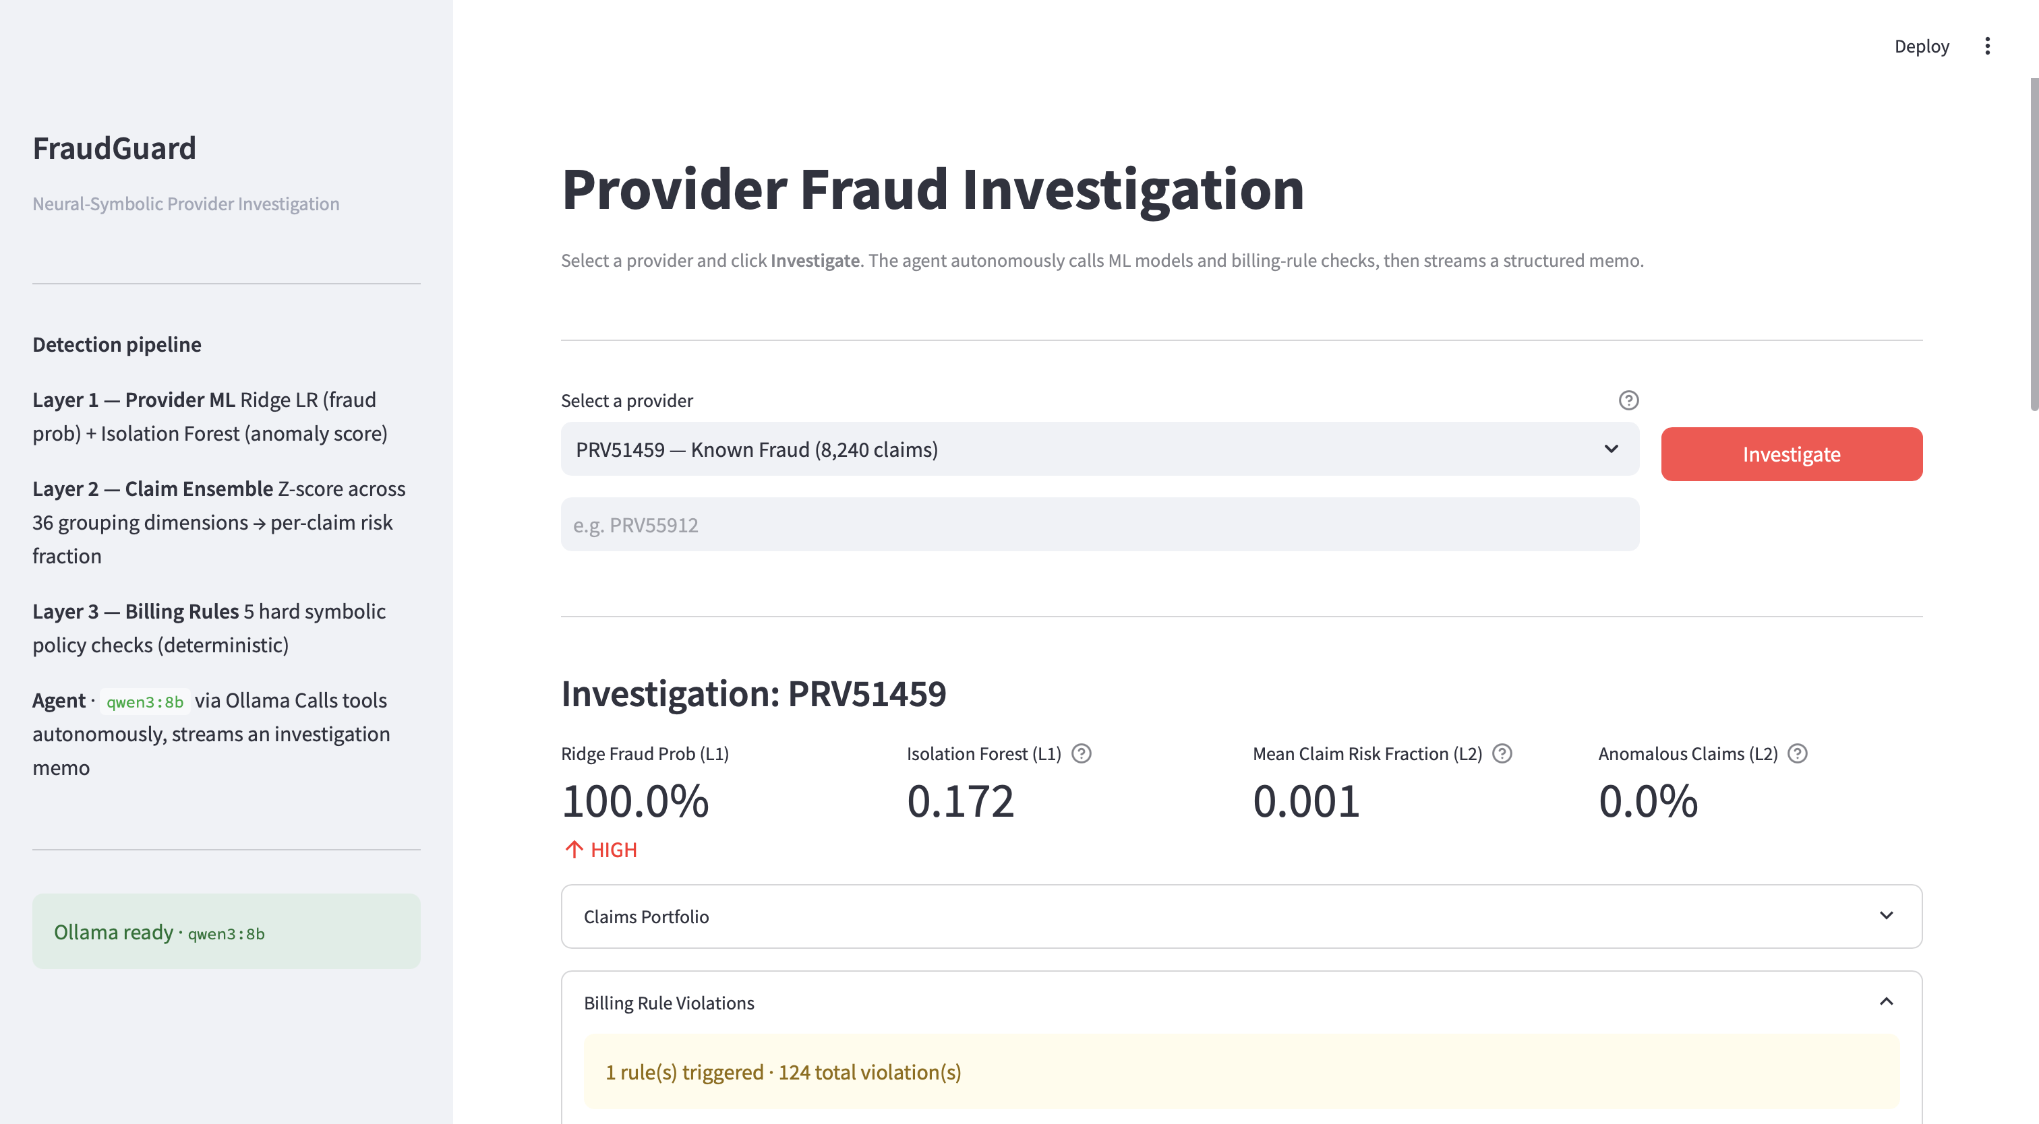
The POC: Symbolic Rules + Agentic Investigator
A Streamlit app: enter a Provider ID, watch a local LLM investigate in real time.
Symbolic rule engine
~5 deterministic, domain-grounded billing rules — procedure–diagnosis support, mutually-exclusive codes, reimbursement ceilings, impossible admit/discharge dates, deductible consistency.
Agentic loop
A local Ollama LLM autonomously calls the detectors + rules, reasons over both, and writes an investigation memo. Step-capped and sandboxed for reliability.
Cold-start strength
For unseen providers, Layer 1 can't run — but the symbolic rules still evaluate a single hand-entered claim. Rules cover exactly where history-dependent ML is silent.

Slide 9
Opportunities & Threats
Opportunities
Threats
Explainability by construction — every flag cites a rule or peer-comparison.
Investigator augmentation — auto-triage and drafted case memos.
Cold-start coverage — rules work on unseen providers.
PHI-safe — local inference keeps data on-premises.
Statistical artifacts — size confounds can masquerade as signal (see Layer 3).
LLM reliability — local models need sandboxing, step caps, verified tool outputs.
Adversarial adaptation — schemes evolve to evade fixed rules and stale models.
Drift — ongoing rule curation and retraining required.

Slide 10
Recommendations for Cotiviti
1
Pilot an agentic neural-symbolic assistant
Pair existing ML risk models with codified payment policy to produce explainable, investigator-ready case narratives.
2
Standardize scale-invariant validation
Make it a guardrail for every new fraud feature, so size artifacts are caught before production.
3
Invest in local LLM inference for PHI workflows
Capture agentic capability while keeping sensitive claims data on-premises.
4
Treat cold-start detection as first-class
Lean on the symbolic layer where history-dependent models cannot operate.

